Slide 1
Research Data mantra (management training) Online course launch
AQMeN event
10 October,2011
Robin Rice
University of Edinburgh

Slide 2
Overview
Robin Rice - Project background
Jon Turner - View from the IAD
Stuart Macdonald - On creating an Open Educational Resource
Cuna Ekmekcioglu – Online demo

Slide 3
Context of the MANTRA Project
How did we (the data library) get here?

Slide 4
Data Library services and projects
Data Library & consultancy
Edinburgh DataShare
JISC-funded projects
DISC-UK DataShare (2007-2009)
Data Audit Framework Implementation (2008)
Research Data MANTRA (2010-2011)

Slide 5
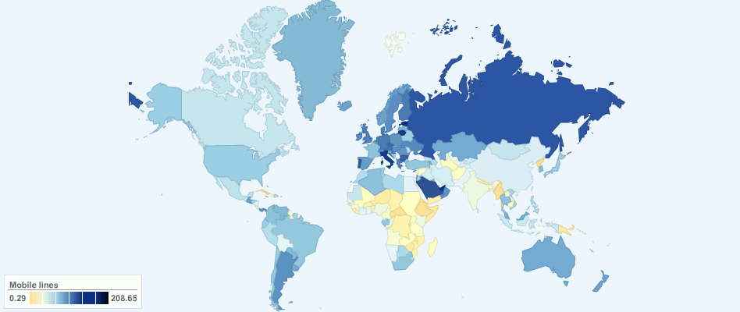
Data Library service at UoE: Research data support within IS
finding…
accessing …
using …
teaching …
managing
iStock Photo, ChartsBin and mkandlez on flickr

Slide 6
Data repository service

Slide 7
DataShare project findings - e.g. barriers to deposit
Lack of clarity about ethics, rights, ownership
Fear of errors found by users
Fear of ‘scooping’
Poor documentation
Lack of incentives / reward
Donald McLeod on flickr

Slide 8
Findings from 5 Data Audit Framework case studies in UoE
Storage provision often insufficient
Long retention periods needed for high value data
Ad-hoc practices; no formal data mgmt plans
Lack of standardised procedures in creating and storing data
Minimal metadata; much effort expended in finding extant data on servers
European Parliament on flickr

Slide 9
Responses to past project findings
Develop online guidance
Develop training
Develop university policy along with services to support our researchers

Slide 10
Web guidance
Online suite of web pages for University academic staff
http://www.ed.ac.uk/is/data-management

Slide 11
Training: MANTRA for Change
Raising the standards of data management practice by contributing to long-term culture change.
Creating a new PhD training course to promote data management skills, supported and delivered by the Institute for Academic Development, University of Edinburgh

Slide 12
Research Data MANTRA (MANagement TRAining)
Creation of open online learning materials in RDM for postgrads and early career researchers
Grounded in three disciplines, working with graduate schools
Video stories from researchers in variety of settings
Data handling exercises in four data analysis environments: R, SPSS, NVIVO and ArcGIS
.ash on flickr (CC-BY-ND)

Slide 13
Online learning materials
Eight units with activities, scenarios and videos:
Research data explained
Data management plans
Organising data
File formats & transformation
Documentation & metadata
Storage & security
Data protection, rights and access
Preservation, sharing and licensing
Used Xerte Online Toolkits to create – University of Nottingham

Slide 14
Data handling software practicals
SPSS – by Joan Corbett, SCOTCEN, National Centre for Social Research Methods
R – by Dr. Duncan Smallman
NVivo – Dr. Aikaterini Chatsiou (UK Data Archive)
ArcGIS – by James Crone, EDINA
Download PDF exercises, work at your own pace

Slide 15
Selling Research Data Mgmt as a Transferrable Skill
The FRUIT principles:
Fun
Relevant
Useful
Interactive
Timely
Green Apple by Image Editor, flickr
CC-BY 2.0

Slide 16
Stepping back
Project evaluation
How will we know if we succeeded?

Slide 17
Critical success factors
1. The commitment of academic staff to the project
2. Positive feedback from user testing
3. Increased advocacy and awareness of research data management best practice across the University.
4. Evidence that the course is useful and used in other contexts outwith the University of Edinburgh.
Curlew, Mikebaird on flickr

Slide 18
University Research Data Management Policy
The policy for management of research data was approved by the University Court on 16 May, 2011.
Vice-Principal Jeff Haywood was a champion for the University of Edinburgh to develop the first RDM policy in the UK

Slide 19
Events influencing the policy
Recent adoption of the Code of Practice for Research (UK Research Integrity Office, 2009) by the university’s research office, obligating the institution to provide support for retention and access to data underlying published research.
‘Climategate’ email review at East Anglia University highlighting the reputational risk and legal accountability associated with staff not being forthcoming in response to Freedom of Information (FOI) requests for data from the public.

Slide 20
The 10 Policy Principles
Research data will be managed to the highest standards throughout the research data lifecycle as part of the University’s commitment to research excellence
Responsibility for research data management through a sound research data management plan during any research project or programme lies primarily with Principal Investigators (PIs).
All new research proposals [from date of adoption] must include research data management plans or protocols that explicitly address data capture, management, integrity, confidentiality, retention, sharing and publication.
The University will provide training, support, advice and where appropriate guidelines and templates for the research data management and research data management plans.
The University will provide mechanisms and services for storage, backup, registration, deposit and retention of research data assets in support of current and future access, during and after completion of research projects.

Slide 21
The 10 Policy Principles
Any data which is retained elsewhere, for example in an international data service or domain repository should be registered with the University.
Research data management plans must ensure that research data are available for access and re-use where appropriate and under appropriate safeguards.
The legitimate interests of the subjects of research data must be protected.
Research data of future historical interest, and all research data that represent records of the University, including data that substantiate research findings, will be offered and assessed for deposit and retention in an appropriate national or international data service or domain repository, or a University repository.
Exclusive rights to reuse or publish research data should not be handed over to commercial publishers or agents without retaining the rights to make the data openly available for re-use, unless this is a condition of funding.

Slide 22
Links
MANTRA course
http://datalib.edina.ac.uk/mantra
Xerte Online Toolkits
http://www.nottingham.ac.uk/xerte/toolkits.htm
Research data management guidance pages
http://www.ed.ac.uk/is/research-data-management
University data policy
http://www.ed.ac.uk/is/research-data-policy
R.Rice at ed.ac.uk

