Slide 1

Welcome to the Main Library at the University of Edinburgh

Slide 2
Where do I start?
Using Edinburgh University Library
Library collections
Library discovery tools
Library Search Strategies
Library support for your study
Notes:
This presentation is a broad overview of library collections and services there to support you during your studies with the School of Social & Political Science. I’m focusing on things that former students have told us they thought were important in their feedback.
We’ll be looking at
Using Edinburgh University Library – basics you need to know
Library collections – at the Main Library Library and elsewhere
Library discovery tools – DiscoverEd, databases and more
Library support for your study – from scanning to study spaces

Slide 3
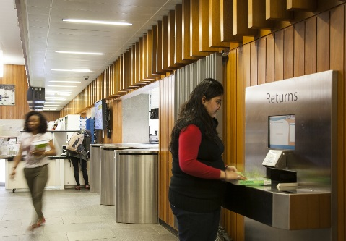
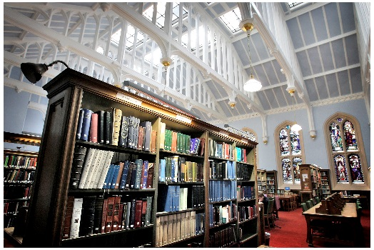
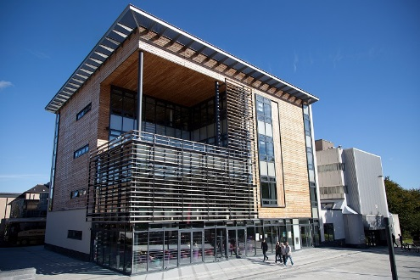
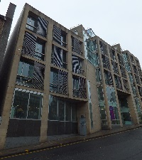

1. Using Edinburgh University Library
8 other site libraries you can also use
  http://www.ed.ac.uk/is/library-locations
  Other Open Access Computing Labs also available
  http://www.ed.ac.uk/is/open-access-locations
Main Library
During semester building is open every day 7.30am-2.30am (Helpdesk hours are shorter)
http://www.ed.ac.uk/is/main-library-opening
Always have your student card for access
to libraries and to borrow items.

Slide 4
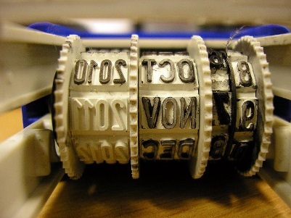

1. Using Edinburgh University Library
http://www.ed.ac.uk/is/library-borrowing
    50 books – PGTs, 60 books - PGRs
    - including up to 3 Reserve Reserve = 3 hours
Short Loan = 1 week
Standard loan = 12 weeks
Keep note of due dates!
Watch out for fines!
    Self-issue and self-return
  Self-issue machines on ground, 2nd, 3rd & 4th floors.
  Self-return machines on ground floor (next to Reception at entrance & next to HUB entrance).
    But please ask the Helpdesk staff if you have questions etc.
Short loan or standard loan item already on loan?
Request via DiscoverEd

Slide 5

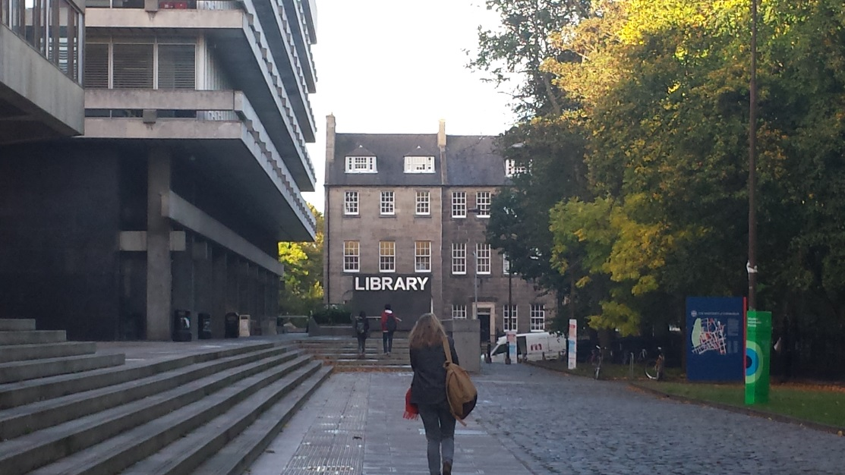
2. Library Collections – General Collections
Main Library
@EdUniMainLib
Holds books, journals, dvds, archives, manuscripts, special collections, etc.
HUB collection on ground floor holds high demand texts on current reading lists
Most Social Sciences collections on Floor 2
Contains study space, open access computing labs, printing & photocopying, wireless, group study pods, uCreate, library café
Careers Service, Student Disability Service & Student Counselling Service (all on third floor).

Slide 6
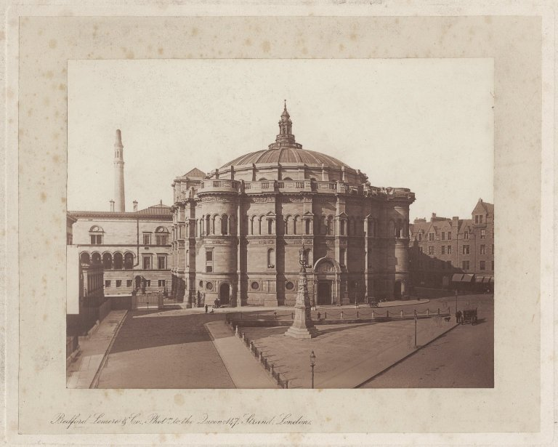
2. Library Collections – Special Collections
Centre for Research Collections
Diverse and rich rare book collections in all areas
University Archives
Research Support Collection
6th floor Main Library
Notes:
Centre for Research Collections
Diverse and rich rare book collections in all areas
6th floor Main Library
University Archives
Research Support collection

Slide 7



2. Digital Collections for Politics
BFI InView
Political Science Complete
Documents on British Policy Overseas
House of Commons Parliamentary Papers
Web of Science (Social Sciences Citation Index)
Scopus
IBSS
JSTOR
These and more available at www.ed.ac.uk/is/databases-subjects (under Sociology)
Notes:
Political Science Complete and JSTOR are collections of e-journals
House of Commons Parliamentary Papers and Documents on British Policy overseas are digital copies of political documents
SCOPUS and Web of Science are key tools for indexing the literature, citation searching and journal citation reports
BFI InView and MEF digital are digital film resources

Slide 8




2. Digital Collections for Sociology
Sociological Abstracts
SocIndex
ASSIA
Web of Science (Social Sciences Citation Index)
Scopus
IBSS
PsycInfo
JSTOR
These and more available at www.ed.ac.uk/is/databases-subjects (under Sociology)
Notes:
SocIndex and JSTOR are collections of e-journals
House of Commons Parliamentary Papers and Documents on British Policy overseas are digital copies of political documents
SCOPUS and Web of Science are key tools for indexing the literature, citation searching and journal citation reports
BFI InView and MEF digital are digital film resources

Slide 9

2. Digital Collections for Social Anthropology
Anthropology Plus
Anthrosource
Web of Science (Social Sciences Citation Index)
Scopus
IBSS
JSTOR
These and more available at www.ed.ac.uk/is/databases-subjects (under Social Anthropology)

Slide 10

2. More Digital Collections
Newspapers
Current and archives
UK and international
Access via http://bit.ly/1K7bMSo
Media
Box of Broadcasts (BoB)
BFI InView
Access via www.ed.ac.uk/is/databases-a-z
Official publications
Access via http://bit.ly/1O6aFjX
Freely available sites such as
  https://www.gov.uk
  http://www.scotland.gov.uk
  http://www.scottish.parliament.uk
  http://europa.eu/
Dissertations and theses
ProQuest Dissertations & Theses Global
Edinburgh Research Archive (ERA)
EThOS
Access via http://bit.ly/1Ma7WIH
Data and statistics
Access via http://bit.ly/1CDzAuJ
Data Library (www.ed.ac.uk/is/data-library)

Slide 11
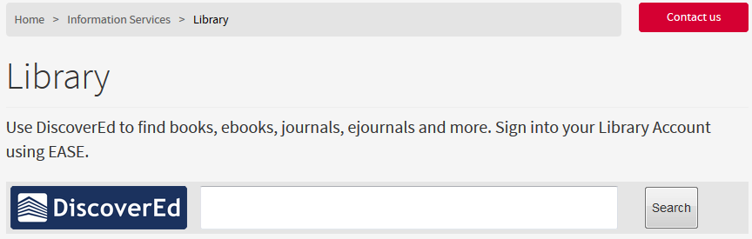
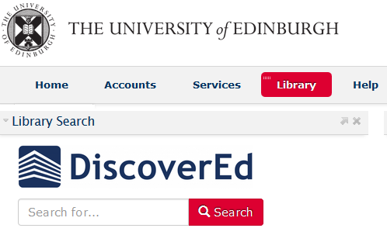
3. Library Discovery Tools : DiscoverEd
Discover Library holdings in online and print, journals and books plus records of articles, theses, conference proceedings…
From the Library homepage http://www.ed.ac.uk/is/library
Library search tab on MyEd
www.myed.ed.ac.uk

Slide 12
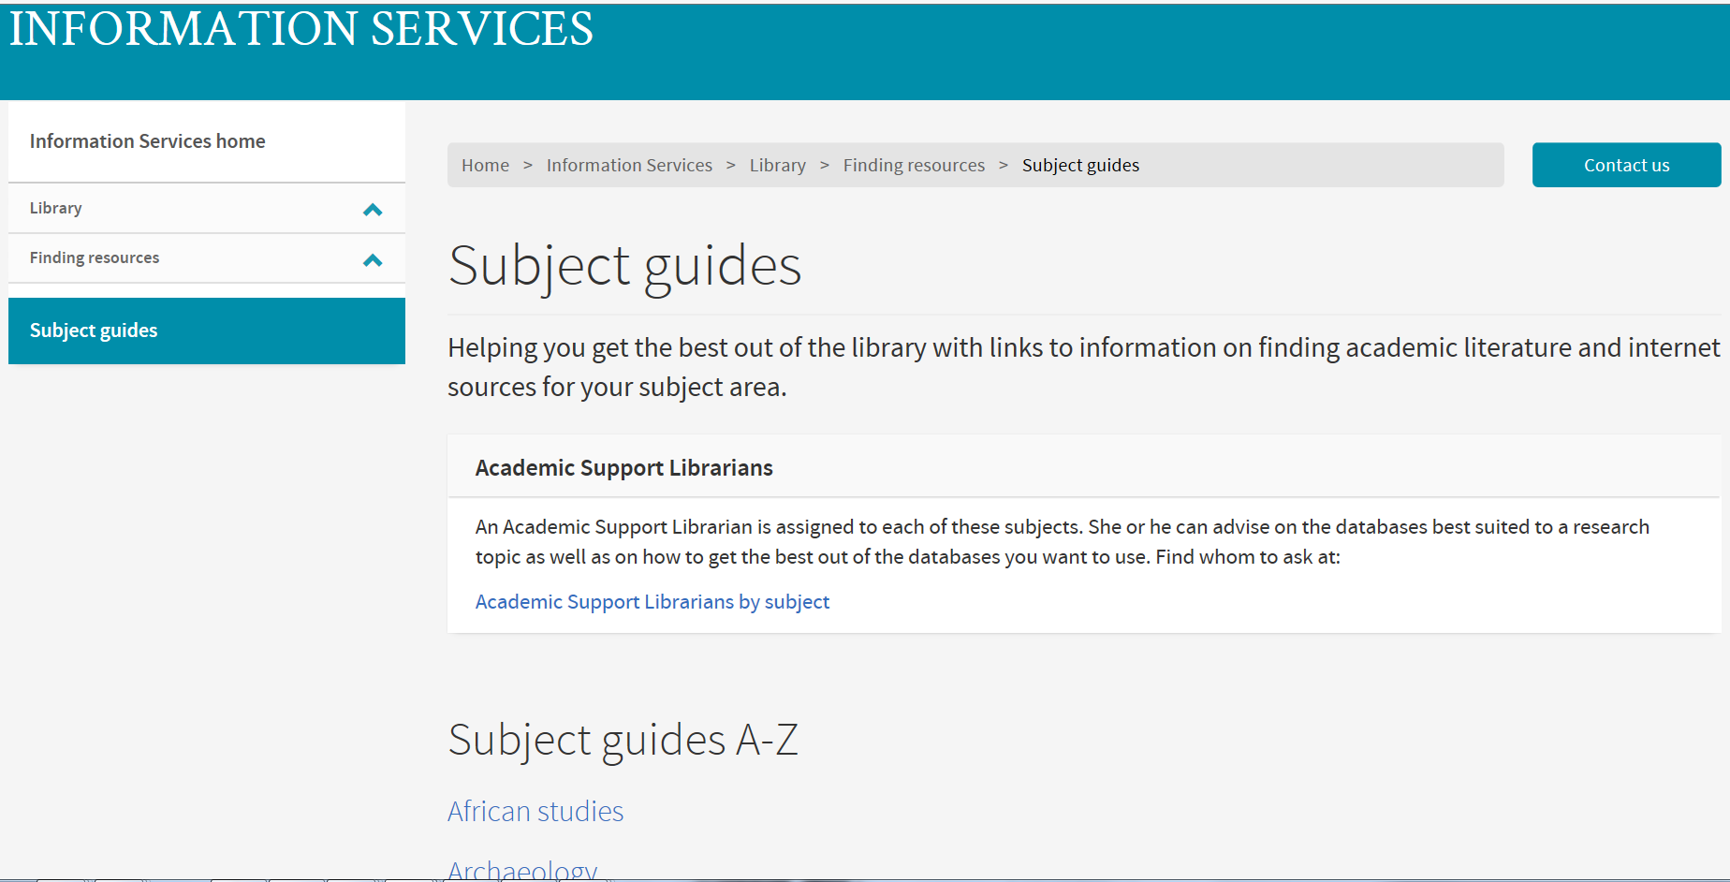
3. Library Discovery Tools: Subject Guides
http://www.ed.ac.uk/is/subject-guides
Notes:
Discover key printed and digital resources for Social and Political Sciences through the Subject Guide for each area – from African Studies through to Science, Technology & Innovation Studies

Slide 13



“Can’t I just use ?”
3. Library Discovery Tools : Google
Google is great
  but it doesn’t search all the online services the University subscribes to.
  Sites may not be not suitable for an academic context
If you’re going to use Google
  Use Google Scholar (http://scholar.google.co.uk/)

Slide 14
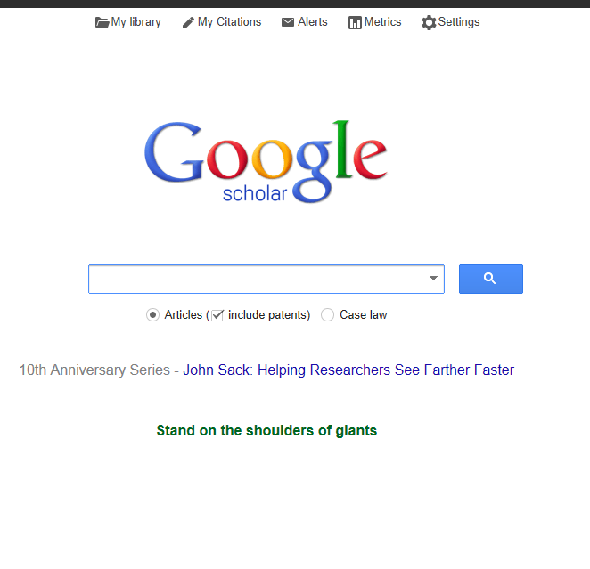
Getting set up for Google Scholar
3. Library Discovery Tools : Google
1. Access the Settings (wheel symbol) web page. Click to enlarge
2. In the library link enter “Edinburgh University” in the search box and select University of Edinburgh.
3. Then click on Save
Notes:
Google Scholar is a free search tool which allows you to access academic literature available on the Web. You can set it up to enable access to online journal articles that the University library subscribes to as well.
Once you complete these steps you will see that your search results will contain on the right hand side of the result page, a ‘findit@:Edinburgh’ link. When you click on this link you will be able to access the online full text articles if we have subscription to them.
Searching in Google Scholar
Find the advanced search menu by clicking on the small triangle in the search box then fill the menu

Slide 15
4. Library Search Strategies : Starting points
Google Scholar vs
Bibliographic databases
Why use it?
Quick and easy way of getting hold of good references, including peer-reviewed papers, theses, books, abstracts and technical reports.
Can be set to retrieve and link to what’s available at Edinburgh.
It’s good enough!
However …
Harvesting of content unknown.
The ranking of content is not clear.
Why use them?
For content & resources not in Google.
Specialist content and focus across a range of disciplines.
Content and coverage is explicit.
Comprehensiveness.
Added value.
Puts you in control!
However …
They index more than we have, which is not necessarily a problem as we can generally get it for you!
Notes:
Choose your starting point (s)
Some of you may, of course, be already using them.
Some of you may be using Google Scholar, find it easy to use with very good results indeed. So, why use a bibliographic database?

Slide 16
4. Library Search Strategies
It’s all about your research question
Identify the principal concepts – these will form the keywords for your search.
What is your research question? What do you need to find out?
  variant spelling: behaviour (UK) behavior (US)
  Types of Resources:
  Primary Sources (archives, images, newspapers, statistics, etc.)
  Secondary Sources (books, journals, theses, book reviews, etc.)
  variations in terminology over time: lame, handicapped, disabled
Search limits –.
  time
  language
  geography
  Searching effectively
  Boolean searching
  Finding full text
Notes:
It all starts with the question!
Then think about your keywords

Slide 17
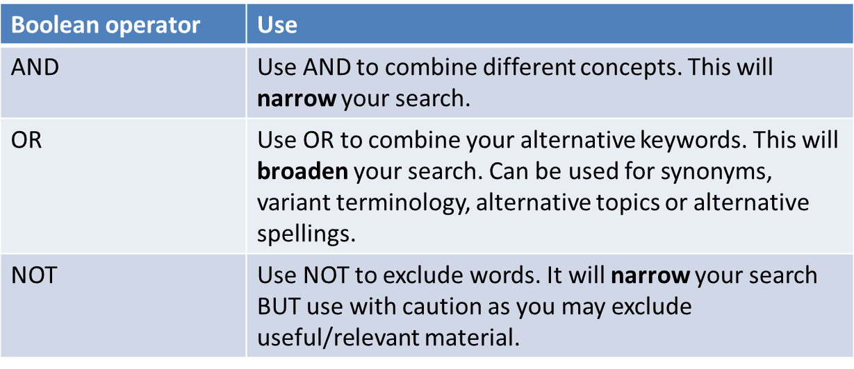
4. Library Search Strategies :
Then try combining your keywords
Use connecting words AND, OR or NOT (Boolean operators).
These will help you widen or narrow your searches.

Slide 18




4. Library Search Strategies : Boolean operators at work!
gin AND tonic
alcohol AND addiction
gin OR tonic
alcohol OR booze
tonic NOT gin
addiction NOT drugs

Slide 19
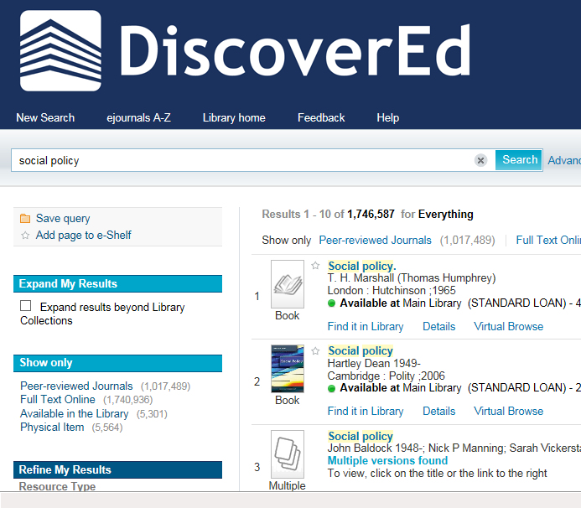
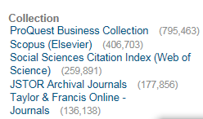
4. Library Search strategies : scoping searches
Google Scholar
DiscoverEd
Click here to search resources beyond EUL
DiscoverEd limiters allow you to see useful database collections for your search
Notes:
Focus in on relevant databases by looking at the sources your search results are coming from. Is there a database that’s particularly relevant to you?
Spread the net wider for your searching by clicking on ‘ Expand results beyond library collections’

Slide 20
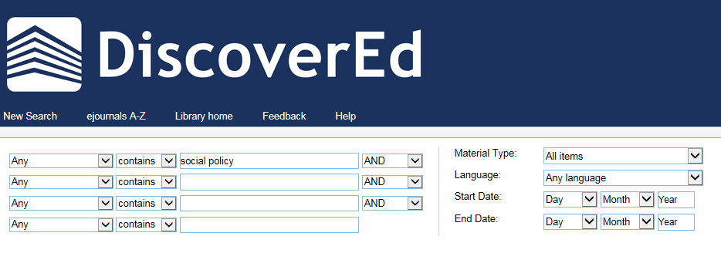
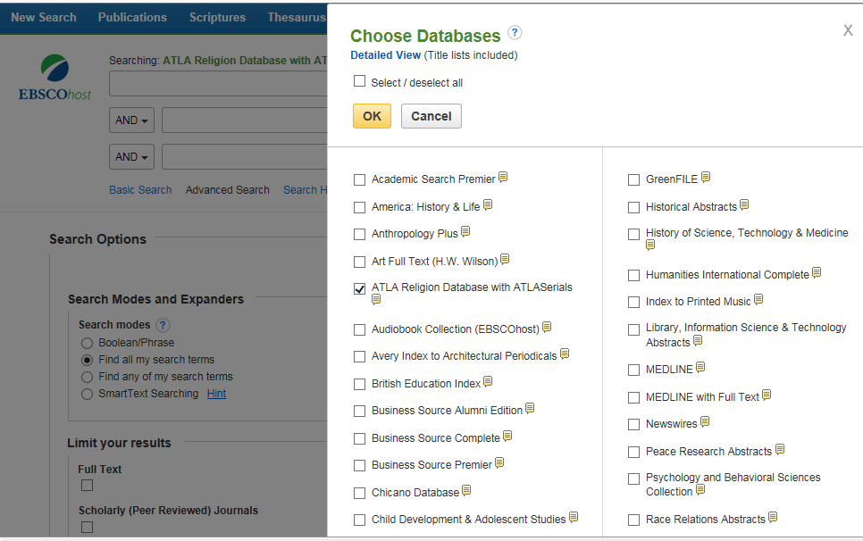
4. Library Search strategies : Use Advanced Search techniques
Use DiscoverEd Advanced search for Boolean Searching
Search across multiple databases from the same provider for systematic but time effective searching. E.g. EBSCO provides SocIndex, Political Science Complete
Notes:
Searching across multiple databases Library databases (EBSCO, ProQuest)
e.g. EBSCO – Child Development & Adolescent Studies, SocIndex

Slide 21
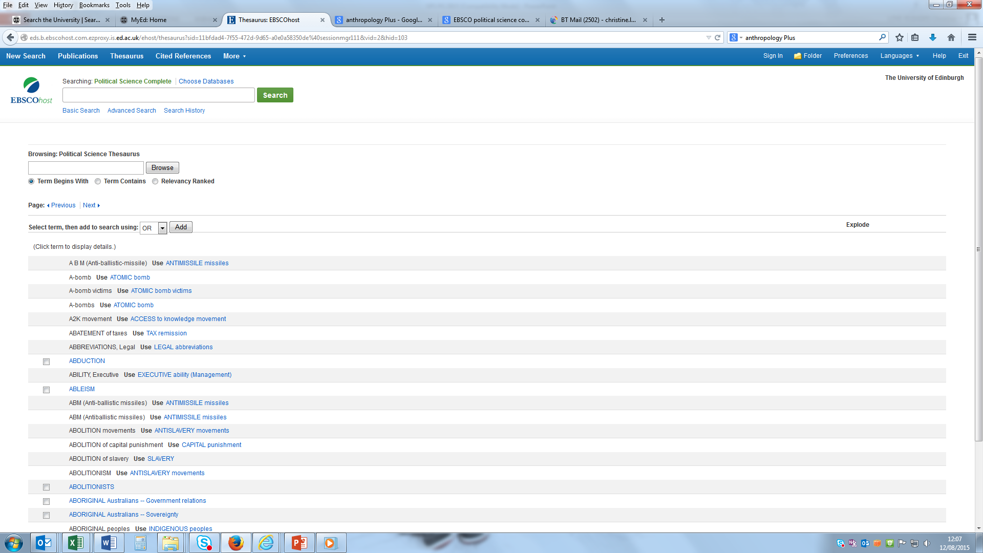
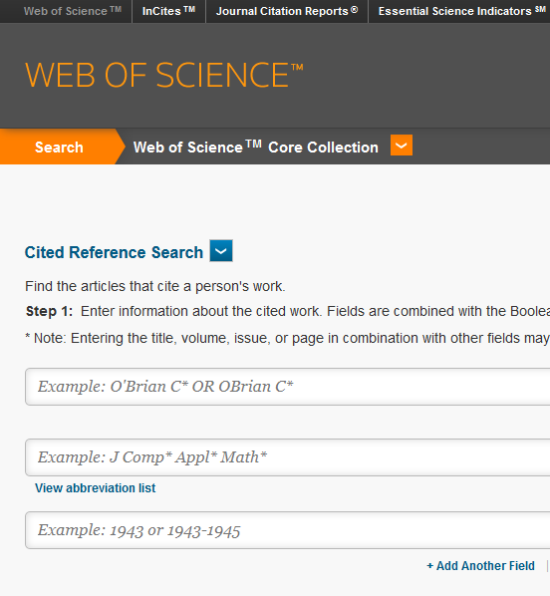
4. Library search strategies :
More advanced Search techniques
Thesaurus searching
Citation searching
Notes:
Thesaurus searching.
This lets you explore the language of your subject area and discover how experts have described your topic
It’s particularly useful in medical and health related database which may have internationally agreed thesaurus terms or subject headings
2. In Web of Science (WoS) it is possible to find records of articles which post-date a useful article and cite (refer to) it. You can follow the citation trail – see who was cited in your article and who cited it. Moreover, unlike other databases which do this, the useful article does not have to have a record in the database. This large and authoritative database includes Social Sciences Citation index.
Google Scholar also identifies other articles that have cited the reference you are looking at and allows citation search.
.

Slide 22

4. Library Search Strategies :
Didn’t find what you wanted? Mix it up again
Too many results?
  Add additional keywords with AND
  Use more specific keywords
  Use thesaurus terms
  Apply limits
  Use phrase searching
Too few results?
  Combine with OR
  Check your spelling – typos really mess things up!
  Use truncation or wildcards
  Use synonyms or alternative spelling
  Check thesaurus terms
  Use Nesting to separate single/group concepts: (concept 1 OR concept 2) AND (concept 3 OR concept 4)
Snowballing – follow up references & citations and see where they lead you.

Slide 23
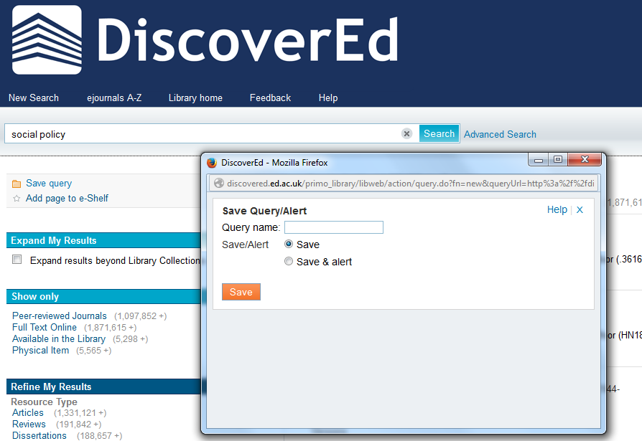
4. Library search strategies : use databases to record and track your search methods
Notes:
DiscoverEd will allow you to save and view your search history, and also to combine saved searches. Make sure you sign in first , then you will be offered the option to Save Query. The dialog box allows you to just save the query, or save and alert – this means you’ll be emailed if material added to the database matches your query.
This provides a valuable record of your methods for systematic literature searching.
The same functionality is also available in large database providers such as EBSCO and ProQuest.

Slide 24
5. Library Support for Your Study
Study Space
Main Library
547 study spaces with computers
Group study pods
Floors 1-4 Quiet Study
Floor 5 Silent Study – dedicated PG area
Additional study spaces and group study areas on the Lower Ground Floor will be available autumn 2016
Accessible study
  15 accessible study rooms on Floor 1 of the Main Library – arrange access with the Student Disability Service.
Notes:
Main Library
547 study spaces with computers
Group study pods
Floors 1-4 Quiet Study
Floor 5 Silent Study – dedicated PG area
Additional study spaces and group study areas on the Lower Ground Floor will be available autumn 2016
Accessible study
15 accessible study rooms on Floor 1 of the Main Library – arrange access with the Student Disability Service.

Slide 25
5. Library Support for Your Study
    Printing and copying
    cloudPrint from University managed desktop machines
    everyonePrint wireless printing from your laptop, tablet or mobile phone
    New students get £4 credit loaded to printing account, add more via MyEd printing channel
    Charges start at 5p for A4 black & white single side
    Scanning
    Use Main Library Print & Copy machines
    Scan an image of a document and email it to yourself.
    No charge for scanning
    Please note copyright regulations displayed above all print and copy machines!
Notes:
Printing and copying
cloudPrint from University managed desktop machines
everyonePrint wireless printing from your laptop, tablet or mobile phone
New students get £4 credit loaded to printing account, add more via MyEd printing channel
Charges start at 5p for A4 black & white single side
Scanning
Use Main Library Print & Copy machines
Scan an image of a document and email it to yourself.
No charge for scanning
Please note copyright regulations displayed above all print and copy machines!
Please note copyright regulations displayed above all print and copy machines!

Slide 26
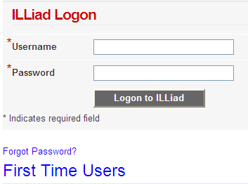
5. Library Support for Your Study
Inter-library loans (ILLiad)
Borrow books or obtain digital copies of articles or book chapters from other libraries
www.ed.ac.uk/is/inter-library
First time registration on ILLiad system required
PGs have 30 free loans, photocopies or scans per year
£5.00 per item for any subsequent successful request
http://illiad.lib.ed.ac.uk/illiad/
Notes:
Inter-library loans (ILLiad)
Borrow books or obtain digital copies of articles or book chapters from other libraries
www.ed.ac.uk/is/inter-library
First time registration on ILLiad system required
PGs have 30 free loans, photocopies or scans per year
£5.00 per item for any subsequent successful request

Slide 27

5. Library Support for Your Study
Student Book Recommendations
Can't find a book you need for your studies? Use RAB to tell us and we will try and buy it for the library.
Not for books you need quickly – use ILL instead
May be purchased as e-book version
Request a Book Service (RAB)
www.ed.ac.uk/is/RAB
Notes:
Student Book Recommendations
Can't find a book you need for your studies? Use RAB to tell us and we will try and buy it for the library.
Not for books you need quickly – use ILL instead
May be purchased as e-book version
www.ed.ac.uk/is/RAB

Slide 28

5. Library Support for Your Study
Using other libraries
National Library of Scotland
Register in person or online
Evidence of ID, address and matriculation card
http://www.nls.uk/
SCONUL Access scheme
Allows borrowing from other UK Higher Education Libraries
www.sconul.ac.uk
COPAC Union Catalogue of UK Research Libraries
http://copac.jisc.ac.uk/
Notes:
National Library of Scotland
Register in person or online
Evidence of ID, address and matriculation card
http://www.nls.uk/
SCONUL Access scheme
Allows borrowing from other UK Higher Education Libraries
www.sconul.ac.uk

Slide 29
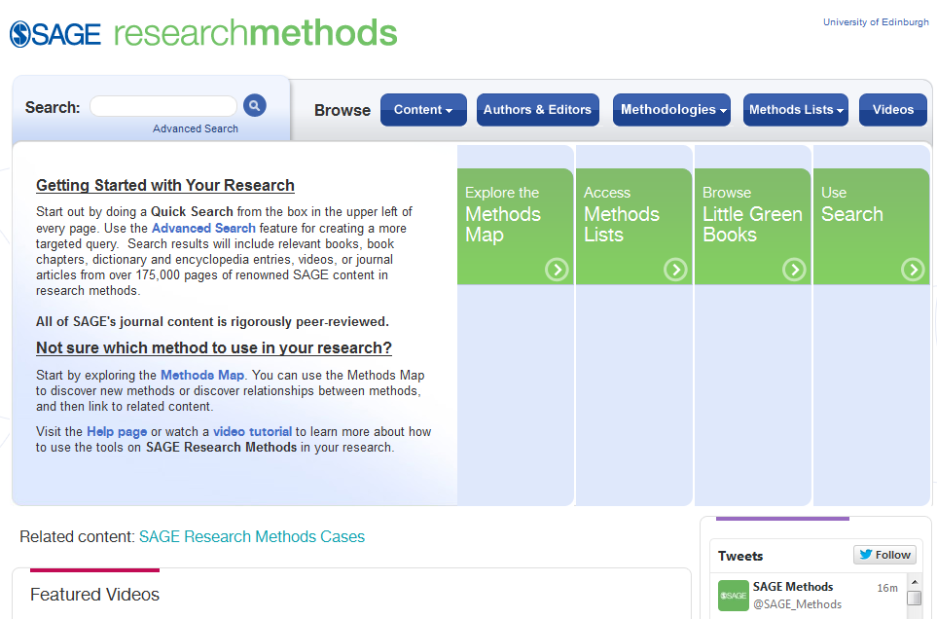
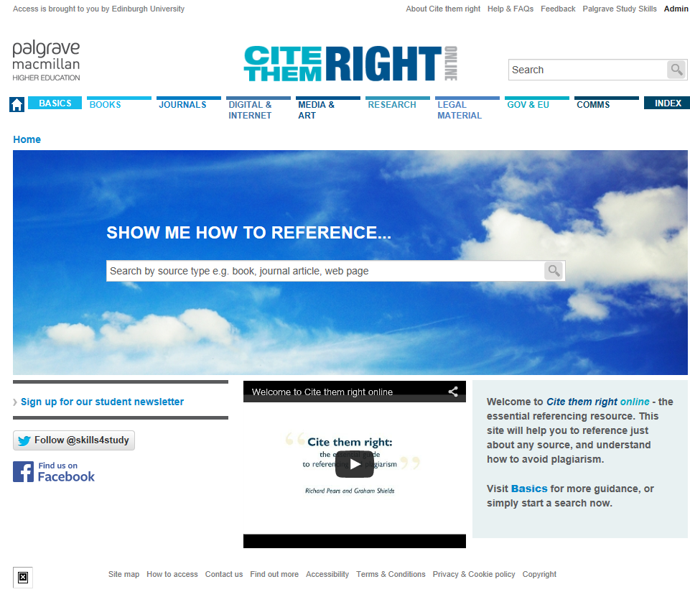
5. Library Support for Your Study : Research skills resources
SAGE Research Methods
Cite them right

Slide 30
5. Library Support for Your Study : Reference management systems
Take the misery out of reference management!
They help you to
Collect, organise, annotate & describe your references and cite them in your work
Style your references for your dissertation, PhD thesis, journal paper or book chapter
Some reference management systems
EndNote X7 – provided on all UoE PCs and fully supported
  Can buy for your own personal computer at discounted rate. See http://edin.ac/1PMUJDQ).
EndNote Online (www.myendnoteweb.com)
Some other free web-based systems: Mendeley, Zotero
  IS Skills run free training courses on EndNote X7 and EndNote Online. For more information and how to book go to http://bit.ly/1KIMdIa
You can also download self-study workbooks from their website.

Slide 31
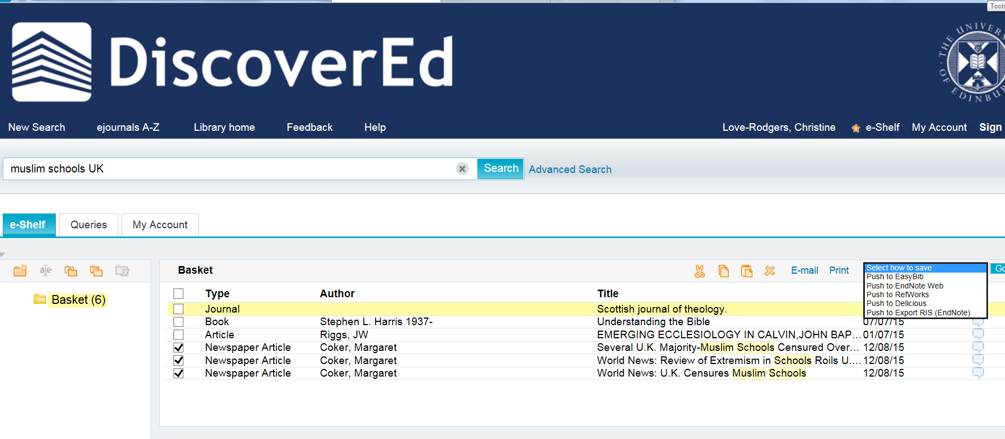
5. Library Support for your study : export your searches to reference management software
Notes:
Use DiscoverEd or databases to export your searches to reference management software.
In DiscoverEd, click the small star icon next to items in your list of results to save them to your e-shelf. Once you have done this click on ‘select how to save’ for a variety of export options – including exporting to reference management software.
In bibliographic databases, choose ‘Save to folder’ or ‘Save to myProQuest’ for similar functionality.

Slide 32
Thank you and keep in touch
Christine Love-Rodgers
Caroline Stirling
Academic Support Librarians – SPS
SPS.Librarian@ed.ac.uk
Twitter @SPSLibrarian, http://libraryblogs.is.ed.ac.uk/spslibrarian/

