Slide 1
Search skills and why you need them
Literature databases
Getting the full-text
Journal impact factors
Keeping up to date
Alerts and/or saved searches
Brief introduction to Reference Management software
Angela.Nicholson@ed.ac.uk http://www.docs.is.ed.ac.uk/docs/Libraries/Presentations/Geo.pptx
Notes:
1

Slide 2
Literature Searching
Define your topic produce a list of keywords and phrases which you could use as search terms
Identify potential sources of information
Search selected resources
Evaluate the information recovered
Organise, apply and communicate the information cite references, consider reference management software
Notes:
Define your topic - produce a list of keywords and phrases which you could use as search terms
Identify potential sources of information
Search selected resources - DiscoverEd, bibliographic databases, relevant websites, grey literature, organisations …
Evaluate the information recovered
Organise, apply and communicate the information - cite references, consider using bibliographic reference management software

Slide 3
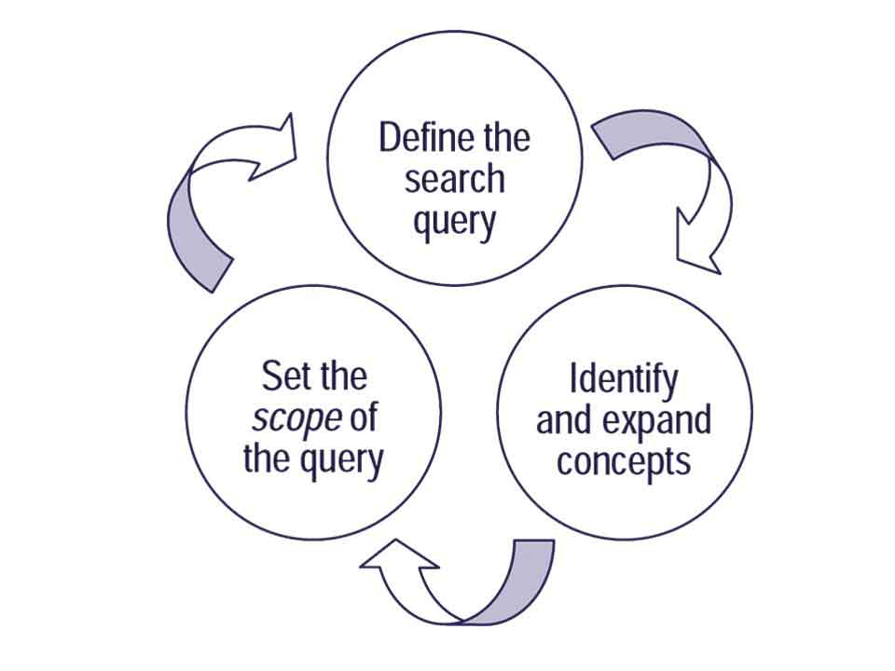

Slide 4
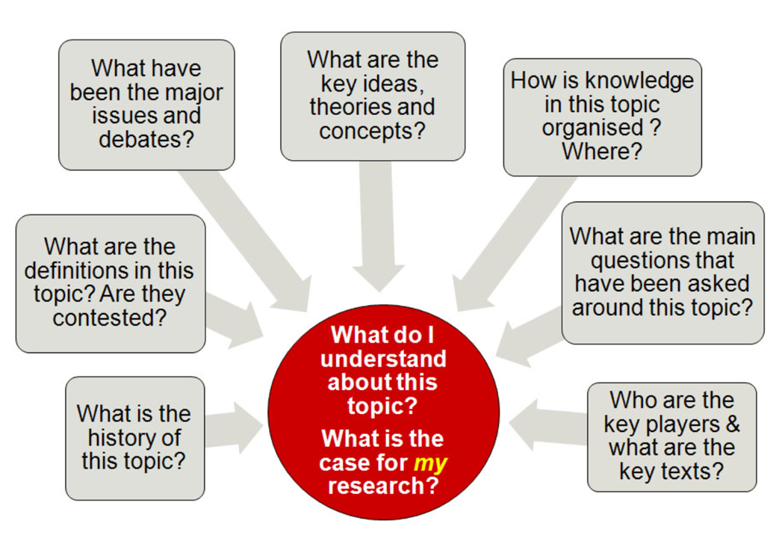
Mewburn, I., Hacking the Literature Review. RMIT University. Accessed online Sep2012 URL: https://docs.google.com/presentation/d/1r_sIg1SFMoIh3E26-dg3aSR5xRap91iDkaijNVdx4Ds/edit?pli=1#slide=id.p

Slide 5
Think about the information you need – why?
It does not have to be everything published on the topic.
What keywords will you use in your search?
Identify the concepts
Think of the relevant terms for each concept
Think of alternative words, US spelling, acronyms, broader and narrower terms
Any limits/what you don’t need to read about
Record you ideas
Notes:
It’s not a systematic review of everything published on the topic.

Slide 6
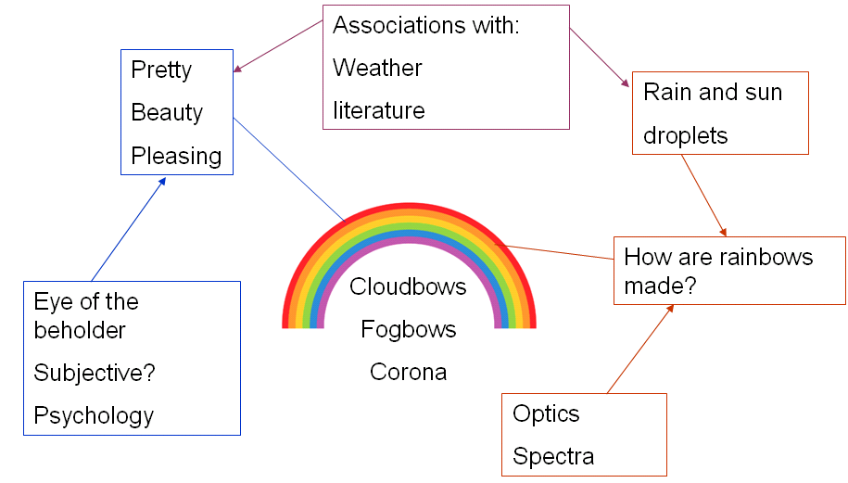
Mind maps - Inspiration
Tables
Which antihypertensives are safest in treating hypertension during pregnancy or childbirth?
Major subjects | antihypertensives | hypertension | pregnancy or childbirth
Alternative spellings related terms synonyms | anti-hypertensive(s) beta blockers specific drug names | high blood pressure toxemia preeclampsia PIH | Parturition Birth Labour/ labor

Slide 7
Some more ways to improve your search
Truncation: allows you to search for variations
climat* = climate, climatic
optic* for optic, optics or optical
Phrase: helps retrieve more relevant results
“soil organic matter”
“North Sea”
Notes:
7
7

Slide 8
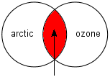
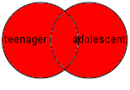
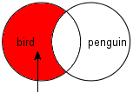
Search Strategy - combining your terms can help
AND: to combine terms - will narrow your search
OR: between alternative words - will broaden your search
NOT: to exclude unwanted items
Notes:
8
8

Slide 9
Question: What are the effects of agricultural management on soil organic carbon (SOC) stocks?
Keywords: Soil organic carbon, Agricultural practices, Long-term, Tillage, Fertilization, Crop rotation, Cover crop, Sequestration
Search:
Soil*
AND
(arable OR agricult*OR cultivat*OR …
AND
(“soil organic carbon”OR carbon sequestrat* OR …
These techniques help but at the start, keep it simple.
Notes:
9
9

Slide 10
Think about the information you need – why?
It does not have to be everything published on the topic.
Reverse engineer from ideal data
Get ideas for your search terms by looking at prior reviews and known relevant studies

Slide 11
Exercise
Your research question. https://padlet.com/EdinLib/geo1
What is your search?
Identify the concepts.
Set the scope.
Text to copy: https://padlet.com/EdinLib/geo1
Possible sources. https://padlet.com/EdinLib/geo2
Text to copy: https://padlet.com/EdinLib/geo2
Notes:
Remember:
Synonyms
Alternative Spelling
Limits

Slide 12
Sources of Information
The web
Google
Google Scholar
Relevant websites
The library
DiscoverEd – books, book chapters, journal articles, theses
Databases
other sources
A recommended article can be a good start
Use the search terms you’ve planned and be methodical

Slide 13
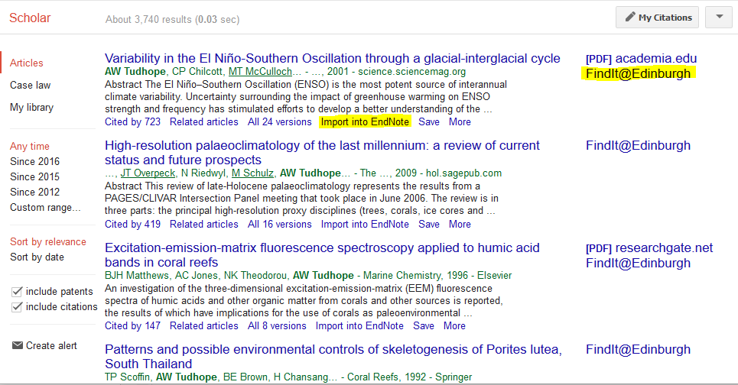
Google Scholar
A good place to start but not always a good place to stop

Slide 14
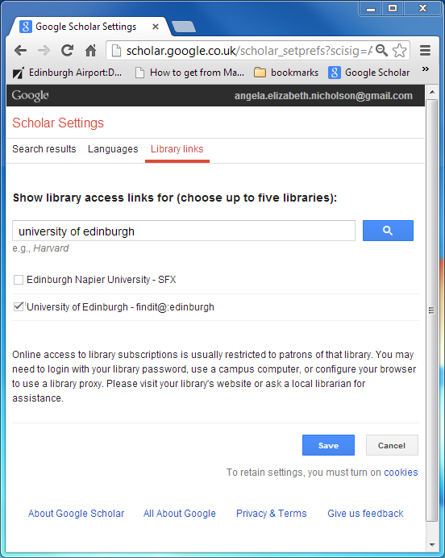
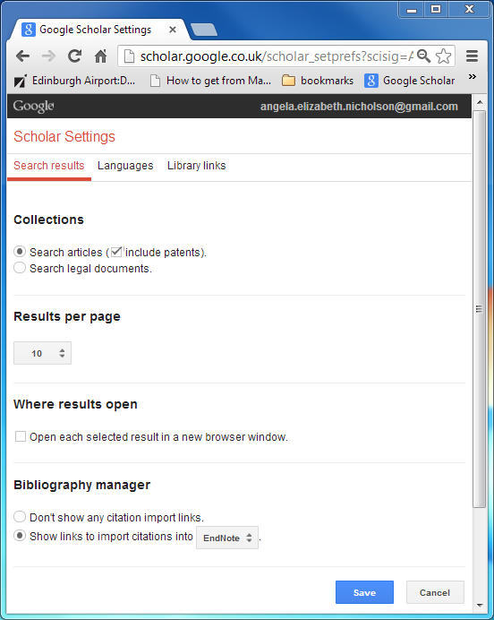
Google Scholar settings can help you – Findit@, Import to
Notes:
If you haven’t already look at the options available and how they may help you

Slide 15
Exercise
Your research question.
Google Scholar. Modify preferences to show ‘findit@edinburgh’ and ‘import into’
Try your search terms in Google Scholar

Slide 16
DiscoverEd http://discovered.ed.ac.uk/
Search the Library’s collections – books, e-books, subscription content & journals.
Sign in to access all online content, manage your searches, loans and requests.
Notes:
DiscoverEd is the key tool to find books and other resource that the Library provides. You can find it on the Library webpage and via the MyEd Library Tab.
In addition to finding resources, when you sign-in (as a UoE member) DiscoverEd enables you to renew your loans and request books that are on loan to someone else.
Although wide-ranging, there are also more resources, which are not available through DiscoverEd but are available via the webpages. More on that in a later slide …

Slide 17
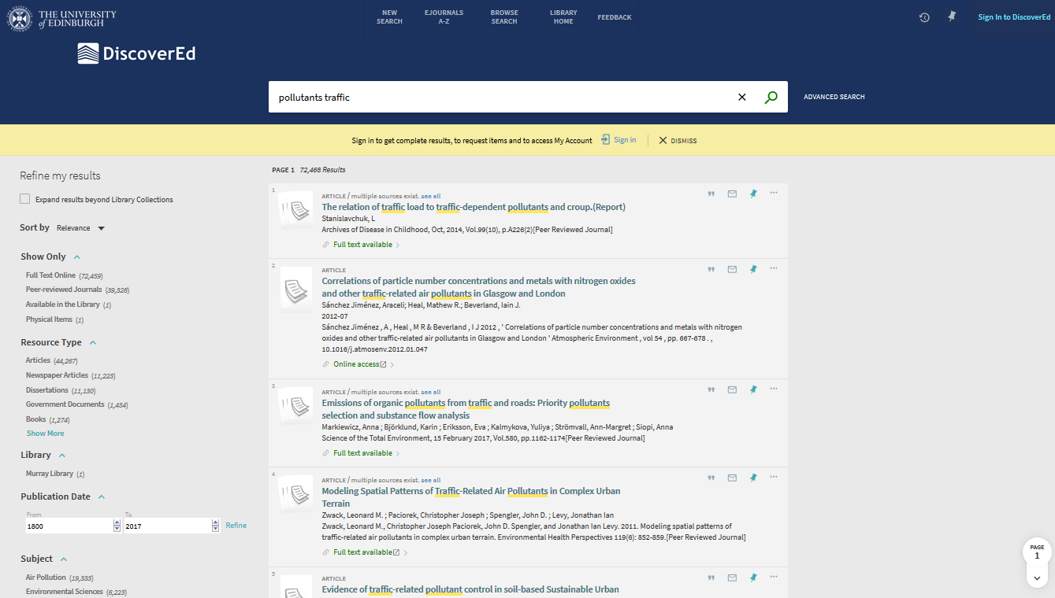
Sign in
Notes:
17
17

Slide 18
Exercise
What search terms are relevant to your research?
Google Scholar. Modify preferences to show ‘findit@edinburgh’ and ‘import into’
Try your search terms in Google Scholar
Try your search terms in DiscoverEd
Notes:
Look at the options to: create an account, save references to folder, save searches etc

Slide 19
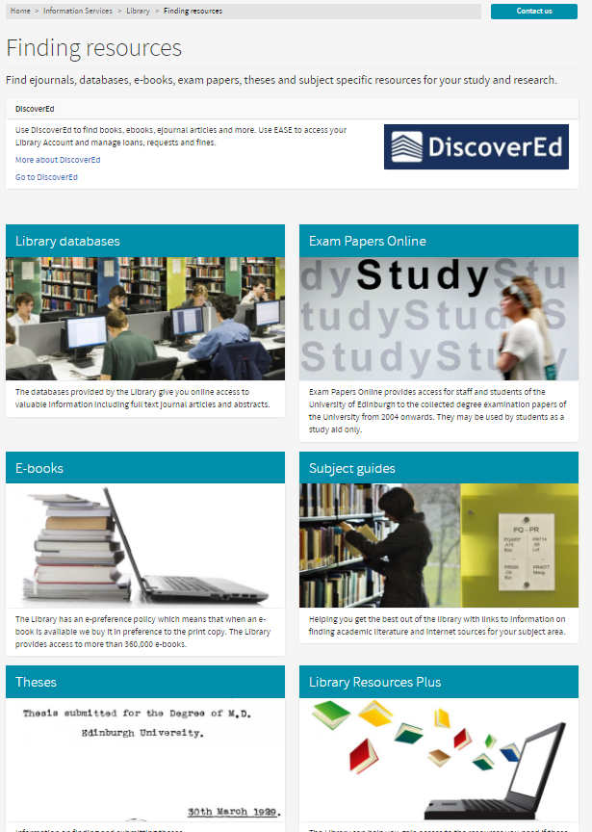
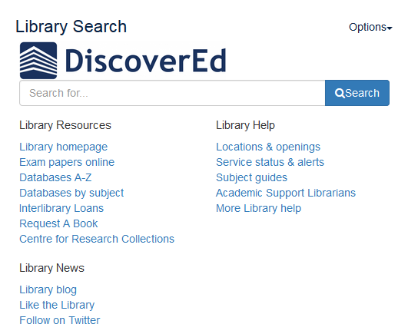
Databases Search by A-Z or subject list

Slide 20
Bibliographic databases
Can find articles and full-text not found via DiscoverEd or Google Scholar
Search details of millions of articles to find what publications exist about a topic - even if not held in our library
Can be subject specific – although you may need to use more than one
Can use sophisticated searches

Slide 21
Subject Specific Bibliographic Databases
Subject database lists, or A-Z
Web of Science Core Collection (Science Citation Index , Conference Proceedings)
Scopus
Agricola (agriculture)
Biosis (biology, environmental)
CAB Abstracts (forestry, environmental, tourism)
GeoScience World (mineralogy journals not elsewhere)
Scifinder (geochemistry)
Sociological abstracts
…

Slide 22
Other sources – not available through DiscoverEd
Newspaper databases e.g FACTIVA
Allow you to search multiple newspaper sources include local UK and international
Business Data - wide range of company, financial and market data. http://edin.ac/1RBEXgb
Wide range of data sets, including economic and social Data Library - http://www.ed.ac.uk/is/data-library
UK maps and geospatial data http://digimap.edina.ac.uk/

Slide 23
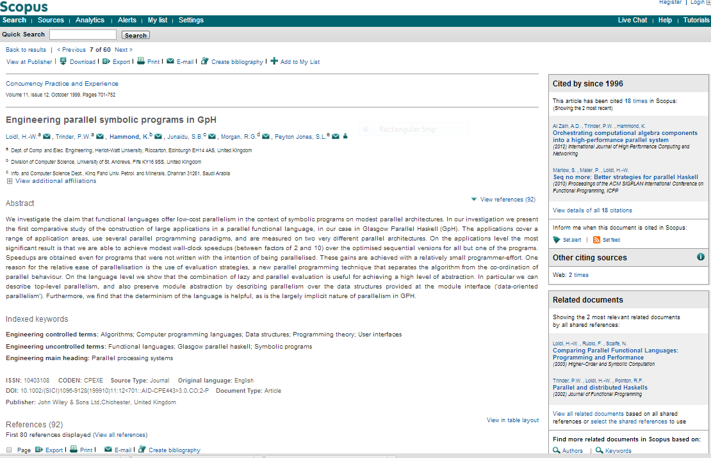

Slide 24
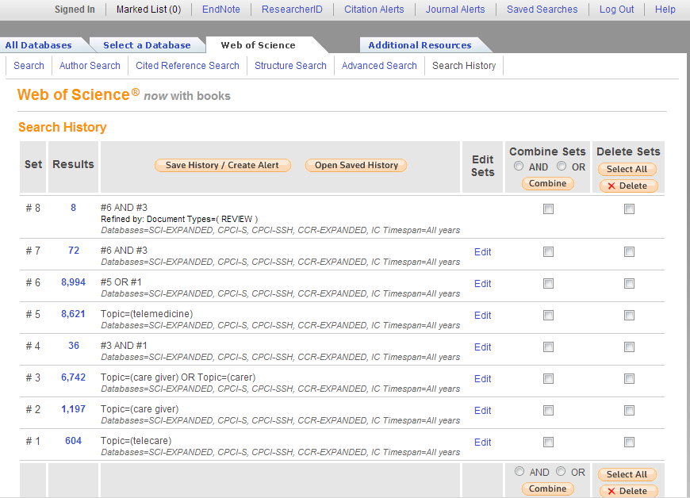
Create an account to save searches and manipulate them later

Slide 25
Exercise
What search terms are relevant to your research?
Google Scholar. Modify preferences to show ‘findit@edinburgh’ and ‘import into’
Try your search terms in Google Scholar
Try your search terms in DiscoverEd
Try your search terms in a relevant database
Notes:
Show how to get to WoS via Subject Database list
Show other databases for the subject
Select WoK/WoS

Slide 26
Evaluate your results
Currency - Is there a date attached? Does it matter?
Relevancy - how close a fit is it to your search strategy/inclusion criteria?
Accuracy - Is there information included which you know is inaccurate?
Authority - Do you trust the author of the information?
Objectivity - Is there bias?

Slide 27
Exercise
What search terms are relevant to your research?
Google Scholar. Modify preferences to show ‘findit@edinburgh’ and ‘import into’
Try your search terms in Google Scholar
Try your search terms in DiscoverEd
Try your search terms in a Web of Science
Create an alert for a search (or journal)
Notes:
Show how to get to WoS via Subject Database list
Show other databases for the subject
Select WoK/WoS

Slide 28
If it’s not available … www.ed.ac.uk/is/library-resources-plus
Use the Inter-Library Loan Service to have materials delivered from other UoE campuses and other libraries around the world.
Use the Request a Book service to tell us when we do not have a book you require for your studies and we will try to buy it for the Library.
Notes:
If we don’t have the resource you need, there are a few options.
If someone has the book on loan – you can request it through DiscoverEd
If they book isn’t in the library – use ‘Request a Book’ via the MyEd or webpage link www.ed.ac.uk/is/rab.
If a book or a journal article isn’t available – we can try to borrow it from a library that does have it, using the inter-library loan service. You have 30 free inter-library loans per academic year.
(Book purchase ratios are typically 1:20 for essential and 1:40 for recommended reading)

Slide 29
Managing your references
Reference management software saves you time
Use it to construct and manage a database of references
Automatically build bibliographies in Word
EndNote & Endnote Online Support and training from the University - see MyEd events
http://www.docs.is.ed.ac.uk/skills/documents/3815/3815.pdf (Endnote)
https://www.youtube.com/watch?v=mldro9MV0bo#action=share (4 min video)
http://www.docs.is.ed.ac.uk/skills/documents/3814/3814.pdf (Endnote Online)
https://media.ed.ac.uk/media/Using+EndNote+Online+to+Manage+your+References/1_5syfceq6 (Video)
Other good options include Mendeley https://community.mendeley.com/guides/videos

Slide 30
Developing your skills
Institute for Academic Development
Workshop, resources and advice for taught and research postgraduates.
http://www.ed.ac.uk/iad
Lynda.com
Online courses covering technology, business and creative skills, and include an extensive section focussing on education and e-learning. https://www.lynda.com/
Notes:
Please explore the opportunities available to you for training. Some examples are:
The Institute for Academic Development, who provide a wide range of academic skills resources and course. One of which focuses on finding research literature.
There is also a wide range of online courses available through Lynda.com

Slide 31
Help
Academic Support Librarians
www.ed.ac.uk/is/asl
Library Help Desks
IS Helpline
IS-Helpline@ed.ac.uk
Library web pages
www.ed.ac.uk/is/library
Notes:
There is always help available.
Each library has a helpdesk and you can email or phone the IS Helpline with library or IT questions. There is also a wide range of information on the Library and Information Services web pages.

