Slide 1

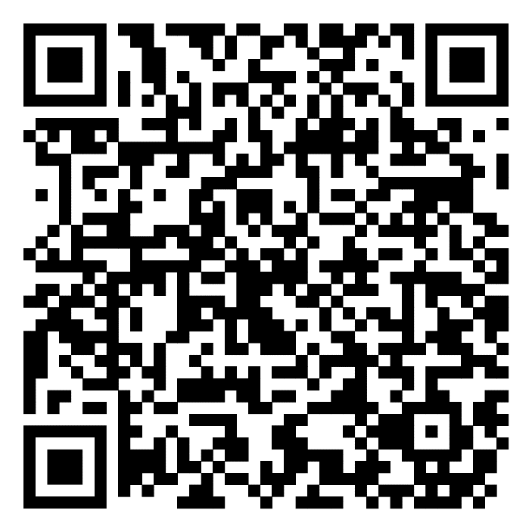
Library Academic Support
Helping you get the best from the Library, its collections, resources and services
Study Resources for
Literature Reviews
Rowena Stewart
rowena.stewart@ed.ac.uk
Academic Support Librarian
AY24-25, v.Apr25
This presentation:
www.docs.is.ed.ac.uk/docs/Libraries/Presentations/Skillslitrev.pptx

Slide 2
Library Academic Support Team
Study Resources for Literature Reviews
Aims
To know:
What to consider when thinking about your subject.
Effective ways of finding academic literature on your subject.
How to keep records you find.

Slide 3

Have a think
Library Academic Support Team
Do I have to?
What sort of work are you producing?
What is your literature review on?
Make your topic into a question you want the academic literature to answer
It helps you to:
Decide your research focus which may prevent you getting distracted.
2) Prepare words and phrases, “Search Terms”, which may relate to the right kind of research for your review.

Slide 4

Search Terms - Using what you know
Library Academic Support Team
Use the words and phrases which come to mind immediately.
Use papers you have already and find – vocabulary, authors, references
What is the experience of adolescents with a history of disruptive behaviour undergoing a course of mindfulness training?
adolescents | disruptive behaviour | Mindfulness training | experience
adolescen(ts) teen(agers) “young people” youth(s) “young adult(s)” | “disruptive behav(iour)” aggress(ion) violen(ce) | mindful(ness) Meditation Training/education/ program(me)/course… | attitude(s) / (dis)satisfy(action) Compliance Dropout(s)
Thinking along these headings may be useful:
Population, Problem, Intervention, Comparison, Outcome, Study design
Population, Phenomena of Interest; and Context [reviews of qualitative evidence, JBI]
More information about PICOS/T, PEO, PICo, SPIDER (pdf)
www.docs.is.ed.ac.uk/docs/Libraries/PDF/PICOS.pdf

Slide 5
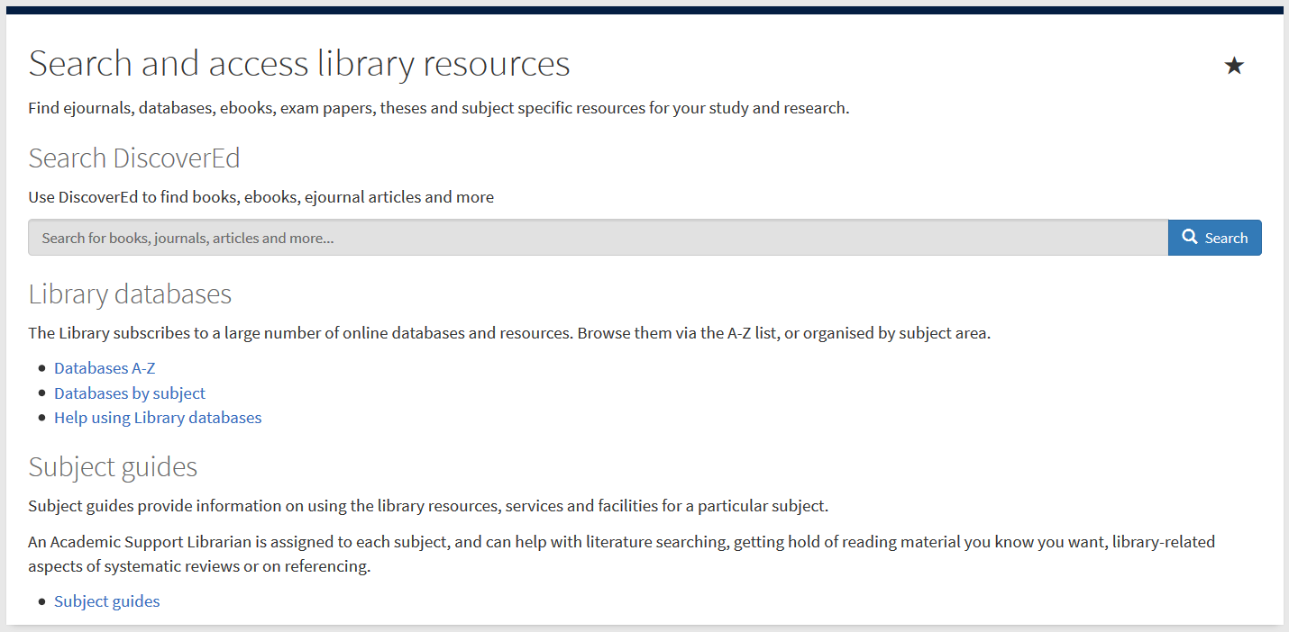
Using what you know – scoping the academic literature
Library Academic Support Team
Using resources you are familiar with can help you get
a feel for the literature.
an idea of whether you will find relevant papers for your topic.
DiscoverEd includes article level records.
Default setting is to what you can read because the library has bought it.

Slide 6
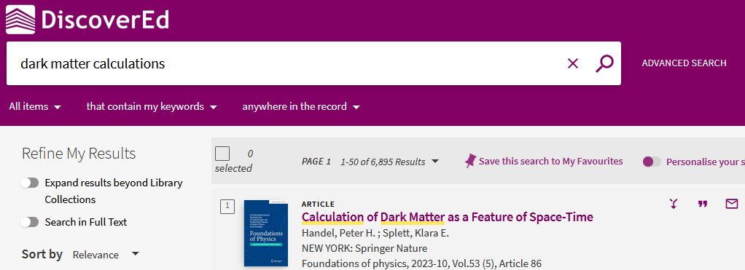
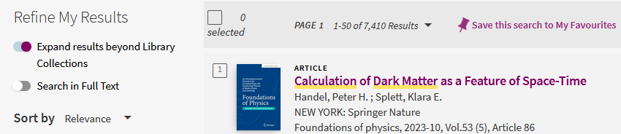
Databases for Reviewing the Literature
Library Academic Support Team
DiscoverEd includes article level records.
Default setting is to what you can read because the library has bought it.
Get more results but which you may not be able to read immediately.

Slide 7
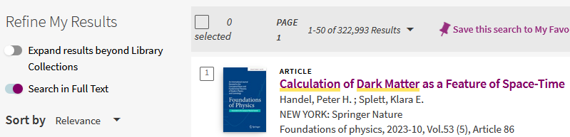
Databases for Reviewing the Literature
Library Academic Support Team
DiscoverEd includes article level records.
Default setting is to what you can read because the library has bought it.
Get more results but in which your search terms may be pages apart.

Slide 8
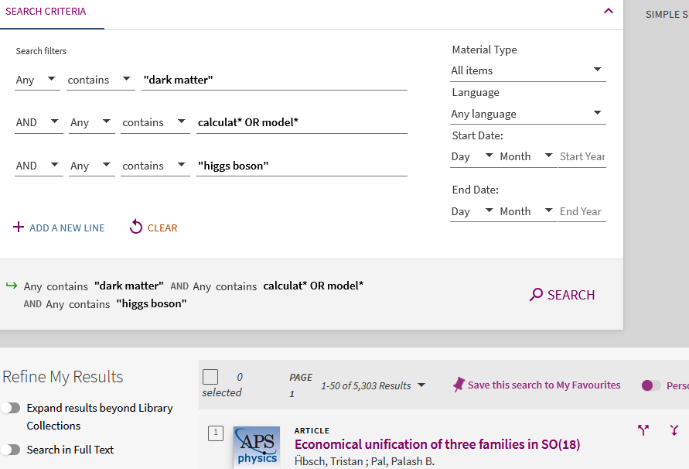
Using what you know: DiscoverEd – Advanced Search
Library Academic Support Team
Opportunities for “snowballing”

Slide 9
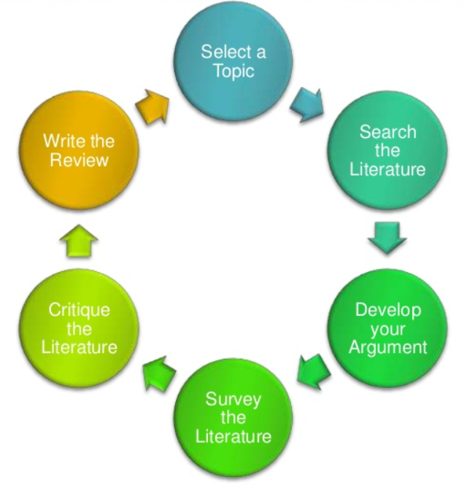
Library Academic Support Team
Some Steps
Define your topic
Identify potential sources of information
Use resources you are familiar with to get:
an initial feel for the literature.
an idea of whether you will find relevant papers for the review topic you’ve chosen.
Scoping
Search selected resources including relevant abstracting and indexing / bibliographic databases
Original Diagram: Machi, L.A. & McEvoy, B.T. (2012) The literature review: six steps to success, 2nd ed, Thousand Oaks, California: Corwin Press. https://discovered.ed.ac.uk/permalink/f/gfso8q/44UOE_ALMA21101100770002466

Slide 10
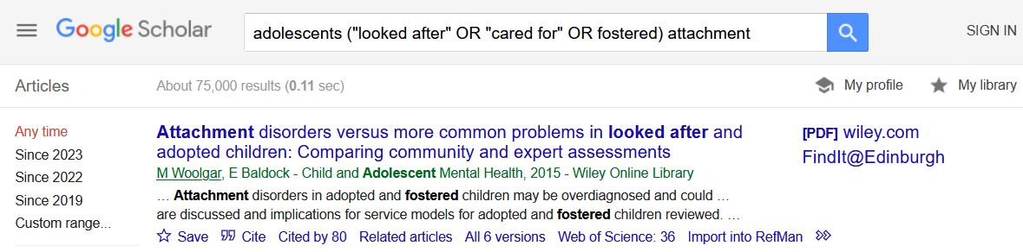
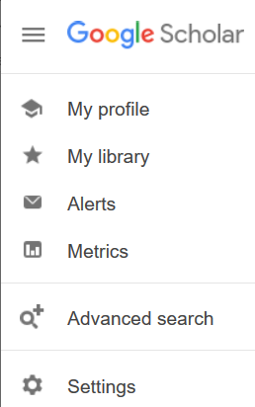
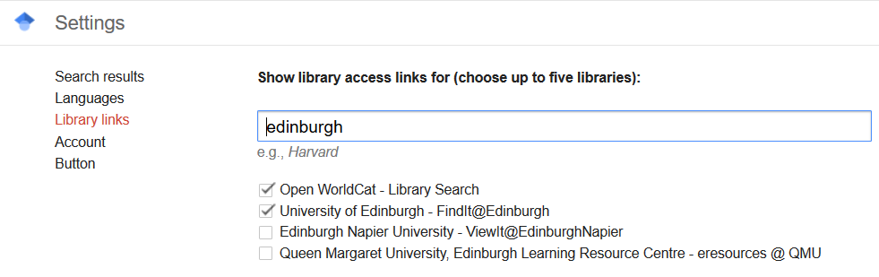
Using what you know: Google Scholar – Library Collections
Library Academic Support Team
Go to Settings > Library links to add:
findit@edinburgh to results view.

Slide 11
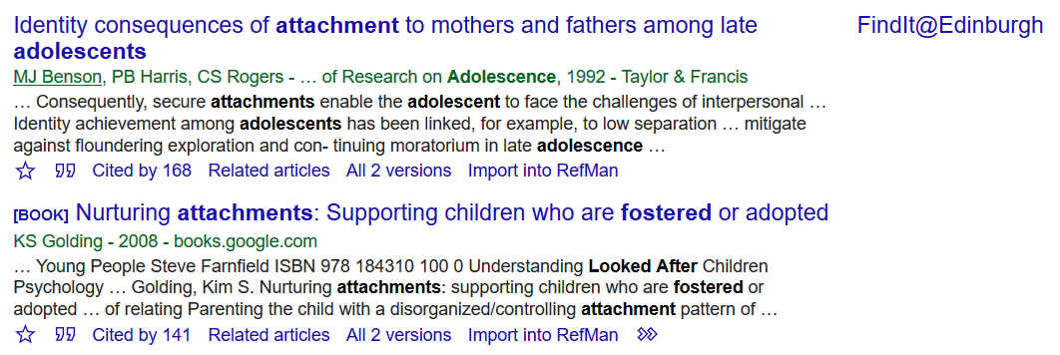
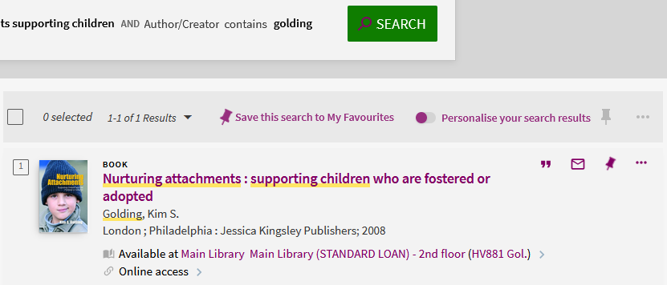
Library Academic Support Team
Check: can you read what you have found?
No link?
Link does not give you full-text?
Treat like a normal reference.
Use DiscoverEd
Opportunities for “snowballing”
The library may have what you want:
    Online from a different site
    In print

Slide 12
Library Academic Support Team
Access to Online Collection
University login for the majority of online resources.
VPN – access to University network + wireless access
www.ed.ac.uk/is/vpn

Slide 13
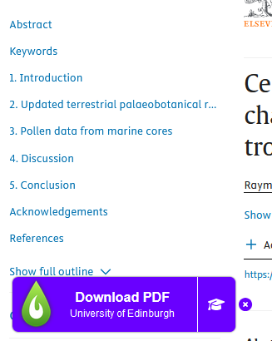
LibKey Nomad
Library Academic Support Team
Have the quick link button appear when you are on sites recognised to have full-text available to University of Edinburgh staff and students.
Can sometimes help overcome temporary authentication issues
Download the LibKey Nomad Browser Extension
More information:
https://library.ed.ac.uk/libkey-nomad

Slide 14
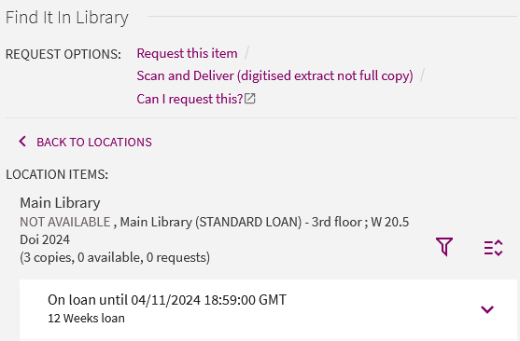
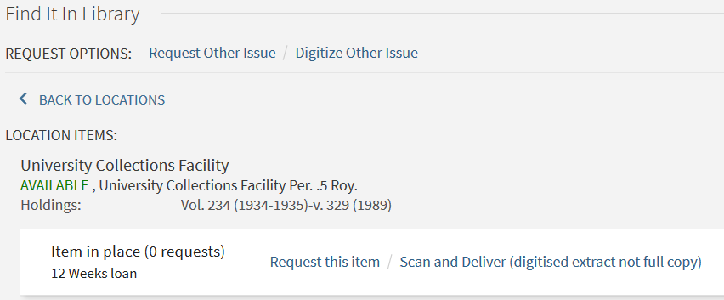
Library Academic Support Team
Print-only material in the Collection
Sign In to DiscoverEd to get the REQUEST OPTIONS
Ask for scans of material (journal article, book chapter) which the Library only has in print.
not all collections are available and
copyright limits apply
Request early return of books already borrowed.

Slide 15

Library Academic Support Team
Inter-Library Loan (I.L.L.) service
For when The Library does not have what you want at all
Scan of part (article, chapter etc) to keep, or
Physical items to borrow
edin.ac/inter-library-loans
Free per year (after which £5 per request received):
5 for undergraduates
30 for postgraduates and staff
2 renewals which are done via Helpdesk or I.L.L. staff.

Slide 16

Library Academic Support Team
Combining search terms: using your synonyms
Higher number of results

Slide 17
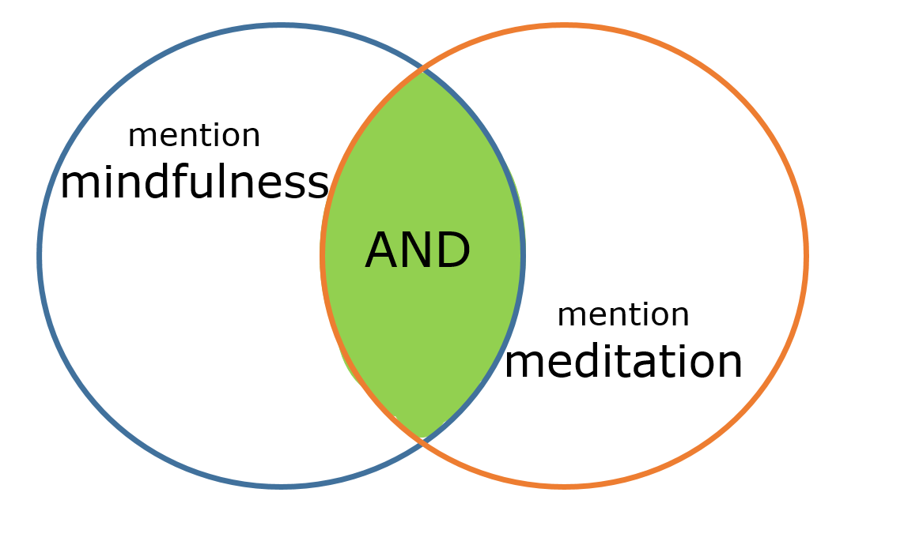
Library Academic Support Team
Combining search terms:
looking for more than one concept
Smaller number of results

Slide 18

Library Academic Support Team
Combining search terms - be careful with NOT!
Excludes all records/results which have the word meditation.
What about research which looks at both?

Slide 19
Library Academic Support Team
What is the experience of adolescents with a history of disruptive behaviour undergoing a course of mindfulness training?
adolescents | disruptive behaviour | Mindfulness training | experience
adolescen(ts) teen(agers) “young people” youth(s) “young adult(s)” | “disruptive behav(iour)” aggress(ion) violen(ce) | mindful(ness) Meditation Training/education/ program(me)/course… | attitude(s) / (dis)satisfy(action) Compliance Dropout(s)
adolescen* OR teen* OR “young people” OR “young adult*”
“disruptive behav*” OR agress* OR violen*
experience* OR attitude* OR satisf* OR dissatisf*
mindful* OR meditat*
“disruptive behav*” OR agress* OR violen*
experience* OR attitude* OR satisf* OR dissatisf*
mindful* OR meditat*

Slide 20
Library Academic Support Team
Knowing what you want to read
Inclusion/Exclusion criteria are further to your research question and define conditions research must meet to be relevant to your review
Age … geography … gender … production conditions…study type… methodology/analysis ... previous histories of population … field conditions …
Not everything you want a paper etc to contain has to become a search term.
You can make decisions by eye/reading results.
Inclusion/exclusion criteria, even some concepts, may not make useful search terms, eg methodologies.

Slide 21
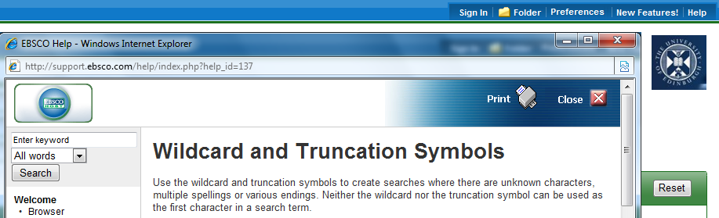
Library Academic Support Team
Search strategy - truncation
Truncation allows you to look for all forms of a keyword.
music* = music, musical(s), musician(s), musicianship
Symbols can vary but asterisk * is common.

Slide 22
Library Academic Support Team
Search strategy – wildcards
Watch out for UK/US spellings (behaviour, behavior).
A wildcard allows for variation in a letter in the middle of a word and usually stands for 0 or 1 character
organise/organize: organi?e.
counselling/counseling: counsel?ing
[organise OR organize is more specific]

Slide 23
Library Academic Support Team
Search strategy – phrase marks
Returning words entered in order, ie as a phrase rather than just all the words being present.
use “double quotes”
“high blood pressure”
“exam* stress*”

Slide 24
Library Academic Support Team
Search strategy – proximity operators
Proximity searching for words near or next to each other in any order,
eg catalyst* NEAR/X engine*
“civil war*” ADJ4 regeneration
This is the most variably worded command.
Use interface/supplier Help to check if it exists and what to use.

Slide 25
Abstracting & Indexing databases
Library Academic Support Team
Include material not found in DiscoverEd or Google Scholar.
Contain details of millions of articles from 1000s of publications.
  Conference proceedings, journal articles, book chapters, reports and standards.
Subject specific databases.
Databases by subject
edin.ac/databases-subjects
Library Subject Guides
edin.ac/library-subject-guides

Slide 26
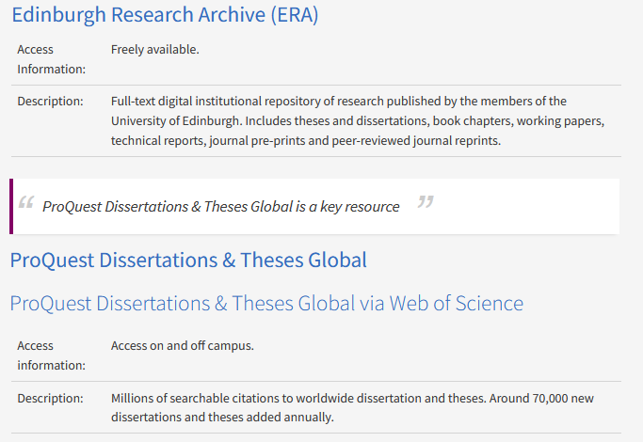
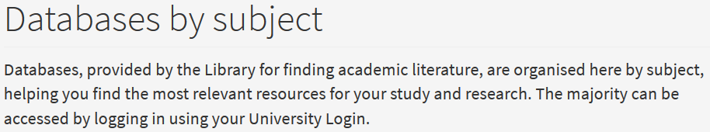
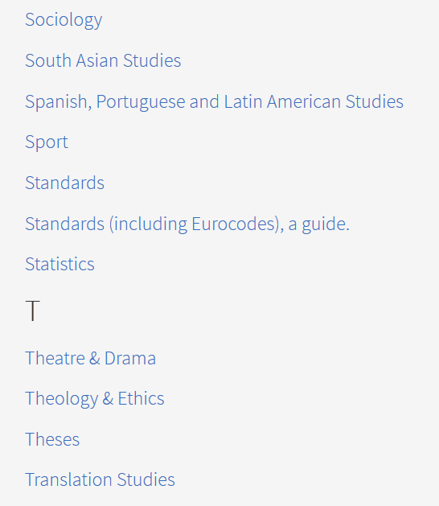
Abstracting & Indexing databases
Library Academic Support Team
Go to the resource via the title in the list.
Flagged resources are particularly strong in the subject area.

Slide 27
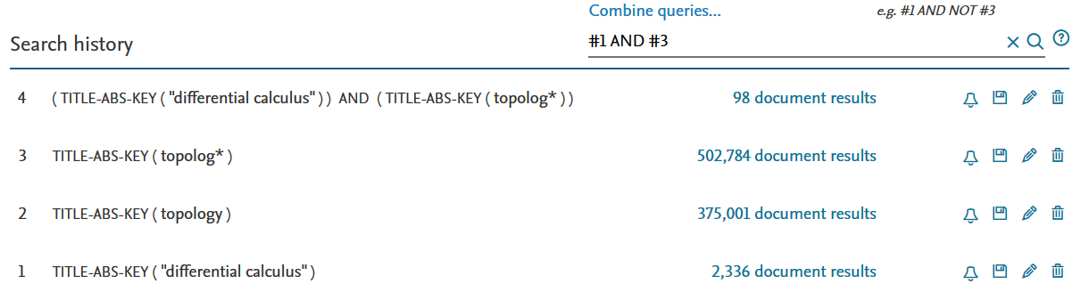
Library Academic Support Team
Abstracting & Indexing databases – Search History
Search concept by concept.
Add synonyms as you think of them.
See the difference (in result numbers) combining makes.
Know the limiting concept(s) (lowest result number).

Slide 28
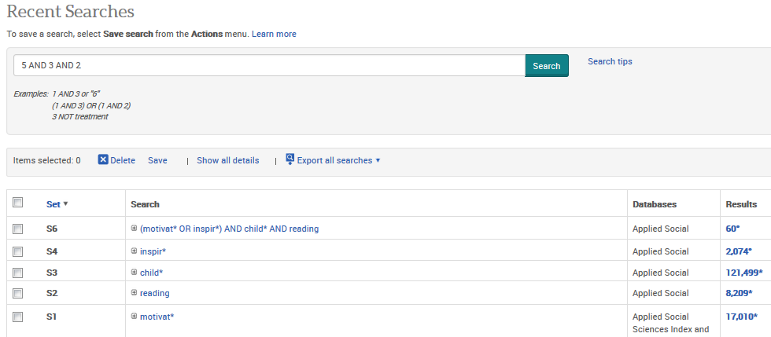
Library Academic Support Team
Abstracting & Indexing databases – Search History
A&I database interfaces/suppliers offer the same feature but with slight differences

Slide 29
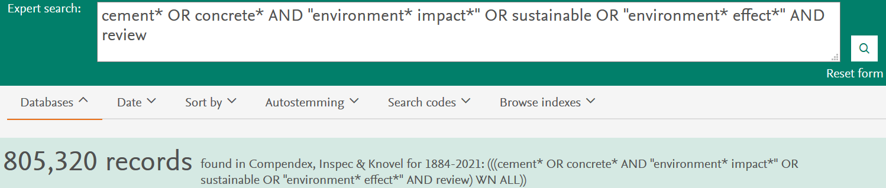
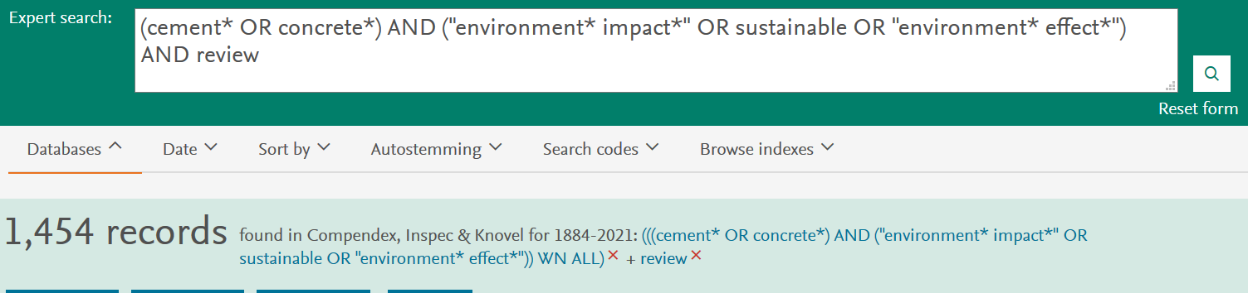
Library Academic Support Team
Search interfaces – brackets for multiple concepts

Slide 30
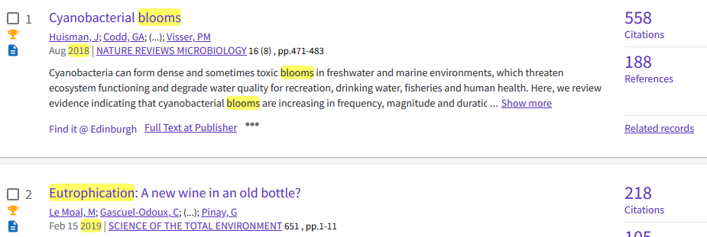
Library Academic Support Team
Search Strategy – “Snowballing” using citations
Using one article etc to get to more:
Search for other work by the same authors.
Follow up references used in the bibliography.
Use “cited by” or “more like this” feature if there is one.

Slide 31
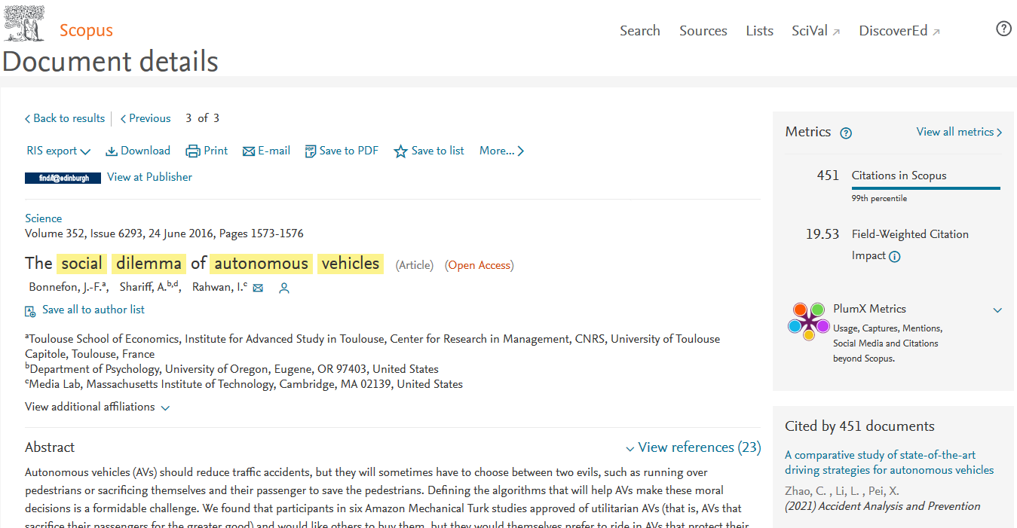
Library Academic Support Team
Search Strategy – “Snowballing” using citations
References in a paper

Slide 32
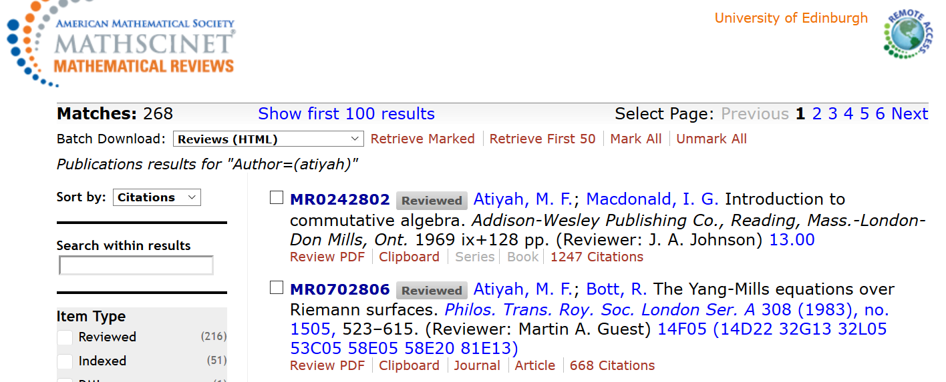
Library Academic Support Team
Search Strategy – “Snowballing” using citations
Papers with a work in their reference lists

Slide 33
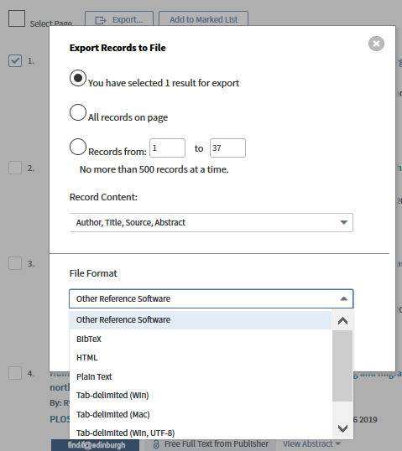
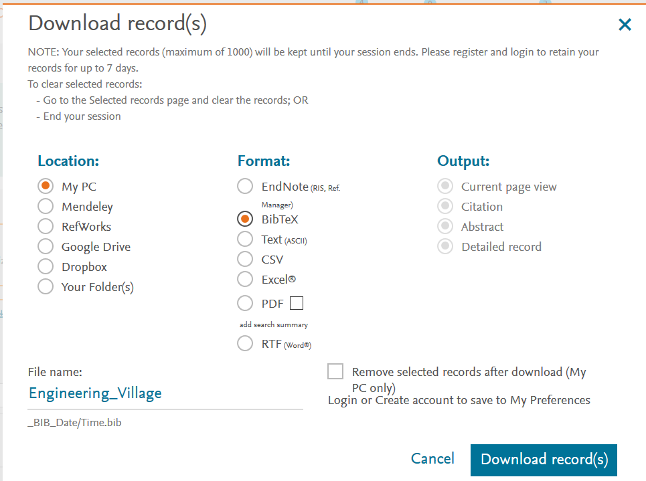
Library Academic Support Team
Keeping results somewhere you control
Look for the label Export / Download / Save.
Often above the results list.

Slide 34
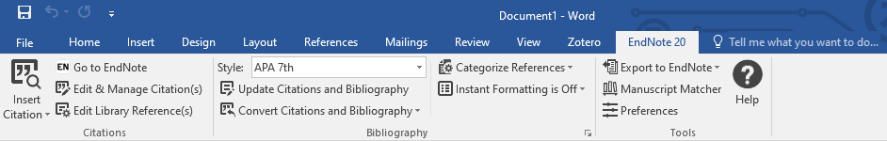
Library Academic Support Team
Reference management software - can save you time
Construct and manage a database of references
Automatically build bibliographies in Word
Export references in BibTex
Bibliographic management comparison table (pdf):
www.docs.is.ed.ac.uk/mvm/BiblioManagersTable.pdf
Choosing a Reference Manager guidance documents:
https://uoe.sharepoint.com/sites/digitalskillsandtraining

Slide 35
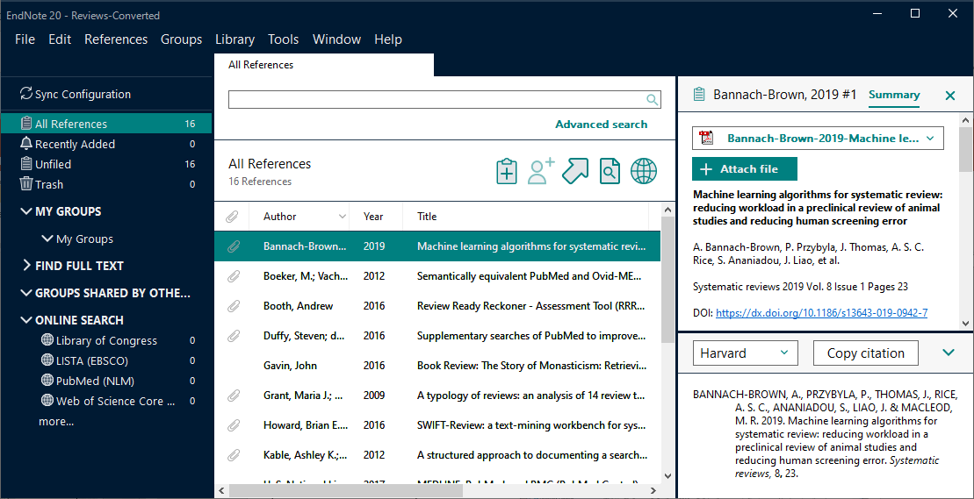
Library Academic Support Team
EndNote
Construct and manage a database of references
Search for and attach full-text [VPN]
Import PDF files or folders of files
Download EndNote desktop for free using the University forms
[ www.ed.ac.uk/is/software ]
EndNote tutorials and support resources
https://proquest.libguides.com/endnote
Library's Referencing Gubject Guide:
edinburgh-uk.libguides.com/referencing

Slide 36
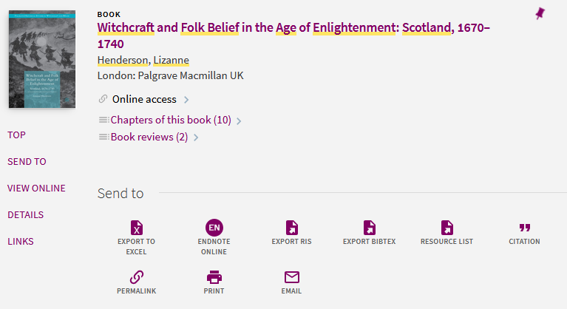
Library Academic Support Team
Records direct from DiscoverEd
Pin to favourites to export more than one at once.
EXPORT RIS
for Endnote desktop and other reference management products

Slide 37
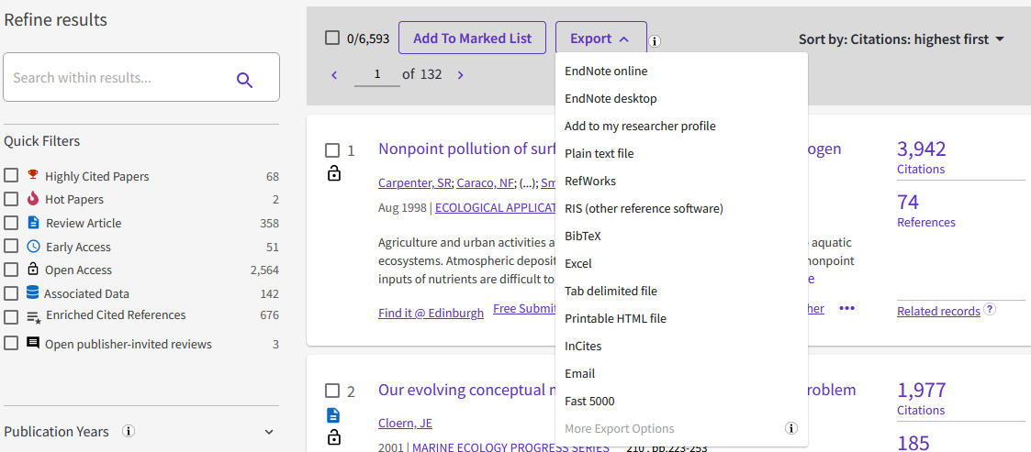
Library Academic Support Team
Records direct from Web of Science

Slide 38
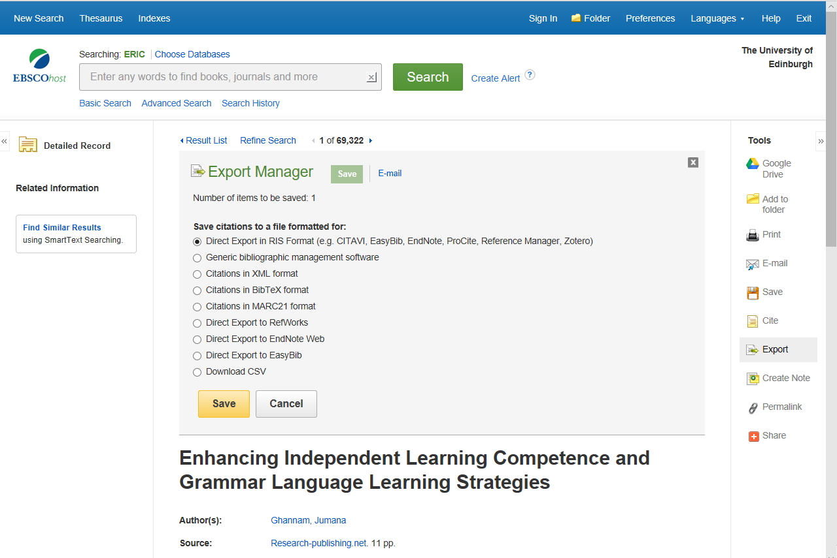
Library Academic Support Team
Records direct from other abstracting and indexing (A&I) database interfaces
Look for Export/Save/Download/Share

Slide 39
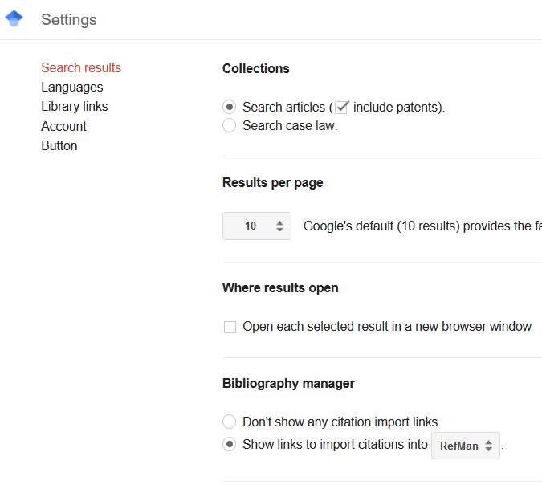
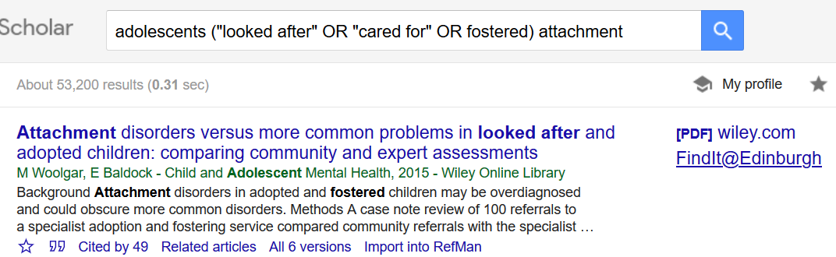
Records from Google Scholar
Library Academic Support Team
Go to Settings > Search results to add:
Import to Reference Management Software to results view

Slide 40
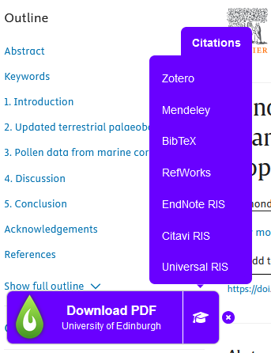
LibKey Nomad
Library Academic Support Team
Has an export citation option too
Download the LibKey Nomad Browser Extension
More information:
https://library.ed.ac.uk/libkey-nomad

Slide 41
Library Academic Support Team
How much of the literature do you read?
Read the literature reviews of a similar type of study to yours.
You will begin see the same references in your search results lists.
The references cited in useful papers will (hopefully) begin to look familiar.
Reviewing the literature systematically combines well focussed research question and search strategy with rigorous appraisal and synthesis of the literature. Someone reading the review should be able to repeat it.

Slide 42
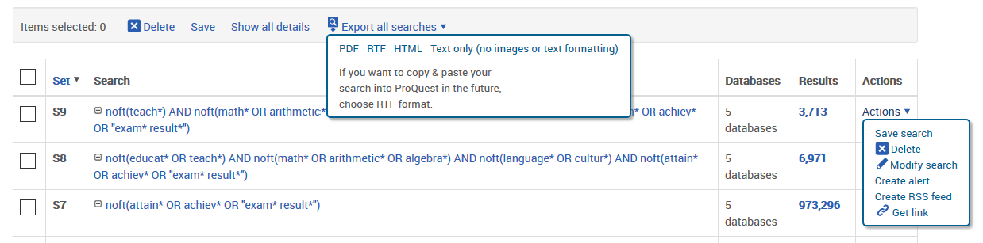
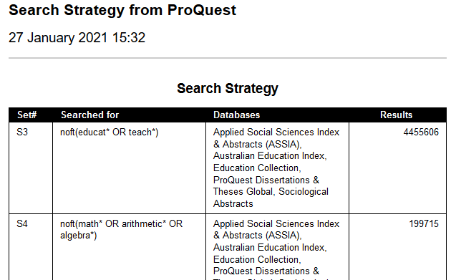
Library Academic Support Team
Help for your methodology
Record your search strategy(ies) for the databases you’ve used.
Keeping current
Saved searches for re-running or generating alerts.
Table of contents alerts directly from journals strong in your field.

Slide 43
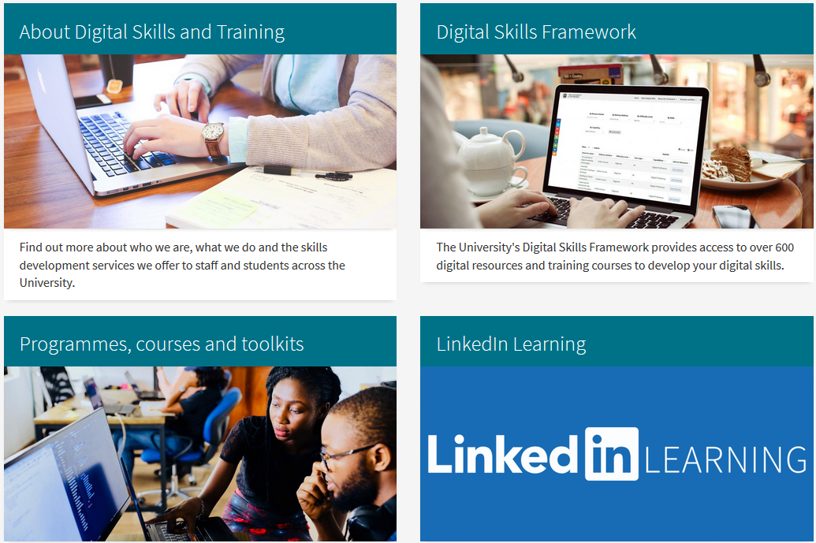


Library Academic Support Team
Help
Your Academic Support Librarian from
Library subject guides: www.ed.ac.uk/is/subject-guides
IS Skills Development courses and the online manuals
www.ed.ac.uk/is/skills
Institute for Academic Development resources by degree and career role
www.ed.ac.uk/iad
Research Data Service
edin.ac/research-data-service

