Slide 1
Library Academic Support
Helping you get the best from the Library, its collections, resources and services
Searching and reviewing
the literature
Section 1:
Search techniques and preparation
This presentation:
http://www.docs.is.ed.ac.uk/docs/Libraries/Presentations/SearchingAndReviewingLiterature1.pptx
Rowena Stewart
(she/her) rowena.stewart@ed.ac.uk Academic Support Librarian
Research in Health, ODL MSc.
AY23-24, Sep23

Slide 2
Library Academic Support Team
Use what you know to get a feel for the literature
What language seems to be used in the research literature on a topic of interest?
If you want to do a systematic style review, does there seem to be enough papers?
Academic literature
Google Scholar
DiscoverEd
Clinical decision tools and Cochrane Library
Give clinical guidance but also the references used to put together the guidance.
BMJ Best Practice
Cochrane Library for Cochrane reviews
See the Health literature module in LibSmart II

Slide 3
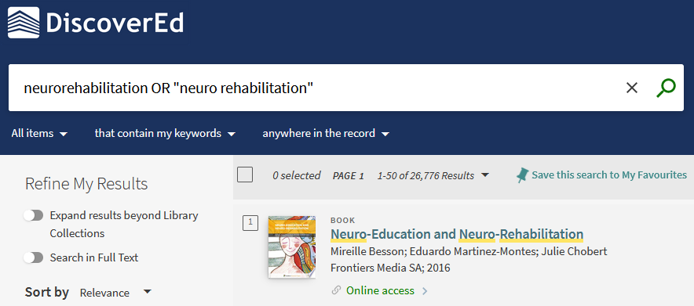
Using what you know: DiscoverEd
Library Academic Support Team
Records for articles etc you may not be able to read from the library immediately.
“Expand results beyond Library Collections”
3

Slide 4
Using what you know: DiscoverEd
Library Academic Support Team
Even more results.
The search term(s) could appear “anywhere”.
Better for difficult-to-find-anything type terms
“Search in Full Text”
4

Slide 5
Library Academic Support Team
A research question
When you have a feel for the literature published in your area of interest…
…can you make a research question which the literature can answer?
What are the risks factors for homelessness identified through administrative data?
What is the impact of exercise or physical activity on health-related outcomes in children and adolescents with brain tumor?
What is the effectiveness of CBT-T for those with non-underweight eating disorders?
What is the impact of nurse prescribing on health care delivery for patients with diabetes?
What would research answering your question have to address for you to be prepared to use it?

Slide 6
Library Academic Support Team
Identifying concepts
Frameworks can be useful, for example:
Population / Problem
Intervention
Comparison
Outcome
Study design
Population
Phenomena of Interest
and
Context
[reviews of qualitative evidence, JBI]
More frameworks (pdf)
www.docs.is.ed.ac.uk/docs/Libraries/PDF/PICOS.pdf
Not every framework heading may be populated for your research question.
Not every populated heading has to be used in an academic literature search strategy.

Slide 7
Library Academic Support Team
Frameworks in action
Researchers proposing to undertake a systematic review can make their intention available for others to see on, e.g. The National Institute for Health Research’s PROSPERO database.
PROSPERO’s protocol documents use PICOS type headings for authors to describe the extent and purpose of their proposed systematic review:
Participants/population.
Intervention(s), exposure(s).
Comparator(s)/control.
Context.
Main/Additional outcome(s).
Types of study to be included.
PROSPERO: International prospective register of systematic reviews
Changes to the proposed review content or methods are logged.
Reviews which reach completion in publication are linked to from their PROSPERO protocols.

Slide 8
Library Academic Support Team
Search terms for concepts
When you have a possible research question, identify:
main concepts a useful paper should address.
synonyms for those concepts which researchers in the field may use.
What is the experience of adolescents with a history of disruptive behaviour undergoing a course of mindfulness training?
adolescents | disruptive behaviour | mindfulness training | experience
adolescen(ts) teen(agers) "young people" youth(s) "young adult(s)" "emerging adult(s)" | "disruptive behav(iour)" | mindful(ness) training/education/ program(me)/course… | attitude(s), perception(s), perspective(s), view(s), belief(s)
Synonyms
Synonyms
(truncation opportunity)
UK / North American English

Slide 9
Library Academic Support Team
Truncation
A symbol which stands in for letters – often the asterisk *
adolescen* - returns: adolescent, adolescents, adolescence…
mindful* - returns: mindful, mindfully, mindfulness…
Phrase marks
If it is important a phrase is found - enclose in "double quotes".
Words have to be together and in that order. Truncation is possible.
"emerging adult*" – returns: emerging adult, emerging adults, emerging adulthood…
Most search interfaces will assume multiple words should be combined with AND
- all words will appear but they could be separated and not in the order given.

Slide 10
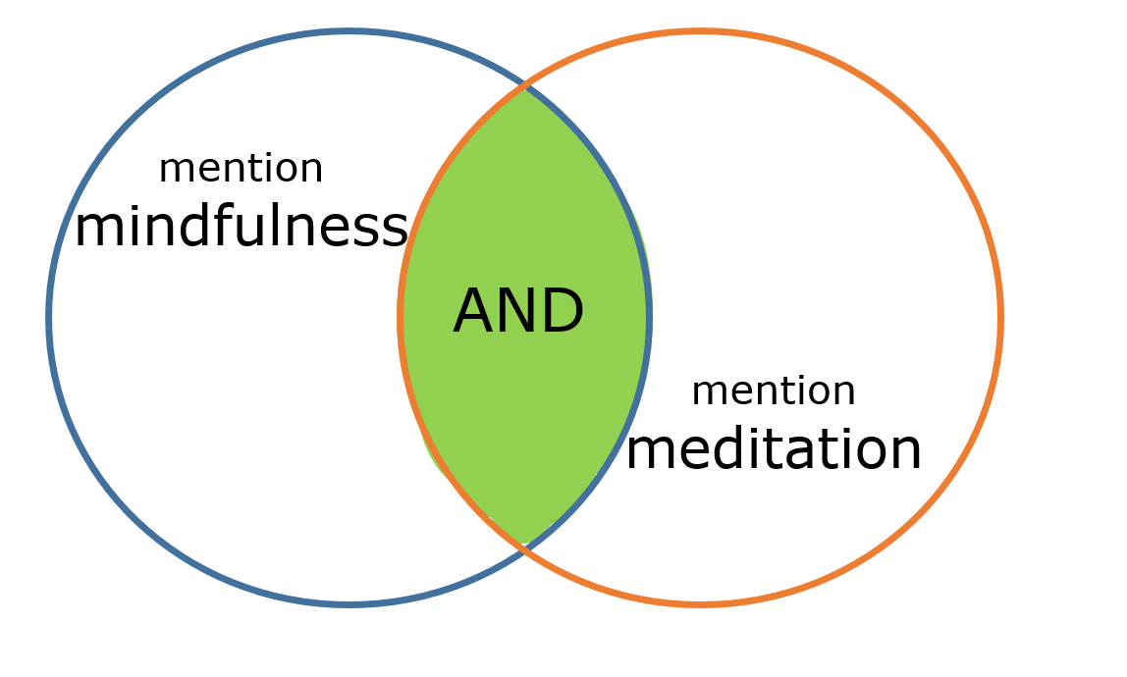
Library Academic Support Team
Boolean operators: AND, OR
Synonyms combined
- Higher number of results
Concepts combined
- Smaller number of results

Slide 11
Library Academic Support Team
Search terms for concepts
Have some approaches to fall back on if your first thoughts do not return what you need…
What is the experience of adolescents with a history of disruptive behaviour undergoing a course of mindfulness training?
adolescents | disruptive behaviour | mindfulness training | experience
adolescen(ts) teen(agers) "young people" youth(s) "young adult(s)" "emerging adult*" | "disruptive behav(iour)" | mindful(ness) training/education/ program(me)/course | attitude(s)/perception(s), perspective(s)/view(s), belief(s)
 | aggress(ion) violen(ce) | meditation | (dis)satisfy/action
Acceptable alternatives
Consider specifics
Antonyms

Slide 12
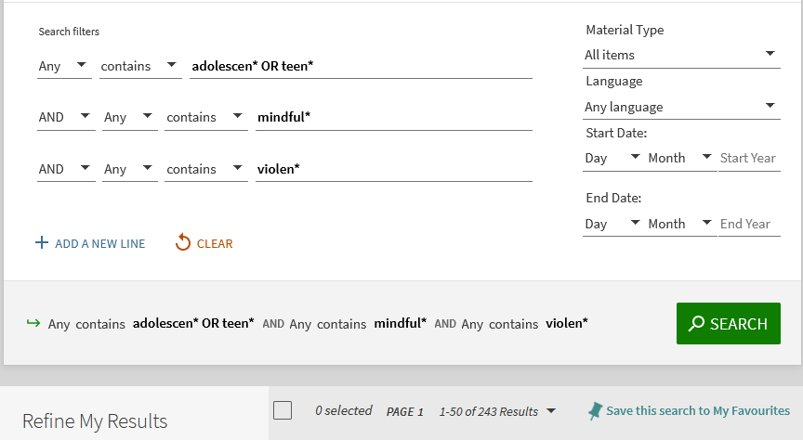
DiscoverEd – Advanced Search
Library Academic Support Team
Use an abstracting & indexing database for a more thorough search of the literature.
These databases have some useful search functions too…

Slide 13
Library Academic Support Team
Help
Please get in touch to
ask about any library-related problems or questions or to
arrange to meet for help with finding academic literature.
Rowena Stewart
rowena.stewart@ed.ac.uk
(she/her) Academic Support Librarian
Library’s Nursing guide:
www.ed.ac.uk/is/subject-guides-nursing

