Slide 1
Library Academic Support
Helping you get the best from the Library, its collections, resources and services
Reviewing & Searching
the Literature
To cover:
Self help introductory options
Using what you know
Academic literature databases
Rowena Stewart
(she/her) rowena.stewart@ed.ac.uk Academic Support Librarian
Research Methods in Health, PgCert
September 2021

Slide 2
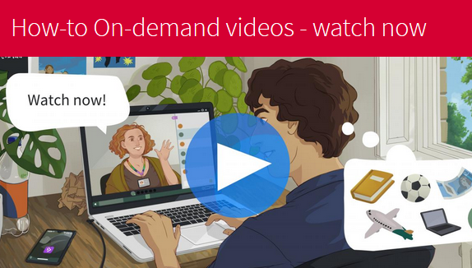
Library Academic Support Team
“In your own time” options – from the Library Subject Guides
Library’s Nursing Subject Guide - New students’ library introduction
LibSmart is a self-enrol Learn course of two parts
LibSmart1
Getting started with the Library.
Your information landscape - Explore and use key library resources appropriate to your discipline.
Finding and retrieval - material for an essay or report on a topic.
Managing information – to avoid information overload.
Citation and Referencing.
Recordings of the 2021-22 Welcome Week How-To Sessions are available
…access online library resources.
…find academic literature online.

Slide 3
Library Academic Support Team
Coming up with search terms
The Little Book of Literature Searching
Library’s Nursing Subject Guide - Literature searching advice
Thinking along headings, such as the following, may be useful:
Population, Problem, Intervention, Comparison, Outcome, Study design
Population, Phenomena of Interest; and Context [reviews of qualitative evidence, JBI]
What is the experience of adolescents with a history of disruptive behaviour undergoing a course of mindfulness training?
adolescents | disruptive behaviour | Mindfulness training | experience
adolescen(ts) teen(agers) “young people” youth(s) “young adult(s)” | “disruptive behav(iour)” aggress(ion) violen(ce) | mindful(ness) Meditation Training/education/ program(me)/course… | attitude(s) / (dis)satisfy(action) Compliance Dropout(s)

Slide 4
Library Academic Support Team
Use what you know to get a feel for the literature
Academic literature
Google Scholar
DiscoverEd
Clinical decision tools and Cochrane Library
Give clinical guidance but also the references used to put together the guidance.
BMJ Best Practice
Cochrane Library for Cochrane reviews
See the Health literature module in LibSmartII
Helps you understand the language used in the research literature on your topic of interest.
Search terms

Slide 5
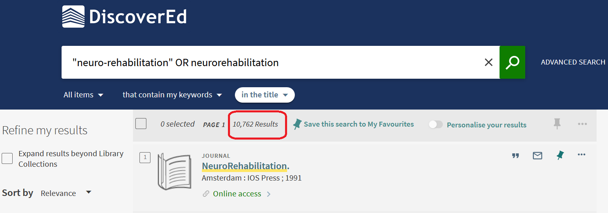
Using what you know: DiscoverEd
Library Academic Support Team
– “Expand results beyond Library Collections”
Records for articles etc you may not be able to read from the library.

Slide 6
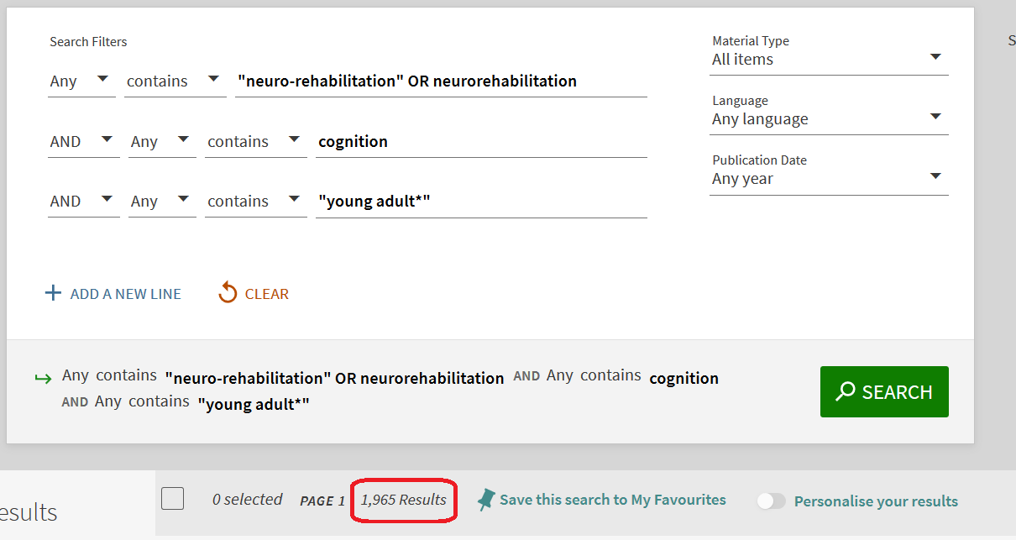
Using what you know: DiscoverEd – Advanced Search
Library Academic Support Team

Slide 7
Library Academic Support
Helping you get the best from the Library, its collections, resources and services
Reviewing & Searching the Literature
To cover:
Self help introductory options
Using what you know
Academic literature databases
Rowena Stewart
(she/her) rowena.stewart@ed.ac.uk Academic Support Librarian
Research Methods in Health, PgCert
September 2021

Slide 8
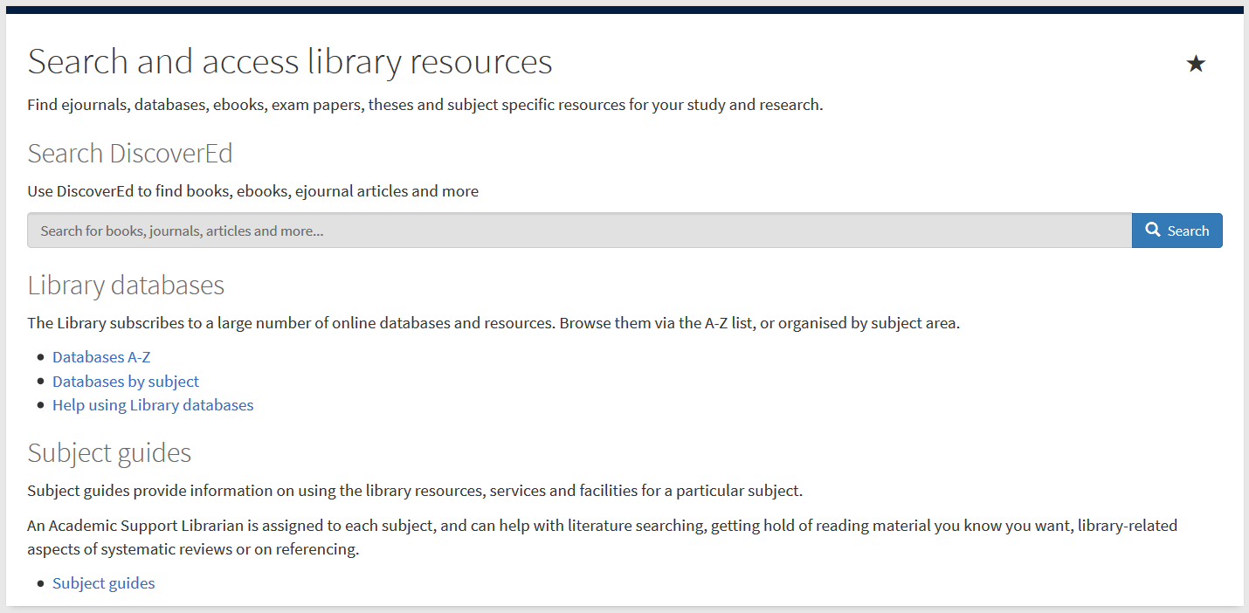
Abstracting & Indexing databases
Library Academic Support Team
Include material not found in DiscoverEd or Google Scholar.
Contain details of millions of articles from 1000s of publications.
Conference proceedings, journal articles, book chapters, reports and standards.
MyEd > Sudies > Library column
Subject specific databases.
Databases by subject
www.ed.ac.uk/is/databases-subjects

Slide 9
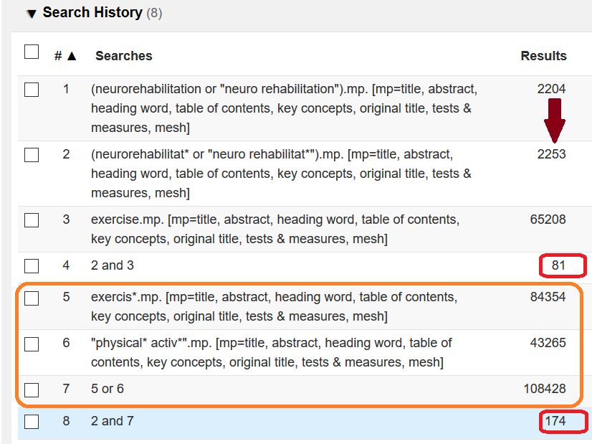
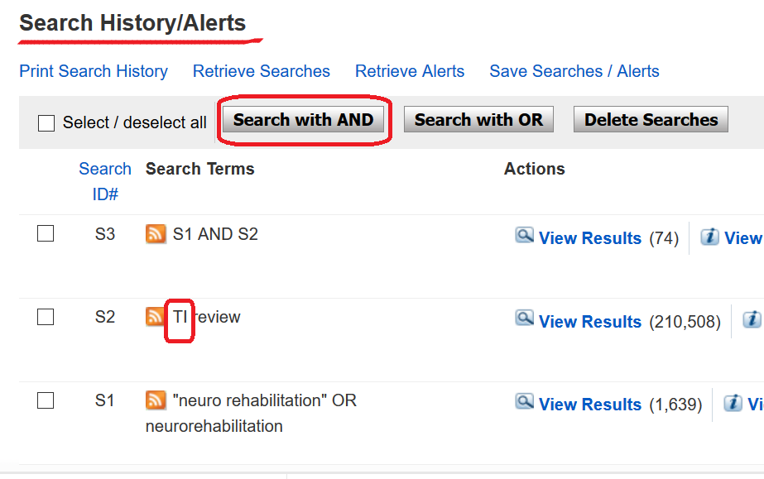
Library Academic Support Team
Abstracting & Indexing databases - search tips
Search History functions are useful

Slide 10
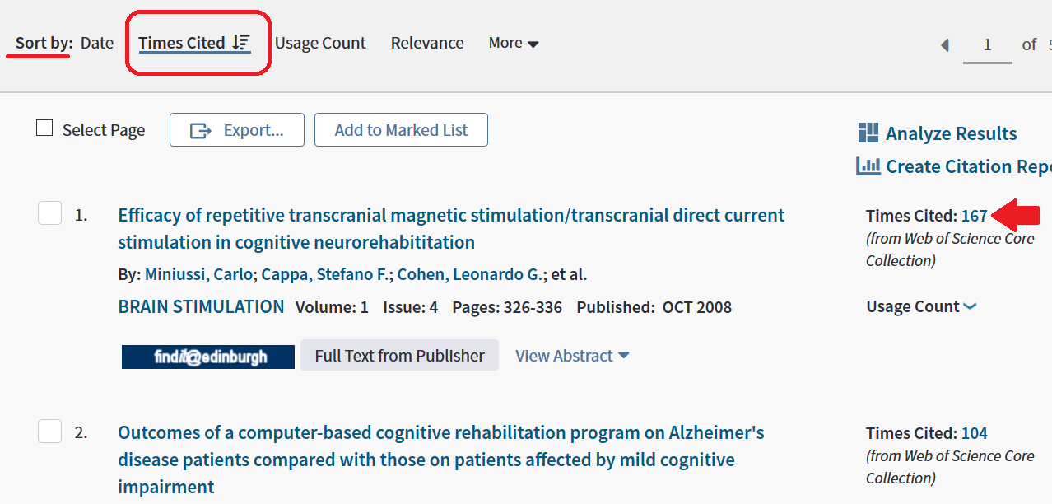
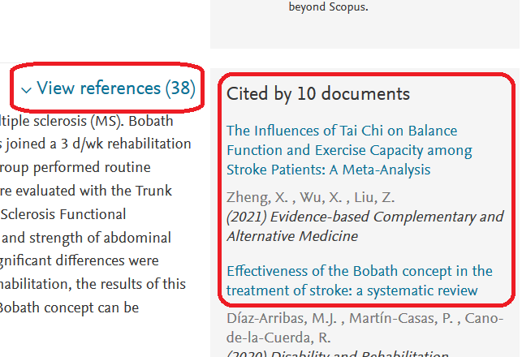
Library Academic Support Team
Abstracting & indexing databases - search tips
Have most cited articles at the top of a results list.
Find articles using a good reference.
See articles used by authors.

Slide 11
Inter-Library Loan (I.L.L.)
Library Academic Support Team
www.ed.ac.uk/is/inter-library
For material The Library does not have at all.
Relies on other libraries’ access to their stock
– ie more limited during pandemic restrictions
30 free per year [5 for undergraduates]
then £5 per request received
2 renewals which are done via Helpdesk or I.L.L. staff.

Slide 12
Library Academic Support Team
Videos - search interfaces
Library’s Nursing Subject Guide - Literature searching advice
Subject Heading searches in CINAHL Plus, MEDLINE and psycINFO.
Using the Search History to build a search.
Saving your Search History steps to run in the future.
Searching more than one database at once and de-duplication by the search platform.
Saving your search methodology and result numbers.
Exporting database results.
LibSmartII
LibSmart2 modules include:
Government and policy research
Health literature
Literature searching for systematic reviews

Slide 13
Library Academic Support Team
Help
Please get in touch to
ask about any library-related problems or questions or to
arrange to meet for help with finding academic literature.
Rowena Stewart
rowena.stewart@ed.ac.uk
(she/her) Academic Support Librarian

