Slide 1

Library Academic Support
Helping you get the best from the Library, its collections, resources and services
Library Bitesize
How to reference and avoid plagiarism
Academic Support Librarians
www.ed.ac.uk/is/subject-guides
Jan25
This presentation: http://www.docs.is.ed.ac.uk/docs/Libraries/Presentations/LibraryBitesizeHowToReferenceAvoidPlagiarism.pptx

Slide 2
Learning outcomes and objectives
Library Academic Support Team
Referencing and avoiding plagiarism
By the end of this session, you will know where to get help with questions about plagiarism and referencing
You should know:
Plagiarism must be avoided and where to go for more information.
What needs cited in your work.
The importance of citations styles and consistency.
How to navigate to Cite them Right.
Automatic referencing options often exist for single references.
Why reference management software may be useful to you.
Where to get hold of reference management software.

Slide 3
Referencing
Library Academic Support Team
Why?
Acknowledge the ideas & work of others.
Show you have read “key” work(s) in your area.
Let your readers follow your thought processes and their influences.
Avoid plagiarism.
To
How?
i) Appropriate attribution - you must reference the sources from which you take ideas, words or research.
ii) Accurate presentation - readers should be able to find the sources you give - include all the details about a source
By giving
Be consistent in the way you present the information.
Make sure you collect all the appropriate information about a source at the time you consult it.

Slide 4
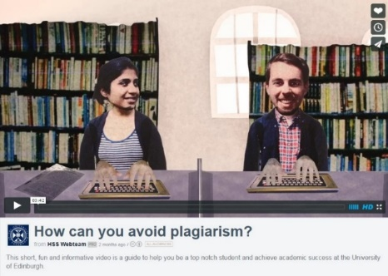
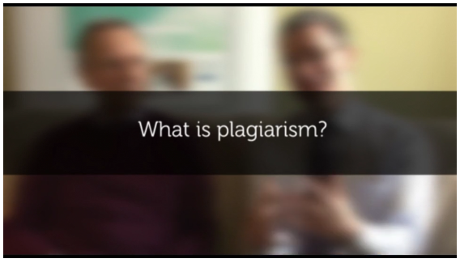

Plagiarism – know your enemy
Library Academic Support Team
You must reference other people’s work appropriately when writing – this is vital! Plagiarism, however unintentional, is taken very seriously.
How can you avoid plagiarism? Highlights different forms of plagiarism, how to avoid them, detection and what happens when work is considered to include plagiarised material.
http://vimeo.com/110597639 - [2014, UoEdinburgh’s CAHSS Webteam]
What is plagiarism? from the Library subscription resource
Cite Them Right. Contains non-video content as well
https://discovered.ed.ac.uk/permalink/44UOE_INST/7g3mt6/alma9921368313502466
IAD’s Good academic practice - Guidance and factsheets on good academic practice, including referencing and avoiding plagiarism.
www.ed.ac.uk/institute-academic-development/undergraduate/good-practice

Slide 5


How might you plagiarise?
Library Academic Support Team
Miss out, give an inaccurate or badly place a citation
Paraphrase poorly
  eg just change a couple of words rather than saying it in your own words
Not attribute
  including, images, photos, diagrams, tables
Self-plagiarism
  ie submitting the same work for credit twice at the same or different institutions
Image by OpenClipart-Vectors from Pixabay
Plagiarism software - Many areas of the University use Turnitin plagiarism detection software to assist in detecting possible cases of plagiarism.
www.ed.ac.uk/information-services/learning-technology/assessment/assignments/turnitin

Slide 6


Plagiarism – University information
Library Academic Support Team
Information for students - how the University defines academic misconduct, including plagiarism, and how it deals with suspected cases:
  www.ed.ac.uk/academic-services/students/conduct/academic-misconduct/what-is-academic-misconduct
Academic Misconduct section of The Students’ Association Advice and Support area – includes information about help available for students accused of plagiarism:
  www.eusa.ed.ac.uk/adviceplace/academic/misconduct/academicmisconduct

Slide 7
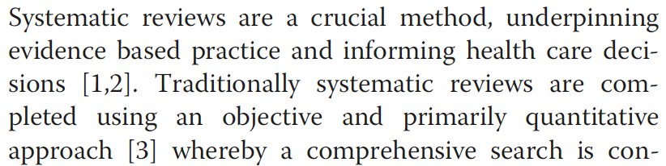
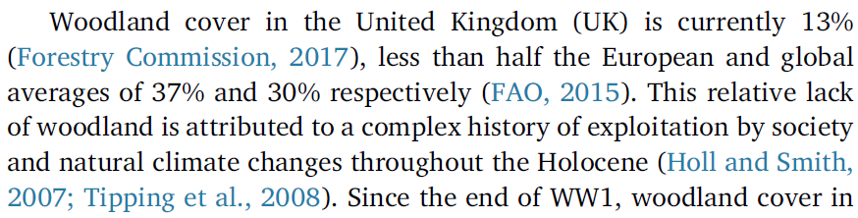
Referencing
Library Academic Support Team
In-text citation
A brief reference appearing at the point in your text where you are referring to someone else's work. The citation comes immediately after the quote, summary, diagram or image.
The in-text citation refers readers to the details of the reference in a reference list or bibliography for them to look up themselves

Slide 8
Bibliographies V Reference lists
Library Academic Support Team
Usually a full list of all the sources consulted, with enough detail to enable the reader to find those sources
The works cited in the text
Different referencing styles have different requirements
Check
Be consistent

Slide 9
Writing about someone else’s work
Library Academic Support Team
Within the body of your own text you can:
paraphrase - restate someone else's thoughts or ideas in your own words.
summarise – condense the main points of someone else's ideas or work, leaving out the details.
directly quote – present the words used by an author in their original order & spelling.
  Short quote (up to three lines/40 words MHRA): “use quotation marks”
  Long quote: start as a separate paragraph, indented (no quotation marks)
copy – present, with or without editing, another’s figures, tables or structure.
IF the source is acknowledged !
Taken from Cite Them Right: Glossary and Tutorials

Slide 10
Writing about someone else’s work
Library Academic Support Team
Paraphrase:
Harrison (2007, p. 48) clearly distinguishes between the historical growth of the larger European nation states and the roots of their languages and linguistic development, particularly during the fifteenth and sixteenth centuries. At this time, imperial goals and outward expansion were paramount for many of the countries, and the effects of spending on these activities often led to internal conflict.
Summarise:
Nevertheless, one important study (Harrison, 2007) looks closely at the historical and linguistic links between European races and cultures over the past five hundred years.
Paraphrasing and summarising text. In: Harvard, Referencing Tutorial, Cite them Right, Bloomsbury Publishing Plc, viewed 17th September 2024 e.g. www.citethemrighttutorial.com/course-modules

Slide 11
Writing about someone else’s work
Library Academic Support Team
Short quotes and long quotes
In their essay Dogs, and the owners who look like them, Terrier and Russell state “it is unequivocal that owners choose dogs that suit the lifestyle they wish to have.” (Terrier & Russell, 2018). Whereas, Spaniel provides evidence that owners are attracted to animals for aesthetic reasons first and foremost:
  I have found through studies of pet owners and surveys of those about to adopt from rescue centres that owners claim to use a select number of criteria to choose their new pets. While many profess to looking for the most appropriate pet for their domestic situation, over 75% state their preference for the aesthetic appeal of a breed or ‘cuteness’ of an individual animal as the top priority. (Spaniel, 2020)
As leading names in this field, I have chosen to expand on their results by conducting my own research by surveying…

Slide 12
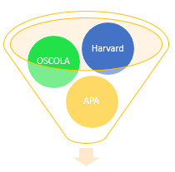
Referencing Styles
Library Academic Support Team
Various referencing styles are in use at the University of Edinburgh.
Handbooks / Supervisor / School Office for the approved style for your subject.
Disciplines (and publications) have their own conventions or preferred Styles.
Once you have chosen your style, stick to it!
Check the one you need to use

Slide 13
Library Academic Support Team
Broadly adopted styles but double check
Author-Date style, often called Harvard - sciences and some other subjects, incl:
Archaeology.
Business School.
Centre for Open Learning.
School of Engineering.
Royal (Dick) School of Veterinary Medicine.
Edinburgh College of Art's Schools of Art and Design.
Chicago (notes and bibliography version):
History and Classics.
Edinburgh School of Architecture and Landscape Architecture.
MLA for some humanities subjects.
OSCOLA for law (although School of Law will accept Edinburgh Law Review style as well).
Vancouver for medicine (Harvard may be accepted as well).
APA (for Psychology).

Slide 14
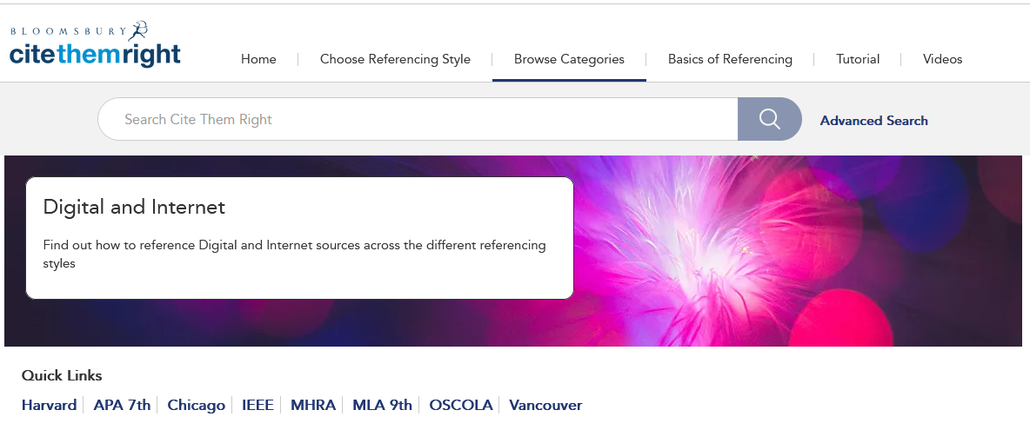
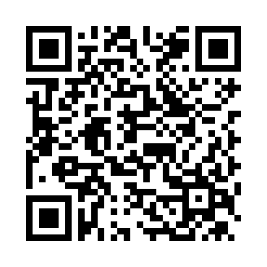
Not sure how to reference something?
Library Academic Support Team
Take a look at Cite Them Right Online
DiscoverEd record: https://discovered.ed.ac.uk/permalink/44UOE_INST/7g3mt6/alma9921368313502466

Slide 15
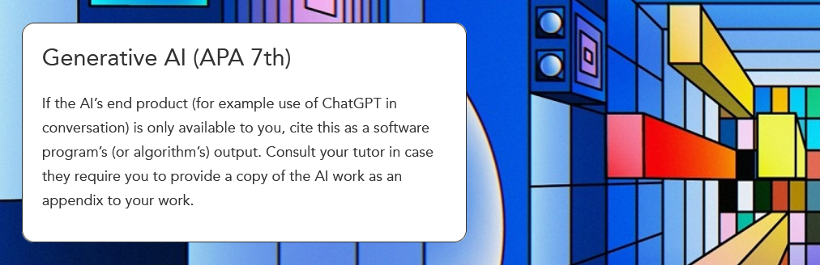

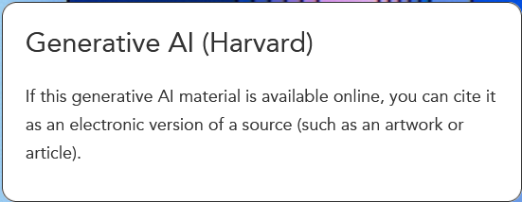
Computer/AI generated content
Library Academic Support Team
Check your course guidance
Check your Style's approach​
Cite Them Right (17/09/2024)
Be aware: the content you ask to be created for you will not discern cited sources and legally posted material from mis-cited observations, uncited ideas, deliberately created false citations or illegally posted material.
University's Guidance for working with Generative AI (“GenAI”) in your studies
https://information-services.ed.ac.uk/computing/comms-and-collab/elm/guidance-for-working-with-generative-ai
Library guide Using Generative AI Tools in Academic Work
https://edinburgh-uk.libguides.com/gen-AI

Slide 16
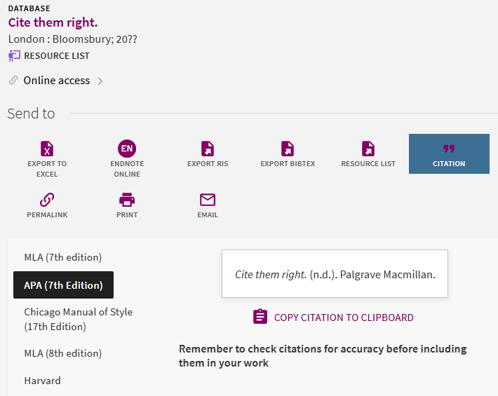
Recording strategies
Library Academic Support Team
    Copy and paste “citation” options in DiscoverEd, databases, publisher websites…
    Reference management software, egs EndNote, Zotero,
Pen and paper!
    www.discovered.ed.ac.uk

Slide 17
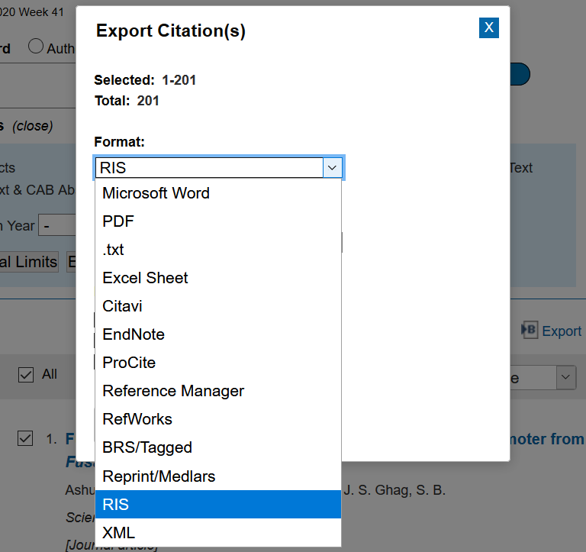
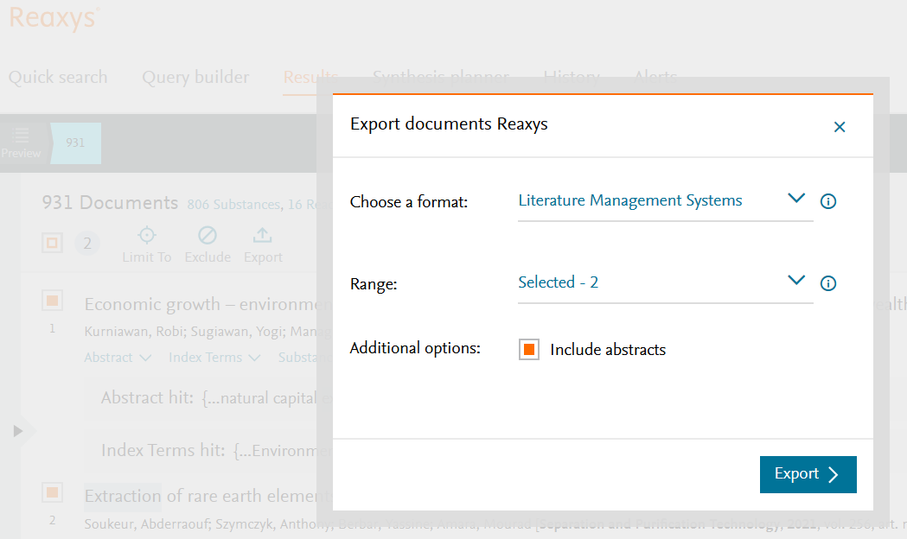
Library Academic Support Team
Databases – getting results out
Look for the label
Export / Download / Save.
Often above the results list.

Slide 18
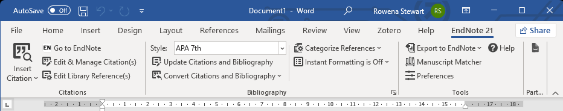
How can Referencing software help?
Library Academic Support Team
Your own database of references.
Organised and searchable.
Full-text can be added (or imported)
Bulk import of records out of databases into them.
Cite While you Write function with Word for automatic in-text citation and reference list creation.
Large library of citation styles.

Slide 19
Reference management software – which one?
Library Academic Support Team
Bibliographic management comparison table (pdf):
www.docs.is.ed.ac.uk/mvm/BiblioManagersTable.pdf
Introduction to reference managers - Short online session introducing the reference management software tools, EndNote, Zotero and Citavi.
  Search Events – www.events.ed.ac.uk
Choosing a Reference Manager guide

Slide 20
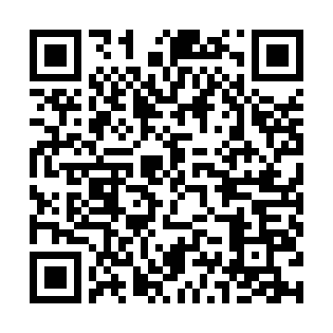

Library Academic Support Team
EndNote desktop (and online)
Download EndNote desktop for free using the University forms
[ www.ed.ac.uk/is/software ]
EndNote tutorials and support resources
http://clarivate.libguides.com/endnote_training/home
EndNote Online – how to register for the web-based version of EndNote:
www.docs.is.ed.ac.uk/docs/Libraries/PDF/guideEndNoteWebregistering.pdf
Library's Referencing and Reference Management Guide:
https://edinburgh-uk.libguides.com/referencing

Slide 21

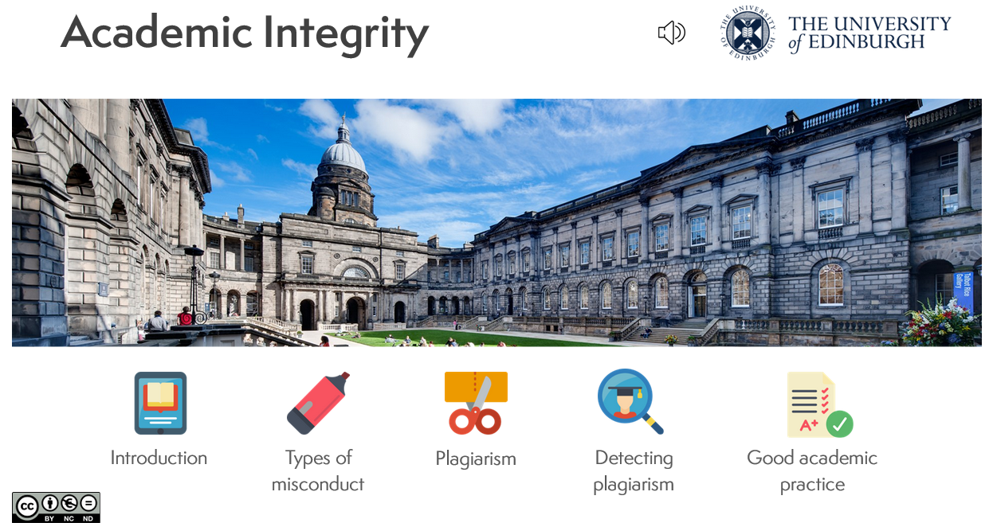
Library Academic Support Team
Help
LibSmart – Auto-enrolled on course in Learn’s “Essentials” section
LibSmart I : Introduction to library resources and search strategies in a University of Edinburgh context.
  Starting to use the library
  Your information landscape
  Finding and retrieval
  Managing information
  Referencing and avoiding plagiarism
www.ed.ac.uk/is/libsmart
LibSmart II : Subject specific modules, eg Literature Searching for Systematic Reviews.
Academic Integrity: An Open Educational Resource for CMVM students but suitable for all.
Reduce the risk of unintentional plagiarism in future coursework.
Improve academic skills, leading towards better grades during studies
https://open.ed.ac.uk/academic-integrity

Slide 22
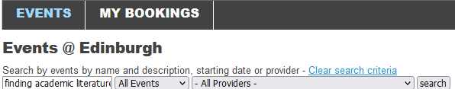


Library Academic Support Team
Training for anyone
Digital Skills and Training
www.ed.ac.uk/is/skills
Librarian consultation (one-to-one session)
www.events.ed.ac.uk
Institute for Academic Development’s Study Hub for resources to help with Academic writing, critical thinking and more
www.ed.ac.uk/institute-academic-development/study-hub
The Royal Literary Fund Fellowship (RLFF) scheme places professional writers in universities for consultation to foster good writing practice across all disciplines and media.
www.ed.ac.uk/library/academic-support-librarians/rlff

Slide 23


Library Academic Support Team
Library Help
Staffed EdHelpdesk in each centrally run library
EdHelp - IT, Finance, Library and Student Admin
www.ed.ac.uk/edhelp
Your Academic Support Librarian via the Library subject guides:
www.ed.ac.uk/is/subject-guides
Dissertation and Thesis Festival
edin.ac/dissertation-festival

