Slide 1
Library Academic Support
Helping you get the best from the Library, its collections, resources and services
Library Bitesize
Using Google and Google Scholar for finding academic literature
Oct24
Academic Support Librarians
www.ed.ac.uk/is/subject-guides
This presentation:
http://www.docs.is.ed.ac.uk/docs/Libraries/Presentations/LibraryBitesizeGoogle.pptx

Slide 2
Learning outcomes and objectives
Library Academic Support Team
By the end of this session, you should be able to:
Identify ways of performing more specific and advanced searches using Google/Google Scholar
Know how to set up Google Scholar to quickly access online full text material available at the Library
Know where to look for other relevant databases for your research

Slide 3
Library Academic Support Team
Why use Google?
Caveats…
Content searched and prioritising unknown.
…but not searching entire internet.
Searches are difficult to replicate and export.
Your previous searches influence results.
Difficult to see what is accessible legally (and what is not).
Easy to use.
Very large.
Powerful search algorithms
Easily accessible
Google is not a one stop shop
DiscoverEd – how you know what you can read via Library (print or online)
Abstracting & Indexing databases - use for literature reviews, systematic reviews, researching a topic, etc.

Slide 4
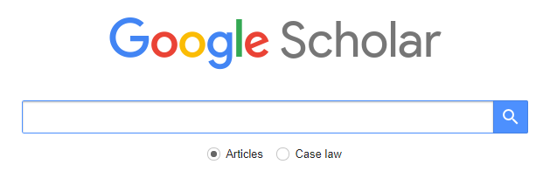
Library Academic Support Team
Google comes in different flavours…
General web search: www.google.co.uk
Books | https://books.google.co.uk/ - good for previews sometimes
Datasets | https://datasetsearch.research.google.com/ - but see Find and reuse data
Images | https://images.google.co.uk/
Videos | www.google.com/videohp
News | https://news.google.com/
- but see Library subject guides
Highlighting Google Scholar…
https://scholar.google.co.uk

Slide 5
General searching tips
Library Academic Support Team
Search tools/engines/platforms
Offer similar features & functions.
Use Helps and Advanced menus to check.
Give some thought to search strategy.
What…do you want to read?...is appropriate to use?...are the best sources?
Get words and phrases which describe the concepts you need to read about.
Have some alternatives e.g. synonyms, variant terminology & spellings, abbreviations, etc.
Start specific and broaden out as necessary.

Slide 6
Library Academic Support Team
Google Search tips
Phrase searching - “Second World War”
Stemming in operation - diet finds dietary, diets, etc.
Combining search terms - Boolean operators: AND, OR and NOT (-)
Look at the refine options
– date, licencing (images), review articles, patents
Where possible use Advanced Search.
Search in a specific site.
“site:” in front of site or domain, e.g.
site:who.int refugees
site:un.org calories
“Cited by” and “Related articles” links - helps broaden your search.

Slide 7
Library Academic Support Team
Combining search terms/keywords – “Boolean operators”
AND – all keywords must be included in search results.
Google assumes AND
A
B
OR – at least one keyword must be included in search results.
Used for synonyms, e.g. teenager OR adolescent OR…
In Google - type OR in upper case.
A
B
NOT – excludes from results those with the given keyword(s)
In Google put “-” in front of the word to exclude
e.g. jaguar speed -car
A
B
Google’s Advanced Search options can be useful to use instead.

Slide 8
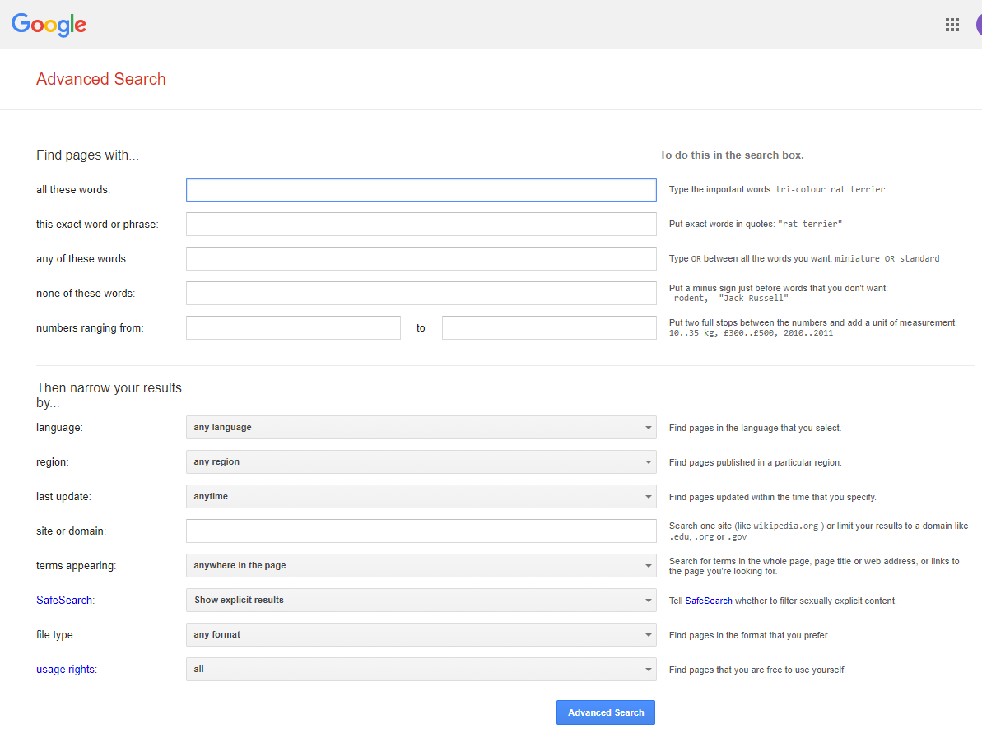
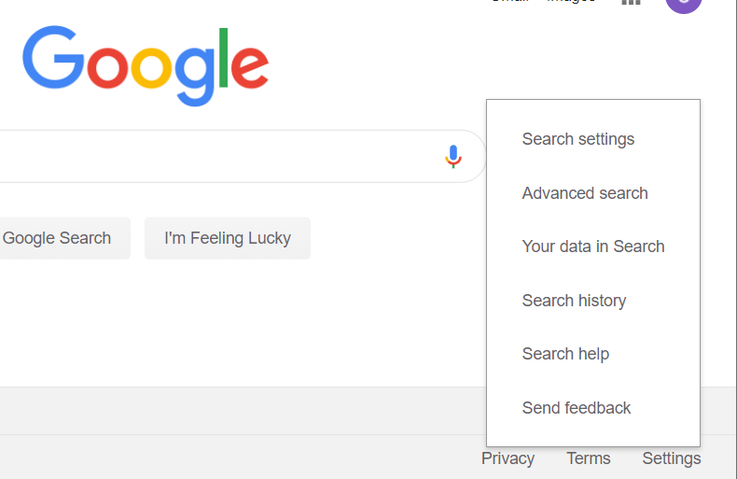
Library Academic Support Team
Advanced Search
www.google.co.uk

Slide 9
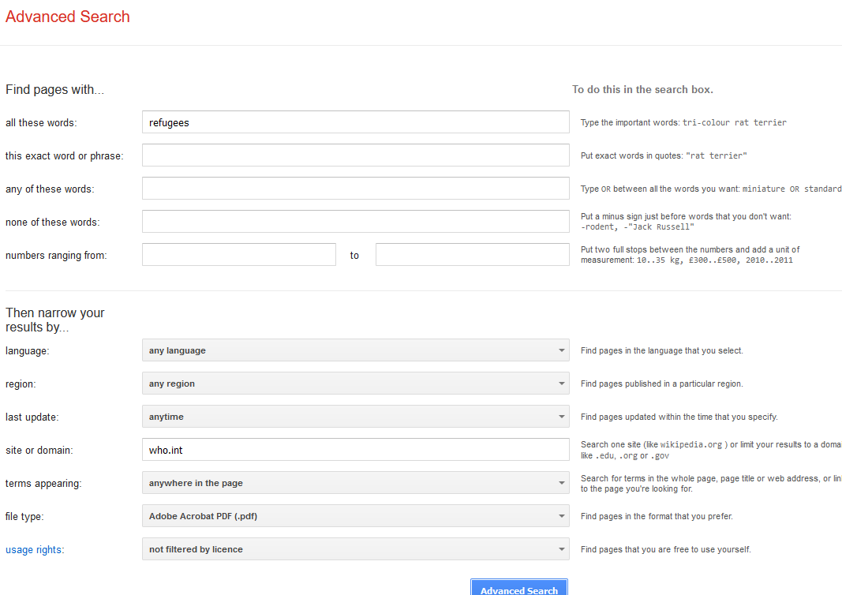
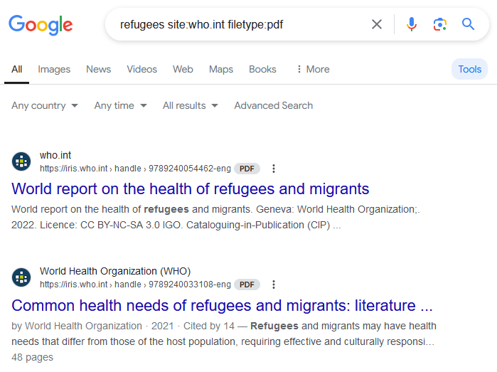
Library Academic Support Team
Google - Searching for grey literature

Slide 10
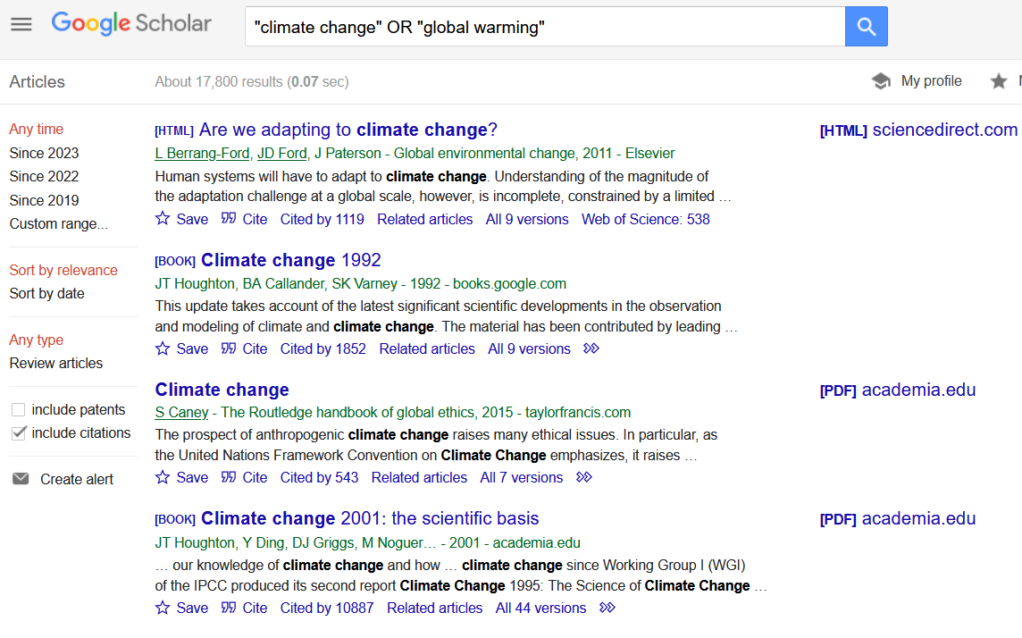
Library Academic Support Team
See what has cited article since publication or see related articles
Duplicates
Examples of how to reference article and options for downloading to EndNote
Export multiple citations to EndNote, etc by clicking the star icon and then going to My Library. You need to be signed in with a Google account.
Notes:
LIVE DEMO

Slide 11
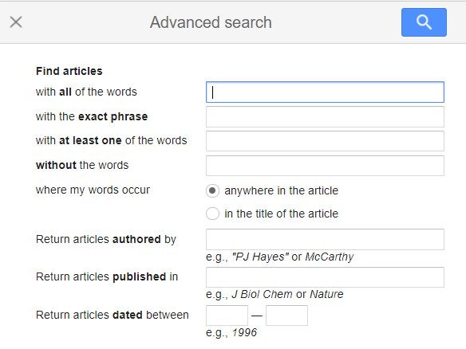
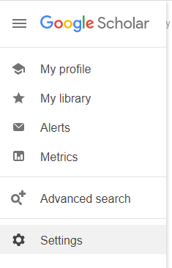
Library Academic Support Team
Google Scholar - Advanced Search
https://scholar.google.com
Notes:
LIVE DEMO

Slide 12
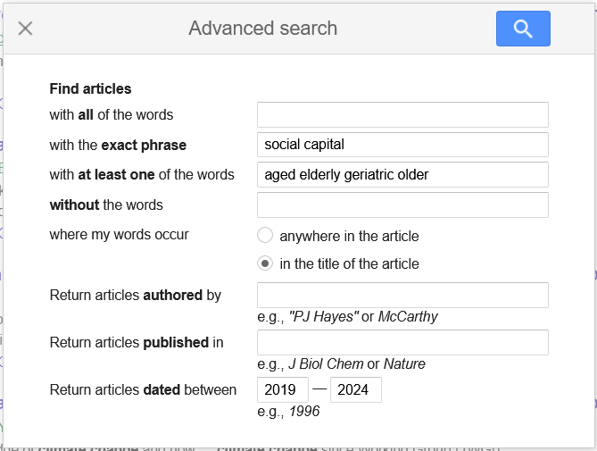
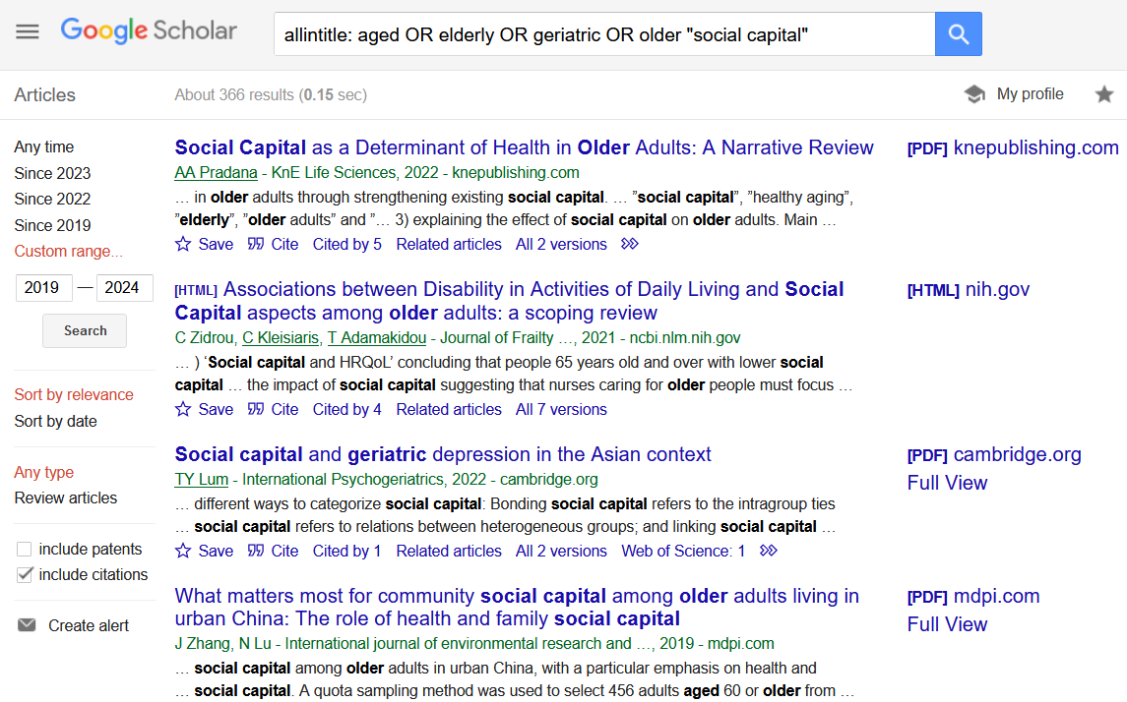
Library Academic Support Team
Google Scholar - Advanced Search
Includes work cited in the work of others but which Google Scholar has not found online.

Slide 13
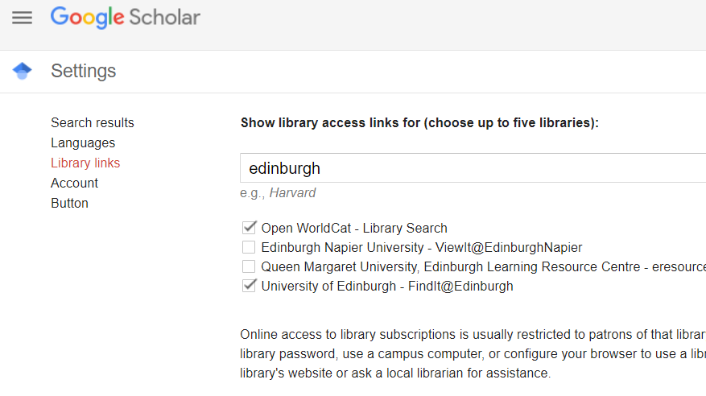
Library Academic Support Team
Google Scholar – full text via the University Library

Slide 14
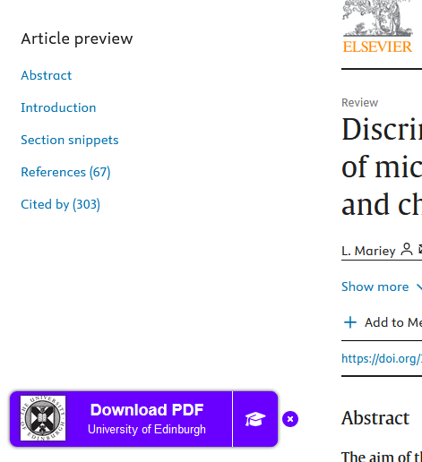
LibKey Nomad
Library Academic Support Team
Have the quick link button appear when you are on sites recognised to be available to University of Edinburgh staff and students.
Can sometimes help overcome temporary authentication issues
Download the LibKey Nomad Browser Extension

Slide 15
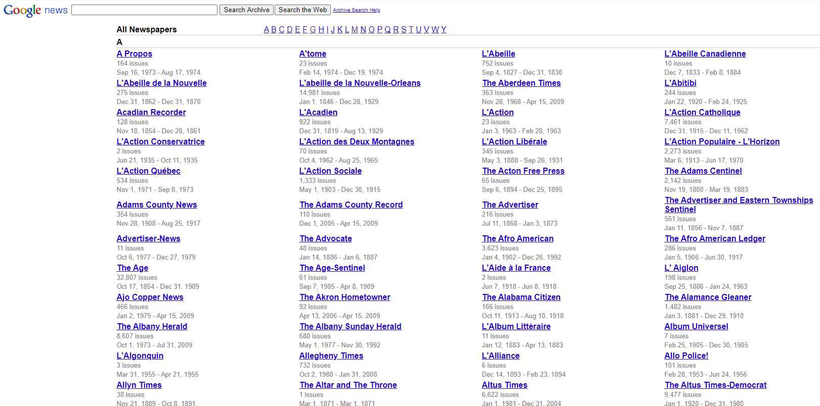
Library Academic Support Team
Google News Archive
To locate an article from a news(paper) website
use Advanced Search domain option
For archive material, try: https://news.google.com/newspapers

Slide 16
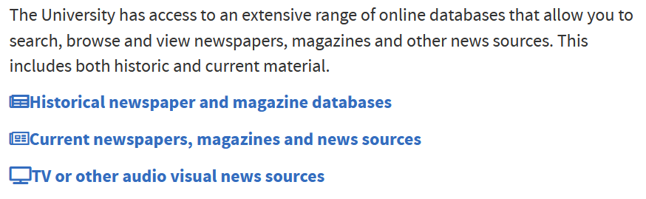
Library Academic Support Team
Newspaper sources
Library subject guide:
Newspapers, magazines and other news sources:
https://edinburgh-uk.libguides.com/newspapers-magazines
LibSmart II course on Learn with modules which include:
Digital news sources.
Digital primary sources and digital scholarship
www.ed.ac.uk/is/libsmart

Slide 17
Library Academic Support Team
More Google help
How search works https://www.google.com/search/howsearchworks/how-search-works
Help topics https://support.google.com/websearch
Refine web searches https://support.google.com/websearch/answer/2466433
Google Scholar Help http://scholar.google.com/intl/en/scholar/help.html

Slide 18
Library Academic Support Team
Finding academic literature - sources and help
DiscoverEd - http://discovered.ed.ac.uk
Library databases - www.ed.ac.uk/is/databases-subjects
Library Subject Guides - www.ed.ac.uk/is/subject-guides
eg Literature Searching Resources

Slide 19
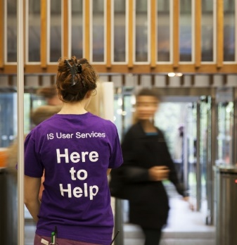
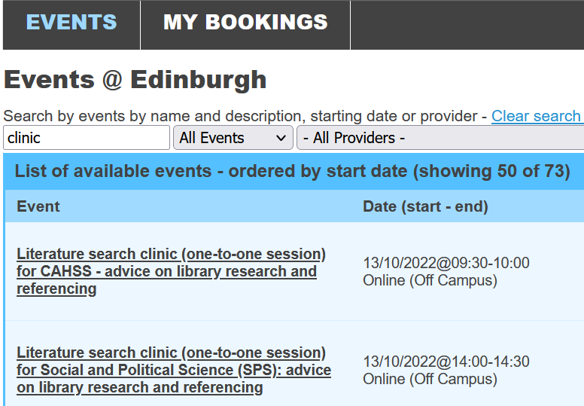
Library Academic Support Team
Help
Your Academic Support Librarian: www.ed.ac.uk/is/ASL
Library subject guides: www.ed.ac.uk/is/subject-guides
Literature search clinics
www.events.ed.ac.uk

