Slide 1

Library Academic Support
Helping you get the best from the Library, its collections, resources and services
Library Bitesize
Citation metrics:
what do numbers tell you about research?
Academic Support Librarians
www.ed.ac.uk/is/asl
This presentation:
http://www.docs.is.ed.ac.uk/docs/Libraries/Presentations/LibraryBitesizeCitationMetrics.pptx
May24

Slide 2
Learning outcomes and objectives
Library Academic Support Team
Know:
Where to find citation metrics.
How they can be used in literature searching – “Snowballing”
How they may inform decisions on where to publish.
Where to find Journal Impact Factors.
Sources of help on research assessment - re-use and impact

Slide 3
Citation Metrics
Library Academic Support Team
Citation metrics are a measure of article, or research publication, (re-)use.
They can be used for “snowballing”.
They can be used in research(er) quality assessment.
! 95% !
Of what?
What kind of Who?
How many?
How was that measured? When?
They are statistics...
…and should be interpreted within the contexts they were calculated.

Slide 4
Apostrophe ‘metrics
Library Academic Support Team
Altmetrics: “…altmetrics will track impact outside the academy, impact of influential but uncited work, and impact from sources that aren’t peer-reviewed”
Priem, J., Taraborelli, D., Groth, P., Neylon, C. (2011) Altmetrics: A manifesto.
https://digitalcommons.unl.edu/scholcom/185/
Bibliometrics: The branch of library science concerned with the application of mathematical and statistical analysis to bibliography; the statistical analysis of books, articles, or other publications.
Oxford English Dictionary
https://discovered.ed.ac.uk/permalink/f/gfso8q/44UOE_ALMA51137288330002466
Scientometrics: The branch of information science concerned with the application of bibliometrics to the study of the spread of scientific ideas; the bibliometric analysis of science.
Oxford English Dictionary
https://discovered.ed.ac.uk/permalink/f/gfso8q/44UOE_ALMA51137288330002466

Slide 5
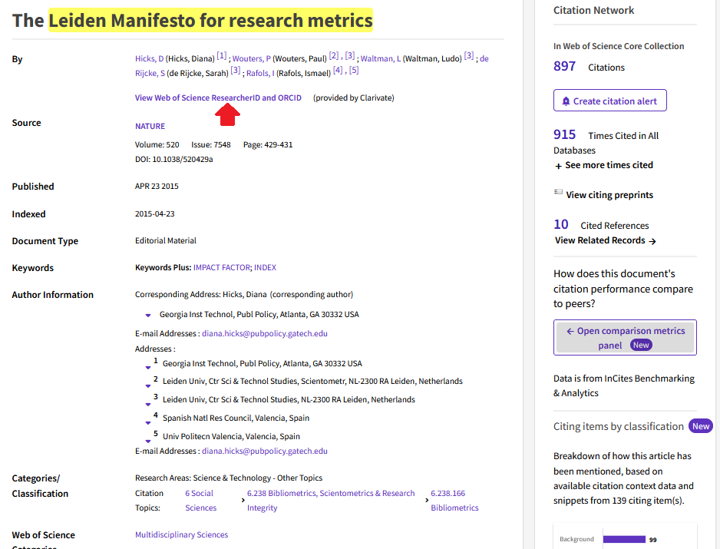

Where are the numbers? - Snowballing
Library Academic Support Team

Slide 6

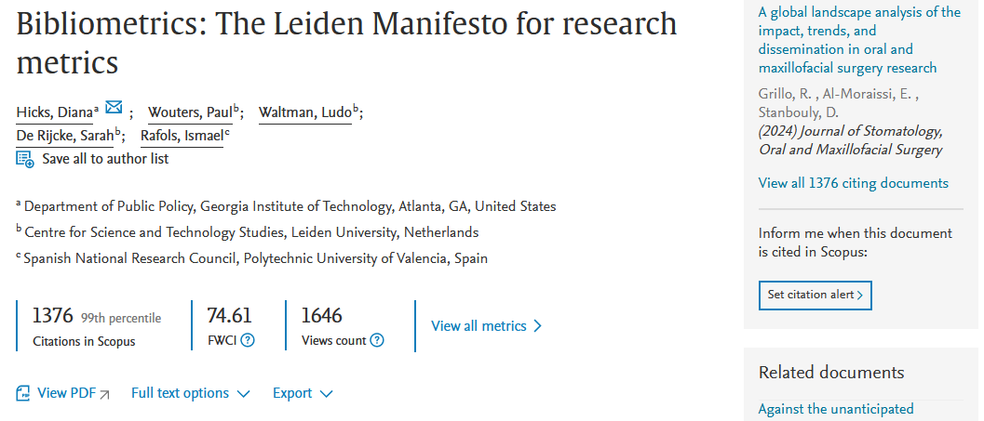
Where are the numbers? - Snowballing
Library Academic Support Team
References below

Slide 7
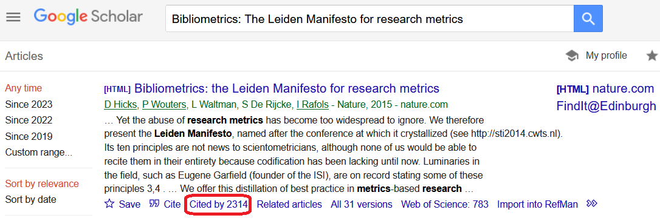
Where are the numbers? - Snowballing
Library Academic Support Team

Slide 8
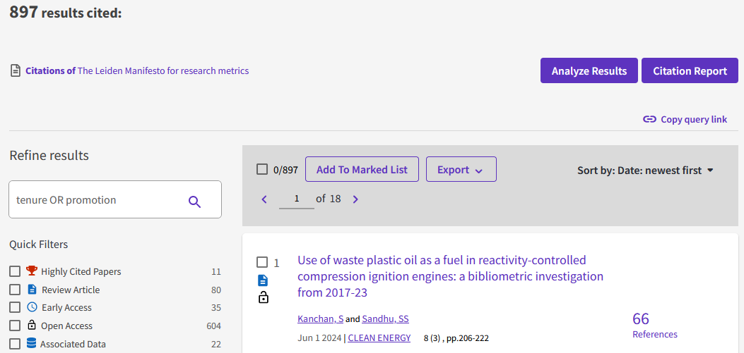
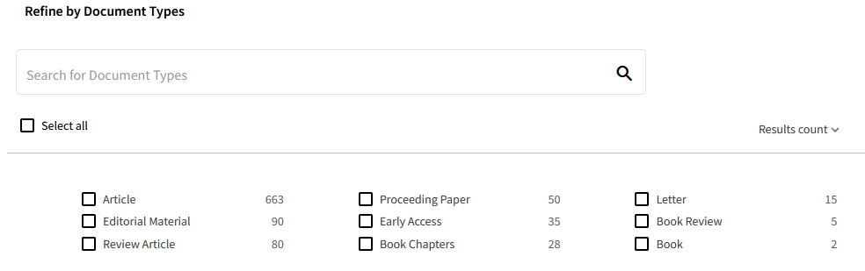
Using the Numbers - Snowballing
Library Academic Support Team

Slide 9
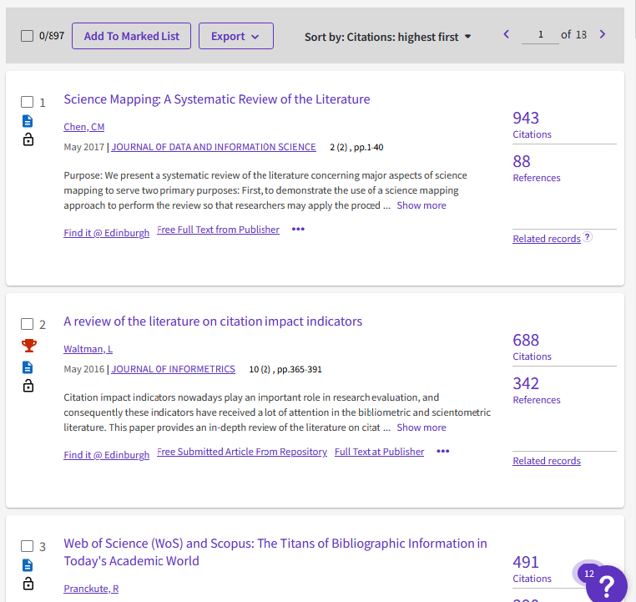
Using the numbers
- Snowballing
Library Academic Support Team
There are other options, eg highest usage in last 180 days…

Slide 10
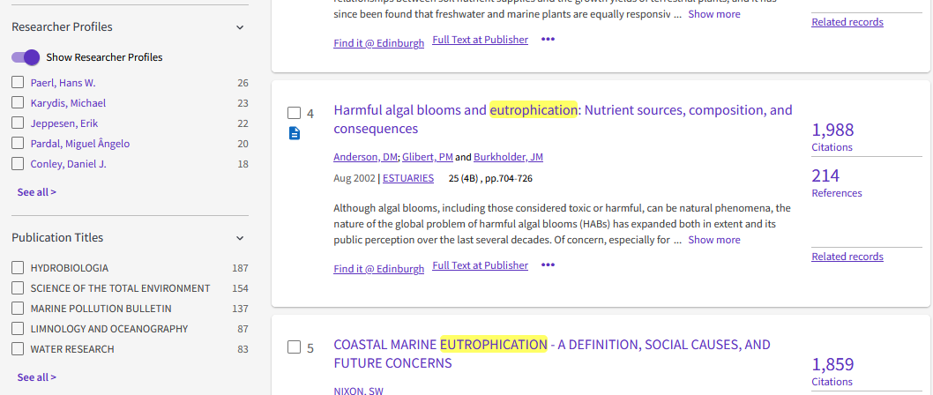
Using the numbers - Whom to read
Library Academic Support Team

Slide 11
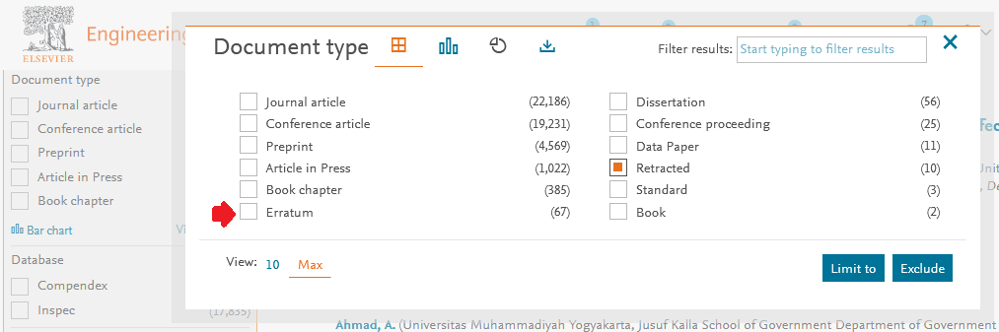
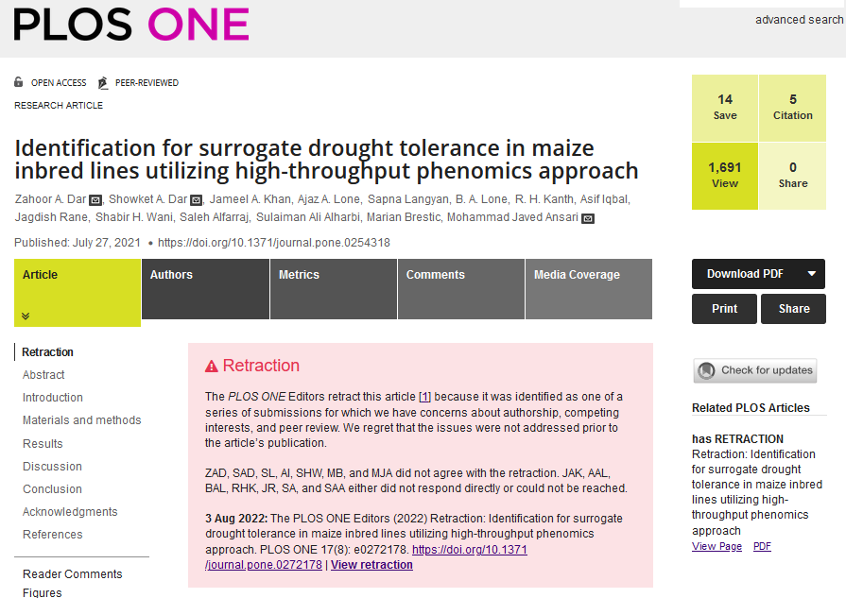

Library Academic Support Team
Retractions
People make mistakes
Some databases label retracted (or similar) publications.
Publishers will label articles they agree to withdraw
Correction
Expression of Concern
Item Withdrawal
Publication With Expression of Concern
Retracted Publication
Retraction
Withdrawn Publication
Retraction Watch Database

Slide 12
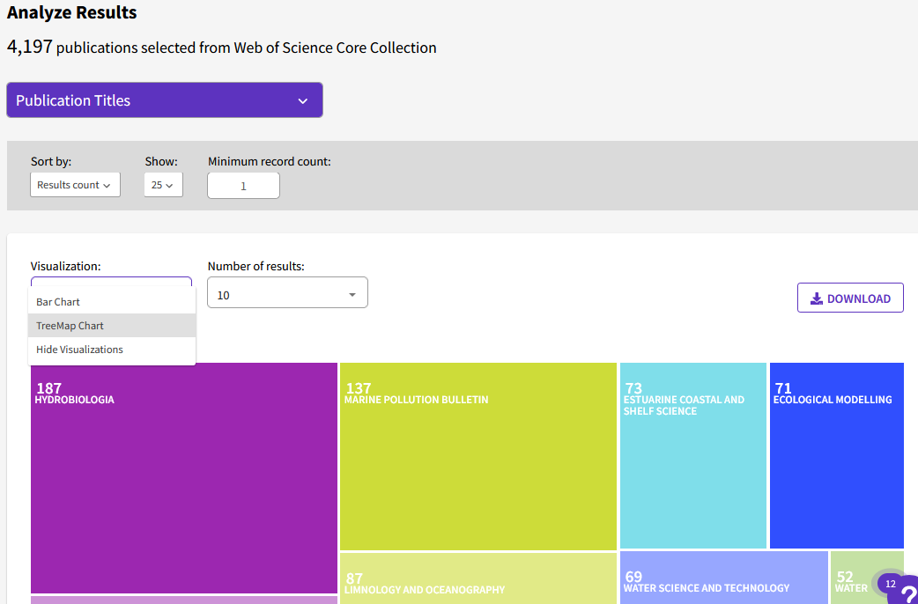
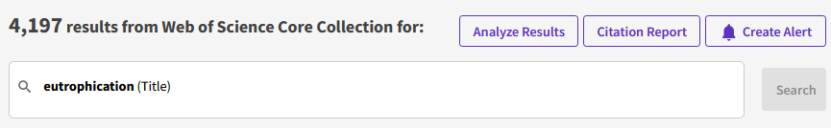

Using the numbers - Where to publish
Library Academic Support Team

Slide 13
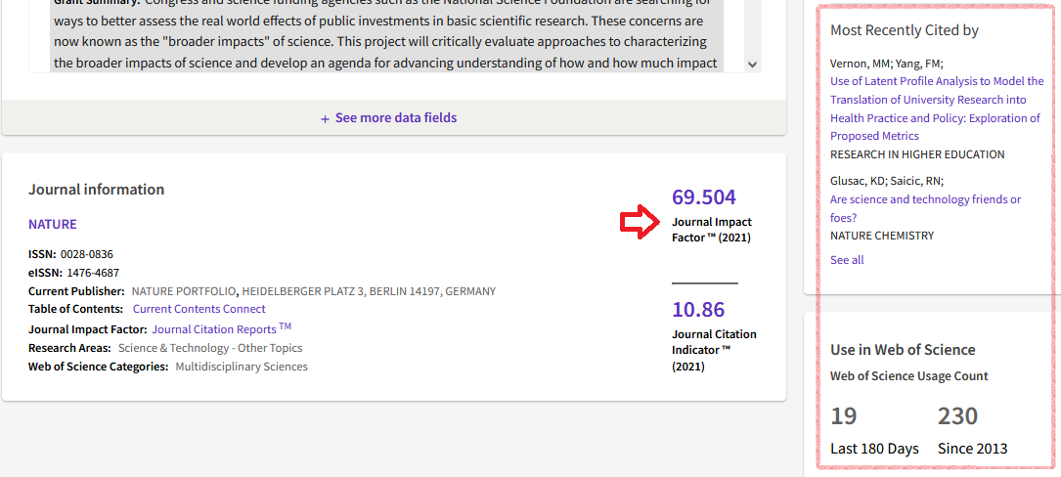
Where are the numbers? - Assessment
Library Academic Support Team

Slide 14
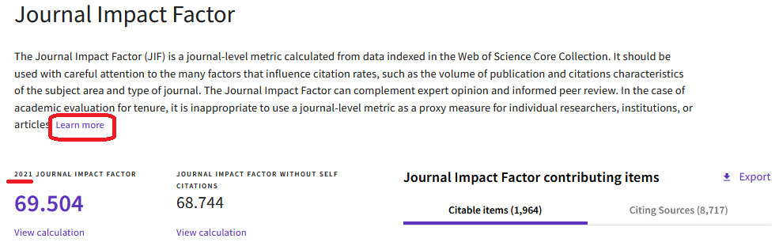
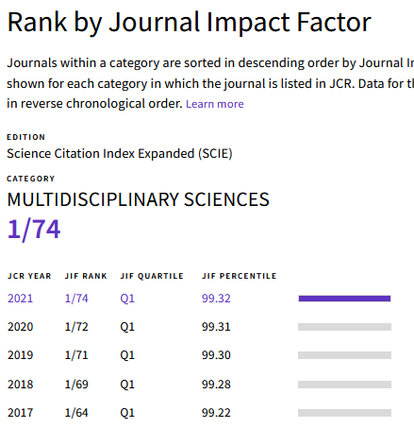
Journal Impact Factors
Library Academic Support Team

Slide 15
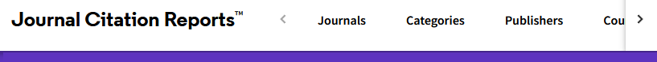
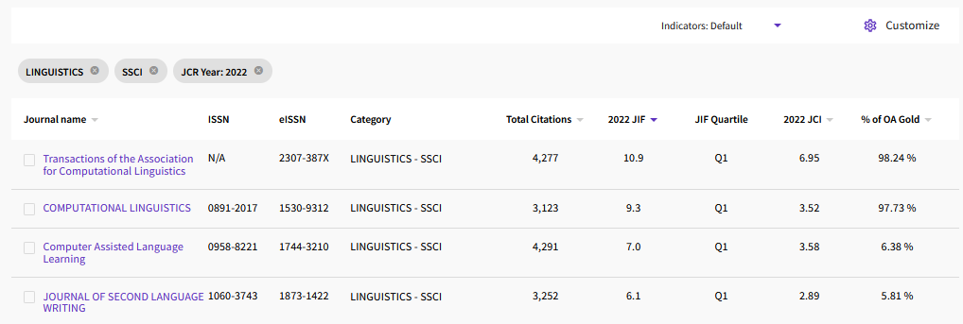
Journal Impact Factors
Library Academic Support Team
You can investigate journal rankings by Category

Slide 16
Library Academic Support Team
Predatory journals
There is money in publishing which means people attempt fraud and theft.
Retraction Watch: Hijacked Journal Checker
  Hijacked journals mimic legitimate journals by adopting their titles, ISSNs, and other metadata…In rare instances, publishers will buy rights to a legitimate journal but continue the publication under considerably less stringent publishing protocols…(sometimes known as “cloned” journals).
Predatory or bogus journals: Guidelines on how to spot and avoid predatory publications

Slide 17
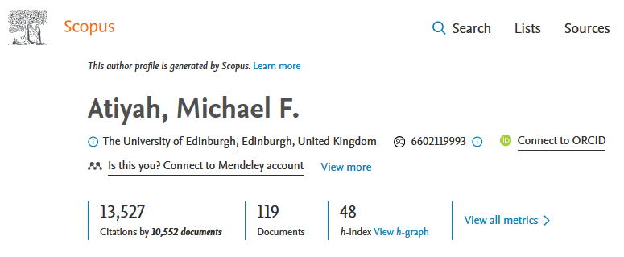
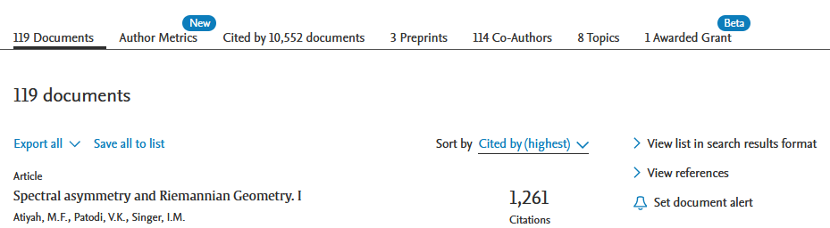
Where are the numbers? - Assessment
Library Academic Support Team

Slide 18
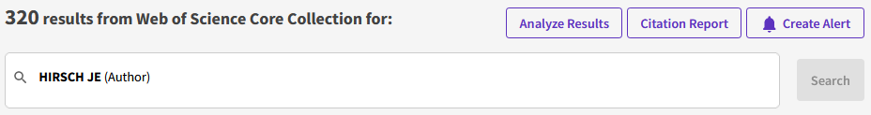
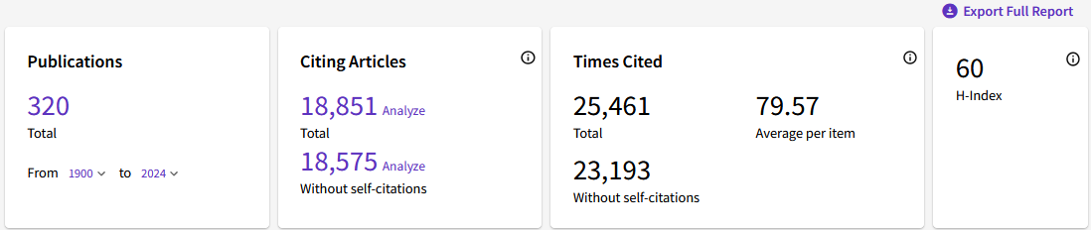
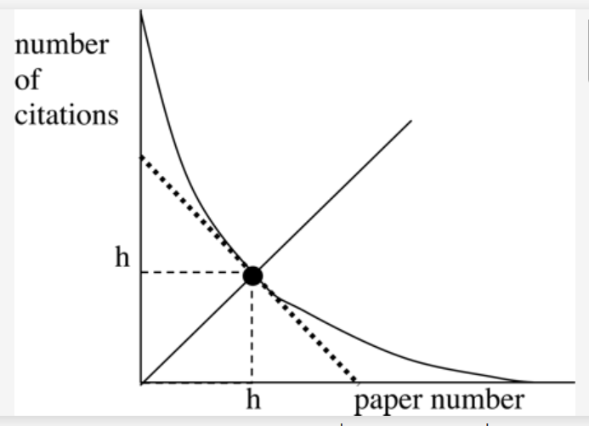
Where are the numbers? - Assessment
Library Academic Support Team
A scientist has index h if h of her or his N_{p} papers have at least h citations each and the other (N_{p} – h) papers have ≤h citations each…
…The highest h among physicists appears to be E. Witten's h, which is 110. That is, Witten has written 110 papers with at least 110 citations each.
Hirsch, J. (2005). An index to quantify an individual's scientific research output. Proceedings of the National Academy of Sciences of the United States of America., 102(46), 16569-16572.

Slide 19
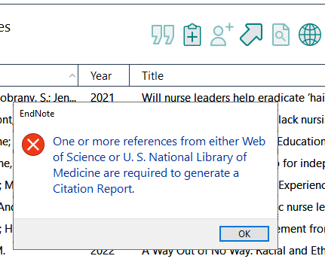

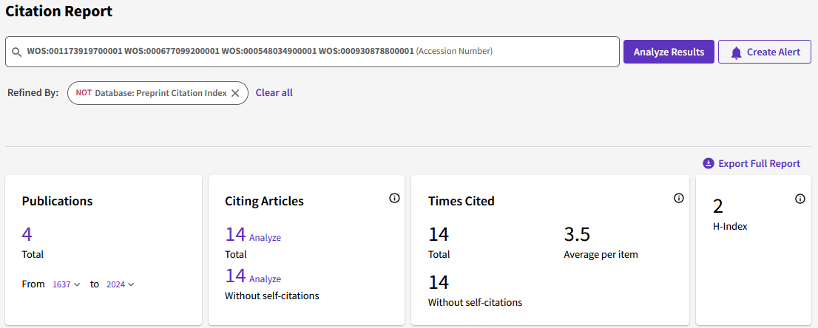
Where are the numbers? - Assessment
Library Academic Support Team
EndNote offers a Citation report generation link
EndNote can create the Citation Report up to 118 references in a single search.
https://support.clarivate.com/Endnote/s/article/EndNote-cra?language=en_US

Slide 20

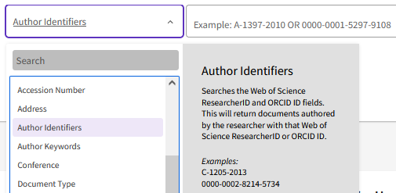
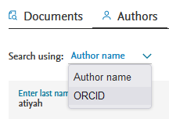
Library Academic Support Team
Where are the numbers? - Assessment
ORCID (Open Researcher and Contributor ID) is a universal identifier academic authors can adopt which is product independent.
https://orcid.org/
Helps to:
Eliminate name ambiguity.
Accurately connect an author with their output throughout a career.
Profiles can be connected, eg ORCID with Pure / Edinburgh Research Explorer www.ed.ac.uk/pure
Scholarly Communications Team ORCID information page:
www.ed.ac.uk/information-services/research-support/publish-research/scholarly-communications/orcid-open-researcher-and-contributor-id

Slide 21
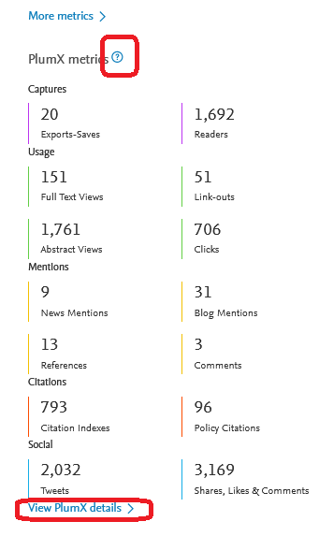
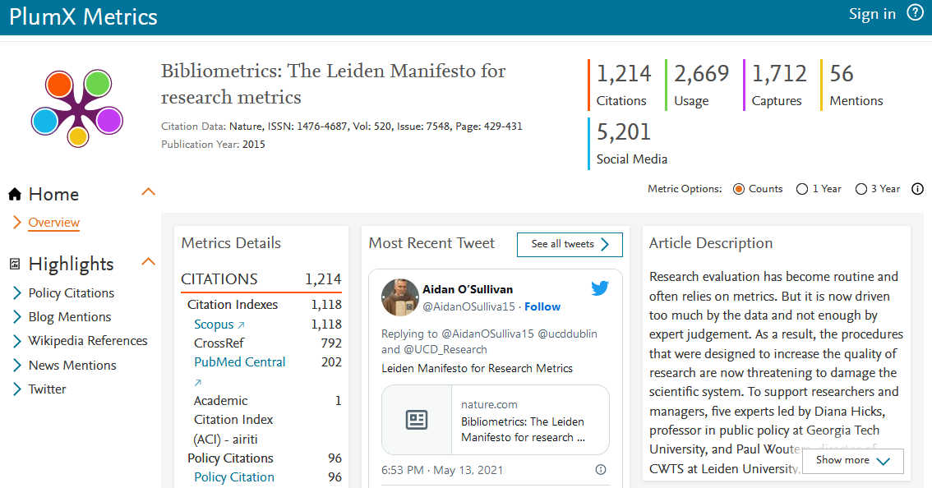
Where are the numbers? - Assessment
Library Academic Support Team
“PlumX Metrics provide insights into the ways people interact with individual pieces of research output (articles, conference proceedings, book chapters, and many more) in the online environment.”
https://plumanalytics.com/learn/about-metrics [Elsevier owned]

Slide 22
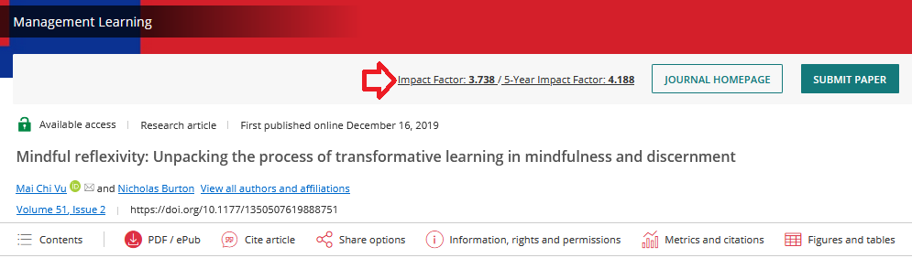
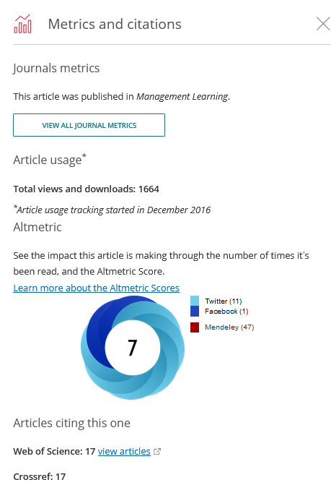

Where are the numbers? - Assessment
Library Academic Support Team
“ …can point to interesting spikes in different types of attention, etc but are not themselves evidence of such. ”
Previous edition of:
www.altmetric.com/about-altmetrics/what-are-altmetrics/

Slide 23

DORA: San Francisco Declaration on Research Assessment
Library Academic Support Team
The University of Edinburgh signed the San Francisco Declaration on Research Assessment (DORA) in Spring 2019. DORA provides a roadmap for global reform in research assessment that universities, funding bodies and individual researchers can sign up to. As a signatory, the University supports DORA’s vision to ‘advance practical and robust approaches to research assessment globally and across all scholarly disciplines'.
Research evaluation and responsible research metrics:
www.ed.ac.uk/research-office/research-talent-and-culture/research-evaluation-and-responsible-metrics

Slide 24
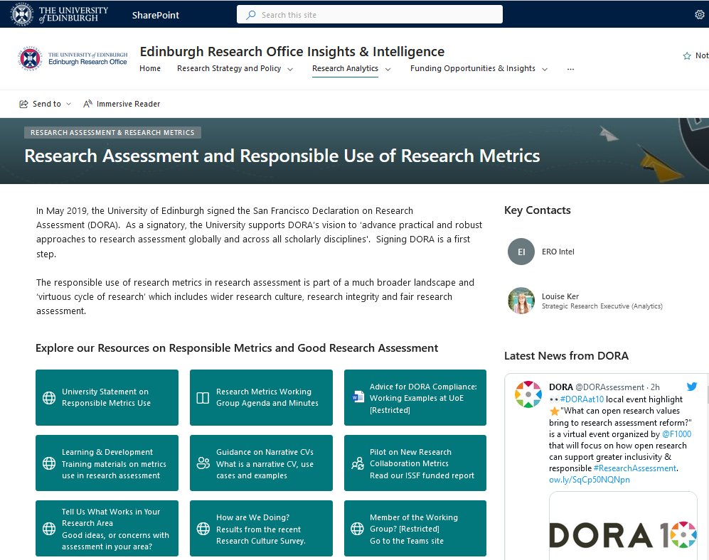

Slide 25
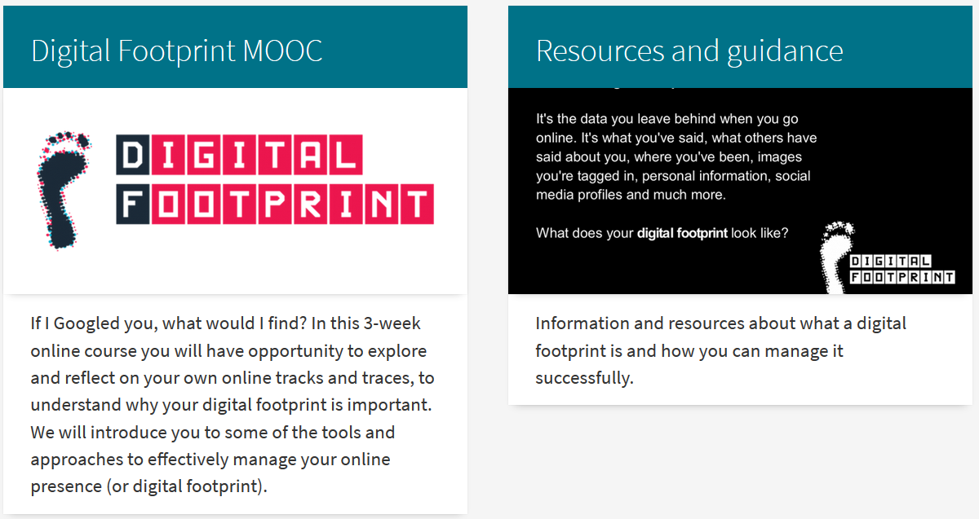
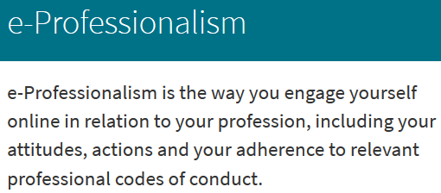
Where are the numbers? - Assessment
Library Academic Support Team
www.ed.ac.uk/iad/digitalfootprint
See also: Digital Safety, Wellbeing and Citizenship – www.ed.ac.uk/is/digital-safety

Slide 26

Library Academic Support Team
Help
Your Academic Support Librarian: www.ed.ac.uk/is/ASL
Library subject guides: www.ed.ac.uk/is/subject-guides
Databases mentioned in this presentation:
www.ed.ac.uk/is/databases-subjects > Bibliometric and publication metrics
Edinburgh Research Office:
Research evaluation and responsible research metrics
Includes links to the University’s Research Metrics Working Group

