Slide 1

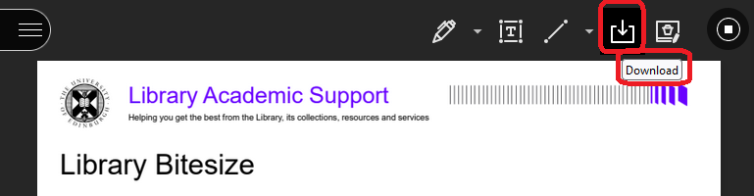
Library Academic Support
Helping you get the best from the Library, its collections, resources and services
Searching the Research Literature
Academic Support Librarians
www.ed.ac.uk/is/asl
For IAD PGT
Slides (pptx):
http://www.docs.is.ed.ac.uk/docs/Libraries/Presentations/IADPGTFindingAcademicLiterature.pptx
AY24-25, v.Oct24

Slide 2
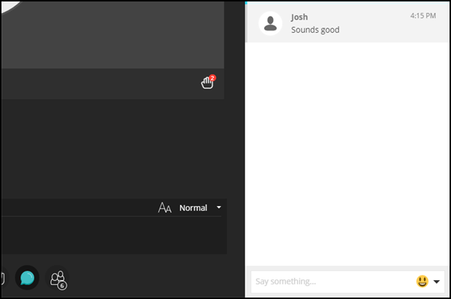
Audio check
Please use the “Text chat area” to say whether or not you can hear me talking.

Slide 3
Searching the Research Literature (IAD PGT)
By the end of the session, you will know:
What to consider before starting to find academic literature.
The range of information resources available to you from UoEdinburgh.
Some techniques to effectively retrieve information for your research.
Know how to be sure you can read what you need from The Library and what to do if you cannot.
Notes:
The overall aim of this session is to look more closely at those resources and give you some general guidance on how to get the best out of them.

Slide 4
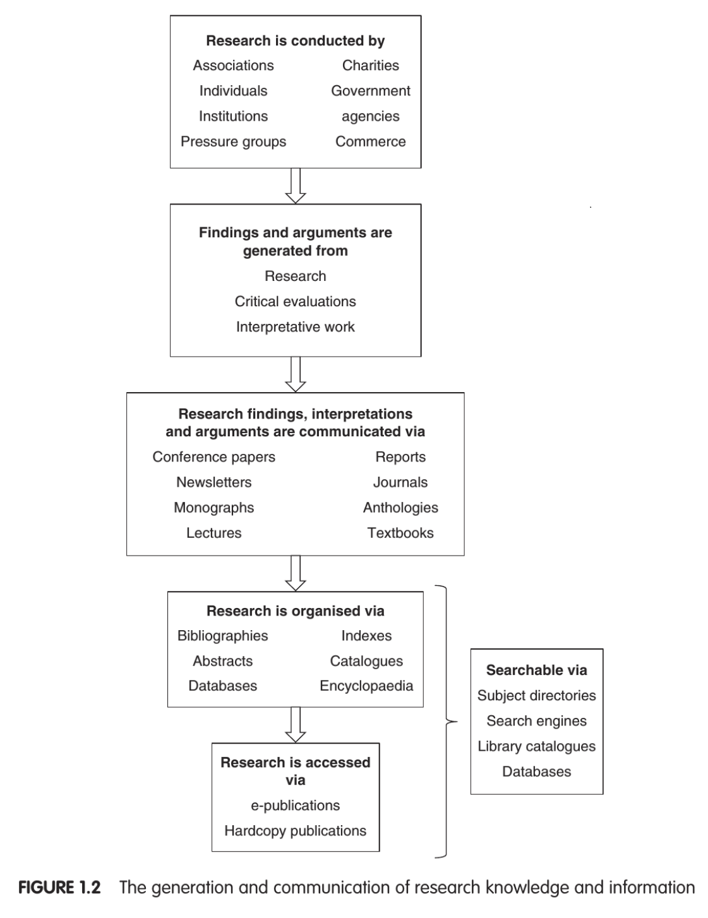
Information landscape
Library Academic Support Team
Libraries buy and provide access to
Chris Hart, Doing a Literature Review. 2nd edition (London: SAGE Publications, 2018) p.14.
https://discovered.ed.ac.uk/permalink/44UOE_INST/7g3mt6/alma9924461186602466
Accessed on 12 Oct. 2021

Slide 5
Source categories
Library Academic Support Team
Primary sources:
Original data or material which is often used to inform further research.
Secondary sources:
Interpretation, commentary or analysis of other (usually primary) sources.
Tertiary sources:
Synthesis or index of primary and secondary sources (often reference sources).
More in LibSmart I
Module 4: Managing Information, Check your source.

Slide 6
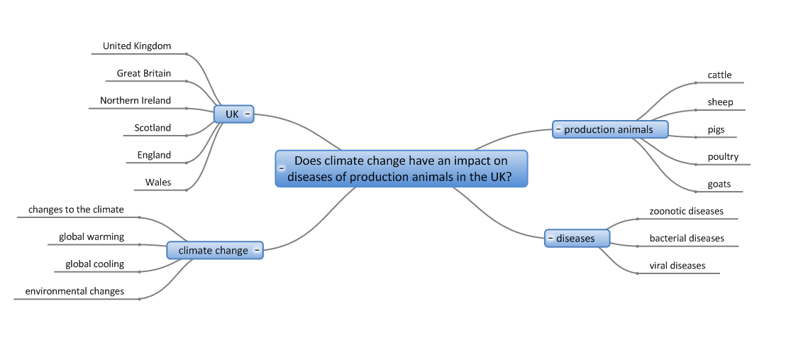
Library Academic Support Team
Thinking before searching

Slide 7
Library Academic Support Team
Thinking before searching
What is your topic?
Identify the main concepts.
What does a paper have to include to make it useful?
    What words and phrases are used for your concepts?
    Synonyms & related terms.
    Words with multiple (all useful) endings, eg:
    modelling, modelled, models
    [modeled, modeling]
    Abbreviations:
    Royal Anthropological Institute, RAI
    Changes in terminology over time
    Geographical differences in terminology, egs
    farmers markets (UK) & greenmarkets (US)
    UK/USA spelling differences, eg:
    behaviour/behavior or paediatric/pediatric
Are there “limits” you want to apply to what you read about?
Can work be too old for inclusion?
Are works in particular languages excluded?
Does research have to have been conducted in a particular way use a particular method of analysis?

Slide 8
Library Academic Support Team
Thinking before searching
What prevents some people from getting vaccinated?
general public | vaccinated | prevents
adult(s) parent(s) mother(s) father(s) | vaccinat(ions) immunis(ation) immuniz(ation) MMR / covid19 | prevent(s) barrier(s) / complian(ce) attitude(s) / behav(iour)
(truncation opportunity)
Synonyms
Synonyms
Useful alternatives
Useful alternatives:
Named programme/problem/vaccine.
Specific population being vaccinated, eg children for whom the attitude of the parents is what determines uptake?
UK / North American
English

Slide 9
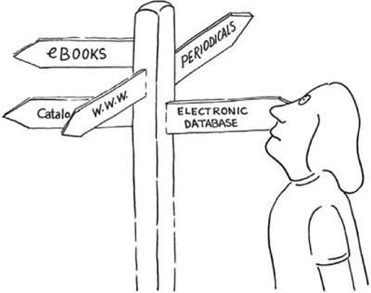
Where to start?
Library Academic Support Team
Start with what you know and/or are comfortable using to find reading material, eg DiscoverEd or Google, textbooks or reference sources.
For more comprehensive searching, consider an abstracting & indexing database.
For primary source material investigate:
Research Data Management Team’s Find and reuse data
Library Subject Guides, eg Digital primary source and archive collections; Newspapers, magazines and other news sources
LibSmart II modules include
Business information | Digital news sources | Literature searching for systematic reviews | Digital primary sources and digital scholarship | Data literacy for beginners | Data mindfulness: finding and managing data for your dissertation \ Health literature

Slide 10
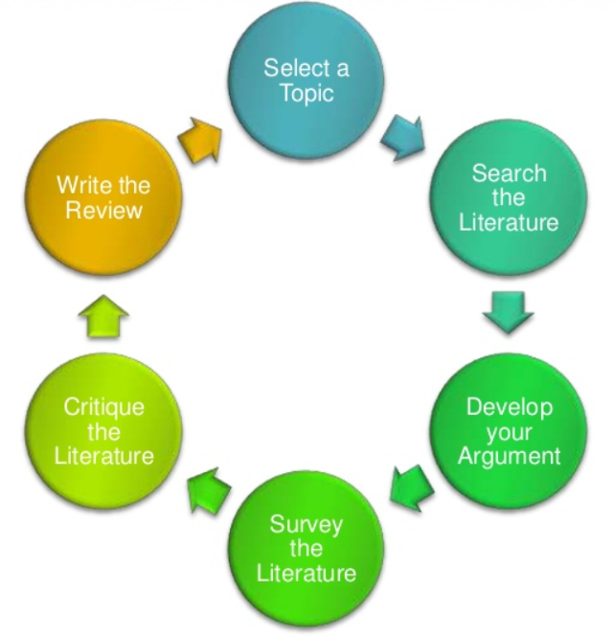
Library Academic Support Team
Some steps in topic selection
Define your topic
Identify potential sources of information
Use resources you are familiar with to get:
an initial feel for the literature.
an idea of whether you will find relevant papers for the review topic you’ve chosen.
Scoping
Search selected resources including relevant abstracting and indexing / bibliographic databases
Original Diagram: Machi, L.A. & McEvoy, B.T. (2012) The literature review: six steps to success, 2nd ed, Thousand Oaks, California: Corwin Press. https://discovered.ed.ac.uk/permalink/44UOE_INST/110jsec/alma9924314053502466
(3rd ed)

Slide 11
Library Academic Support Team
Changing your question
How useful is mindfulness for students experiencing exam stress?
mindfulness | students | exam | stress
mindful(ness) meditat(ion) | student(s) pupil(s) | exam(inations) test(s) | stress(ed) anxi(ety)
essential | Different populations experiencing exam stress may be comparable. | Stress of any kind experienced by students may be useful. | essential

Slide 12
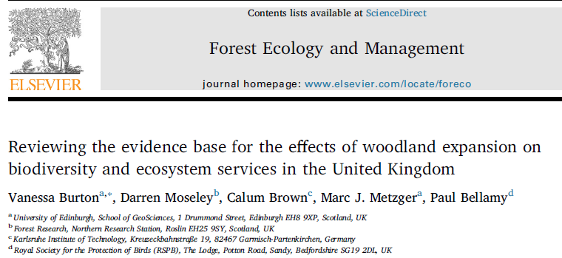
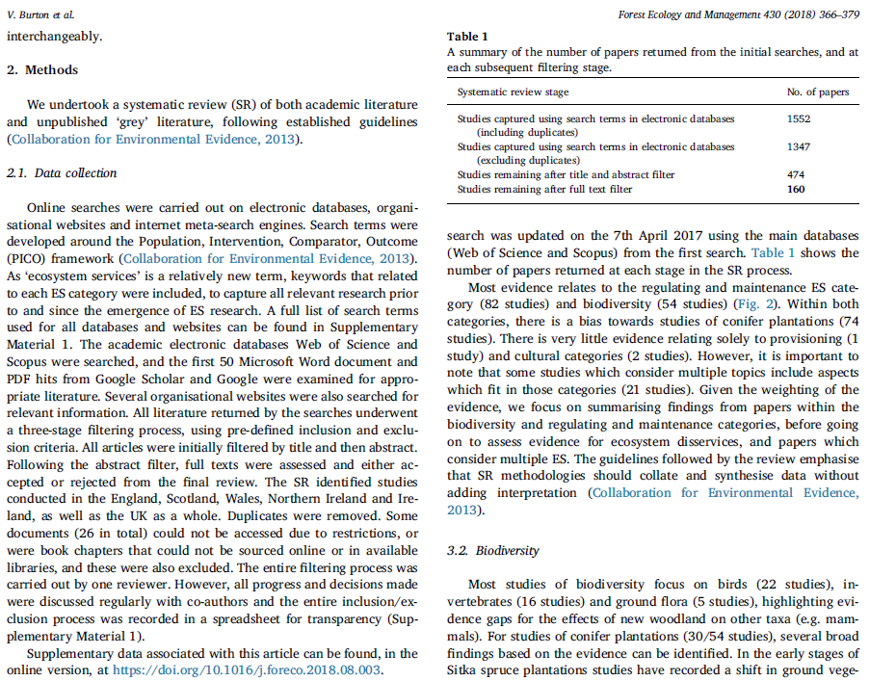
Library Academic Support Team
Published example
Frameworks
Population, Problem, Intervention, Comparison, Outcome, Study Type/Time
More:
PICOS/T, PEO, PICo, SPIDER Frameworks (plus ECLIPSe and SPICE) (pdf)

Slide 13
Library Academic Support Team
Published example – search strategy
Database | Search Terms | Search Settings | Timespan
Web of Science | TS = ((woodland expansion OR "woodland restoration" OR "woodland planting" OR "forest expansion" OR "forest restoration" OR "afforestation" OR "woodland creation") AND (network OR corridor OR connect* OR buffer OR dispersal OR forag* OR "adjacent habitat*" OR "tree plant*" OR "tree species composition" OR "species composition" OR "stocking densit*" OR "planting method" OR size OR edge OR design OR "open space" OR glade OR ride OR soil OR management OR "post-planting" OR treat* OR weed* OR prun* OR thin* OR coppic* OR structur* OR spacing OR fell* OR "dead wood" OR (wet* OR water)) AND (change* OR effect* OR impact* OR benefit* OR establish* OR succes* OR fail* OR increas* OR declin* OR neutral OR "no effect*" OR function* OR service* OR synerg* OR "trade-off*" OR provisioning OR supporting OR regulating OR cultural OR scale OR time) AND (biodivers* OR species OR population* OR communit* OR ecosystem OR habitat* OR site* OR stand OR region* OR landscape* OR "ecosystem function*" OR "ecosystem service*" OR vegetation OR soil* OR nutrient* OR climate OR "carbon sequestration" OR "carbon storage" OR flood* OR "water quality" OR timber OR farm* OR agricultur* OR agro* OR crop* OR peat* OR recreation* OR aesthetic* OR health OR hunt* OR shoot*) AND (“open habitat*” OR habitat* OR bog OR heath* OR grassland OR grass* OR forest* OR wood*)) | Refined to: Web of Science Core Collection and BIOSIS Collection. Region refined to UK, United Kingdom, England, Scotland, Wales, Ireland, North Ireland. Sorted by relvance | All years (1864-2016)
Burton, V, et al (2018) Reviewing the evidence base for the effects of woodland expansion on biodiversity and ecosystem services in the United Kingdom, Forest Ecology and Management, 430, 366-379. https://doi.org/10.1016/j.foreco.2018.08.003

Slide 14

Library Academic Support Team
Combining search terms: using your synonyms
Higher number of results

Slide 15
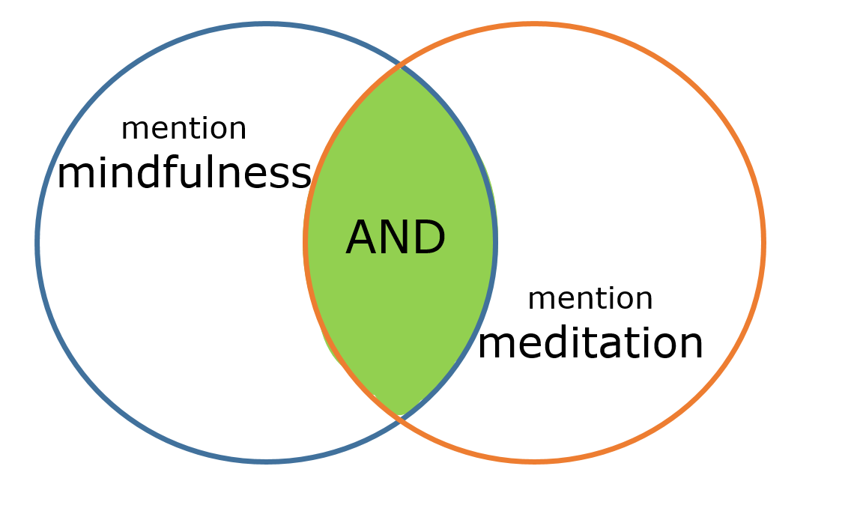
Library Academic Support Team
Combining search terms:
looking for more than one concept
Smaller number of results

Slide 16
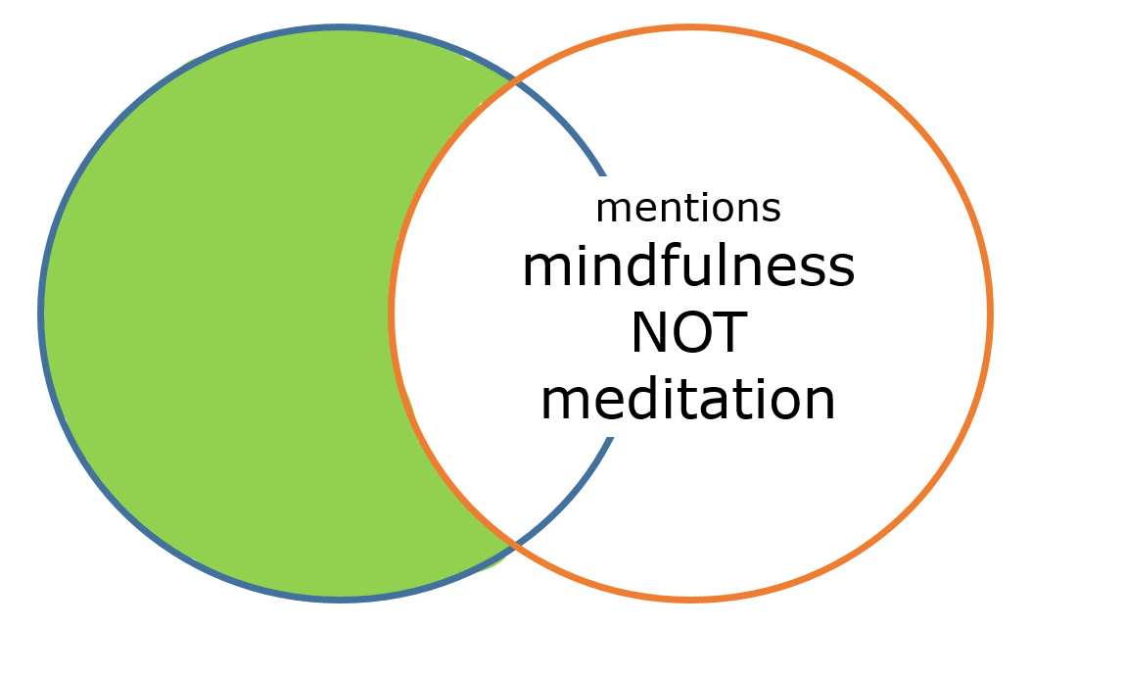
Library Academic Support Team
Combining search terms - be careful with NOT!
Excludes all records/results which have the word meditation.
What about research which looks at both?

Slide 17
Library Academic Support Team
*
Truncation and searching “for phrases”
    Words with multiple (all useful) endings, eg:
    modelling, modelled, models [modeled, modeling]
    UK/USA spelling differences, eg:
    behaviour/behavior
    Truncation symbol, often the asterisk *, to stand for zero or any number of characters:
    model*
    behavio*
…use “double quotes”, eg
“high blood pressure”
“exam* stress*”
Returning words entered in order, ie as a phrase rather than just all the words being present…
Wildcard eg ? for zero/one character differences – encyclop?edia, wom?n
Proximity searching for words near or next to each other, eg catalyst* NEAR/X engine*

Slide 18
Library Academic Support Team
Published example – search strategies
Google Scholar | With the exact phrase: "woodland expansion" afforestation. With any of the words: biodiversity species population community habitat ecosystem landscape "ecosystem function" "ecosystem service" | Advanced search. Sorted by relevance | Any time
Forest Commisson (publications) - no specific search available for FR | 3 separate searches: woodland expansion, biodiversity (returned 2) and woodland expansion, ecosystem services (returned 0) and just woodland expansion (returned 8) | Advanced search. All of the words. | Any time
Scottish Natural Heritage | woodland expansion | No advanced options for sorting in any way, basic search | Any time
The Woodland Trust | woodland creation | Filtered to document
RSPB | Manual search through document library section | Topic: forestry, all years, anywhere.
Burton, V, et al (2018) Reviewing the evidence base for the effects of woodland expansion on biodiversity and ecosystem services in the United Kingdom, Forest Ecology and Management, 430, 366-379. https://doi.org/10.1016/j.foreco.2018.08.003

Slide 19
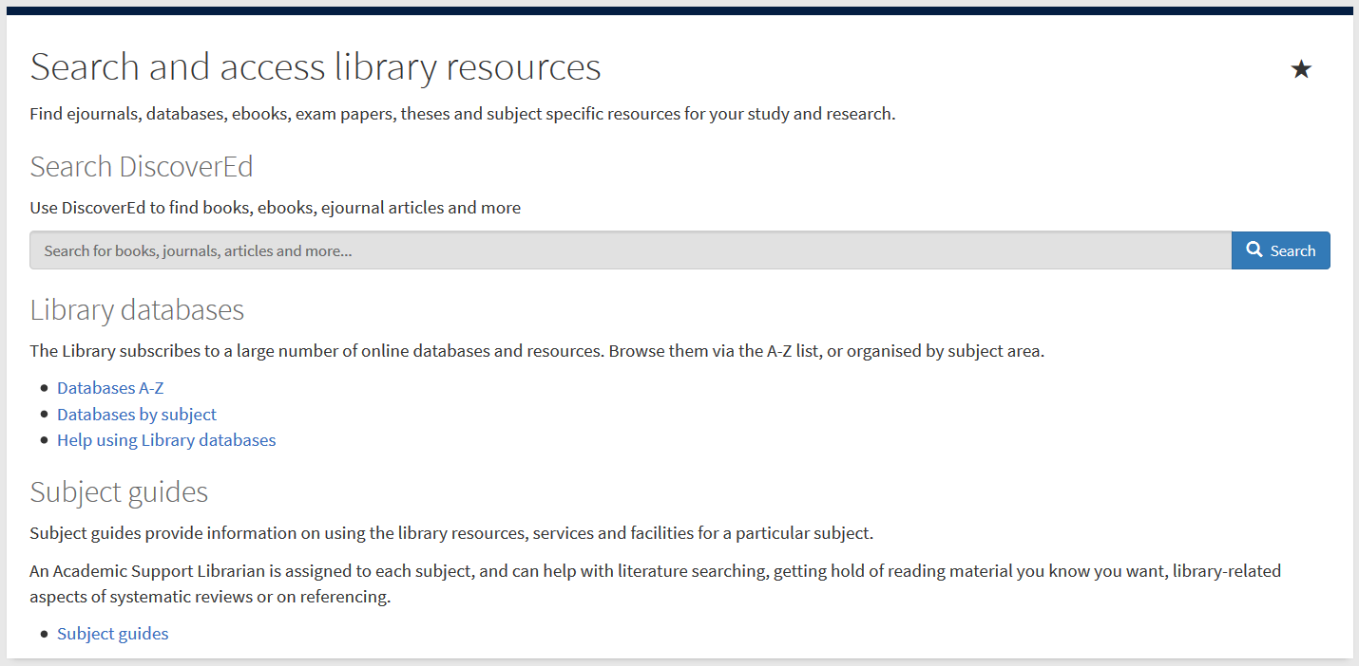
Starting your search with what you know
Library Academic Support Team
Using resources you are familiar with can help you get
a feel for the literature.
an idea of whether you will find relevant papers for your topic.
DiscoverEd includes article level records.
Default setting is to what you can read because the library has bought it.

Slide 20
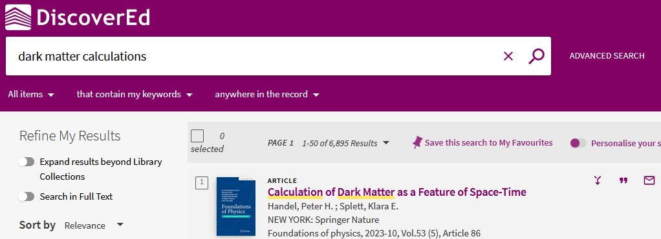
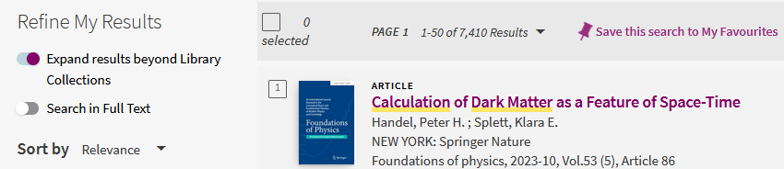
Databases for Reviewing the Literature
Library Academic Support Team
DiscoverEd includes article level records.
Default setting is to what you can read because the library has bought it.
Get more results but which you may not be able to read immediately.

Slide 21
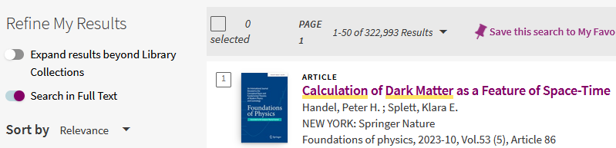
Databases for Reviewing the Literature
Library Academic Support Team
DiscoverEd includes article level records.
Default setting is to what you can read because the library has bought it.
Get more results but in which your search terms may be pages apart.

Slide 22
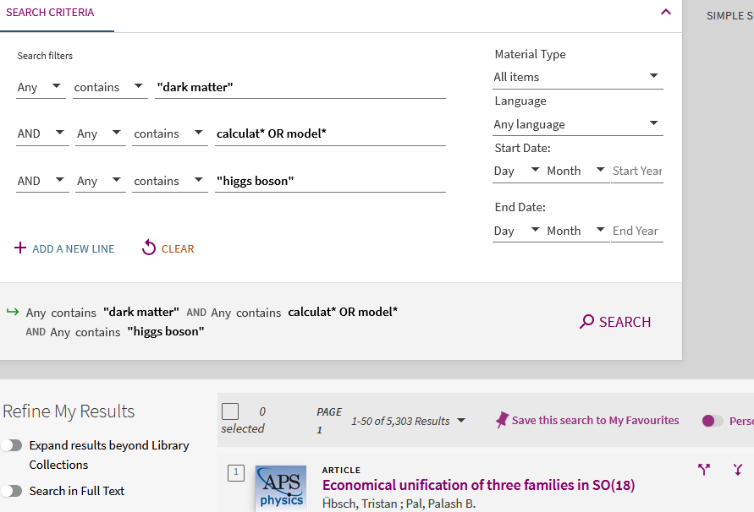
Using what you know: DiscoverEd – Advanced Search
Library Academic Support Team
Opportunities for “snowballing”

Slide 23
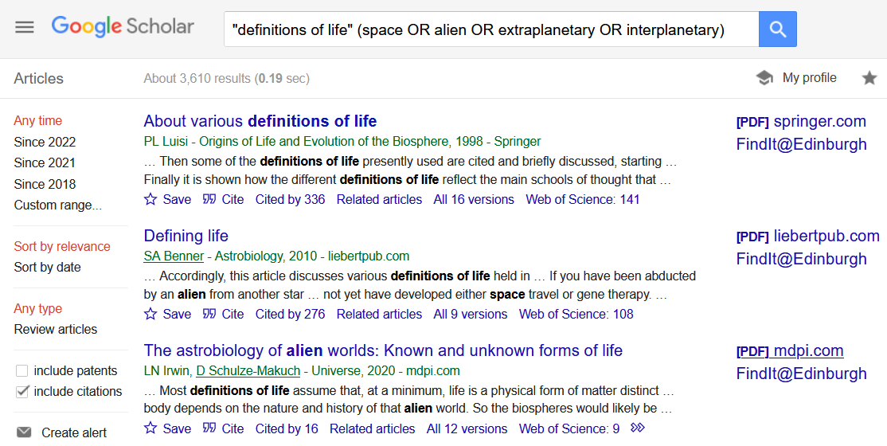
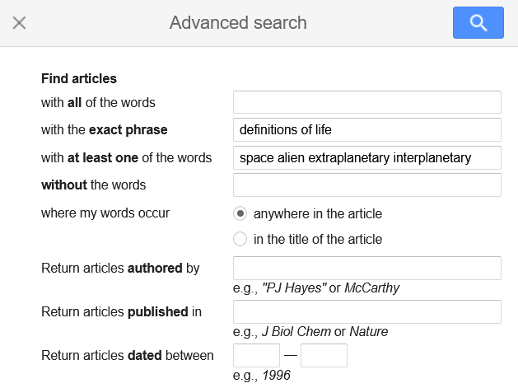
Using what you know: Google Scholar
Library Academic Support Team

Slide 24
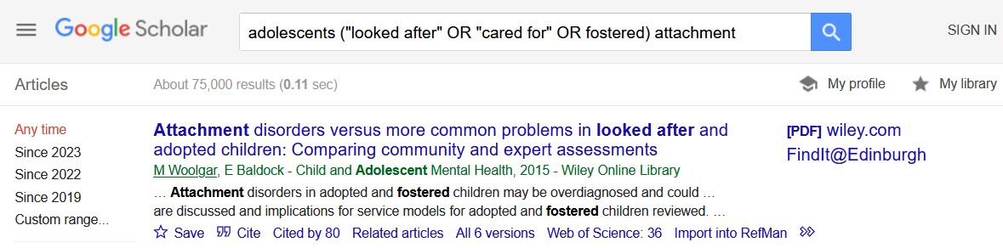
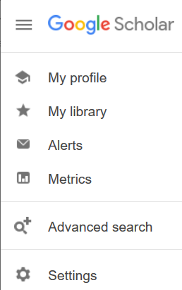
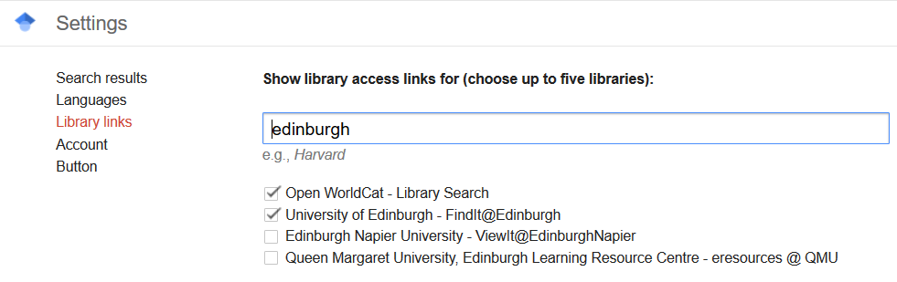
Using what you know: Google Scholar – Library Collections
Library Academic Support Team
Go to Settings > Library links to add:
findit@edinburgh to results view.

Slide 25
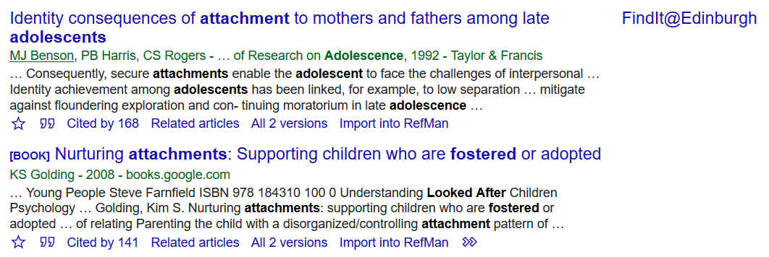
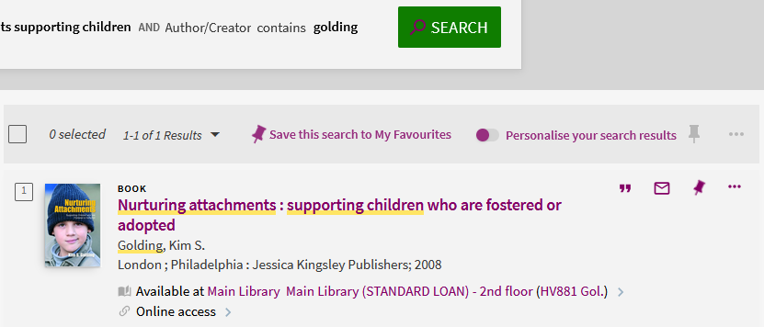
Library Academic Support Team
Check: can you read what you have found?
No link?
Link does not give you full-text?
Treat like a normal reference.
Use DiscoverEd
Opportunities for “snowballing”
The library may have what you want:
    Online from a different site
    In print

Slide 26
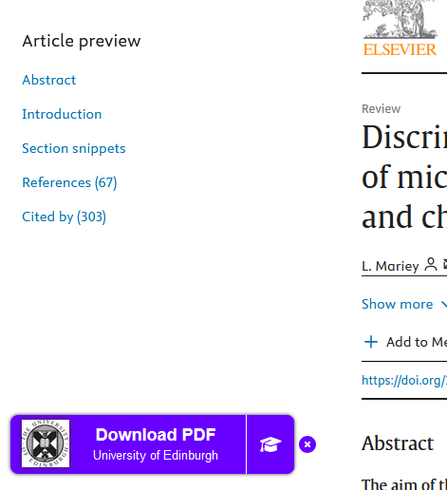
LibKey Nomad
Library Academic Support Team
Have the quick link button appear when you are on sites recognised to be available to University of Edinburgh staff and students.
Can sometimes help overcome temporary authentication issues
Download the LibKey Nomad Browser Extension

Slide 27
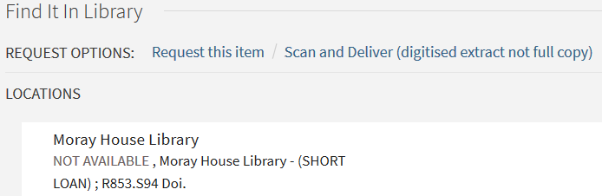
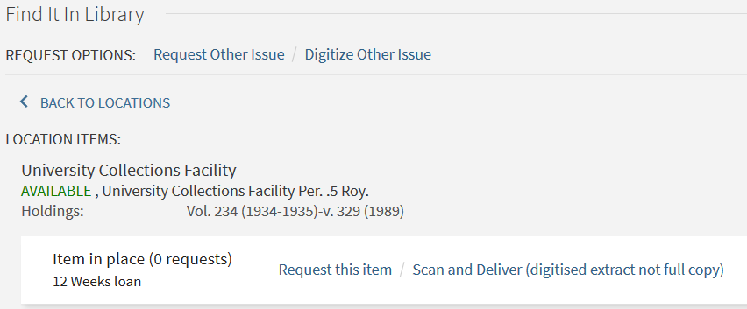
Library Academic Support Team
Print-only material in the Collection
Sign In to DiscoverEd to get the REQUEST OPTIONS
Ask for scans of material (journal article, book chapter) which the Library only has in print.
not all collections are available and
copyright limits apply
Request early return of books already borrowed.

Slide 28

Library Academic Support Team
Inter-Library Loan (I.L.L.) service
For when The Library does not have what you want at all
Scan of part (article, chapter etc) to keep, or
Physical items to borrow
www.ed.ac.uk/is/inter-library
Free per year (after which £5 per request received):
5 for undergraduates
30 for postgraduates and staff
2 renewals which are done via Helpdesk or I.L.L. staff.

Slide 29
Abstracting & Indexing databases
Library Academic Support Team
Include material not found in DiscoverEd or Google Scholar.
Contain details of millions of articles from 1000s of publications.
  Conference proceedings, journal articles, book chapters, reports and standards.
Subject specific databases.
Databases by subject
www.ed.ac.uk/is/databases-subjects
Library Subject Guides
www.ed.ac.uk/is/subject-guides

Slide 30
Abstracting & Indexing databases - Searching
Library Academic Support Team
Be specific when you start.
If you are not finding enough to read, use broader topic search terms.
Use the results to get more search terms.

Slide 31
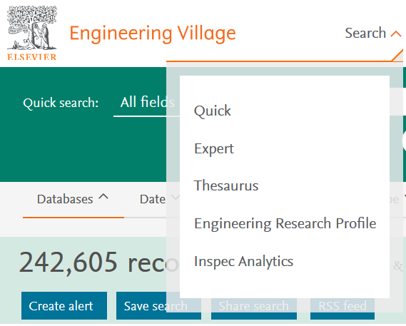
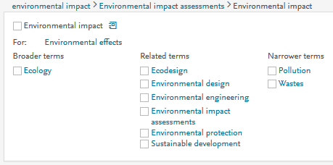
Abstracting & Indexing databases – Subject headings
Library Academic Support Team
Databases often use controlled vocabulary to enrich article descriptions.
Find vocabulary matching a discipline’s terminology
Find search terms which work well in the database.
See other terms which may be useful

Slide 32
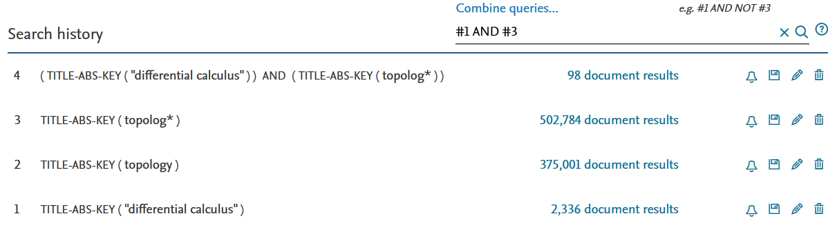
Library Academic Support Team
Abstracting & Indexing databases – Search History
Search concept by concept.
Add synonyms as you think of them.
See the difference (in result numbers) combining makes.
Know the limiting concept(s) (lowest result number).

Slide 33
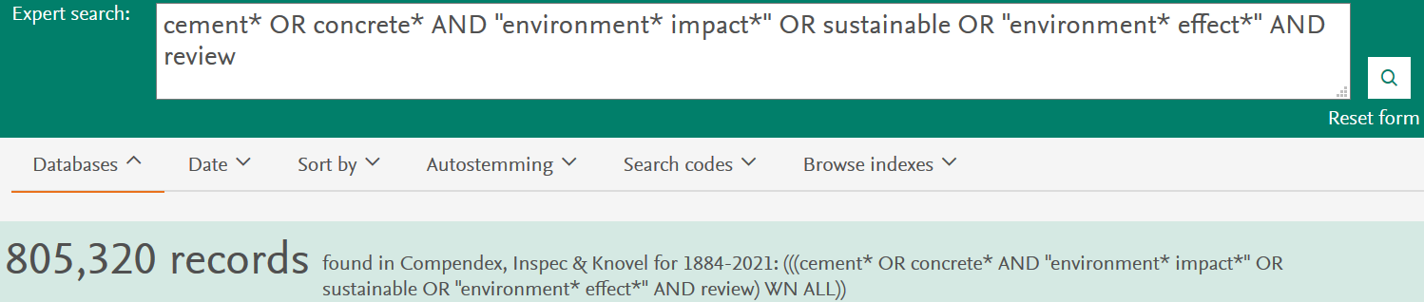
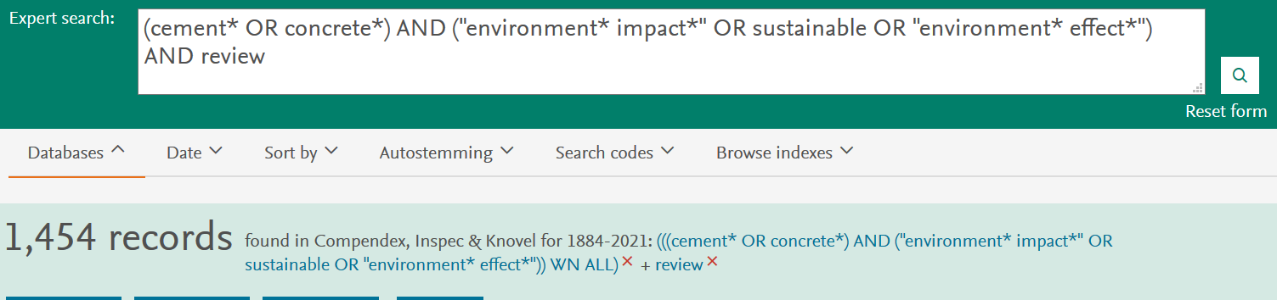
Library Academic Support Team
Abstracting & Indexing databases – Search History
Allows you to:
Think one concept at a time.
Add another concept easily
Know the combination is working the way you want.

Slide 34
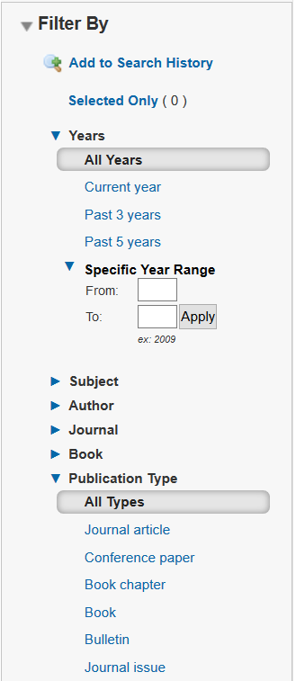
Abstracting & Indexing databases – Refining/Filtering
Library Academic Support Team
Controlled vocabulary may also be used to describe other features of an article.
Refine panels or Limits areas show such features well.

Slide 35
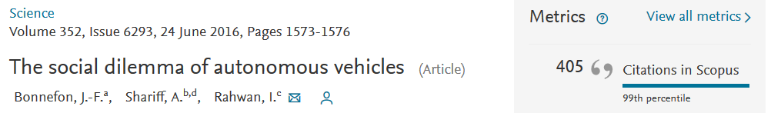
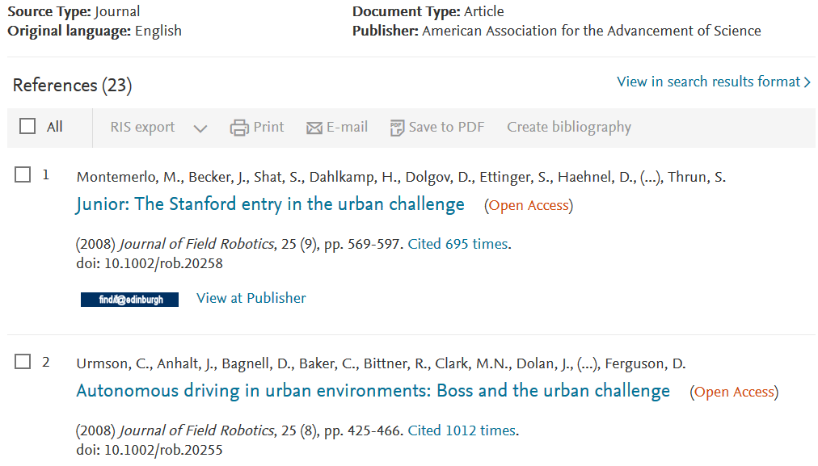
Library Academic Support Team
Using citations
References used in a paper

Slide 36
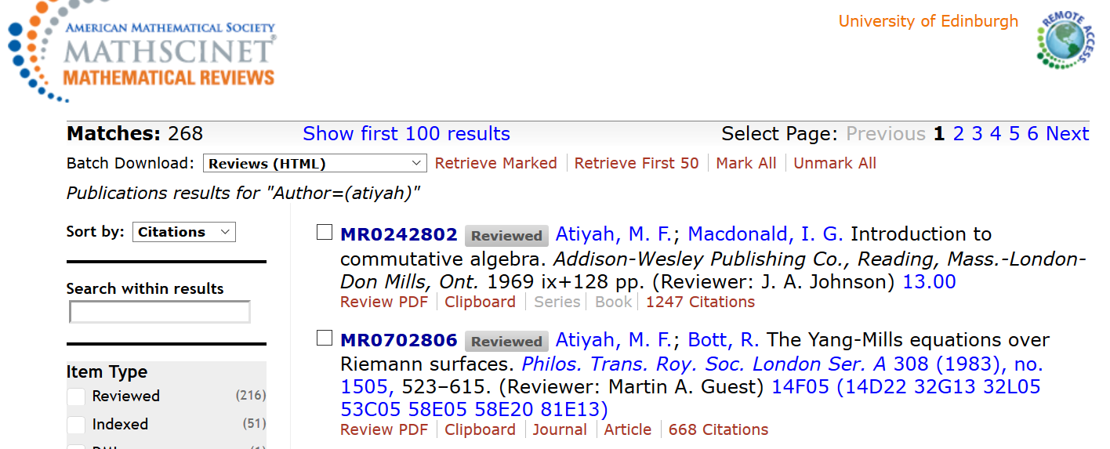
Library Academic Support Team
Search Strategy – “Snowballing” using citations
Papers with a work in their reference lists

Slide 37
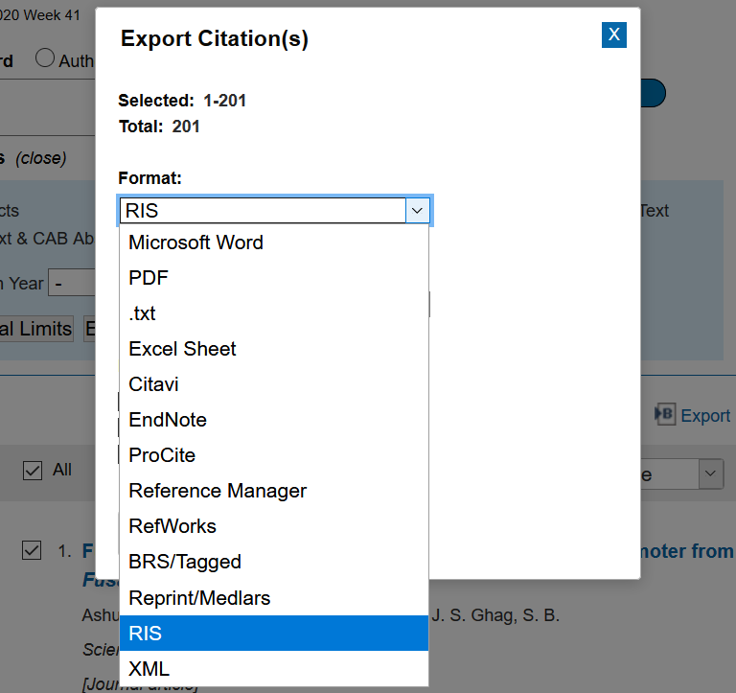
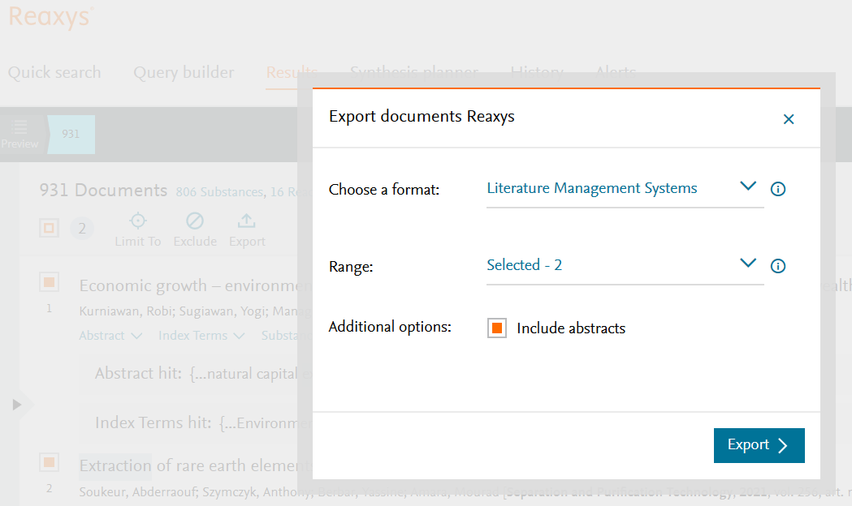
Library Academic Support Team
Keeping results somewhere you control
Look for the label
Export / Download / Save.
Often above the results list.

Slide 38
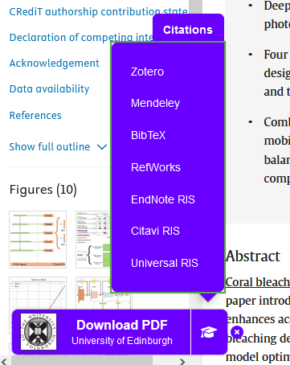
LibKey Nomad
Library Academic Support Team
Has an export citation option too
Download the LibKey Nomad Browser Extension

Slide 39
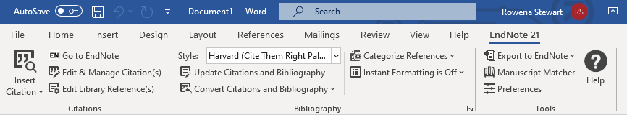
Library Academic Support Team
Reference management software - can save you time
Construct and manage a database of references
Automatically build bibliographies in Word
Export references in BibTex
Bibliographic management comparison table (pdf):
www.docs.is.ed.ac.uk/mvm/BiblioManagersTable.pdf
Choosing a Reference Manager guidance documents:
https://uoe.sharepoint.com/sites/digitalskillsandtraining

Slide 40
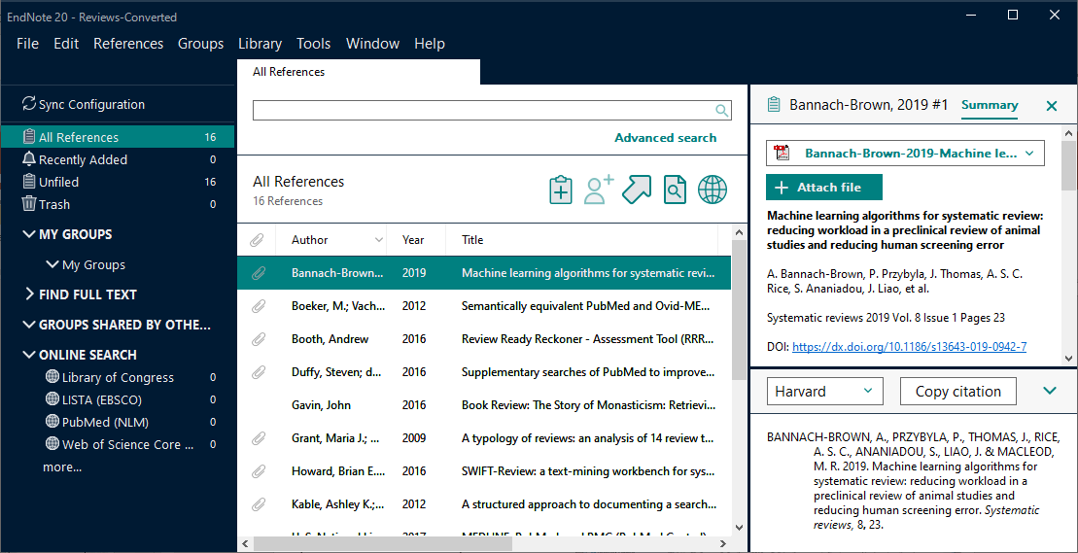
Library Academic Support Team
Reference management software - can save you time
Construct and manage a database of references
Automatically build bibliographies in Word
Search for and attach full-text [VPN]
Import PDF files or folders of files

Slide 41
Library Academic Support Team
URLs for Reference management software
Bibliographic management comparison table (pdf):
www.docs.is.ed.ac.uk/mvm/BiblioManagersTable.pdf
Choosing a Reference Manager - self-paced and self-enrol Learn course. Includes PDF guide from the course:
https://uoe.sharepoint.com/sites/digitalskillsandtraining
Download EndNote desktop for free using the University forms
[ www.ed.ac.uk/is/software ]
Library's Referencing Subject Guide:
www.ed.ac.uk/is/subject-guides-referencing

Slide 42
Library Academic Support Team
How much of the literature do you read?
Read literature reviews or works of a similar type of study to yours.
You will begin see the same references in your search results lists.
The references cited in useful papers will (hopefully) begin to look familiar.
Reviewing the literature systematically combines well focussed research question and search strategy with rigorous appraisal and synthesis of the literature. Someone reading the review should be able to repeat it.
Evaluating information
Be aware of different perspectives of an argument.
Test the accuracy and soundness of claims made.
Assess the accuracy and soundness of evidence used for those claims.
Look for, and assess, assumptions made in a text.
https://edinburgh-uk.libguides.com/micromasters/evaluating-information

Slide 43
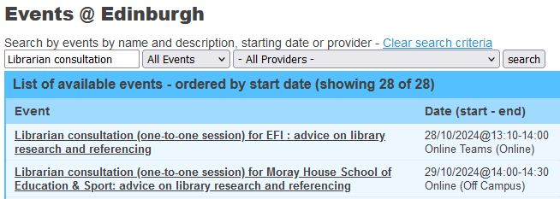
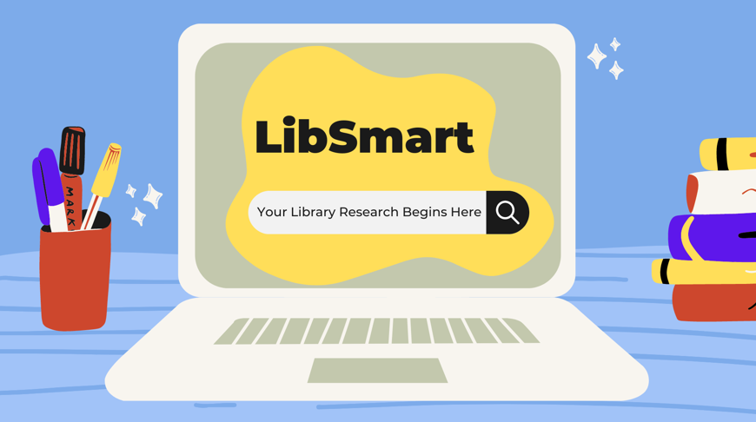


Library Academic Support Team
Help
Librarian consultation – one to one sessions.
Library Subject Guides include contact details for your Academic Support Librarian.
www.ed.ac.uk/is/subject-guides
LibSmart - Self-enrol information literacy course on Learn
www.ed.ac.uk/is/libsmart
IS Skills Development courses and the online manuals
www.ed.ac.uk/is/skills
Institute for Academic Development resources by degree and career role
www.ed.ac.uk/iad

Slide 44
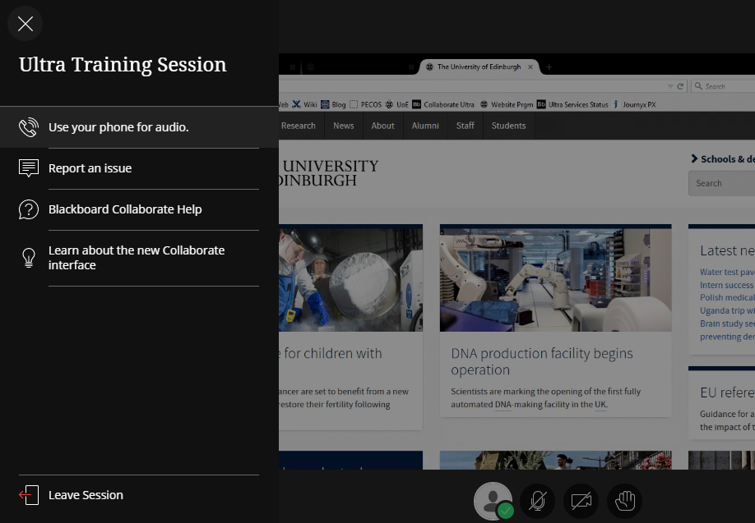
Thank You!
To leave:
Menu > “Leave Session”
Or
Close the browser window.

