Slide 1


Library Academic Support
Helping you get the best from the Library, its collections, resources and services
Library Resources and Services
PhD students
  To cover:
  Finding academic literature on your subject
  Previous theses
  Money for publishing Open Access
  Thinking about your publication record
  Thinking about your data
Rowena Stewart
(she/her)
rowena.stewart@ed.ac.uk
Academic Support Librarian
This presentation: www.docs.is.ed.ac.uk/docs/Libraries/Presentations/HealthLibraryInductionPGRextras.pptx
AY23-24, v.Sep24

Slide 2
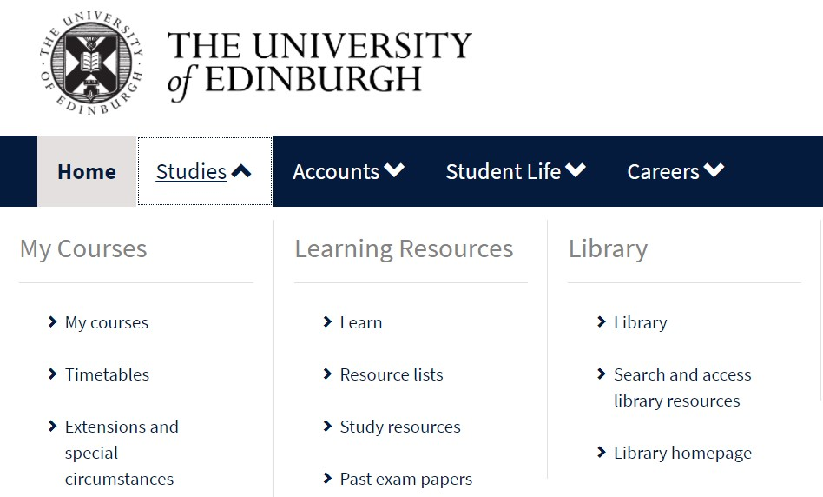
Resources for literature review searches
Library Academic Support Team
DiscoverEd also contains article level information.
By default, results are of material you can read because the library has them.
Abstracting & Indexing (A&I) databases
Produced for researchers to find out about the existence of articles, book chapters and theses whether the Library buys access to the full-text or not.
Designed for sophisticated searches of multiple concepts and their synonyms.
Contents are not restricted to output from any one publisher
www.myed.ed.ac.uk

Slide 3
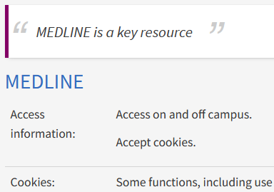
Databases for Reviewing the Literature
Library Academic Support Team
To find what has already been published in your field:
edin.ac/databases-subjects
CINAHL Plus
Nursing
Title is the link
EMBASE and MEDLINE
Both clinical medicine and related fields.
Former has coverage of more European-based journals.
PsycINFO
American Psychological Association for psychology and psychiatry
ASSIA
Social Services Abstracts
Research done or reported for those working outside a clinical setting
ERIC
Education but good on wellbeing of the child.
Web of Science (Science Citation Index , Proceedings…)
Tracking a particularly useful article through the literature since it was published.
Journal Impact Factors

Slide 4
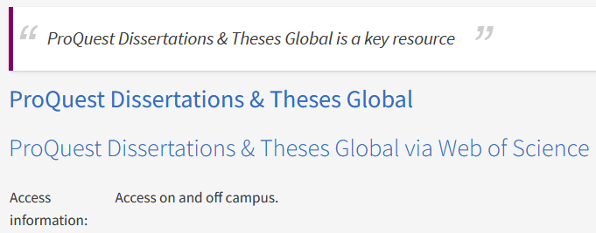

Library Academic Support Team
Theses
Find theses awarded in your field
edin.ac/databases-subjects > Theses
ProQuest Dissertations & Theses Global
for those awarded worldwide.
Includes online full-text.
Edinburgh Research Archive (ERA):
Digital copies of all UoEdinburgh PhD (and some Masters) theses.
Complete copies of any academic output can be posted.
Ask its staff for advice on copyright.
www.era.ed.ac.uk

Slide 5
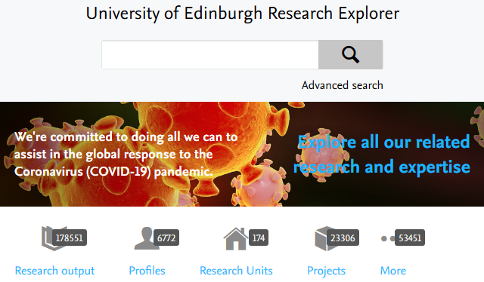

Library Academic Support Team
Your Publication Record
Edinburgh Research Explorer for research output (not a full-text repository).
“PURE” feeds the Edinburgh Research Explorer and its help pages provide information specific to postgraduate research students.
Access to PURE
www.research.ed.ac.uk
ORCiD (Open Researcher and Contributor ID):
Register for a persistent digital identifier to correctly associate your publications, affiliations, grants etc with you.
Research Support Team information about ORCiD
https://orcid.org/

Slide 6
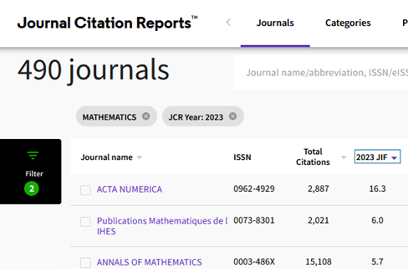
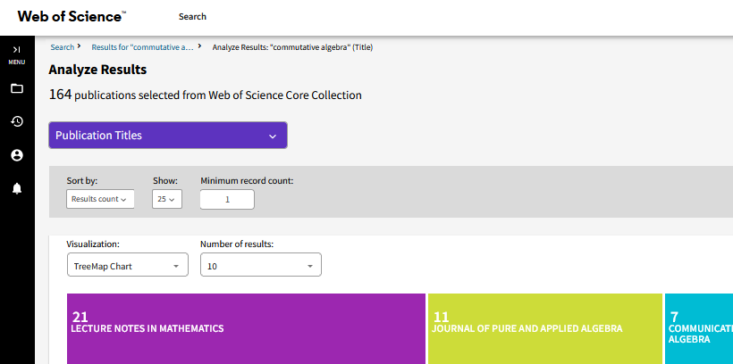
Journal metrics
Library Academic Support Team
Publishing
Bibliometric and publication metrics databases
Search for topic and see which journal titles are most frequent in the results.
Scholarly Communication Team:
Guidelines on how to spot and avoid predatory publications

Slide 7


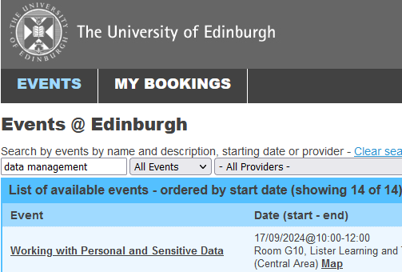
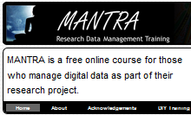
Library Academic Support Team
Research Support Team
managing and publishing your research
Publishing your research - www.ed.ac.uk/openaccess
University policies.
Open Access author fees – money available.
Advice (on copyright implications, next REF etc).
Data
Research Data Service
Advice on planning, storing, sharing or publishing the data your research generates.
Open repository, Edinburgh DataShare.
Training
  – includes self-enrol and self-paced online course MANTRA.
https://mantra.ed.ac.uk

Slide 8
Library Academic Support Team
Help
Academic literature searching and other library-related
problems or questions:
rowena.stewart@ed.ac.uk
Academic Support Librarian (she/her)
Library’s Research Support teams: library.ed.ac.uk/research-support
  Library resources and services (introductory presentation):
www.docs.is.ed.ac.uk/docs/Libraries/Presentations/HealthLibraryInduction.pptx
  Where the libraries are, opening hours, knowing what The Library has & getting what the Library does not have, Literature review resources & reference management software.

