Slide 1

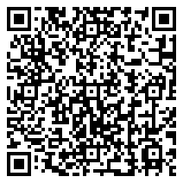
Library Academic Support
Helping you get the best from the Library, its collections, resources and services
Library Resources
and Services
Rowena Stewart
(she/her)
rowena.stewart@ed.ac.uk
Academic Support Librarian
This presentation:
http://www.docs.is.ed.ac.uk/docs/Libraries/Presentations/HealthLibraryInduction.pptx
Feb25

Slide 2
Library Academic Support Team
Library Resources and Services
  Finding out if the Library has what you need.
  Getting what the Library does not have.
  Finding academic literature on your subject.

Slide 3
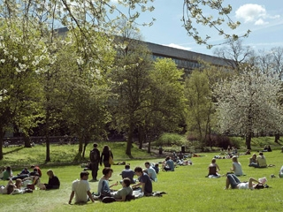
Library Academic Support Team
Which Library holds your print Collections?
Main Library - print collections for Health in Social Science and Medicine (plus most of the Arts and Humanities Collections).
Western General and RIE have libraries.
Main Library:
24/7 during semester time
Postgraduate study area:
Floor 5
There are department libraries, eg Psychology & Philosophy Library in the Psychology Building (7 George Square)
Before visiting them, use the contact details on the page above to check you can use them how you want to.
edin.ac/library-locations

Slide 4
Library Academic Support Team
Bookable study spaces
Group study rooms in many of the libraries, including the Murray Library:
  Book via EventMap booker
Single desks all Main Library, Floors 3 and 5 - 169, not many!
65 for postgraduate students only – Floor 5.
    Book via online form or the SeatEd @ UoE mobile App.
    QR code / unique name on the desk to check-in and out.
edin.ac/study-space
  Accessible study rooms
  require registration with Disability and Learning Support Services.
  https://disability-learning-support-service.ed.ac.uk
Careers service has an Online Interview Booth
A bookable quiet space for an online job interview via MyCareerHub

Slide 5
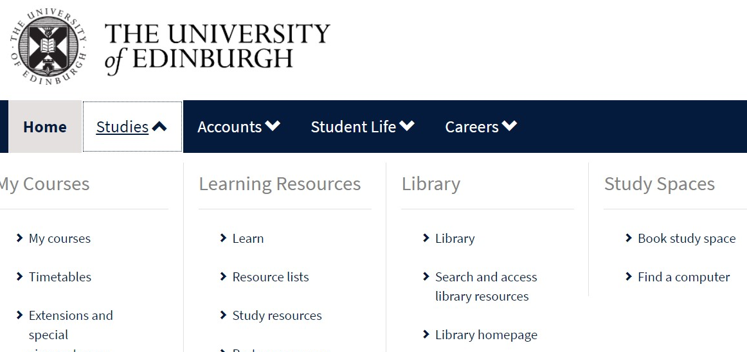
Library Academic Support Team
    Library facilities
As well as physical items (books, newspapers, DVDs, musical scores, laptops…) and staff to help.
MyEd
www.myed.ed.ac.uk
study spaces
open-access computers
printing and scanning
uCreate - 3d printing, scanning, VR, casting and molding…

Slide 6

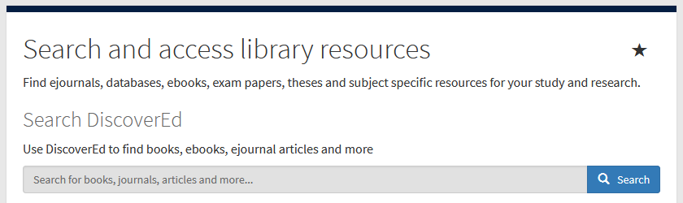
DiscoverEd – http://discovered.ed.ac.uk
Library Academic Support Team
Place of record for what is available:
Online and print.
Journals, books, theses, newspapers, music scores, CDs, videos…
Records for articles.
Library homepage
https://library.ed.ac.uk
Library column in MyEd
www.myed.ed.ac.uk

Slide 7
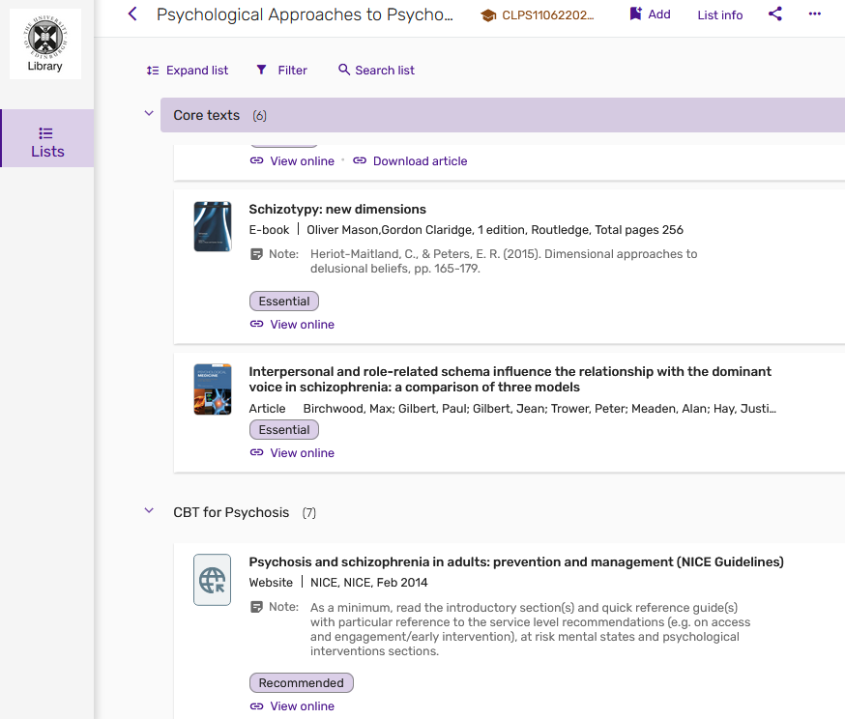
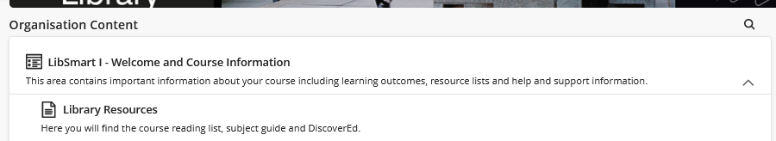
Library Academic Support Team
Resource Lists may be how course reading is presented
Within a Learn course look for the Content section and then Library Resources).
Also standalone site
http://resourcelists.ed.ac.uk

Slide 8

DiscoverEd
Library Academic Support Team
http://discovered.ed.ac.uk
Use DiscoverEd to know…whether or not the library has what you want to read (watch, listen to)…
Use DiscoverEd because…
The Library may have bought what you want from somewhere a standard search engine cannot reach.
What you find from a topic type search, you should be available to read from The Library.

Slide 9


DiscoverEd – http://discovered.ed.ac.uk
Library Academic Support Team
Because records for articles are included…
…use the limiting/filtering options to know if we have a particular journal or book.

Slide 10
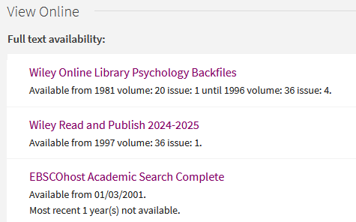
Journals
Library Academic Support Team
online holdings
Journals may be bought online but from companies other than the publisher.
Many search engine etc links to article full-text will go to the publisher’s site but access to what you want to read my be available to you from elsewhere.
Online holdings without an end date?
Current issues are available.
Check the notes for exceptions.

Slide 11
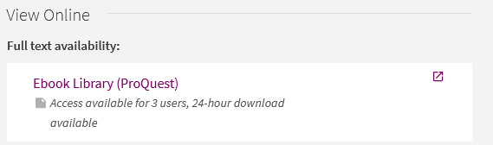
Books
Library Academic Support Team
online holdings
What is available from where?
Information about, e.g. how many people can read an online book at the same time.

Slide 12
Library Academic Support Team
Access to Online Collection
University login for the majority of online resources.
[ VPN – access to University network + wireless access
www.ed.ac.uk/is/vpn
A very few resources may need IP address recognition for access and VPN is the way to do this.
VPN’s main purpose is access to personal drives on the University network (not Sharepoint). ]

Slide 13

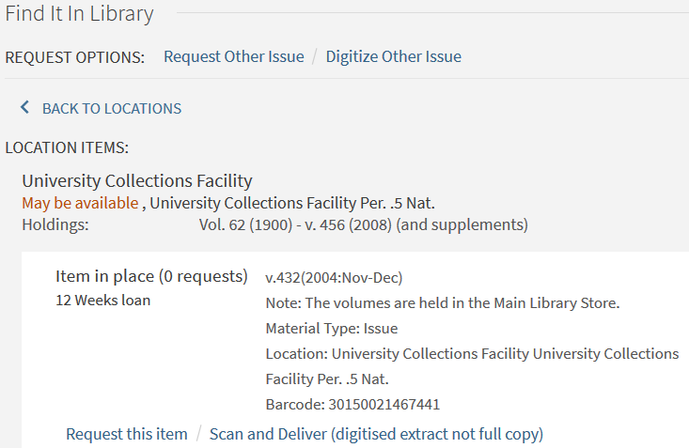

Journals
Library Academic Support Team
print holdings
Digitize Other Issue /
Scan and Deliver
– for a scan of an article.
edin.ac/scan-and-deliver
Request this item /
Request Other Issue
- for whole physical volumes / issues.
Sign-in to DiscoverEd

Slide 14
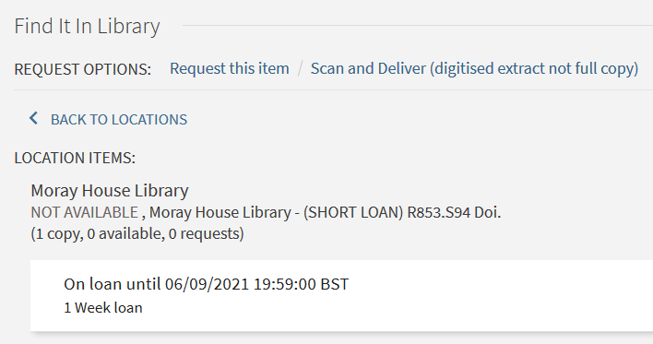
Books
Library Academic Support Team
print holdings
Sign-in to DiscoverEd to be offered:
Request this item
Early return for you to borrow next
Have books transferred from outlying libraries to a Central Area library (and vice versa) for you to collect. [Most of the libraries are Central Area ones]
Scan and Deliver
A scan of a book chapter.
Before heading off to a library to borrow a book, look to see how many of the copies bought are available to borrow.

Slide 15
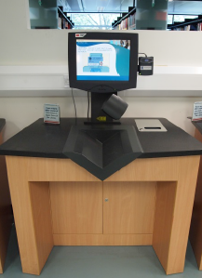


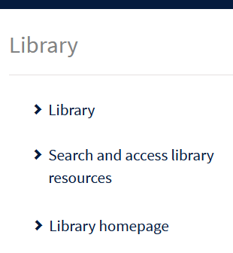
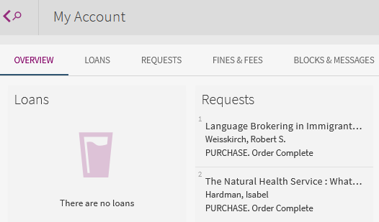
Borrowing
Library Academic Support Team
edin.ac/library-borrowing
    Self-issue and self-return machines
    Use the Library barcode part of your University swipecard, or its chip.
    MyEd’s Library or DiscoverEd (Sign in) My Account
    What you have borrowed.
    When items should be returned.
    Requests you have made.

Slide 16
Borrowing
Library Academic Support Team
edin.ac/library-borrowing
    Borrowing allowance: 100 for all staff & students
    (includes up to 10 RESERVE loans)
(STANDARD) loan | 4 weeks – undergraduates 12 weeks – postgraduates & staff
(SHORT) loan | 1 week
automatically renewed* for 36 months
(RESERVE) loan | up to 3 hours or overnight - cannot be renewed
Laptops | 7 days - automatically renewed for 28 days edin.ac/borrowing-laptops
*No renewal if: Requested books/items | The fines on your library account are over £20

Slide 17
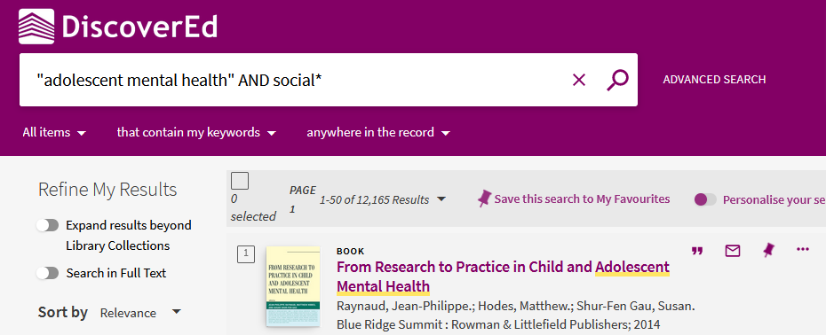
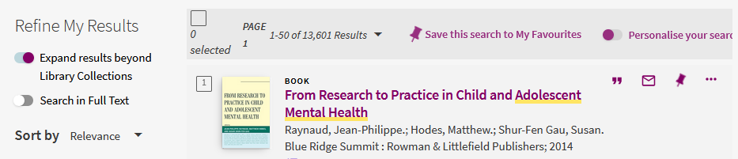
Databases for Reviewing the Literature
Library Academic Support Team
DiscoverEd includes article level records (but books pushed to the top).
Default setting is to what you can read because the library has bought it.

Slide 18
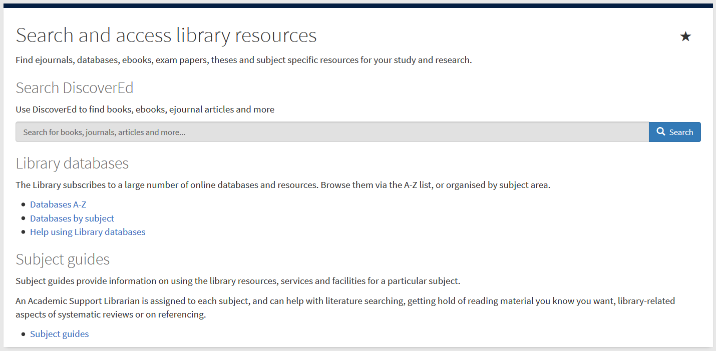
Abstracting & Indexing databases for reviewing the literature
Library Academic Support Team
Useful because they:
Include material not found in DiscoverEd or Google Scholar.
Details of millions of articles from 1000s of publications
Are usually subject specific.
Databases by subject
Library Subject Guides, including Systematic Review Searching (for Clinical Psychology) where there are short demos
https://edinburgh-uk.libguides.com/clinical-psychology/sysrevslides

Slide 19

Library Academic Support Team
Inter-Library Loan (I.L.L.) service
For when The Library does not have what you want at all
Scan of part (article, chapter etc) to keep, or
Physical items to borrow
edin.ac/inter-library-loans
Free per year (after which £5 per request received):
5 for undergraduates
30 for postgraduates and staff
2 renewals which are done via Helpdesk or I.L.L. staff.

Slide 20
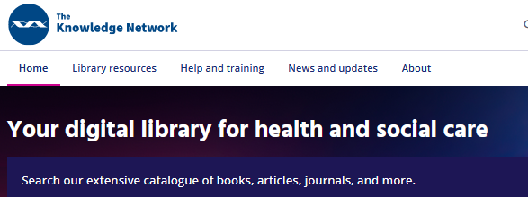

Suggest the (UoEd) Library buys a book to add to stock
Library Academic Support Team
Consider registering for NHS Education for Scotland’s Knowledge Network if you are eligible
www.knowledge.scot.nhs.uk
Books:
edin.ac/RAB
Do not use this instead of the inter-library loan service.
Use it as well.

Slide 21


Reference management software
Library Academic Support Team
Useful because they let you:
Keep and group details of papers etc you have used, or read or plan on reading.
“Cite while you write” – automatically create in-text citations and reference lists in a variety of bibliographic/citation styles, including Harvard and APA.
Attach files (eg full-text pdfs of articles).
To help you decide which reference management products to use:
Bibliographic management tools - comparison table (pdf)
Choosing a Reference Manager documents on Sharepoint
EndNote desktop is installed on the University’s Open Access computers. It is also free to download by members of the University but you must use Software Services’ forms: EndNote desktop free download
For a systematic review, Covidence is useful for de-duplicating and screening records:
Register for Covidence under the University subscription

Slide 22
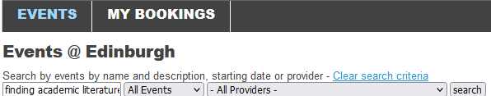



Library Academic Support Team
Training for anyone
www.events.ed.ac.uk
Digital Skills and Training www.ed.ac.uk/is/skills
Institute for Academic Development www.ed.ac.uk/iad
Librarian consultation (one-to-one session)
Autumn Dissertation and Thesis Festival, October.
Spring Dissertation and Thesis Festival, 24th – 28th February.
edin.ac/dissertation-festival
LibSmart – Auto-enrolled on course in Learn’s “Essentials” section
LibSmart I : Introduction to library resources and search strategies in a University of Edinburgh context.
LibSmart II : Subject specific modules, eg Literature Searching for Systematic Reviews.
edin.ac/libsmart
The Royal Literary Fund Fellowship (RLFF) scheme places professional writers in universities for consultation to foster good writing practice across all disciplines and media.
edin.ac/rlff

Slide 23


Library Academic Support Team
Contacting Information Services (IS)
EdHelp - IT, Finance, Library and Student Admin
www.ed.ac.uk/edhelp
Staffed EdHelpdesk in each centrally run library
I am happy to see people individually or in small groups, or be asked questions directly:
rowena.stewart@ed.ac.uk

