Slide 1
Library Academic Support
Helping you get the best from the Library, its collections, resources and services
Finding Research Literature
Angela.Nicholson@ed.ac.uk
http://www.docs.is.ed.ac.uk/docs/Libraries/Presentations/GeoPGT.pptx
Notes:
http://www.docs.is.ed.ac.uk/docs/Libraries/Presentations/GeoPGT.pptx

Slide 2
Aims
This session will cover how to effectively search and find academic literature and introduce you to:
Library resources and services
Constructing a search strategy
Applying a search strategy to academic literature database searching
Organising and using results.
Notes:
The aim of this presentation is to give an overview of the Library collection and services and how you may use them in you research.
Here are the topics we’ll cover
- Library resources and services
- Constructing a search strategy
- Applying a search strategy to academic literature database searching.
- Organising and using results.
The format will be a slide presentation followed by a demo.
Is there anything in particular you hope to find out more about today? If there is do please say either through chat or voice.

Slide 3
Library resources and services
Notes:
First an overview of the Library’s collection and services.

Slide 4
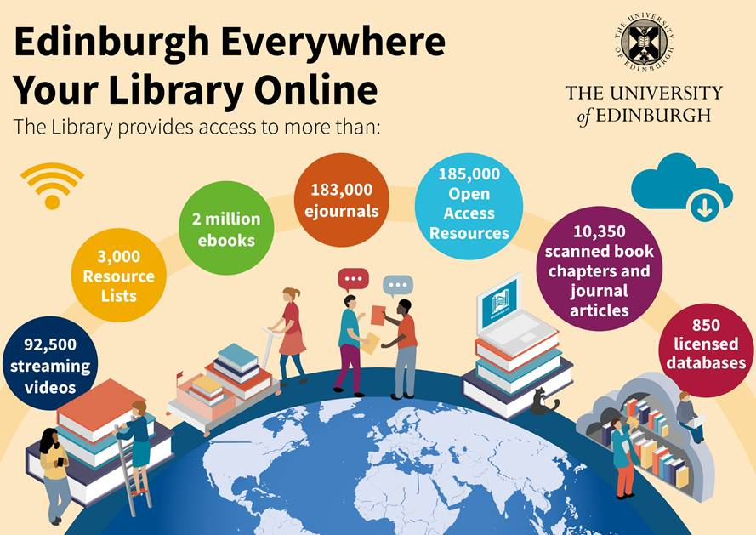
Notes:
The Library has had an e-preference policy for a number of years so there is a large online collection available.
We also welcome your requests for material to add to the collection. Indeed you are more likely to notice the latest publication in your field of research.

Slide 5
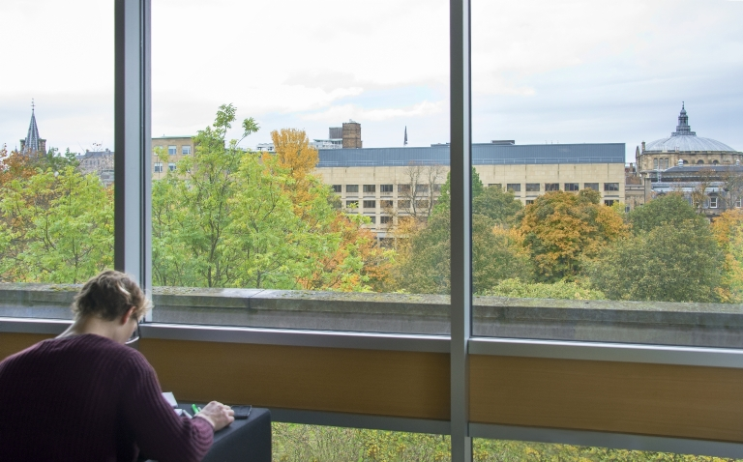
Notes:
In you are in Edinburgh, there are a number of University library buildings and you are welcome to use any of them. In addition to print collections there is study space, computers labs and printers, including A0 conference size.
Also a maker space in the Main Library https://www.ucreatestudio.is.ed.ac.uk/

Slide 6
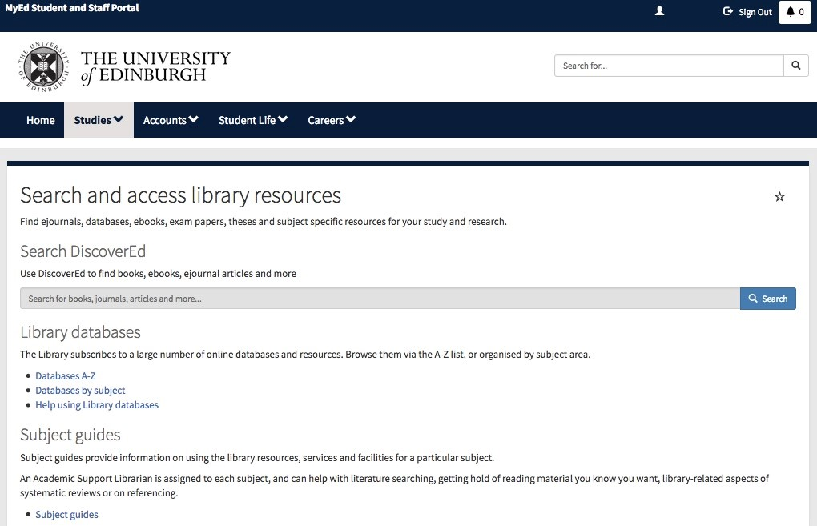
www.myed.ed.ac.uk
Notes:
You can access the Library’s online via MyEd or the Library webpage. MyEd includes the most used links, including a link to the Library webpage with more information if you need it.
When you access online material it is important to go via the Library systems for seamless access, particularly when you are off-campus. This avoids being asked to pay for something the Library already has.
Links.
www.myed.ed.ac.uk
www.ed.ac.uk/library

Slide 7
Finding Academic Literature: searching and sources

Slide 8
Academic Literature and sources
Academic books
Academic journals
Conference proceedings
Available via DiscoverEd https://discovered.ed.ac.uk
Subject databases https://edinburgh-uk.libguides.com/geosciences
Notes:
Let’s look at the type or resources you might use for your research and where you can find them.
First let’s look at academic literature such as books, handbooks and journal articles.
These are written by academics, researchers or professionals in their field.
They focus on a topic, and will cite their sources.
They are often reviewed by experts before they are published (peer review).
This type of material are indexed and searchable via the Library Discovery system, DiscoverEd. Also via subject specific databases - more on that later. Also via Google Scholar.

Slide 9
Academic Literature and sources
News & media – search multiple newspaper sources : Factiva, Nexis
Business Data - company, financial and market data.
Economic and social data
Geospatial – Digimap
Available via the University
Not all available via DiscoverEd
If you can’t find something you need, please get in-touch.
Notes:
There are other sources you can also access via the Library. I’ve listed some that may be of interest on this slides.
The content of these is, in general not searchable via DiscoverEd but are available via the Library database pages.
You may have notice it is possible to search newspaper material via DiscoverEd. However if these are the focus of your work it would be worth looking at the range of newspaper databases that are available as the they offer advantages in term of coverage and advanced search options.
News & media
http://edinburgh-uk.libguides.com/newspapers-magazines
Business Data
http://edinburgh-uk.libguides.com/business
Economic and social data https://www.ed.ac.uk/information-services/research-support/research-data-service/during/discover-and-re-use-data
Geospatial http://digimap.edina.ac.uk/
If you can’t find something you need, please get in-touch.

Slide 10
Web sources
Research reports
Professional literature
Guidelines/Regulations
Government agencies/NGOs
May be influenced by the interest of the organisation – read critically
Not all available via DiscoverEd
Visit directly or via a web search
More : grey literature
Notes:
There are also sources you will want to include that are not consider academic literature but are relevant to your research.
These could be from professional bodies, governments or non governmental agencies.
You can go to the organisation website. Google Advanced search is often helpful when searching for this type of material.

Slide 11
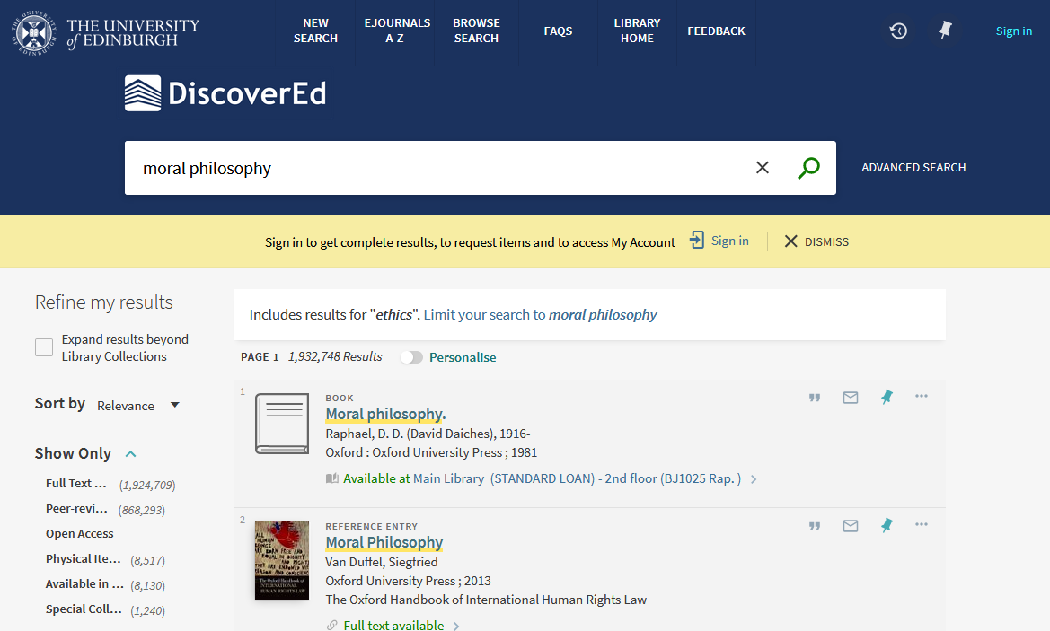
DiscoverEd https://discovered.ed.ac.uk/
Explore!
Sign in here!
For more complex searching
refine your search
Various search results management options
Notes:
DiscoverEd is the Library’s discovery tool. It allow to search across the print and a large selection of the online resources.
Sign in first. Some subscription resources can only be searched on or off campus when signed in.
Use the facets, on the left hand side, to refine down your search results. DiscoverEd is a different way of searching – if using the simple search you’ll rarely come up with a single result.
Choose Advanced Search if you want to search for known items by title or author, or to use Boolean searching
You can search for books using keywords from a title and an author’s surname, If you don’t have this information use the information you do have.
When you sign in to into your Library Account using your University Login it allow you to manage your loans, save searches, request scans from print material and more.

Slide 12
www.myed.ed.ac.uk
Notes:
This a reminder that MyEd is a useful place to get links to Discovered and to other databases.

Slide 13
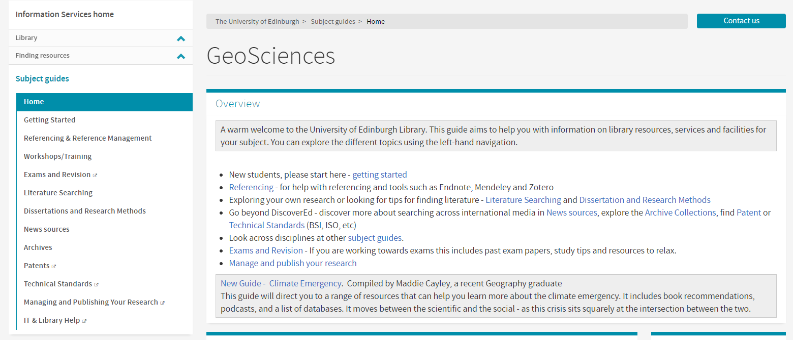
https://edinburgh-uk.libguides.com/geosciences
Notes:
Geosciences subject guide is available via MyEd or from Learn ‘Library Resources’

Slide 14
Finding Academic Literature: literature review
Notes:
Let’s now look at how you might search for academic literature for you research or if conducting a literature review.

Slide 15
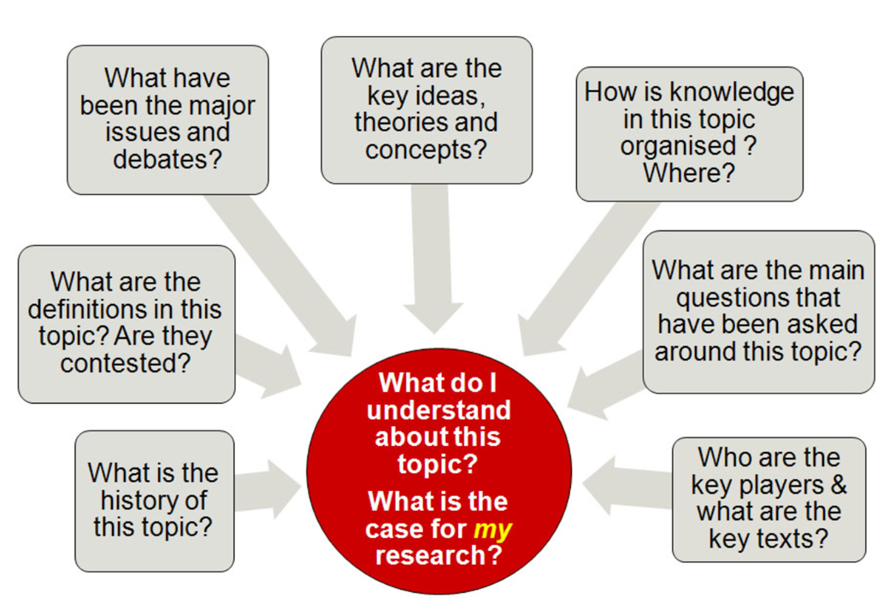
Mewburn, I., Hacking the Literature Review. RMIT University. Accessed online Sep2012 URL: https://docs.google.com/presentation/d/1r_sIg1SFMoIh3E26-dg3aSR5xRap91iDkaijNVdx4Ds/edit?pli=1#slide=id.p
Notes:
Let’s think about some of the question you may want to answer.
It doesn’t have to be everything that has ever been published on a topic.

Slide 16
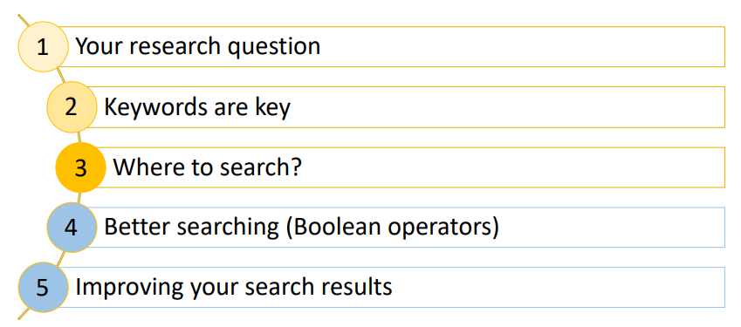
Notes:
Let’s think about some of the question you may want to answer.
It doesn’t have to be everything that has ever been published on a topic.

Slide 17
Getting started
1. Frame your research as a question
This can help clarify what you want to find out and help you achieve.
2. Key words
Identify the principal concepts
These will form the keywords for your search
Expand your search terms by considering
Synonyms, related terms, antonyms, homonyms
Variant terminology: farmers markets (UK) & greenmarkets (US)
Variant spelling: behaviour(UK), behavior (US); paediatric (UK), padiatric (US)
Apply search limits for greater focus and relevance
e.g. date, language, geography, methodology?
Notes:
A good research question will provide a good framework from which to extract your key search terms and give you focus when retrieving and evaluating information.
Expanding your search terms and considering variation in terminology and spelling very important if your search is to retrieve all relevant information.

Slide 18
Framing your research question
Which antihypertensives are safest in treating hypertension during pregnancy or childbirth?
Major subjects | antihypertensives | hypertension | pregnancy or childbirth
Alternative spellings related terms synonyms | anti-hypertensive(s) beta blockers specific drug names | high blood pressure toxemia preeclampsia PIH | Parturition Birth Labour/ labor

Slide 19
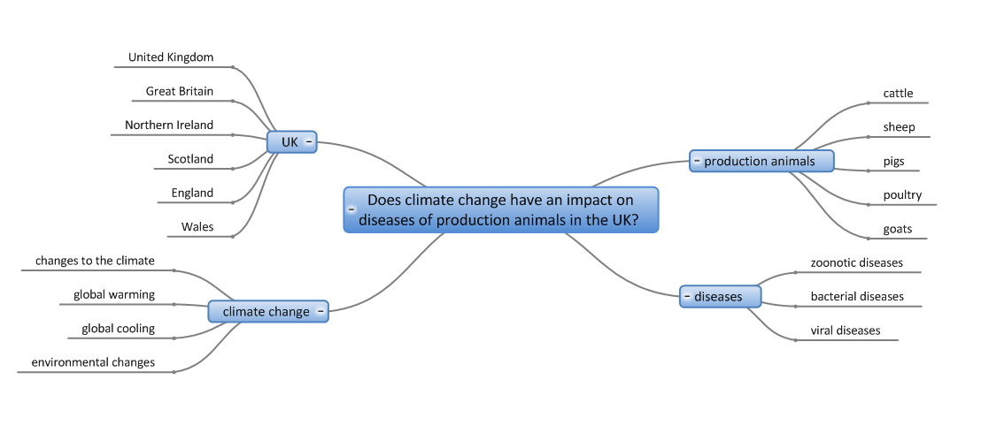
Framing your research question
Notes:
(Mind Genius)

Slide 20
Some ways to improve your search
Use AND to find records containing all of your search terms
Use OR to find records containing any of your search terms
Use NOT to exclude records containing certain words from your search
Use NEAR/n to find records containing all terms within a certain number of words (n) of each other e.g. respiratory NEAR/3 diseas*

Slide 21
Some more ways to improve your search
Truncation: allows you to search for variations
* zero to many characters *carbon* for carbon, hydrocarbon, polycarbonate
? One character organi?ation
$ zero or one character
Phrase: rather that individual words - helps retrieve more relevant results
“woodland expansion”
These techniques can help but at the start, keep it simple.
Notes:
21
21
In addition to Boolean terms there are more options that may also help your search.
There are other which you want to use and each of the subject databases will give more information
e.g. NEAR ADJ

Slide 22
Framing your research question What is the effect on classroom behaviour of young adults diagnosed with ADHD?
“attention deficit hyperactivity disorder” OR Hyperkinesis OR ADHD
Adolescent* OR teenager* OR “high school pupil*”
Behaviours OR Behavior OR
“disrupti*
What is the effect on classroom behaviour of young adults diagnosed with ADHD?
ADHD | Young Adult | Behaviour
“Attention deficit hyperactivity disorder” | Adolescent | Behaviours
Hyperkinesis | Teenager* | Behavior
ADHD | “high school pupil*” | Disrupti*
AND
Trial & error may be required!
Some ‘translation’ may be needed when switching from one database to another
It’s important to explore all possible terms to address lack of consistency in the assignment of indexing terms.

Slide 23
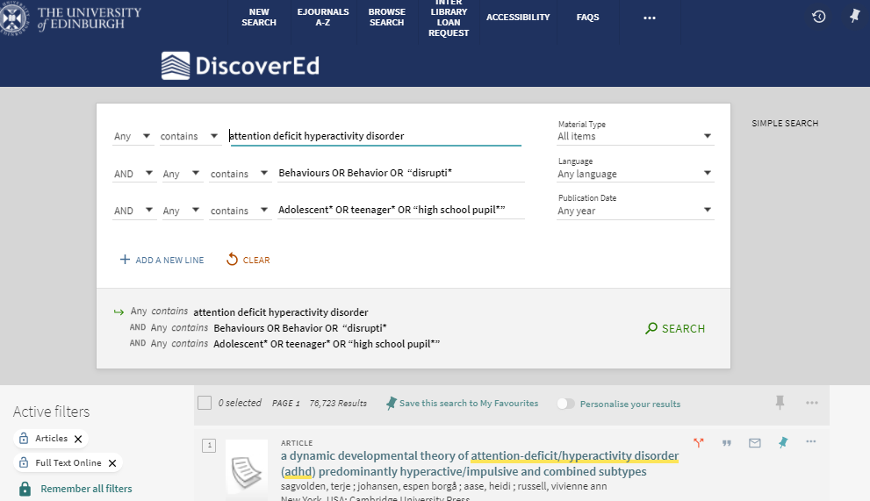

Slide 24
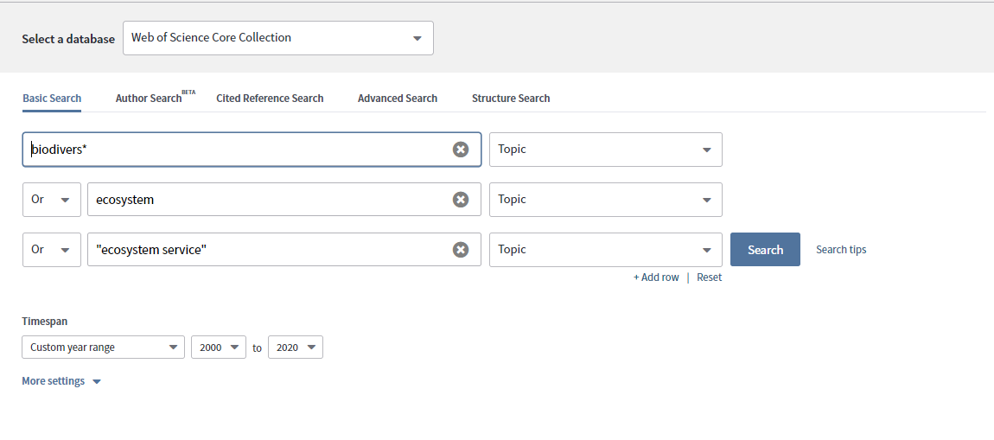

Slide 25
Changing your question
How useful is mindfulness for students experiencing exam stress?
mindfulness | students | exam | stress
mindful(ness) meditat(ion) | student(s) pupil(s) | exam(inations) test(s) | stress(ed) anxi(ety)
essential | Different populations experiencing exam stress may be comparable. | Stress of any kind experienced by students may be useful. | essential

Slide 26
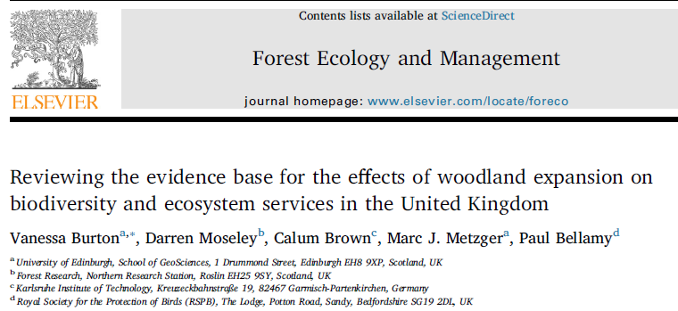
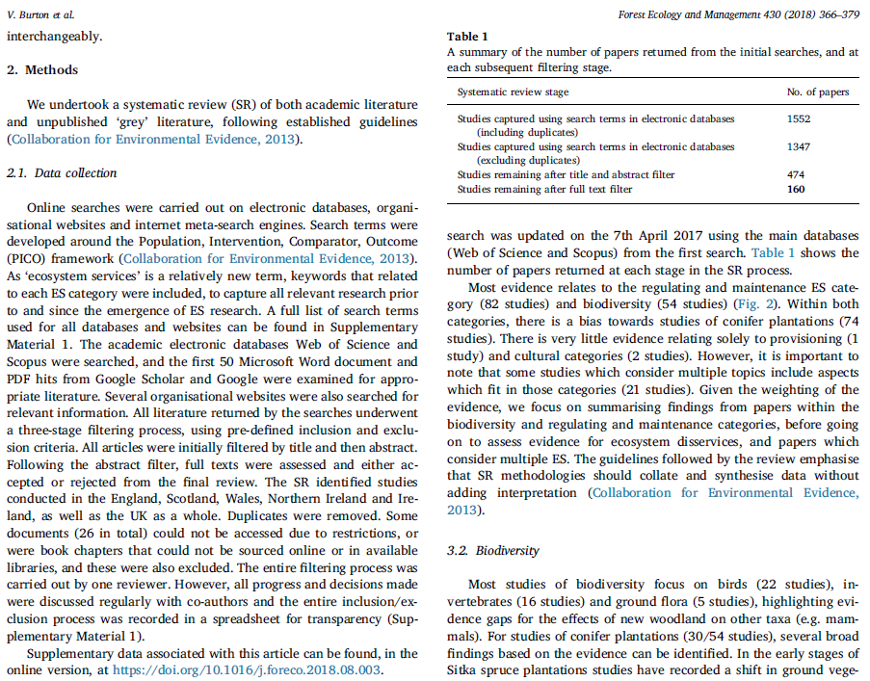
Published example
Frameworks
Population, Problem, Intervention, Comparison, Outcome, Study Type/Time
More:
PICOS/T, PEO, PICo, SPIDER Frameworks (plus ECLIPSe and SPICE) (pdf)
Notes:
Look at some published examples
These are from systematic reviews – I do not expect any of you will be undertaken a formal systematic review.
I have chosen this types of work as examples because they have published details of the search strategy and search terms used.

Slide 27
Published example – search strategy
Database | Search Terms | Search Settings | Timespan
Web of Science | TS = ((woodland expansion OR "woodland restoration" OR "woodland planting" OR "forest expansion" OR "forest restoration" OR "afforestation" OR "woodland creation") AND (change* OR effect* OR impact* OR benefit* OR establish* OR succes* OR fail* OR increas* OR declin* OR neutral OR "no effect*" OR function* OR service* OR synerg* OR "trade-off*" OR provisioning OR supporting OR regulating OR cultural OR scale OR time) … | Refined to: Web of Science Core Collection and BIOSIS Collection. Region refined to UK, United Kingdom, England, Scotland, Wales, Ireland, North Ireland. Sorted by relevance | All years (1864-2016)
Burton, V. et al. (2018) ‘Reviewing the evidence base for the effects of woodland expansion on biodiversity and ecosystem services in the United Kingdom’, Forest Ecology and Management, 430, pp. 366–379. doi:10.1016/j.foreco.2018.08.003.

Slide 28
Published example – search strategy
Database | Search Terms
Web of Science | (TITLE-ABS-KEY (“urban green” OR “urban green space” OR “urban park”) AND TITLE-ABS-KEY(“quality of life” OR “recreation” OR “social cohesion” OR “social inclusion” OR “integration” OR “social value” OR “accessibility” OR “well-being” OR “human health” OR “perception”)).
Kabisch, N., Qureshi, S. and Haase, D. (2015) ‘Human–environment interactions in urban green spaces — A systematic review of contemporary issues and prospects for future research’, Environmental Impact Assessment Review, 50, pp. 25–34. doi:10.1016/j.eiar.2014.08.007.

Slide 29
Question: Review the evidence base for the effects of woodland expansion on biodiversity and ecosystem services in the United Kingdom
Keywords: woodland expansion, afforestation, biodiversity, species population, ecosystem landscape "ecosystem function" "ecosystem service"
Search:
(ecosytem OR biodiver* OR habitat*OR …
AND
(“woodland expansion "OR “woodland restoration” OR “woodland planting” OR …
Burton, V, Moseley, D, Brown, C, Metzger, M & Bellamy, P 2018, 'Reviewing the evidence base for the effects of woodland expansion on biodiversity and ecosystem services in the United Kingdom', Forest Ecology and Management, vol. 430, pp. 366-379. https://doi.org/10.1016/j.foreco.2018.08.003
Notes:
29
29

Slide 30
Question: Human–environment interactions in urban green spaces — A systematic review of contemporary issues and prospects for future research’,
Keywords: Urban green space, urban green, social value, social inclusion, recreation,
Search:
(urban green” OR “urban green space” OR “urban park”)
AND
(“quality of life” OR “recreation” OR “social cohesion” OR “social inclusion” OR “integration” OR “social value” OR “accessibility” OR “well-being” OR “human health” OR “perception”)).
Kabisch, N., Qureshi, S. and Haase, D. (2015) ‘Human–environment interactions in urban green spaces — A systematic review of contemporary issues and prospects for future research’, Environmental Impact Assessment Review, 50, pp. 25–34. doi:10.1016/j.eiar.2014.08.007.
Notes:
30
30

Slide 31
A recommended article can be a good place to start
Use the search terms you’ve planned and be methodical

Slide 32
Published example – search strategies
Google Scholar | With the exact phrase: "woodland expansion" afforestation. With any of the words: biodiversity species population community habitat ecosystem landscape "ecosystem function" "ecosystem service" | Advanced search. Sorted by relevance | Any time
Forest Commisson (publications) - no specific search available for FR | 3 separate searches: woodland expansion, biodiversity (returned 2) and woodland expansion, ecosystem services (returned 0) and just woodland expansion (returned 8) | Advanced search. All of the words. | Any time
Scottish Natural Heritage | woodland expansion | No advanced options for sorting in any way, basic search | Any time
The Woodland Trust | woodland creation | Filtered to document
RSPB | Manual search through document library section | Topic: forestry, all years, anywhere.
Burton, V, Moseley, D, Brown, C, Metzger, M & Bellamy, P 2018, 'Reviewing the evidence base for the effects of woodland expansion on biodiversity and ecosystem services in the United Kingdom', Forest Ecology and Management, vol. 430, pp. 366-379. https://doi.org/10.1016/j.foreco.2018.08.003
Notes:
Search included ‘grey literature’ that although not academic literature it is relevant to the research question.

Slide 33
Bibliographic databases
Can find articles and full-text not found via DiscoverEd or Google Scholar
Search details of millions of articles to find what publications exist about a topic - even if not held in our library
Can be subject specific – although you may need to use more than one
Can use sophisticated searches
Can create alerts to new publications that match your search
Subject Guides will provide more https://edinburgh-uk.libguides.com/geosciences

Slide 34
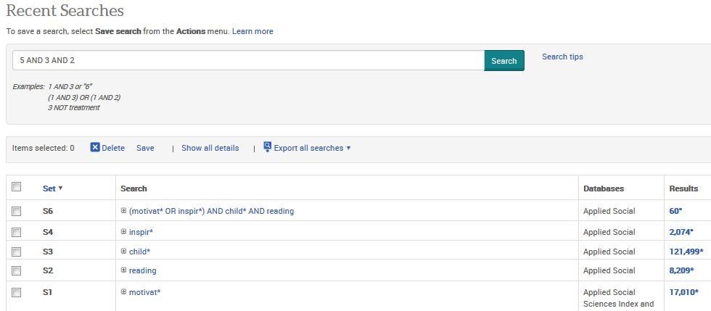
Search History
Let’s you:
Think one concept at a time.
See the difference (in result numbers) combining makes.
Know the limiting concept(s) (lowest result number).
Add another concept easily.

Slide 35
Keeping up to date
Email alerts of relevant results from bibliographic databases
Saved searches to re-run on bibliographic databases
Table of Contents alerts from journal publisher sites

Slide 36
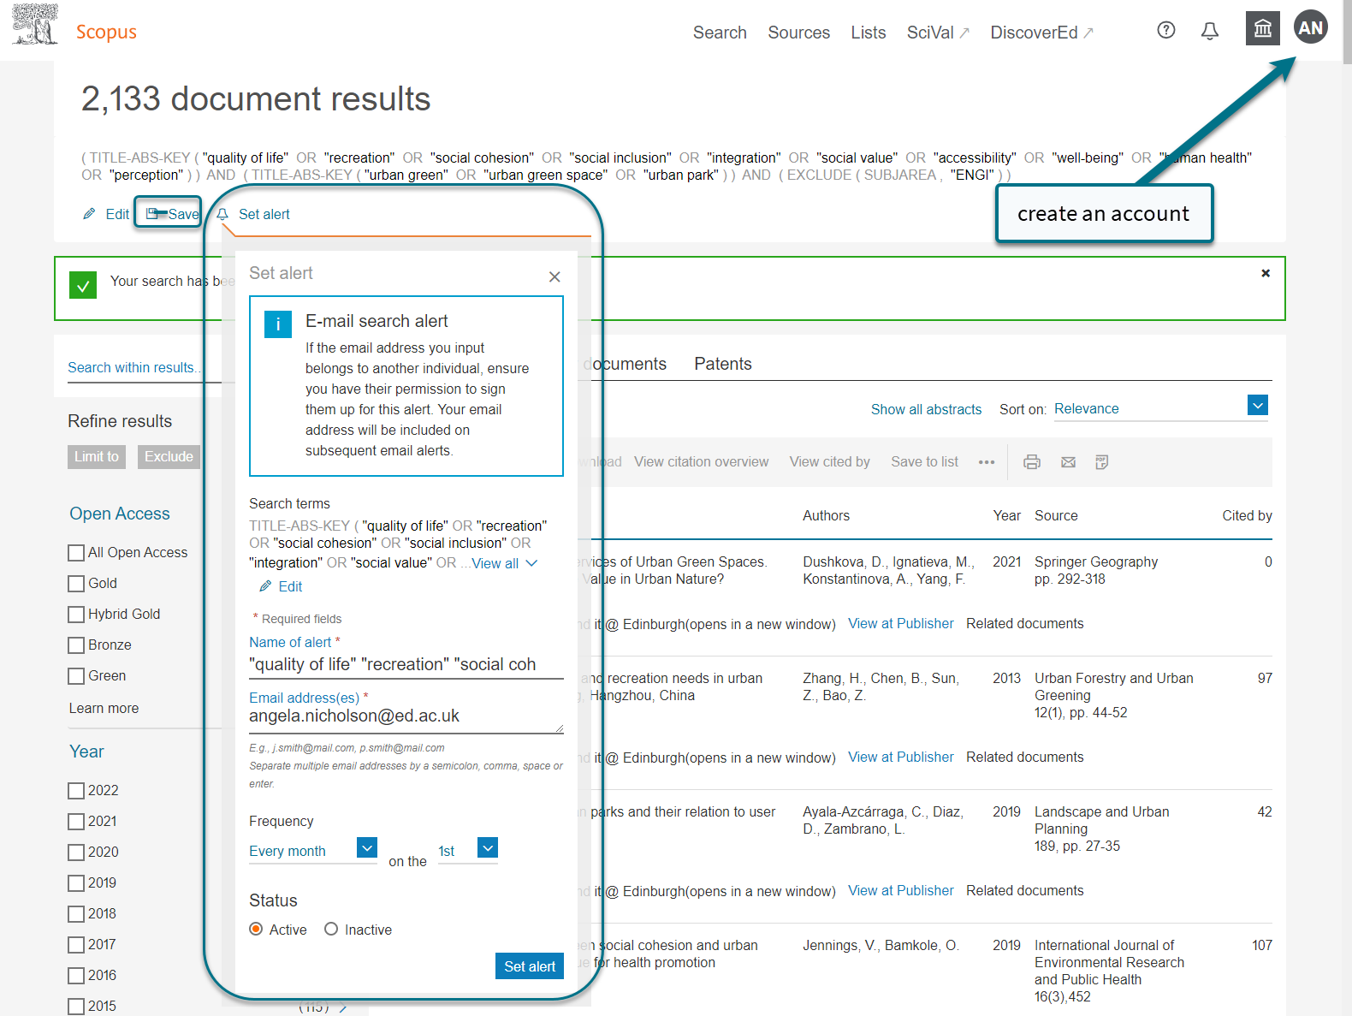
Notes:
Create an alert to be notified of new articles published that match your search.

Slide 37
What if we don’t have what you need?
Document Delivery (Inter-Library Loans) www.ed.ac.uk/is/ILL
You can request books, scans of book chapters or journal articles not held in UoE Library.
https://www.ed.ac.uk/files/atoms/files/guide_for_requesting_interlibrary_loans.pdf
Scan & Deliver
Request a Book www.ed.ac.uk/is/rab
Suggest new purchases for the Library.
Journal subscription etc
Contact your Academic Support Librarian – via EdHelp or directly.
Notes:
If the library doesn’t subscribe to a journal with an article you need, or we don’t have a book chapter you need, then you can use the ILL service to request a scan from other libraries, with which we have reciprocal arrangements.
If you are an online student do add this information to your request to let the teams know that you need things delivered online.
As a postgraduate student, you can request 30 interlibrary scans per academic year from libraries external to the University of Edinburgh free of charge.
Another thing you can do if we don’t have a book you need, is to recommend that we buy it for the Library.
You can find links to recommend a book purchase from MyEd or the Library website – just fill in the details of the book you need and submit the request.
By default, we’ll try to buy an electronic version of the book, but if it’s only available in print, we’ll try to get the print.

Slide 38
Managing literature
Notes:
First an overview of the Library’s collection and services.

Slide 39
Managing your references
Reference management software can save you time
Use it to construct and manage a library of references
Automatically add citation and build bibliographies in Word
Share libraries
Endnote, Mendeley, Zotero (all free)
Comparison Table: http://www.docs.is.ed.ac.uk/mvm/BiblioManagersTable.pdf
More information: https://edinburgh-uk.libguides.com/referencing

Slide 40
Dissertations and Theses
Theses databases: find theses on your subject worldwide
Edinburgh Research Archive (ERA): University of Edinburgh theses full-text online
Edinburgh Theses: find University of Edinburgh theses from any year
British Library EThOS: UK’s national thesis service
"This is the real me (3)" by ChocolatEClairable licensed under CC BY 2.0

Slide 41
SAGE Research Methods https://discovered.ed.ac.uk/permalink/44UOE_INST/7g3mt6/alma9922808783502466
Notes:
SAGE research methods supports every step of a research project, from writing a research question, with information on the full range of qualitative, quantitative, and mixed methods.
Of most use to those working in the sciences, social sciences, business and technology disciplines, though offers some useful research ‘tools’ e.g. project planner that will be appropriate to all.
Improve your research skills with SAGE Research Methods https://media.ed.ac.uk/media/1_ul6hpfk5 (webinar recording)
https://discovered.ed.ac.uk/permalink/44UOE_INST/7g3mt6/alma9922808783502466

Slide 42
Help is always available
EdHelp
www.ed.ac.uk/edhelp
Angela.Nicholson@ed.ac.uk Academic Support Librarian
www.ed.ac.uk/is/asl
Notes:
There is always help available, in person and online.
Each library has a helpdesk and you can email or phone the IS Helpline with library or IT questions. There is also a wide range of information on the Library and Information Services web pages.

Slide 43
Thank you

