Slide 1
Library Academic Support
Helping you get the best from the Library, its collections, resources and services
Introduction to Reference Management Software
Ishbel Leggat, Angela Nicholson Library Academic Support www.ed.ac.uk/is/asl
Notes:
Hello and welcome to this session ‘Introduction to Reference Management Software’
We will focus mostly on Endnote but will also mention other tools along the way.
My name is Angela and I am joined by Ishbel and we are both Academic Support Librarians.

Slide 2
Learning outcomes and objectives
By the end of this session, you should be able to:
Add records to reference management software manually and directly from literature databases
Inserting citations and reference lists in Word
Changing the formats of citations and reference lists
Notes:
The Learning outcomes and objectives today are:
By the end of this session, you should be able to:
Add records to reference management software manually and directly from literature databases
Inserting citations and reference lists in Word
Changing the formats of citations and reference lists

Slide 3
Referencing
Good academic practice
IAD’s Good Academic Practice website: www.ed.ac.uk/schools-departments/institute-academicdevelopment/undergraduate/good-practice/referencing
Cite Them Right Online
Referencing Subject Guide: www.ed.ac.uk/is/subject-guides-referencing
Reference management tools, such as Endnote, support good practice. They can also save you time.
Notes:
Accurate referencing, or acknowledgement of the work you have consulted is important and here are a few links that you may find useful. Reference management tools, such as Endnote, can help support good practice and also save you time.

Slide 4
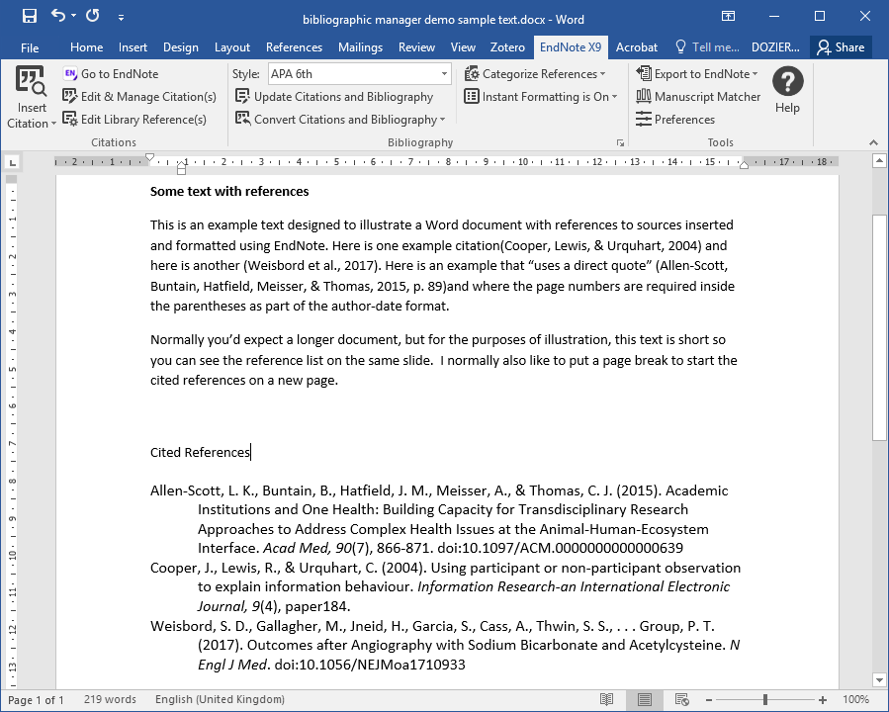
Example text with references
Notes:
This slide is an example of work which includes citations in the text with full details in the cited reference list.
In this example the style chosen is APA 6th but you may can choose a different style.

Slide 5
Why use reference management software?
Create collections of references that you can re-use in different projects
Import references automatically from sources
Add citations to Word
Share and collaborate with others
Notes:
Why use reference management software?
It allows you to create collections of references that you can re-use in different projects.
Import references automatically from different sources.
Add citations to Word documents.
Share and collaborate with others.

Slide 6
Which one?
Comparison http://www.docs.is.ed.ac.uk/mvm/BiblioManagersTable.pdf
Each available for Windows or Mac and at no cost
Notes:
Although we will focus on Endnote, there are other options and this link will take you to a table to help you compare them.

Slide 7
EndNote

Slide 8
Endnote
Endnote Desktop and Endnote Online.
Endnote online is more limited but only requires a web browser.
Endnote Desktop and Endnote Online can be synchronised (via Endnote account) so the same references are available in both.
Notes:
Endnote has a Desktop and Online version.
Endnote Desktop has full features and is download onto your computer or you can access it from open-access labs around the university.
Endnote Online is more limited but only requires a web browser to access it.
Endnote Desktop and Endnote Online can be synchronised (via an Endnote account) so the same references are available in both. Therefore you can access and work with your library from any computer.

Slide 9
Endnote
Pros | Cons
Full version available from the University | Desktop version only free when you are a student, but you can keep references in (free) Endnote Online, or transfer to other application
Supported by the University | Endnote Online has limited functions
Unlimited storage | Web browser ‘Capture’ limited
Edit formatting styles
Can have multiple libraries
Find full text
Preferred tool for systematic reviews
Notes:
Here are some pros and cons to mention. The main things to mention is that Endnote is available for free whist you are a student at the University. It is also supported by the University so you can request help if you have any problems.

Slide 10
Getting Started

Slide 11
Endnote – getting started
Available on-campus in open access labs
Personal copy https://edin.ac/2UQV5XE
Available from ‘Software Center’ for University managed computers
Full link: https://www.ed.ac.uk/information-services/computing/desktop-personal/software/main-software-deals/endnote
Notes:
Endnote is available on-campus in open access labs.
If you have a University managed computer, it is available from the ‘Software Center’
You can get a personal copy and the current link is shown here: https://edin.ac/2UQV5XE

Slide 12
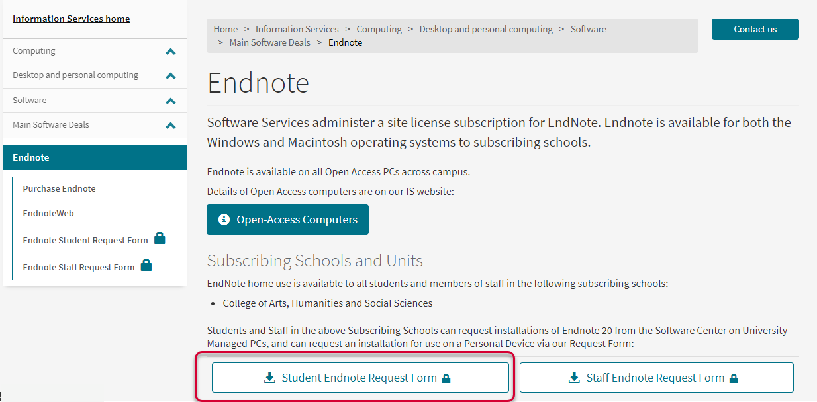
https://edin.ac/2UQV5XE
Notes:
https://www.ed.ac.uk/information-services/computing/desktop-personal/software/main-software-deals/endnote
Select the Request Form.

Slide 13
Adding Records to Endnote

Slide 14
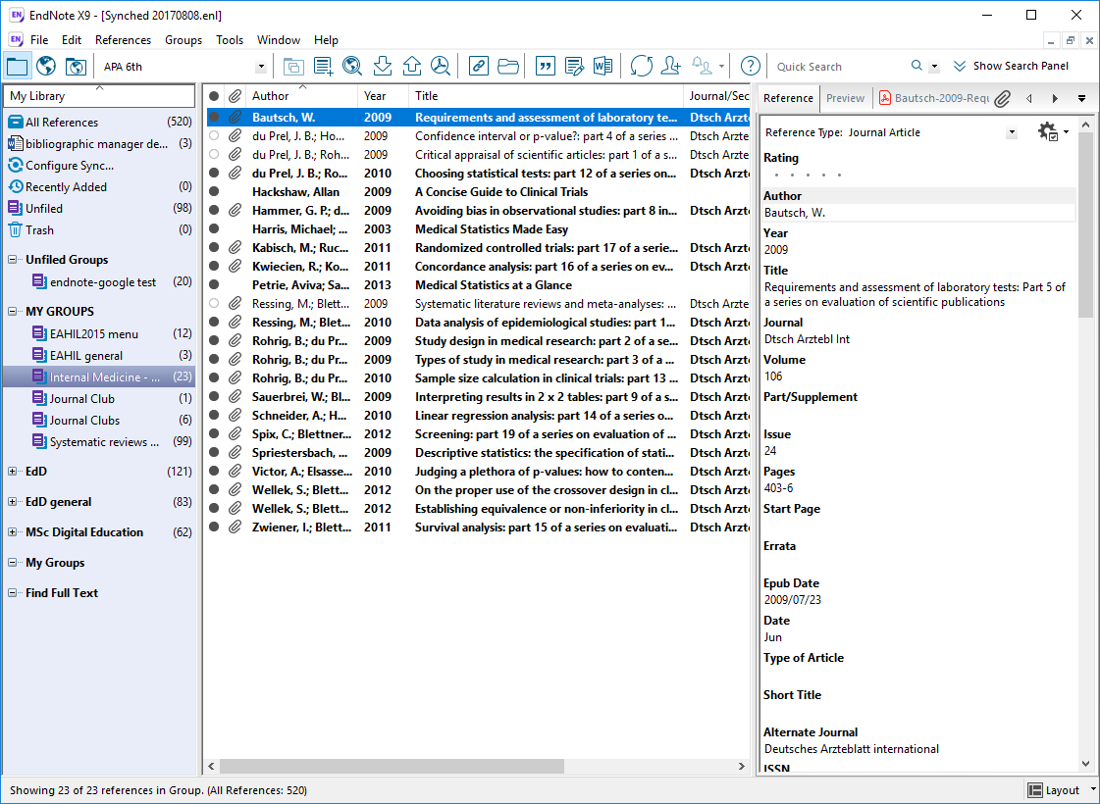
Notes:
This is what EndNote looks like when you first open it. There are no references at the moment, so we will first add some references.
There a number of ways to add references and I will demonstrate some of those that may be useful to you.
The first would be to add the reference manually.
Direct import from a reference source e.g. DiscoverEd; Google Scholar; database
Import PDF(s)

Slide 15
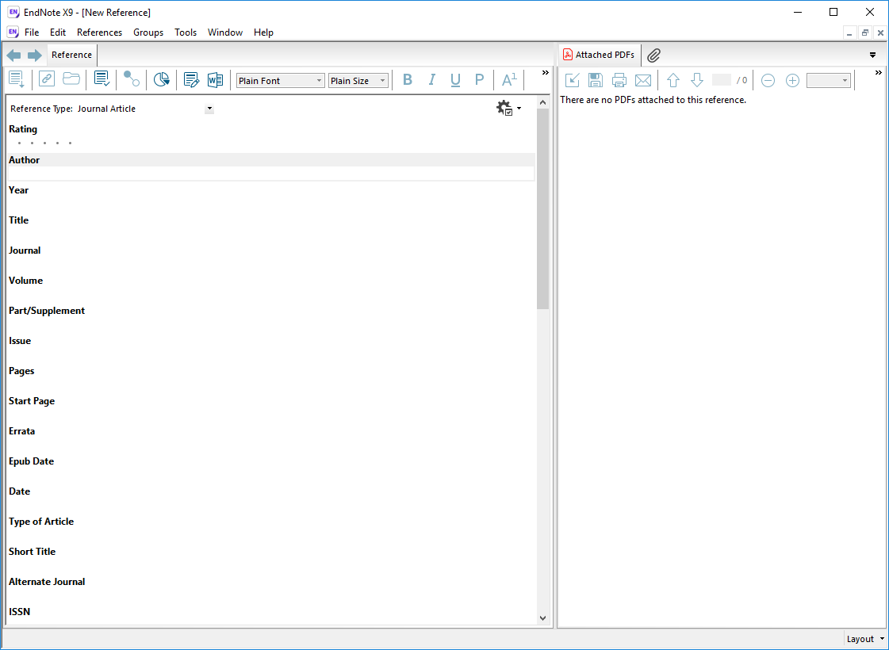
Adding records to EndNote manual entry

Slide 16
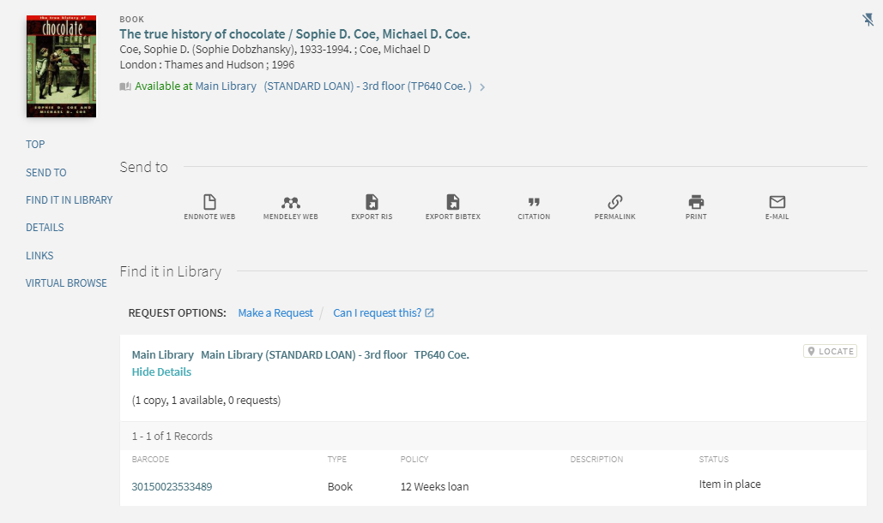
Adding records – ‘Export RIS’ for Export to Endnote (desktop)
Notes:
Adding records 2 – export from DiscoverED

Slide 17
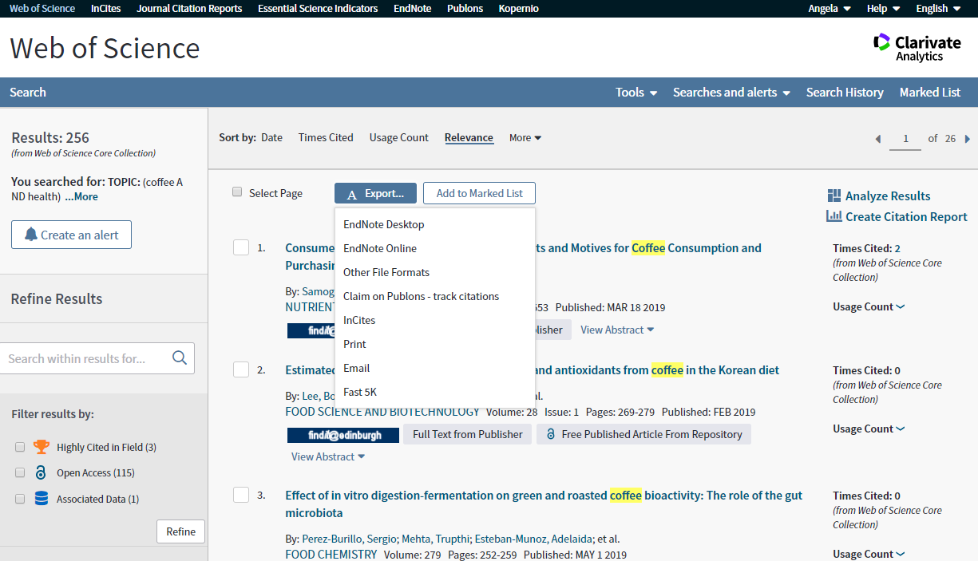
Adding records – export from Web of Science

Slide 18
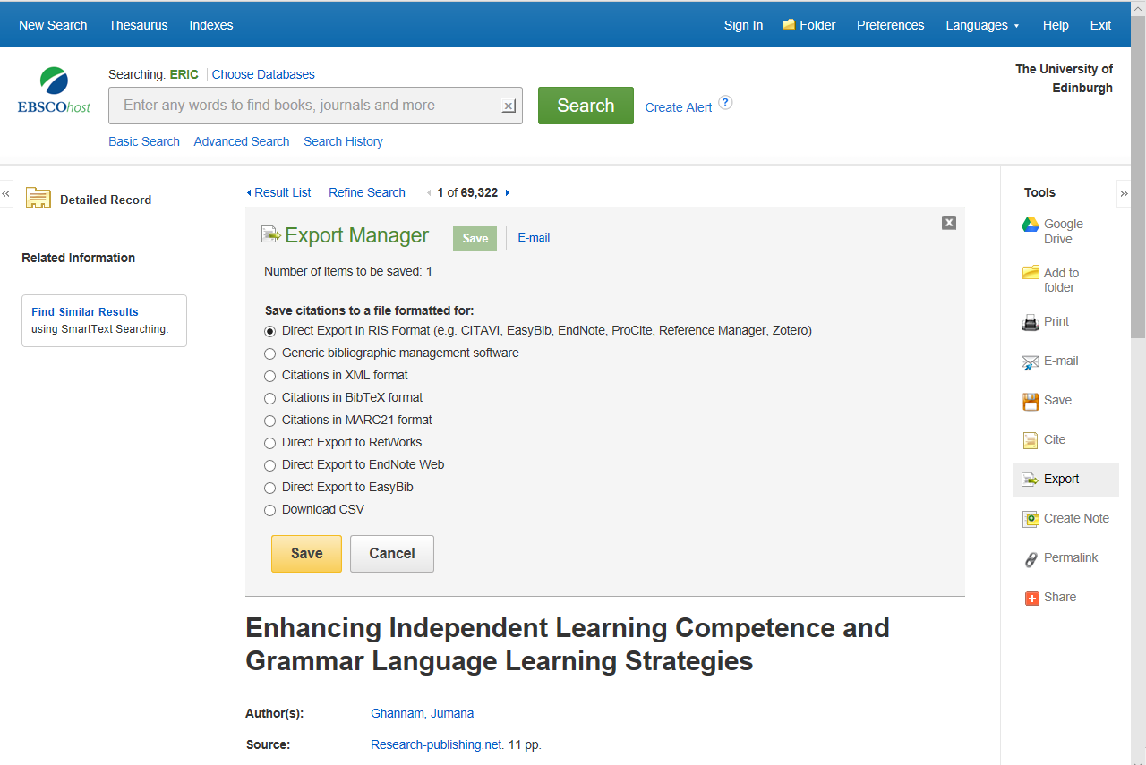

Slide 19
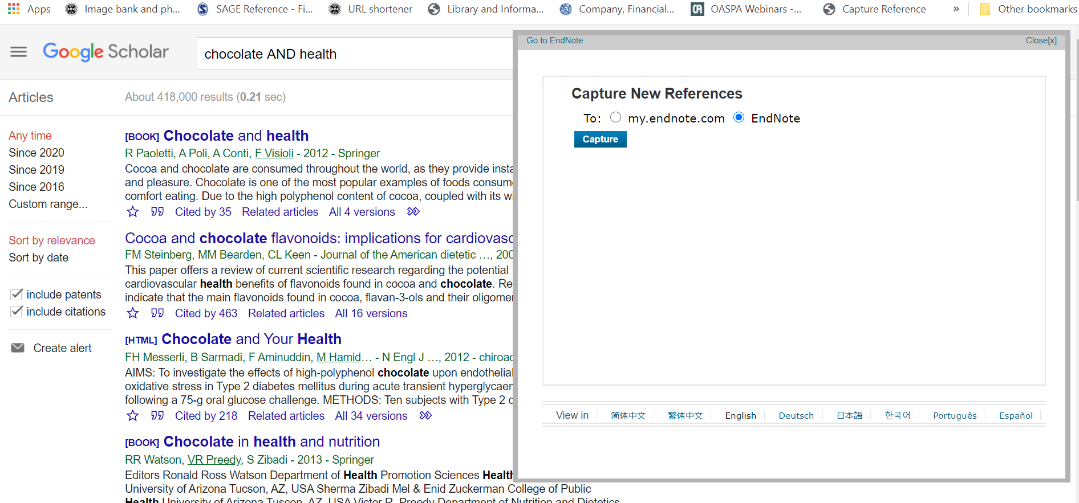
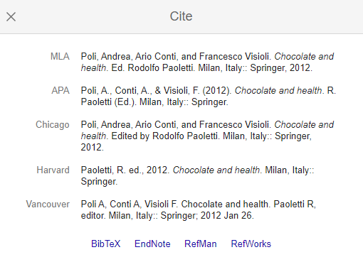
Adding records - via web capture
Notes:
How to add the Capture Tool is covered later (slide 36)

Slide 20
Demo

Slide 21
Creating citations in Word from Endnote

Slide 22
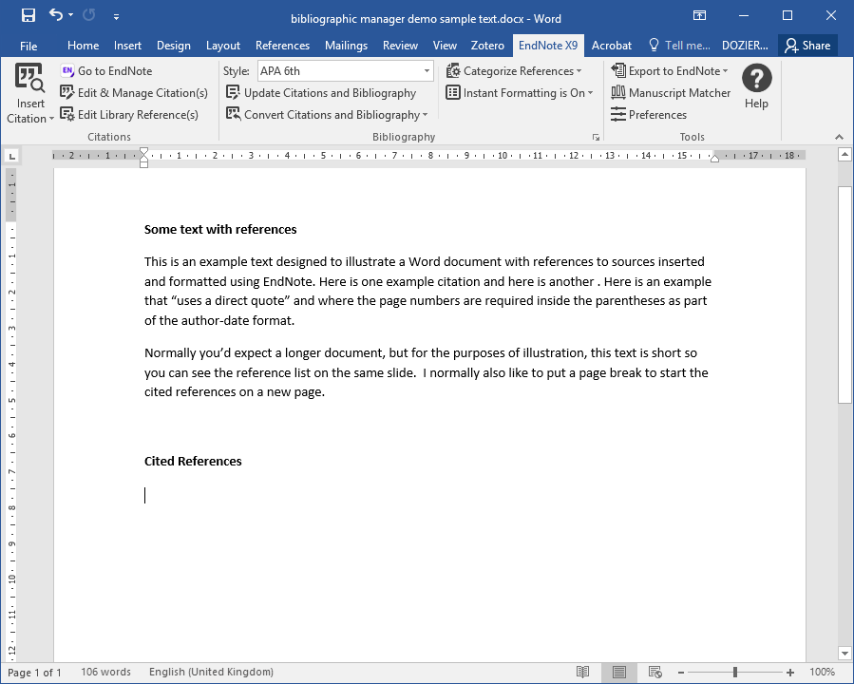
Endnote & Word *Requires the desktop version of Word.* Microsoft Office available via https://edin.ac/2iMeJSg

Slide 23
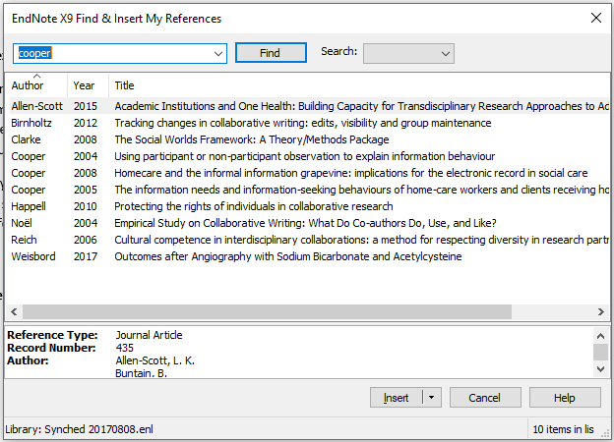
Endnote & Word

Slide 24
Why use EndNote? Example text with references

Slide 25
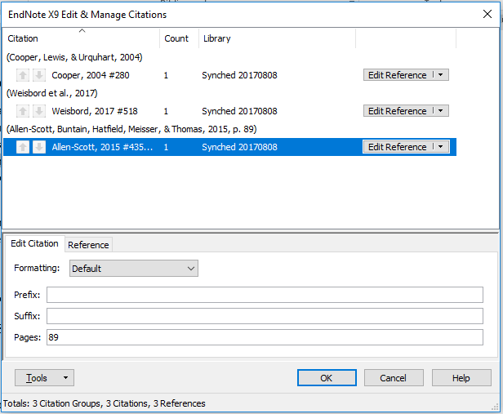
Why use EndNote? Example text with references

Slide 26
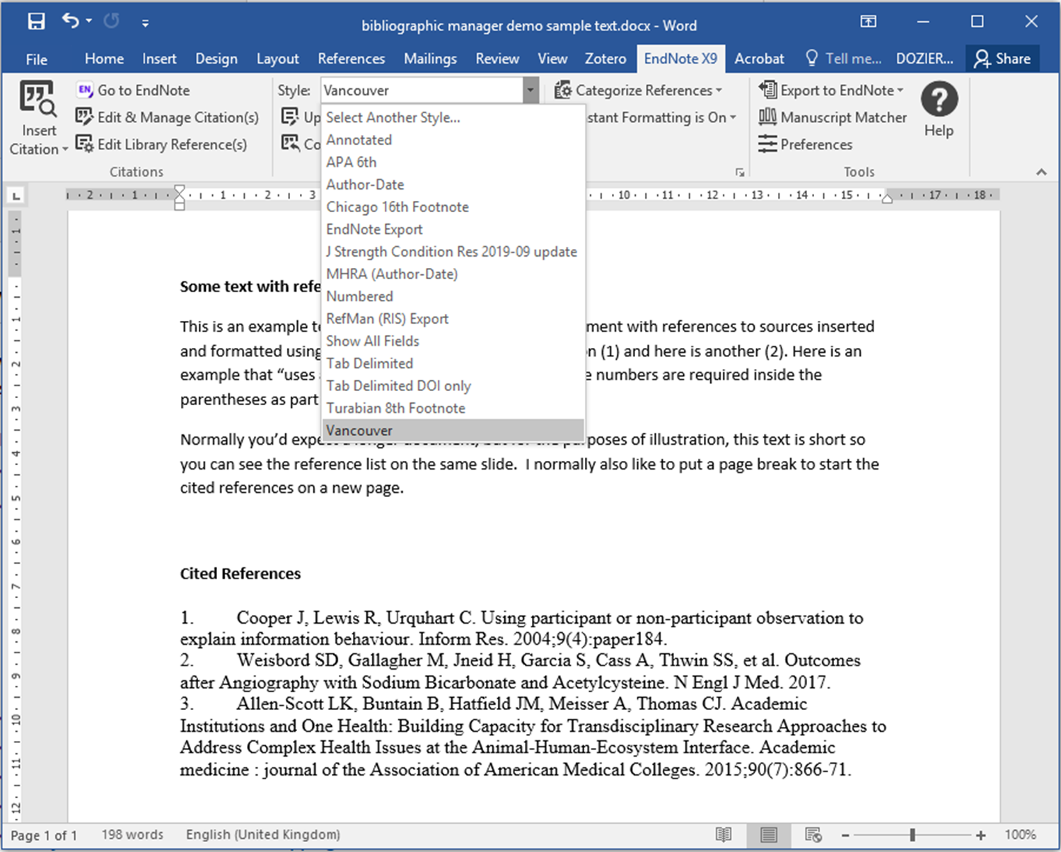
Style

Slide 27
Adding value – managing your literature sources

Slide 28
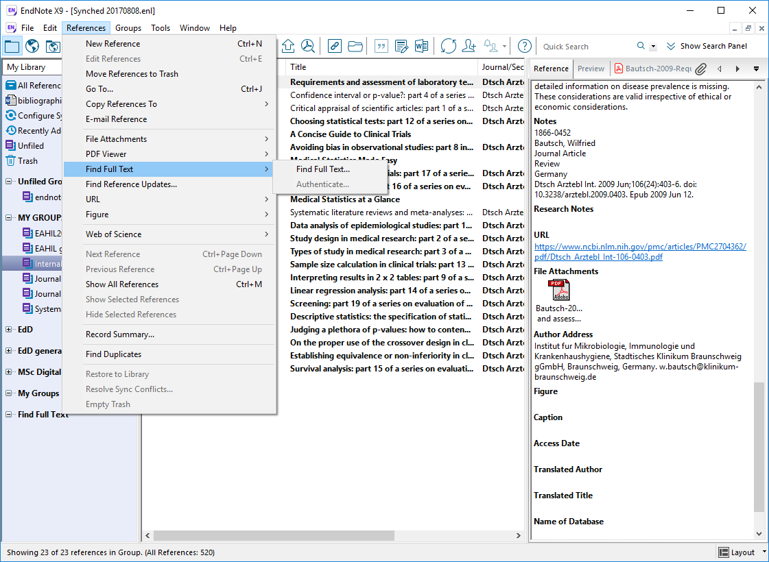
Adding file attachments
VPN on helps
www.ed.ac.uk/is/vpn
Notes:
VPN

Slide 29
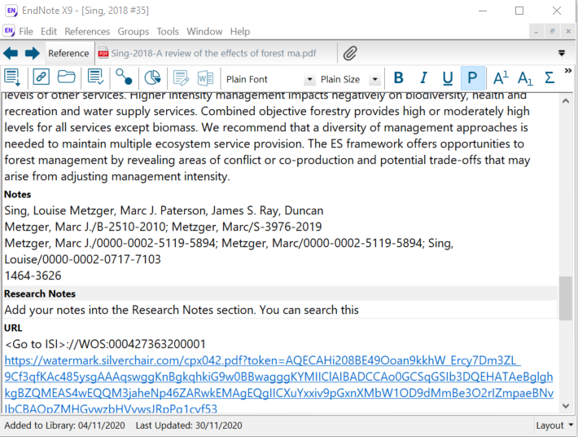
Adding your own research notes

Slide 30
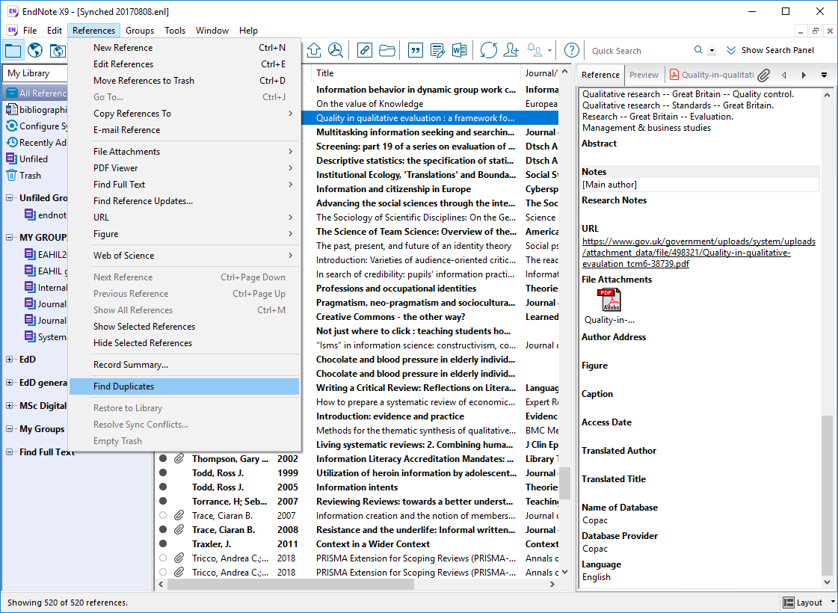
Removing duplicates

Slide 31
EndNote Online

Slide 32
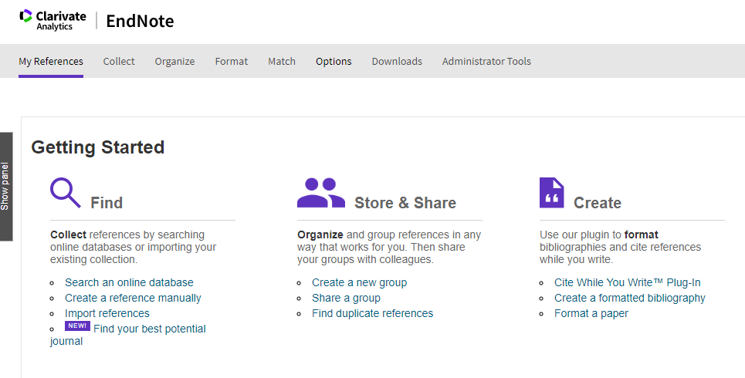
Download installers for Word and web browsers

Slide 33
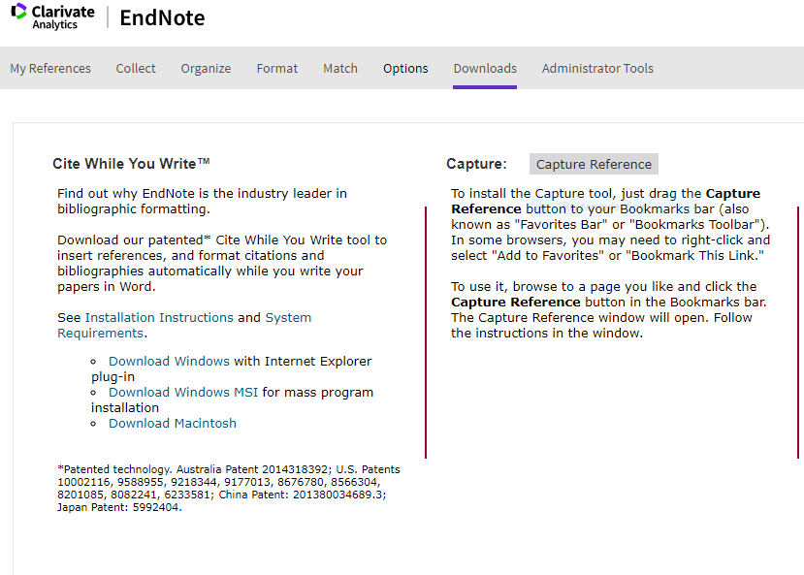

Slide 34
Alternatives to Endnote

Slide 35
Which one?
Comparison http://www.docs.is.ed.ac.uk/mvm/BiblioManagersTable.pdf
Each available for Windows or Mac and at no cost

Slide 36
Zotero www.zotero.org
Pros | Cons
Open source | 300MB storage, which is less than others. Subscription for more storage space
Can add tags and categories | Challenge to have multiple projects
Options for add-ins/plugins which can help workflow | Not supported by the University
Zotero Community – discover researchers working on similar work
Zotero Connector – save from your browser

Slide 37
Mendeley www.mendeley.com
Pros | Cons
Free | 2GB storage limit. Subscription for more storage space.
Capture tool – save from your browser | Challenge to have multiple projects
Easy to add references and pdfs | Not supported by the University
Researcher tool – discover what others are adding to their collection | Difficult to edit styles
 | (Currently undergoing changes – may be a pro)

Slide 38
Time for remaining questions

Slide 39
Thank you
Academic Support Librarians
www.ed.ac.uk/is/asl

Slide 40
Endnote Download and Help
EndNote personal download: https://www.ed.ac.uk/information-services/computing/desktop-personal/software/main-software-deals/endnote
Via the Software Center for University managed computer.
https://edinburgh-uk.libguides.com/referencing
EdHelp: www.ed.ac.uk/edhelp
Clarivate/Endnote support: endnote.support@clarivate.com

