Slide 1
Phrases, Truncation, Search history & Boolean
Use “phrase marks” if you want the words you enter to appear together as you have entered them.
Use the truncation symbol, which is usually the asterisk, *, to look for words with a common “trunk”, eg behavio*
Use the Search histories to begin with. Look at each concept separately and then put them together. The advantages of doing this are:
Seeing which concept has the smallest number of records (which can explain zero results).
Being able to add synonyms and extra concepts as you think of them.
Not having to worry about how the search interface prioritises commands.
You need to “bracket off” OR clauses in a one string search, eg
(geriatric* OR elderly) AND (mobil* OR exercise) returns records which mention at least one of each concept.
geriatric* OR elderly AND mobil* OR exercise returns records with the words elderly and mobil* but also any record with only one of the other words.
Boolean reminder:
OR = more results (all the grey area ←)
AND = less results (just the grey area →)

Slide 2
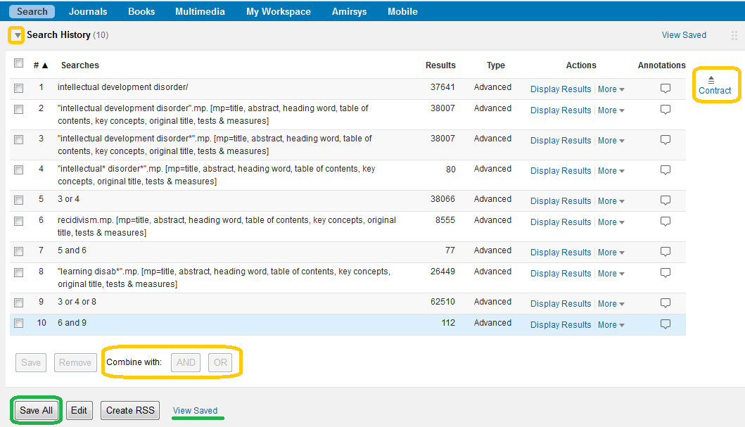
Search History – Ovid interface example
Click/Select the arrow to see the search history, which is the searches you have done during a session
Click/Select Expand/Contract to see more than the most recent four searches/just the most recent four searches
Click/Select sets to activate AND/OR commands.
Save All to make the search (not the records) available post-logoff. Personal account registration required (not EASE authenticated)
View Saved to get to your personal account and run this search against the databases chosen, as they are then.

