Slide 1
Library Academic Support
Helping you get the best from the Library, its collections, resources and services
Academic literature databases
for Systematic Reviews
Section 1:
Thinking about your search
This presentation (no narration): http://www.docs.is.ed.ac.uk/docs/Libraries/Presentations/ClinPsychDClinSysRevDatabases.pptx
Rowena Stewart
(she/her) rowena.stewart@ed.ac.uk Academic Support Librarian
DClin.
AY24-245 Mar25
Notes:
1 – Introduction
Hello, everybody.
My name is Rowena Stewart. I am Academic Support Librarian for Health in Social Science and with this presentation I hope to help you start the literature search process for your systematic reviews. We will think a bit about the workflow that may be involved as well as how you can come to a search strategy that works for your review question using the academic literature (or “abstracting & indexing”) databases you will be expected to have used.
Should you think it useful when you get to the searching stage, I am happy to try to answer questions you send me or to arrange to meet to try to help with your specific search strategy.

Slide 2
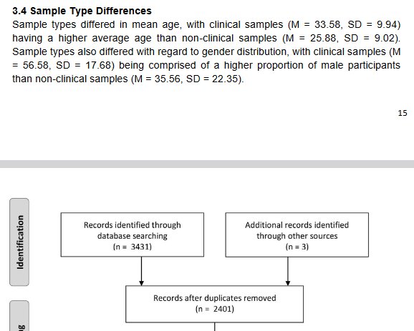
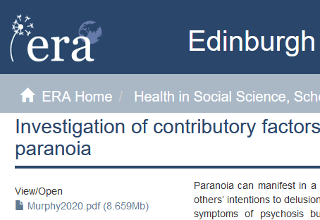
Getting started - looking for systematic reviews
Library Academic Support Team
Previous DClin theses are on the Edinburgh Research Archive (ERA)
Most will be available to read in full
Many will include a systematic review section.
www.era.ed.ac.uk
Notes:
It might be useful to begin the process by seeing what you are aiming at and, if you have not seen one already, previous Doctorate theses are on the Edinburgh Research Archive (ERA), the University’s online repository. Many DClins have systematic reviews.
Your own thesis will be deposited in ERA which is an open access repository…except when it comes to theses. If there is an embargo on releasing research results in a thesis (for example because of commercial sponsorship, or sensitive data) the file is not available to read. A closed padlock symbol indicates an embargoed theses rather than the page with downturned corner highlighted on the lefthand screenshot.

Slide 3
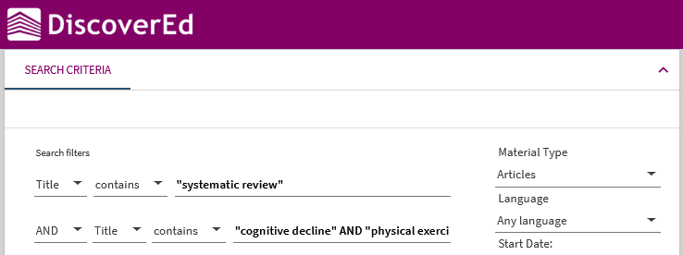
Getting started - looking for systematic reviews
Library Academic Support Team
Look for “systematic review” (or other review, etc) in an article title.
Use Google Scholar if you prefer.
Notes:
To look for published systematic reviews, use whatever you would normally use to find academic literature. The examples here though are DiscoverEd and Google Scholar.
We are looking at DiscoverEd’s Advanced Search option in the top screenshot here. Limit a search to be for eg, “systematic review” in the title, along with anything else that interests you.
The use of double quotes in the search shown is to force the search to be of just the phrase / the words together in the order given. Not just the occurrence of both words but separated.
Google Scholar is another option of course. The advantage to DiscoverEd is that the results returned should be ones you can read because The Library has them.
Search tools with which you are already familiar are also what to use to give you an idea of whether there is work out there on the review topic you are hoping may be possible.

Slide 4
Library Academic Support Team
Finding a review question – can be a frustrating stage
Use resources you are familiar with to get an idea of whether you will find enough (or too many) relevant papers for the review topic you have chosen.
Choose a topic of interest
Search the literature
Screen the results
Review the research that makes it through
Too little research: What interests you most and what concept(s) can you drop or loosen or broaden?
Too many publications: What additional concepts can you add which still leaves enough papers to review?
A too recently published review already exists: Is there a more specific theme you can do your own on? Check with your supervisor.
Notes:
Getting your own review question can take some time. Use resources with which you are familiar to get a feel for the literature on a proposed topic. Even better is finding some papers you think you would include in your review. These can be used to build search and/or to test a search strategy you devise for the abstracting & indexing databases.
For a literature review, you look widely for relevant research and select those which best support the current thinking in the area you are reviewing. For a systematic style review, you search widely but include in your review all the work which matches your relevancy and inclusion/exclusion criteria. No cherry-picking.
The number of papers you want to be reviewing is probably not more than 25 or so.
The minimum you need could be as little as five. Take advice about the number from your supervisor.
If it looks like there is no, or not enough, published research on your topic, consider what is most important to you and broaden out on the other aspects. Or perhaps on the important aspect in a way that still keeps it relevant.
If the papers you see all seem relevant, your review topic probably needs to be more specific. Use what you are finding, to identify a more specific aspect of the topic that will work as a review question.
If you find a review which matches what you were hoping to do, check with your supervisor whether that scuppers your own. If it is old enough and inconclusive, updating may be possible. If it is slightly broader than your own proposal, a theme within in it may still be possible. Previous reviews can be helpful for search terms if you can find one that is in the area.
Although the sequence shown here suggests that after the literature search the process is a straightforward, linear one, it may be that the circling back extends beyond the two stages shown. By the time you have settled on a review topic (or review question), you may have already done a lot of screening (screening being reading enough to know whether or not a work is excluded from your review). Your final search, the one you document for your readers and from which you use the results for the rest of the process, may, in effect, be “doing it all again”. Which is to say, running a search you have already tried on the databases you worked it out on and screening the results as you perhaps already did to decide whether or not you were happy with your search strategy.

Slide 5
Library Academic Support Team
Framework headings may be useful
Population,
Problem,
Intervention,
Comparison,
Outcome,
Study design
Population,
Phenomena of Interest
Context
[reviews of qualitative evidence, JBI]
More information about PICOS/T, PEO, PICo, SPIDER (pdf)
www.docs.is.ed.ac.uk/docs/Libraries/PDF/PICOS.pdf
Not every framework heading need be populated for your research question.
Not every heading has to be used as a search concept.
Notes:
You will probably set your review question against a framework. In this context, frameworks are sets of headings that help you consider what would make a piece of research eligible for your review. There are a number of frameworks which you can use.
The one on the left is PICOS, commonly used in medicine to identify your Population and the Problem you are interested in, the Intervention you want to see having been attempted and the Comparison which need to have been applied as well as the Outcome you are interested in seeing reported and anything important to you about the study design in general. This PICOS, is best suited to reviews focussing on RCTs perhaps.
On the right is a PICo framework from the Joanna Briggs Institute which may work better for reviews of qualitative research.
You still identify a Population of importance but that may include what has happened to them now or in the past. Phenomena of Interest heading allows the intervention to be experiences of a specific intervention but also of broader aspects of treatment or environments. Socioeconomic or cultural factors or specific settings may come under the Context heading.
The headings and other inclusion/exclusion criteria that become clear to you during your preliminary literature searching and reading do not all have to be used as search terms, or concepts, in your literature search.
The literature search needs to get you a set of results that contains “all” the papers which are relevant to your review question. How specific you make the search is up to you. It will be a balance between the number of results returned and how you feel about screening that number and the feeling of possibly missing something.
It is worth remembering that the time taken to screen is not the time it takes to read all the results as full papers. You can exclude based on the information in a title.
And the fear of missing something can be mitigated by testing a search set against papers you already know you are going to include.

Slide 6
Library Academic Support Team
Frameworks in action
Researchers proposing to undertake a systematic review can make their intention available for others to see on, e.g. The National Institute for Health Research’s PROSPERO database.
PROSPERO’s protocol documents use PICOS type headings for authors to describe the extent and purpose of their proposed systematic review:
Participants/population.
Intervention(s), exposure(s).
Comparator(s)/control.
Context.
Main/Additional outcome(s).
[Data extraction (selection and coding)]
PROSPERO: International prospective register of systematic reviews
Changes to the proposed review content or methods are logged.
Reviews which reach completion in publication are linked to from their PROSPERO protocols.
Notes:
PROSPERO is a site on which authors can register their intent to undertake a systematic review. The proposals are registered using a protocol template which includes the headings as shown for potential authors to use to outline the scope of their proposed review.
If you have to populate a framework which is not necessarily the best fit for your topic, you can leave some headings blank.
Finding a PROSPERO protocol that is similar to your own review topic, can be a way of gathering potentially useful search terms as well as seeing how others have thought about their systematic review process.
PROSPERO submissions can be updated as changes take place for the review. This includes with details of publication for those that reach that stage.
If you find a review proposal on PROSPERO that seems the same or very similar to the one you are hoping to do, take advice from your supervisor about the options available to you.

Slide 7
Library Academic Support Team
Coming up with potential search terms
Identify your concepts and then synonyms
What is the experience of adolescents with a history of disruptive behaviour undergoing a course of mindfulness training?
adolescents | disruptive behaviour | Mindfulness training | experience
adolescen(ts) teen(agers) “young people” youth(s) “young adult(s)” “emerging adult*” | “disruptive behav(iour)” aggress(ion) violen(ce) | mindful(ness) Meditation Training/education/ program(me)/course… | attitude(s) perception(s) perspective(s)… Compliance Dropout(s)
Synonyms can come from your own knowledge and reading including systematic reviews on similar topics.
Abstracting and indexing databases’ "subject headings” are potential sources too.
Notes:
Your search strategy will involve searching a number of different abstracting and indexing databases using words and phrases [or “search terms”] that will pick up relevant research.
As we have said, the search strategy does not have to include everything you want to read about. However, it may help to start by being specific to start with, thinking about all the concepts you want to see reported whilst considering the, possibly many, ways those concepts may be referred to.
For your concepts, refer to your framework heading entries. For how those concepts may be described (or named or labelled) in the academic literature you will have your own knowledge and the reading you have already done.
The example here uses a table to set out possible terms for the concepts useful research would ideally address, but you use whatever method works best for you.
You will see here lots of terms for the age range of the population. Straight synonyms in this case.
For the problem they exhibit, more specific forms of disruptive behaviours have been added because it is probable that research has been done on a particular named behaviour and such research could be useful.
Meditation has been added as a similar enough intervention to mindfulness, incase there is not enough literature which looks at mindfulness.
You may also have found similar systematic reviews in which the authors (should have) presented their own search strategy.
It helps to consider which of your concepts are most important to you, incase you need to make changes to your initial review question.
Abstracting and indexing databases’ add value to their records by adding information about the piece of research the record describes. This information includes “descriptors", "subject headings", or "subject terms" which are words and phrases selected from a thesaurus and consistently applied to a particular database’s records. These subject headings are potentially good synonyms.
Some functions are common to many abstracting and indexing database search interfaces (or “platforms”).

Slide 8
Library Academic Support Team
Search strategy – phrase marks
Returning words entered in order, ie as a phrase rather than just all the words being present.
use “double quotes”
“emerging adult*”
“disruptive behav*”
For search terms which could be a single (compound) word or a phrase or a hyphenated phrase, look for both:
wellbeing OR “well being” OR illbeing OR “ill being”
Notes:
In the table on the previous slide you will have seen some of the potential search terms were enclosed in double quotes.
In many search interfaces these are needed to make the results returned contain only the words together in the order entered, rather than just all the words, ie they force a search for the phrase.
For search terms which could be single (compound) words or a phrase or a hyphenated phrase, look for both. A hyphen is often ignored, or treated like a space but neither will find the two words run together into a single word and vice versa. Hence the example at the bottom of this slide looking for wellbeing as one word and also as a phrase.

Slide 9
Library Academic Support Team
Search strategy - truncation
Truncation allows you to look for all forms of a keyword.
behav* = behaviour, behaviours, behavior, behaviors, behave, behaves, behaving
Symbols can vary but asterisk * is common.
Notes:
In the phrase examples in the previous slide you will have seen asterisks used instead of letters.
The asterisk is a commonly used symbol standing for any number of characters or none. It is useful for words with a variety of endings all of which could be relevant.
This type of feature is called a “truncation symbol”.
In the table of possible search terms there were brackets around words which could benefit from truncation. Words for which singular or plural are relevant such as experience or experiences but also for mindfulness incase mindful was useful as well as mindfully and mindfulness itself.
In the academic literature/abstracting and indexing databases multiple words in a phrase can usually be truncated.

Slide 10
Library Academic Support Team
Search strategy – wildcards
Watch out for UK/US spellings (paediatric, pediatric).
A wildcard allows for variation in a letter in the middle of a word and usually stands for 1 character, or 0 or 1 character.
organise/organize: wom?n.
counselling/counseling: counsel?ing
[woman OR women is more specific]
Notes:
Wildcard symbols may be offered and differ from truncation by being able to be used inside a word and to stand for a more specific change. Zero or one character for example.
If they exist as an option they may be able to be used in combination with other symbols (such as truncation). Personally I would have to consult the Help option of a database’s host platform (search interface) to be sure if that was possible.
I would also use the Help to see what wildcard symbols were available beyond the asterisk for truncating as they tend to vary more between platforms.

Slide 11
Library Academic Support
Helping you get the best from the Library, its collections, resources and services
Academic literature databases
for Systematic Reviews
Section 2:
Academic literature databases
This presentation (no narration):
http://www.docs.is.ed.ac.uk/docs/Libraries/Presentations/ClinPsychDClinSysRevDatabases.pptx
Rowena Stewart
(she/her) rowena.stewart@ed.ac.uk Academic Support Librarian
DClin
Mar25
Notes:
Hello everybody and welcome to section two of a presentation on the search process for a systematic style review.
In this section we will look at searching academic literature (or abstracting and indexing) databases, such as psycINFO, MEDLINE and CINAHL, and at how the functions and features available can help you decide on a search strategy, record it for reporting and get the results out of the database environments (which change with updating) and into something you can use for screening.

Slide 12
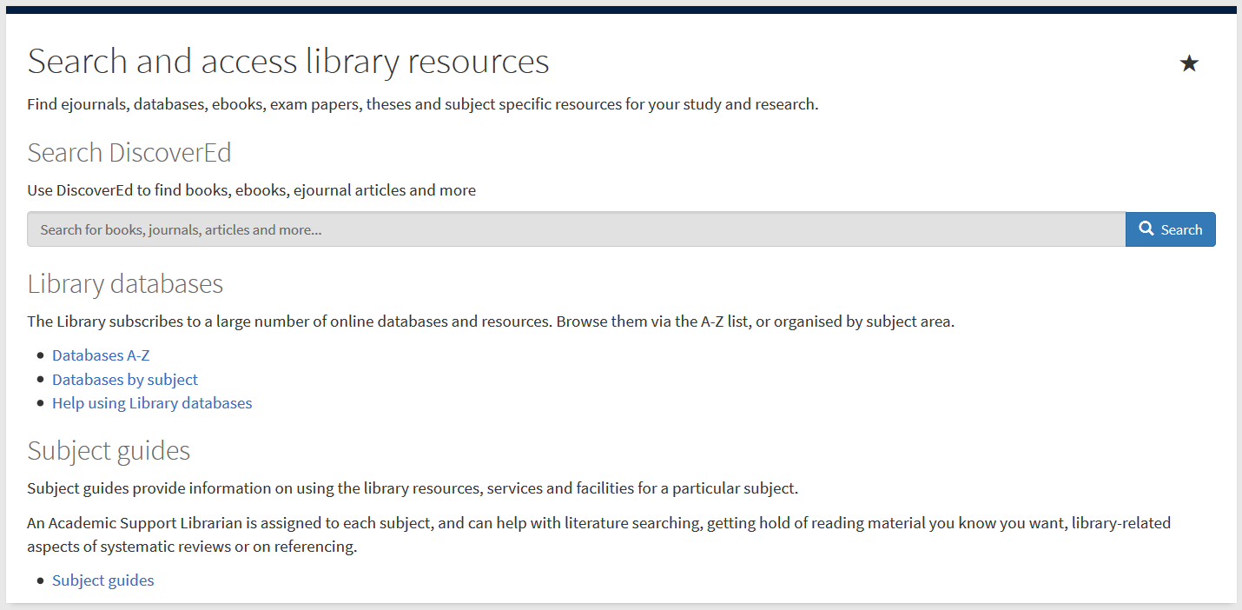
Abstracting & Indexing (A&I) databases – Getting to them
Library Academic Support Team
Include material not found in DiscoverEd or Google Scholar.
Contain details of millions of articles from 1000s of publications.
Conference proceedings, journal articles, book chapters, reports and standards.
MyEd > Studies > Library column
Subject specific databases.
Databases by subject
www.ed.ac.uk/is/databases-subjects
Notes:
There are library webpages which list academic literature databases by the subjects they are useful for.
As the slide suggests, the reason to use them is that they index (with an abstract if there is one) journals, often publishing in particular subject areas. Sometimes they contain information about book chapters and theses as well also conference proceedings.
Their contents do not tell you only about what The Library has. You use them to know what there may be published on a topic.
One route to an appropriate page is via MyEd’s Studies tab which has a Library menu. Choose the “Search and access library resources” section from the Library menu to stay in MyEd but then choose the “Databases by subject” link to get to the webpage which lists subject areas taught and researched in the University.
are also called abstracting and indexing databases which is an indication of why they are useful. They contain records for predominantly journal articles (but also book chapters and theses and other types of material depending on the database’s focus). The information recorded is typically citation information, an abstract and words and phrases which further describe the content and are drawn from a thesaurus each database maintains for the purpose.
These sorts of databases go beyond the contents of journals etc for which one particular library provides access (DiscoverEd is good for that though). They also go beyond one publisher’s output as well and they tell you more than you can find out about from things like Google Scholar or just a web-based search.
They are designed for people like you to find out what exists on a topic, and having been around for a long time (“before the internet”) they have functions and features which help with this kind of task.
There are abstracting and indexing databases, such as Web of Science (despite its name) and Scopus, which are created to cover all academic disciplines. There are also ones which index journals publishing in a particular area, such as engineering, divinity or law but also psychology, medicine and nursing.
You can investigate the databases which may be useful in a particular subject area from the library webpage “databases by subject” and perhaps the easiest route to that is via MyEd’s “Search and access library resources” section its Studies’ Library column.
The arrow is pointing at the link to the databases by subject page which just takes you out of MyEd and into the page on the library website.

Slide 13
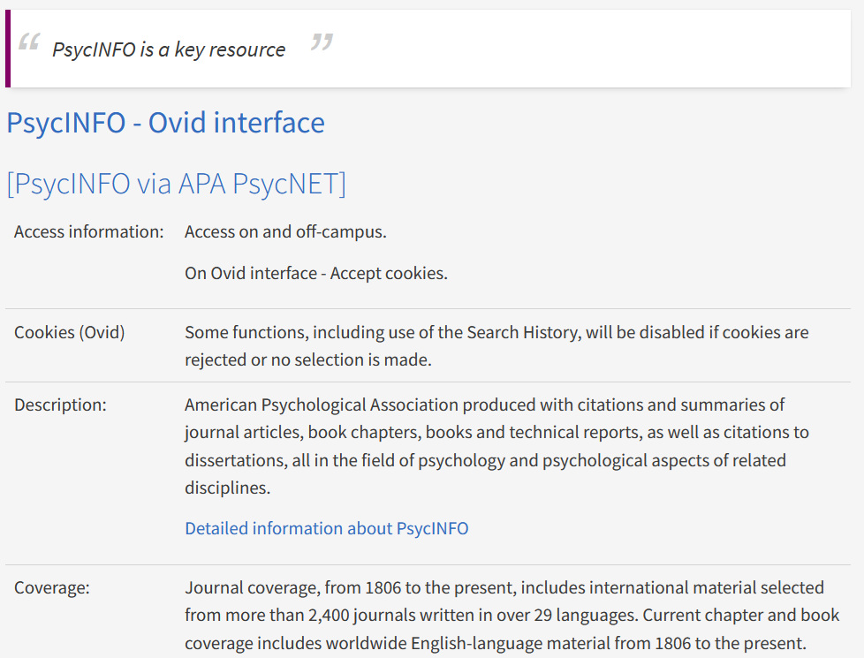
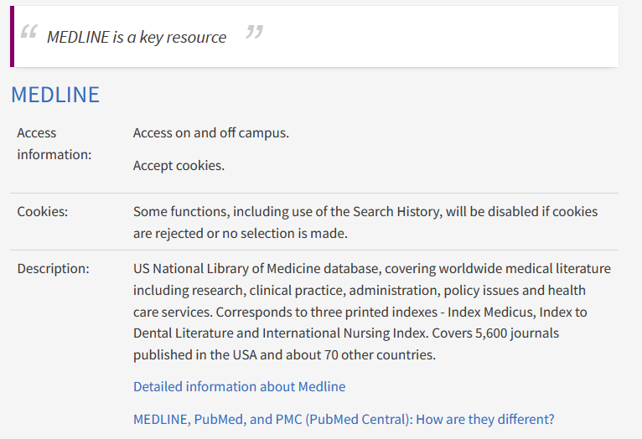
Databases for Reviewing the Literature – which ones to use
Library Academic Support Team
“key resource” banner indicates core databases
Title(s) links to where the library buys the resource (authentication built in).
Description helps you know why you may want to use the resource.
www.ed.ac.uk/is/databases-subjects
Notes:
When you have gone into the page for the subject area you think the best fit Clinical Psychology for instance!, you see an alphabetical list of resources which the library buys and which may be useful to you. It is not just abstracting and indexing databases which are listed. There may also be collections of full-text or videos relevant to the area and other types of resources too.
The “Description” section of each entry helps you know what may be useful for your particular needs.
The “key resource” banners suggest the ones to start with.
You will probably want to have used psycINFO and MEDLINE. If you like PubMed then you can use it to search MEDLINE records because PubMed is the free interface to MEDLINE. The search interface/platform the library links go to is Ovid. You can see that is the top named link for psycINFO too.
Also on the Ovid platfom is Embase which is a medicine database with coverage of European journals which perhaps MEDLINE does not have. Also, the way it indexes sometimes means a lot more results for some topics.
Because all three (psycINFO, MEDLINE and Embase) are available to you on the Ovid platform, they can be searched all at the same time if keyword searching is used.
CINAHL Plus is what to use if nurses are involved in your topic of interest.
If your population or professionals are not clinically based “Sociological Abstracts” and “Social Services Abstracts” may be useful.
If an intervention happens in Schools, ERIC or other Education Abstracts could be useful.
Finally, there are some databases which are “All subject” ones and which you may see reported in systematic reviews or have used yourself: Scopus and (despite its name) Web of Science.
Part of working out your search strategy is deciding on the databases to use as well as the search terms and their combination.
Eventually, it is usually the case, that adding more databases to your search strategy stops adding more useful records to your results. You can choose to use all the databases (perhaps deciding that deduplication will help bring numbers down to a more manageable number to screen if they looked high). Or you assess the results you get from the different databases you have tried and decide which ones are not needed or which ones are core.

Slide 14
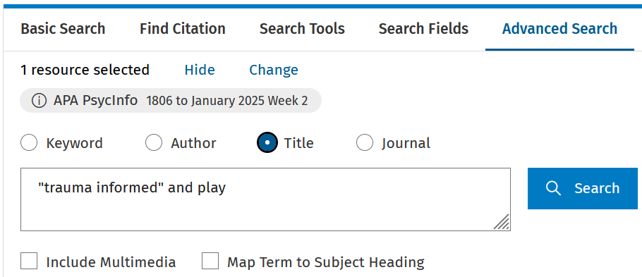
Title only – highly relevant papers
Library Academic Support Team
Title only searches can get you a concentrated set of records, strongly on topic.
May help you decide if your review topic will work.
May help you decide an aspect to review within a general area of interest.
Look for the Title only limit.
Remove anything that may force a search of subject headings thesaurus.
Notes:
In all academic literature search engines or platforms, you can limit your search to finding words and phrases only present in document (or article) titles.
Doing this returns a more immediately obvious set of relevant records and may help you get an idea of whether or not there could be enough published research for you to do the review question you were thinking about. On the other hand, results from such a search may help you decide on a more specific question if you have an area of interest but are not sure which aspect within in it may support a review.
Searching only titles is not the search strategy you would adopt for a systematic style review which needs to incorporate searches done through abstracts and heading fields as well.
The screenshot on the slide is taken from the Ovid platform. The selection above the search box to make a search be in the Title only is ringed. The short arrow though is pointing at an option below the search box called “Map term to subject heading” and which may be selected by default. It overrides selections made above the search box and needs to be de-selected for title searching (or for keyword searching).
Looking at the full records of the most topical sounding titles may provide additional synonyms for concepts.

Slide 15
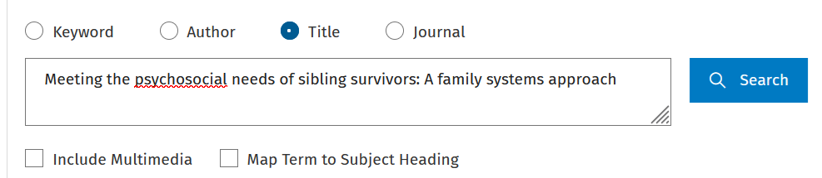
Title only – known papers
Library Academic Support Team
Search for records of papers you already think will be useful.
If it does:
Look at the full record to see what search you could sensibly put together that will find it and therefore other (possibly) relevant records.
Look at any Subject Heading entries. They may be useful synonyms.
Notes:
If you already have papers you think you will be including in your review, look them up in the databases you are planning on using by doing very specific title-only searches, entering the whole title of a paper in the search box, for example.
The results tell you whether you should be finding out about these papers from those databases (if they are not where you found out about them already). Records for these known papers can be used to test a search strategy as we will see later.
Looking at the full records may also suggest a search strategy that will find them and which could therefore provide a starting point for a search.
Looking at any subject headings the databases have added is, again, a source of synonyms for your concepts and more information about subject headings, what they are and their usefulness is coming up next.

Slide 16
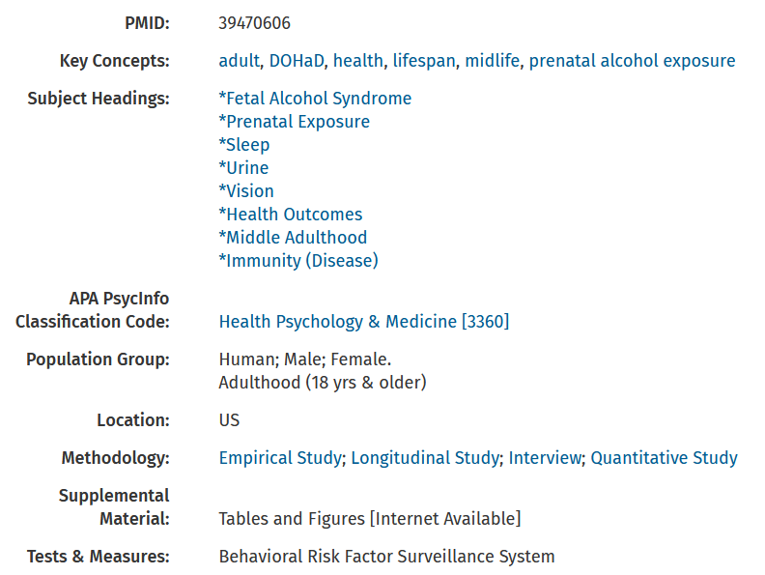
Databases for Reviewing the Literature – Subject Headings
Library Academic Support Team
Subject headings/terms are words or phrases added to records in a database.
Describe the content of an article etc
Consistent in their application across the records in one database.
Key concepts here are the words and phrases the authors or publication uses to describe an article.
Only consistently applied on single author’s output or within a single publication
Notes:
One of the useful features that academic literature databases have are "subject headings" (variously called "subject terms“ or “descriptors“ perhaps). These are words and phrases selected from a database’s thesaurus and consistently added to its records for articles which cover that content. You may have heard of MeSH which is short for “MEDLINE Subject Heading”
Subject Headings help describe more fully the content of the paper the record is summarising. They help “smooth out” differences in terminology over time, and geography and disciplines perhaps. Knowing how a database describes a concept may provide you with potentially good synonyms.
Databases may add other fields to describe the content of an article, for example “Population Groups” and “Methodology” on the psycINFO record shown here.
As you could guess from the way they look, you can click on a Subject Heading displayed in a database record to find all those records which have that word or phrase added to their record too. This would be a great way of getting all the relevant records on a topic in a database except that not all records have been fully processed and those which have not, lack a Subject Heading field completely. These records cannot be returned by a search looking for a word/phrase in that field.
The records that have not been fully processed will include the more recently added records from newer publications.
Nevertheless, subject headings remain a good source for synonyms.

Slide 17
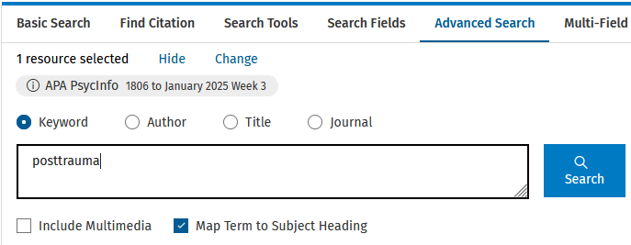
Subject Headings – looking up a thesaurus
Library Academic Support Team
Searching a database’s thesaurus of subject headings
“Keyword” type search:
Remove the tick and your search terms appear in title, abstracts or heading fields.
A “normal keyword search”
Notes:
As well as finding useful Subject Headings by looking at a relevant record, you can also search for them. This is the default search for our links to psycINFO, MEDLINE, Embase and CINAHL.
You know this when you see the tick against “Map Term to Subject Heading” in the Ovid platform (for psycINFO, MEDLINE, Embase).
Remove the tick to do a “normal keyword” search, looking for your words or phrases in the title, abstract and headings fields.
Keep it ticked to investigate the way a database (possibly) describes your concepts.

Slide 18
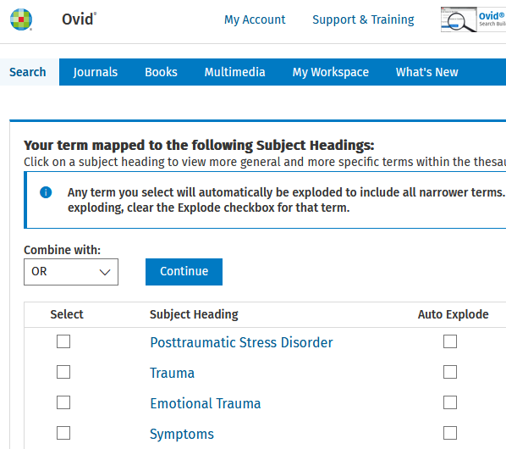
Library Academic Support Team
Subject Headings – looking up a thesaurus
Click on a term that looks like your concept to see where the subject heading sits in the thesaurus.
This context may provide more search terms.
Notes:
If you have chosen to do a “Map Term to Subject Heading” search, you will get a choice of subject headings which the database, psycINFO in this example, calculates are similar to the search term you entered.
Click on a term that looks like your concept to see where the subject heading sits in the thesaurus.
This context may provide ideas for additional synonyms.

Slide 19
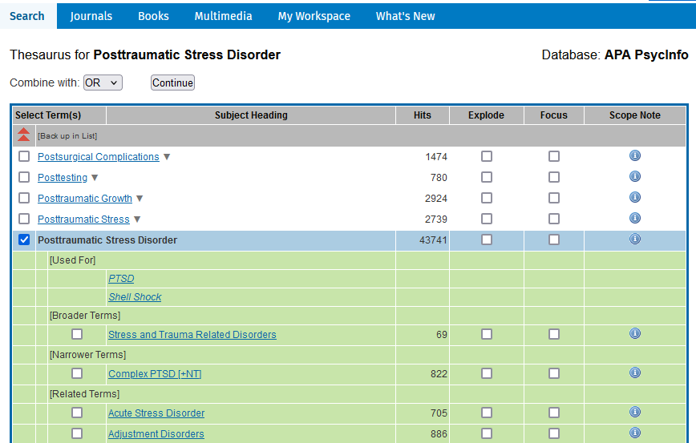
Library Academic Support Team
Subject Headings – context from classification
Scope Note: for the database’s definition of the subject heading.
Continue: to do a search for subject heading in the subject heading field.
Search in the top menu takes you to the search screen.
Notes:
Databases organise their Subject Headings in a classification tree or scheme. The subject headings get more specific the further down the scheme they appear.
Other databases (MEDLINE on Ovid & CINAHL for example) will display the whole classification scheme. However, psycINFO on Ovid shows you the subject heading above the one you are investigating under “[Broader Terms]”, those more specific than the one you are investigating are displayed under “[Narrower Terms]” and suggests subject headings which may in some way be similar (and therefore potentially useful), under “[Related Terms]”.
Under “[Used For]” are words and phrases which authors may have used but which mean the subject heading displayed is the one added to the record. They are another source of synonyms.
Narrower terms may have their own narrower terms and you will see “[+NT]” after those in psycINFO which do (or a plus symbol nearby when the whole classification scheme is displayed).
More specific types of your concepts may be good additional search terms. You can perhaps imagine research being done on a specific type or population of what interests you without the resultant publication mentioning the broader concept they fall beneath. That research may still be relevant and you may not want to miss out on being able to assess whether or not it is.
“Scope Notes” (in the far right information symbol on the screenshot here) provide a database’s definition of the subject heading. Even if the terminology itself is not what you would use, when a definition matches that of the concept(s) you are interested in, the subject heading should still be useful in returning relevant records in that particular database.
“Continue” will do a search for the subject heading you have ticked and return records where it appears in the subject heading field.
The number in the “Hits” column is the number of records that should come back from a search like this.
Choose “Search” from the top menu to leave this view and go back to the Search area without anything being done.

Slide 20
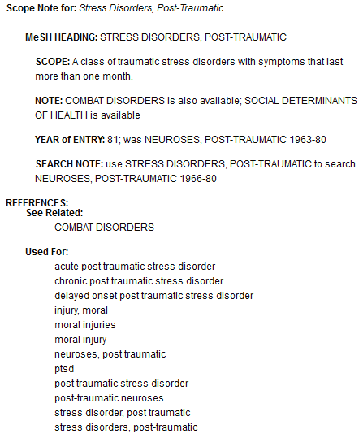
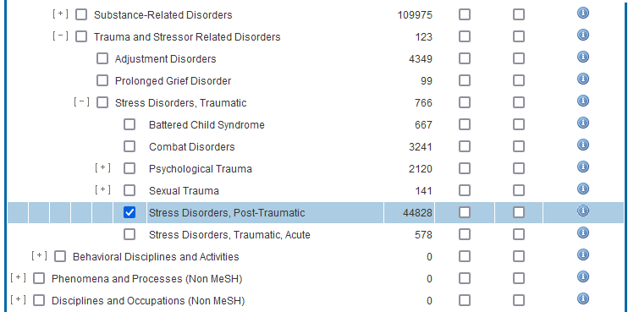
Library Academic Support Team
Subject Headings – differ between databases
Databases do not use the same subject headings
“Used For:” type entries are other, sometimes older, terminology
Notes:
This slide shows how MEDLINE on Ovid presents its subject headings.
It also shows that subject headings differ between the databases: psycINFO using “Posttraumatic Stress Disorder” (from the previous slide) and MEDLINE using “Stress Disorders, Post-Traumatic”
A consequence of this is that a search strategy which includes a subject heading search in the subject heading field has to be run on each database separately using the subject headings which are the best fit from each.
Such a search strategy would have to include a keyword search to catch records without subject headings.
A keyword search which takes account of subject headings used by relevant databases could be run across multiple databases.

Slide 21
Library Academic Support Team
Keyword searching
The number of results returned matches the “Hits” number but is limited to those records which have subject heading fields.
Remove the tick from the mapping option for a Keyword search.
Using the same phrase as a subject heading, returns all the records with the phrase in the subject heading field plus records where the phrase appears in title, abstract or other fields.
Notes:
The top “Search Returned” number screenshot on this slide is the number of results from the pscyINFO search for records with subject heading “posttraumatic stress disorder”.
Remove the tick against “Map term to Subject Heading” for a Keyword search which returns records with the phrase in the subject heading field but also title and abstract (and other fields).
The number of results goes up but still includes all those found by the subject heading field only because the same phrase has been used as the search term.

Slide 22
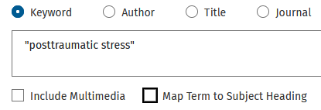
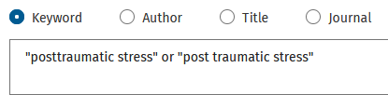
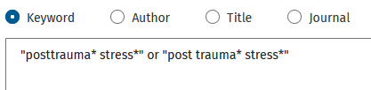
Library Academic Support Team
Keyword searching – increasing the number of results
A word or words from longer phrases return the same results plus more.
Hyphens are often ignored but a compound word does not find a phrase (hyphenated or otherwise) and vice versa. Use both.
Truncation increases result numbers too.
Notes:
Using a word or words which appear in longer phrases will return the same results as using the longer phrase but add more of course.
For words which can be a phrase but also a compound word, use both. Posttrauma is the example here and wellbeing is another.
Search interfaces often treat a hyphen as a space. You can always check a search interface you are using by comparing the result numbers from a search for a phrase with a hyphen to one without.
A Truncation symbol (as discussed previously) in place of no, or variable, characters will also increase the number of results.

Slide 23
Library Academic Support Team
Search History
A Search History section
Lists the searches done in a browser session.
N.B. Lost on leaving the database or if the session times out.
Shows the number of results found by each search.
Allows combining of search sets.
Build a search one step at a time.
– see what happens to results when different search terms are used.
Try different search strategies
– alternative synonyms and combinations of concepts
Test a search strategy by checking the results for known (good) papers.
Notes:
Another useful function or feature offered by academic literature databases is a "Search History". The area may be labelled differently "Recent Searches" or “Session Queries” perhaps).
Whatever it is called, the search history area, lists the searches you have done in a particular browser session and lets you re-use them.
Using a Search History area to do a search step by step, helps you work towards a successful search strategy.
You can try out different combinations of search terms or concepts without having to enter entire search strings.
You can change one thing at a time and assess the difference a change makes.
It also highlights if any of your concepts are returning a small number of results which in turn may explain a lack of results from a search strategy using that concept AND others. You can then concentrate on additional acceptable synonyms for that concept. Or, you may decide to use fewer concepts in your search strategy because one is doing the work for you. Alternatively, it may mean you have to try a different approach or question completely.
The last point there about testing a search strategy is because you can do a very specific search for a title to find out if a database has a record for it. If it does, you can look to see if that record has been found by a search you are hoping may work for you. If it does, that maybe gives you some confidence in your search. If it does not, that tells you need to re-visit your search

Slide 24
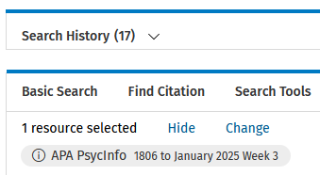
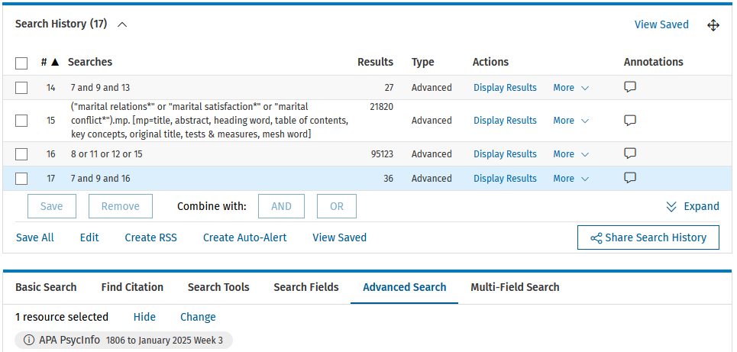
Library Academic Support Team
Search History – opening it
May have to choose to show the Search History
Ovid platform shows the most recent four searches...
…“Expand” to see them all
Notes:
Often the search history is a closed section or a different page. Look for the option to open it up or the link/ which takes you to it.
You can see here that when you do open it up, the searches are listed and you can combine them in different ways. Trying different combinations of synonyms (with OR) and different combinations of concepts (with AND).
On the Ovid platform, the most recent four searches are displayed. When you want to start using earlier ones, use “Expand”.

Slide 25
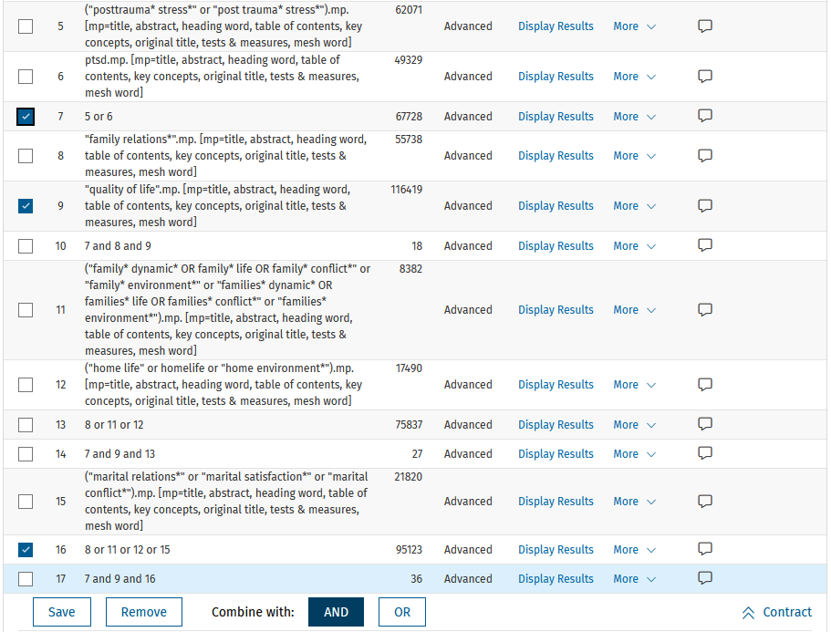
Search History – trying things out
Add synonyms when you think of them
Add synonyms when you need more records/ results
Notes:
On display here are searches done in a single psycINFO session.
Each search is a new one, looking through all psycINFO’s records each time.
I have used the Search History to see the number of records each concept returns and then to see the number of records returned when those concepts are put together, using the AND command in the Search History option. Or changing the synonyms using OR. I can do this step by step and be more sure about what is making the difference to the numbers.
For example, search 5 at the top is the phrases posttraumatic stress (truncated and looking for both the compound and the phrase version of posttrauma). I then remembered to look for ptsd (set 6). Set 7 is the addition of ptsd to the phrases (using OR from the Search History menu).
My other concepts are family relations (set 8) and quality of life (set 9). Each of those three concepts returns many thousands of results. However, when I looked for records with mention of each (set 10) by ticking or selecting the sets I want to re-use and then selecting AND from the Search History menu, only 18 records are found. Having split up the concepts I know it is the combination of concepts which returns such a small number of results. The small number of results is not because one of the concepts has hardly any results and is limiting the number of results any search can return which looks for it AND something else.
I chose to expand the family relations terms (sets 11 & 12) to see if results numbers increase helpfully when the three concepts are combined again (set 14). Nine more records was the result.
Still concentrating on the family relations concept, I added another set of possibly synonymous terms around marital relationships. When the family relations concept is made up of all the terms in sets 8, 11, 12 and 15 (ie set 16) and combined with the ptsd concept (still set 7) AND the quality of life set (still set 9), the number of records returned although still relatively small (set 17’s 36), it is double the number from the first attempt on show (set 10’s 18 results).
This approach can help you decide on a search strategy that may work for your review question.
It is not just about the numbers returned of course. Some of the records have to be for relevant articles, so you have to look at what is returned as well as how much.

Slide 26
Known papers to test a search strategy
Library Academic Support Team
Look to see if a search you may be happy with includes records for papers you know are useful.
One of the three records for the useful paper was already in the search set tested.
Notes:
As mentioned earlier, if there are records in the databases for papers you already know you will be including in your review, you can use them to test whether a search strategy you have come up with has been successful in finding them. This can give you confidence that your search is working.
The screenshot here is of a search done on a combination of concepts [set 17, which brought back 98 results] and for a single paper [set 18] which used the whole title as the search term with the search limited to looking in titles only, as outlined previously.
There are three results in set 18 because the search is of three databases at once and each database has a record for the chosen article. This is an expected aspect of searching more than one database, especially databases compiled for similar disciplines. All medicine related databases are likely to index the contents of the BMJ for instance. It is why there is a deduplication stage before screening in the systematic review process.
To find out whether the concept search has found the chosen article, the example here combines the two search sets with OR. This creates a set with two more results than set 17 by itself, however that means one of the three records for the useful article in set 18 was already there and so the search of concepts has succeeded in catching a record of the chosen article.
Using AND to combine the concepts search set and the title search set would result in a set containing 1 result which again indicates success because it shows a record for a known and useful paper was in the concept search set as well as the set which looked only for it.

Slide 27
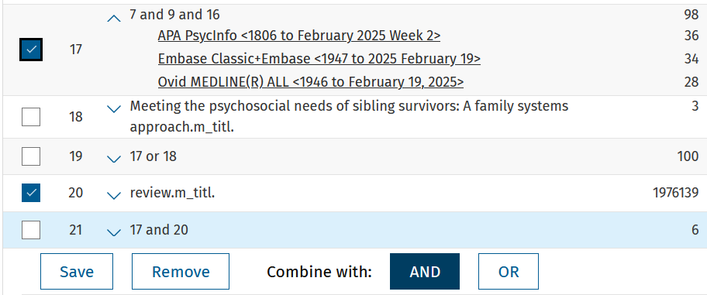
Quick check for review articles
Library Academic Support Team
Get records in a search set which also have the word review in the title
Check “your” review has not been done.
Reviews including similar concepts may be useful for possible search strategies.
Notes:
You can do a quick, but not entirely comprehensive, search for review articles within a particular search set. Do a title-only search for the word review and combine that search [set 20 in the screenshot] and the concepts search set [set 17 again with its 98 results]. Use the command AND.
In the example shown, there were 6 results from the concept set which also have the word in review in their title.
If any of them feel too much like your own proposed review, check with your supervisor whether it stops you doing yours. If it is broader than your own, you may still be able to do your own review, and the review should also present some relevant papers. If it is old (and possibly inconclusive) you may be able to update it.
Reviews which include one of your concepts and which report search strategies in sufficient detail, may provide ideas for your own search.

Slide 28
Library Academic Support Team
Search strategy – proximity operators
Proximity searching for words near or next to each other in any order,
This is the most variably worded command.
Use interface/platform Help to check if it exists and what to use, egs NEAR/3, N4, W/5
Notes:
The use of AND for combining concepts and OR for combining synonyms is widespread in academic literature databases. There is often also a command that returns records which have words within a given number of words of each other for “proximity searching”.
A proximity search is looser than a phrase search for which words have to be together in the order entered. Proximity searching allows search terms to be before or after each other as long as they are not further apart than the number of words you decide is sensible. The platform or search engine will usually ignore small words such as “the”, “and”, “a”, “an” in the count.
The Ovid platform uses the operator command ADJ followed by the number chosen. This is a very variable command and other database search platforms will use similar language for proximity searching (often related to the work near) and the command may or may not be separated by a forward slash. Personally, I have to check Help sources to be sure, especially on platforms which are new to me.
A possible advantage of using a proximity search could come when trying to associate a particular problem or phenomenon of interest with a particular population. In the screenshot example here, we are looking to see if proximity searching could be used in a more specific search strategy where it is the experience of parents that is of interest, rather than the experiences of their children or healthcare personnel.

Slide 29
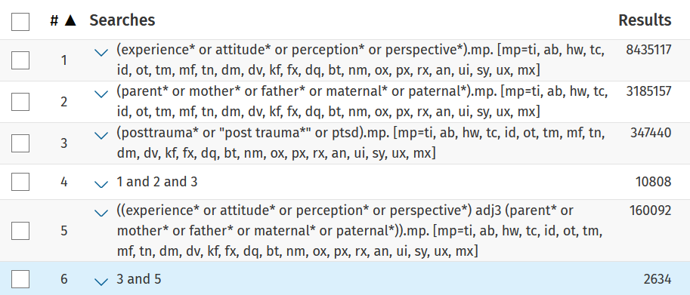
Library Academic Support Team
Search strategy – proximity searching
Proximity searching for words near or next to each other in any order,
Notes:
Having already done a search of the concepts of experience, parents and posttrauma combined [search 4 on the screenshot here] which returned 10,808 results, the Search History area can be used to compare an alternative approach where two of those concepts are “tethered together”, using the proximity search example from the previous slide.
Set 6 uses that search (for experience synonyms to be within three words of the parent synonyms) and then looks to see how many of them have one of the posttrauma terms as well. The number of results (2,634) looks more manageable but a comparison of the records as well is needed, of course, before search strategy decisions are made. A fourth concept may be preferable, or at least tried and the results assessed.

Slide 30
Library Academic Support Team
Search History – recording it
Use Save/Save All to keep the search strategy saved in a personal account space.
You can then have the steps put in automatically in a later session.
Share Search History to get a record of a particular strategy.
APA PsycInfo <1806 to February 2025 Week 1>
1 posttraumatic stress disorder/ 43830
2 "posttraumatic stress disorder".mp. [mp=title, abstract, heading word, table of contents, key concepts, original title, tests & measures, mesh word] 51932
Notes:
As well as disappearing when you leave a search session, search histories will also clear if a session times out.
Save a search to have the set of steps automatically entered when you come again. On the Ovid interface use “Save” and then “View Saved” to do this. You will need to create a personal account for this function to work.
The search that is automatically entered when you select “View Saved”, is run on the databases as they are. This means the result numbers will not necessarily be the same because databases have been updated with new records for example.
To get the details of a current search, look for an option in the Search History area that captures the steps you have run. In Ovid, this is the “Share Search History” option pointed to on the top screenshot.
Choosing this generates what you see in the bottom screenshot and documents the databases used, search strategy and result numbers. Keeping this information may be useful for when you are writing up any methodology-type section relating to your search process.

Slide 31
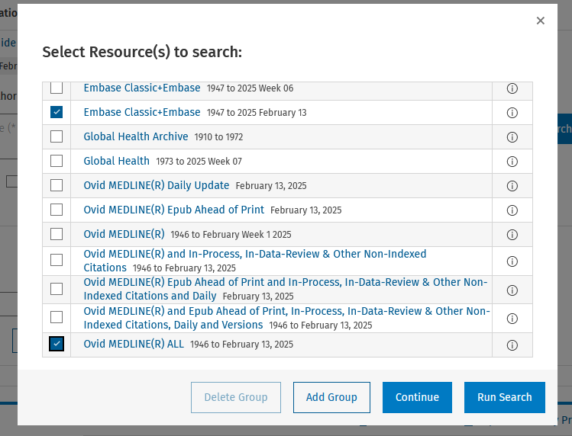
Library Academic Support Team
Searching more than one database at once
See & search other databases on the same platform.
Notes:
It is possible to search more than one database at the same time if they are bought or available on the same platform.
It is worth remembering that this only works “systematically” if the searches run have been keyword type searching: looking for words and phrases in titles, abstracts and heading fields.
Searches looking for subject headings in their single subject heading field (or their two fields in some databases, such as CINAHL), are database-specific. Search strategies incorporating this approach should be run on each database separately using the subject headings from each database which best fit your concepts. As outlined earlier, because not all records may have subject headings added, keyword searching would normally be done too.
To add another database to search (or to use a different one you know is available on the same platform)…On the Ovid platform, look for “Change” above the search box.
The menu of options includes a number of different sections of MEDLINE. Choose “Ovid MEDLINE All”.
There is more than one option for Embase with slightly differing end dates (an update week or an update date). Make your choice of either.
Although not shown in screenshot on the slide, psycINFO selection is easy, as it has just the one entry.
When you have made your selections, choose “Run Search” to have the searches re-run but on the new database selection(s). Other options may return you to the search area but with an empty Search History.
In other platforms, to get records matching a search already run that session but from new database choices is done from the search history area and the “re-run” search options available there.

Slide 32
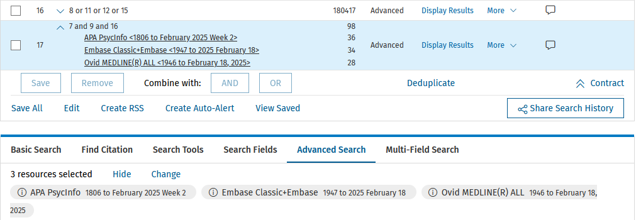
Library Academic Support Team
Searching more than one database at once
Open a search to see how many each database returned
- This is not transferred by “Share Search History” options
“Deduplicate” to get a better idea of how many records may need to be screened.
Notes:
In the Ovid platform, you can see which databases are being searched if you look above the search box [the dashed arrow on the screenshot].
Not shown on this slide is that when more than one database is selected, the ability to search databases’ subject heading thesauri via the “Map term to subject heading” option beneath the search box disappears. However, the long upward arrow points to an Ovid function which appears and that allows you to “Deduplicate” results sets. Doing this gives you a better idea of how many records you may have to screen of a search you feel may be working for you.
You can see how many each database returned by opening up a particular search set in the Search History using the downward pointing chevron type arrow which sits beside the set number and the search entered [ringed on the screenshot].
It is worth noting that the “Share Search History” will not transfer these numbers. So copy and paste them or note them down. The total number returned by each database may be numbers you want to report on your PRISMA flowchart (or however you are reporting numbers returned by your search).

Slide 33
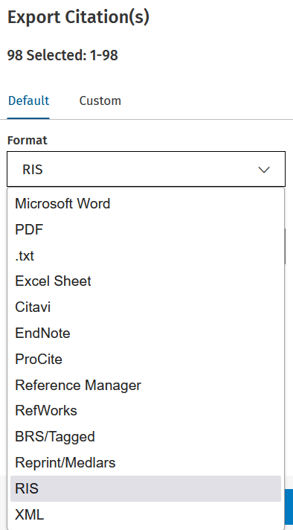
Library Academic Support Team
Exporting results – file type
The options for getting records out of a database (or storing them there) are often located above a results list.
Look for: Export, Download, Share, Save…
Choose the file type you need,
RIS is a generic file type for reference managers.
Use it for Covidence too.
Other file types are often available, eg spreadsheet and text based.
Notes:
It is possible to take out records from a database and keep them somewhere else, to store for your own future use (perhaps in a reference manager like EndNote or Zotero).
For systematic style reviews you will get to the stage when you are happy with a search strategy and you know which databases you want to search. At that stage you run the search, or searches, on those databases. (I say “or searches” because there may be good reasons to run different strategies on different database, including use of subject heading searching). After this you want to take those results out into something you control because
1) Academic literature databases are regularly updated which means the same search run tomorrow will not necessarily return the same results as when run today.
2) You want results to be together for deduplication and then screening. It may be possible to do this if the databases are hosted on the same platform (maybe) but not if they databases are on different platforms.
The command to look for is often above the results list display area and labelled “Export” or “Download”, perhaps “Share” or “Save”
There is usually a choice of file types for how you get the results and they often include text based options and something compatible with spreadsheets. Named reference managers may be listed, as EndNote is in the slide’s screenshot, but there is also usually a generic option, often labelled “RIS”. RIS files are also able to be imported into Covidence.

Slide 34
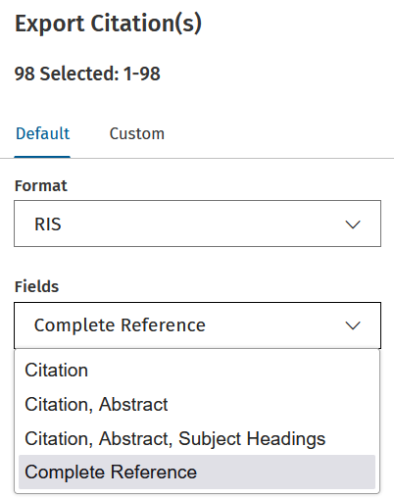
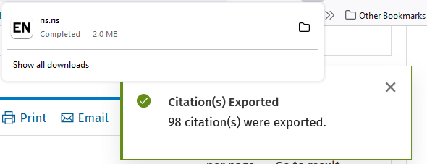
Library Academic Support Team
Exporting results
As well as file type, check if there is a choice for how much of each record you can take out.
Choose an option that includes an abstract
The exported file will be saved as is usual for the browser and/or type of machine being used.
Rename and save somewhere sensible for future retrieval.
Notes:
As well as choosing the file type for the exported results, look to see how much of the result records you can take too. Choose an option that includes, when there is one, an abstract which you will use for your first pass at screening results for eligibility in your review.
Where the exported/downloaded file goes depends on your browser and on the machine you are using, rather than on the database or database platform. Wherever the files go you may want to name them something descriptive and save them somewhere sensible where you can get them again should you need to (after their initial use in populating an EndNote Library and/or Covidence review project).

Slide 35
Reference management software
Library Academic Support Team
Useful because they let you:
Keep and group details of papers etc you have used, or read or plan on reading.
“Cite while you write” – automatically create in-text citations and reference lists a variety of bibliographic/citation styles, including Harvard and APA.
Attach files (eg full-text pdfs of articles).
To help you decide which reference management products to use:
Bibliographic management tools - comparison table (pdf)
Choosing a Reference Manager documents on Sharepoint
EndNote desktop is free to download by members of the University but you must use Software Services’ forms:
EndNote desktop free download
Covidence is a web-based resource, designed for the screening (and extraction) stages in a systematic review. Automatic de-duplication and generation of a PRISMA flowchart is available as is the invitation of a second reviewer.
Register for Covidence under the University subscription
Notes:
You do not have to use any particular software for deduplicating and screening. You just have to do it and apply the right processes.
As well as being generally useful for storing information about reading material and for their automatic referencing function in Word, reference managers, such as EndNote, are a tool you could use to help with the screening process. They will do some automatic deduplication and have a “find full-text” function too. Files, such as article PDFs, can be attached to records and records can also be created from directly imported PDF files themselves. In EndNote, records can be arranged in separate Libraries and as groups within Libraries. Notes, ratings and tags can be added to records.
Covidence is web-based software designed for the screening process. Imported records undergo some automatic de-duplication and as you make decisions about what is left, the remaining records are moved through the various screening stages. Two reviewers is the default set up for a Covidence review project, but reviews can be set to operate with a single reviewer. PICO type Framework headings can be added to help with eligibility decisions, a menu of reasons for exclusion at the relevant stage can be augmented and Extraction templates created too. In addition, Covidence populates a PRISMA-type flow diagram which can be downloaded as a Word document if wanted for inclusion in your review. This Word document can be edited.
Download EndNote desktop onto your own devices for free via the University subscription. Similarly, register for Covidence under the University subscription to be able to create multiple review projects and import lots of records.

Slide 36
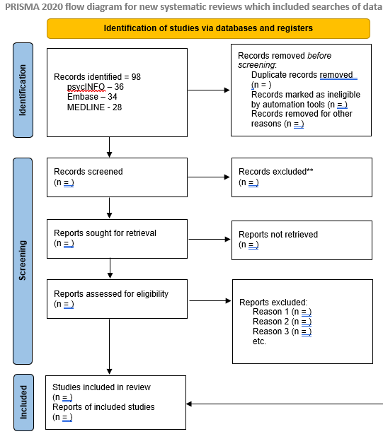
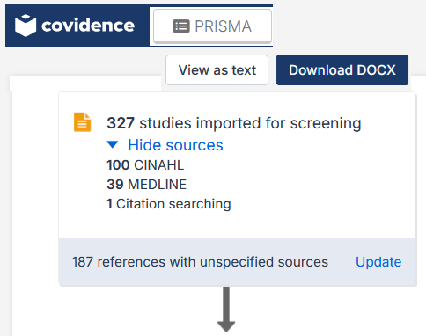
Library Academic Support Team
PRISMA flowchart / flow diagram
Reminders for writing up your method & reporting result numbers.
www.prisma-statement.org > PRISMA 2020 flowchart
Covidence populates a PRISMA flowchart
Downloaded as a Word document, it can be edited for accuracy… if you have kept the data!
Notes:
A PRISMA flowchart or flow diagram is often used to report the number of results or records you ended up with after applying your search strategy and what happened as you made decisions about including or excluding, in your review, the research they describe. You can download a Word file template from the PRISMA site and edit it to reflect your review’s search and screening outcomes. The template is shown on the right of this slide.
If you have kept your Search History output (top left screenshot on the slide) you will be able to enter the numbers needed into the first Identification level box.
The headings in the rest of the boxes indicate the numbers you need to hold onto as you go through the screening process and therefore perhaps help you decide on a workflow that means you know you will have those numbers to hand when you want them. The workflow could be the arrangement of EndNote Libraries and groups within EndNote libraries for example.
If you are using Covidence and want to use the PRISMA flowchart it generates with as little editing as possible, export results from undeduplicated search results sets. Further, you may want to consider searching databases separately, even if more than one can be searched on the same platform, and export each set of results separately.
One of the choices available when Importing a file into a Covidence review is to add which database the records have come from. This information then appears in Covidence’s flowchart. A set of results from a search of more than one database at once cannot be assigned a single database label on Import. The total number of records you started with will not be inaccurate (if you exported undeduplicated sets of search results) but the number of results returned by the individual databases searched will not be able to be automatically displayed.
You can see on the third screenshot here a Covidence generated Identification level top box with a total number of records of 327, made up of 100 records from CINAHL, 39 from MEDLINE, 1 from citation searching and then the rest (187) from “unspecified sources”. I know the latter were an import from one result set of a search run across more than one database.
However, as has been said, Covidence’s flowchart is downloaded as a Word file which can be edited and therefore, if you have saved the Search History and result numbers as would be good practice anyway, you can add those numbers yourself.
The number in the bottom box is of work you include in your review. Which may be eight to 25 or so papers, but check with your supervisor if it seems like you are going to fall outside that range.
That sort of range though, does mean you will be excluding the majority of the work you find out about. Even if the search strategy you settle on, generates result numbers in the low hundreds.

Slide 37
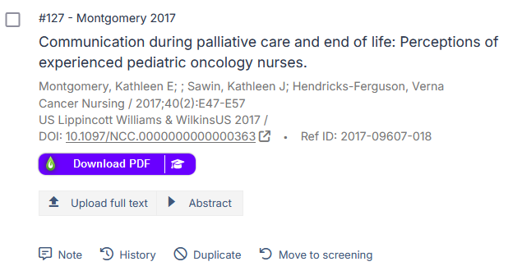
Library Academic Support Team
Finding full-text
Reference managers help with this as they have find full-text type functions.
Covidence provides an upload full-text option for articles identified as Open Access.
Add a UoEdinburgh Library catalogue browser extension called LibKey Nomad to see a download option for articles it identifies as being held in DiscoverEd.
https://library.ed.ac.uk/libkey-nomad
Notes:
At some stage, getting the full-text of results is needed, either because you need all the information reported to know whether a work is eligible or not, or because you want to use the work. Not being able to get the full-text is a reason for excluding a result from your review.
Reference managers can help with this (getting the full-text). They have auto-find features.
In the “Full text review” section of Covidence, Open Access full-text is automatically attached to a record which Covidence recognises as freely available to anyone.
Again in Covidence’s “Full text review” section, if you have downloaded the LibKey Nomad browser extension, a “Download PDF” button appears on a record which it recognises as being available from the Library.
However, to be sure whether or not you can get a journal article, use DiscoverEd.

Slide 38
DiscoverEd for journal articles
Library Academic Support Team
To know whether or not you can read an article published in the issue of a particular journal [magazine]:
Look up the journal title in DiscoverEd.
Use the limiting/filtering options available.
https://discovered.ed.ac.uk
Notes:
The check to do in DiscoverEd, for getting full-text of a journal article, is to search on the journal title.
You can set limits on the search so that the results are only of journal holdings. Do this by choosing “Journals” from the menu which defaults to “All items”. You can tell DiscoverEd to look only “in the Title” (rather than “anywhere in the record”).
If you are very sure of the journal title, you can further limit the search to be for exactly the phrase, or to start with, what you have entered in the search box.
If the journal you need is there, open the record and look to see what issues or years we have from which online suppliers or whether we have what you need in print.
If you are unsure whether the library has what you want, please ask library staff.

Slide 39
Library Academic Support Team
Inter-Library Loan (I.L.L.) service
For when The Library does not have what you want at all
Scan of part (article, chapter etc) to keep, or
Physical items to borrow
www.ed.ac.uk/is/inter-library
Free per year (after which £5 per request received):
5 for undergraduates
30 for postgraduates and staff
2 renewals which are done via Helpdesk or I.L.L. staff.
Notes:
For material the library does not have at all, please make an inter-library loan request.
You can get 30 requests of these a year (5 for undergraduates) for free. You can request more but there is subsidised cost if my colleagues are able to get hold of what you want.
For articles or book sections you can get up to copyright limits supplied as a scan emailed to you. For book sections this is one chapter or 10% of the whole work, whichever comes first. For journal articles, the limit is one article per issue.
Whole physical items (which is to say a whole book) can be requested too.
To place a request, you need to be signed into DiscoverEd, which will make active the “INTER LIBRARY LOAN REQUEST” function in the very top menu. Put the information you have about what you want in to the online form which opens up.
Requests can take 4-6 working days to arrive if they are easily sourced in another library which is also able to lend or scan what you want. This, ideal, situation may not always be the case.

Slide 40
Library Academic Support Team
Help
Please get in touch to ask questions or to arrange to meet for a database demonstration or search strategy chat.
Rowena Stewart
rowena.stewart@ed.ac.uk
Self Help
Boland, Cherry & Dickson’s “Doing a systematic review: a student’s guide”. We have multiple editions and print & online copies:
https://discovered.ed.ac.uk/permalink/44UOE_INST/110jsec/alma9924082046702466
The library guide FAQs for Systematic Reviews:
https://edinburgh-uk.libguides.com/systematic-review
Literature searching for systematic reviews in Learn Essentials’ LibSmart II course :
www.ed.ac.uk/is/libsmart
Notes:
For help with the systematic review searching, there are resources you can look through in your own time, including books which go through the whole review process. One such is Boland, Cherry & Dickson’s “Doing a systematic review: a student’s guide” and I know people have found that useful in the past.
For the searching part, the module “Literature searching for systematic reviews” in the LibSmart II course on Learn Essentials area will be useful, as will the library guide, “FAQs for Systematic Reviews” which includes help for after the search as well.
However, do also get in touch with me if you have questions about your search strategy. As Academic Support Librarian for staff and students in the School of Health in Social Science, I will be happy to try to help by email or to arrange a meeting when we can discuss search terms and database searching and anything else you think I might be able to help with.

