Slide 1
Library Academic Support
Helping you get the best from the Library, its collections, resources and services
Library Resources and Services
PhD students
To cover:
Previous theses
Money for publishing Open Access
Thinking about your publication record
Thinking about your data
Rowena Stewart
(she/her) rowena.stewart@ed.ac.uk Academic Support Librarian
This presentation: www.docs.is.ed.ac.uk/docs/Libraries/Presentations/ChemMathsPhysicsInductionPGRextras.pptx
AY24-25, v.Sep24

Slide 2
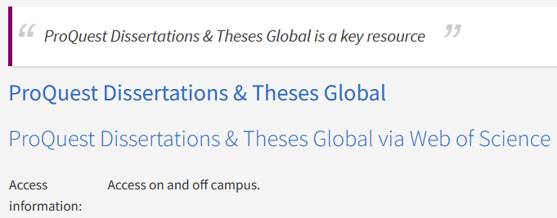
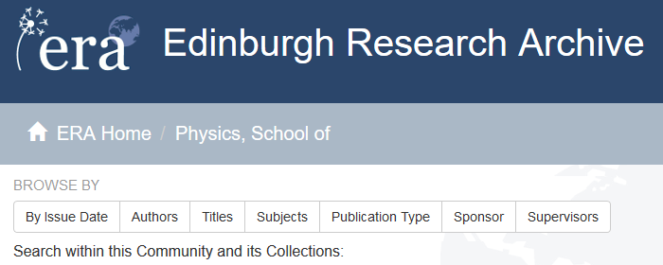
Library Academic Support Team
Theses
Find theses awarded in your field
edin.ac/databases-subjects > Theses
ProQuest Dissertations & Theses Global
for those awarded worldwide.
Includes online full-text.
Edinburgh Research Archive (ERA):
Digital copies of all UoEdinburgh PhD (and some Masters) theses.
Complete copies of any academic output can be posted.
Ask its staff for advice on copyright.
www.era.ed.ac.uk

Slide 3
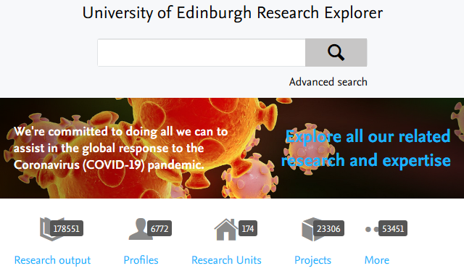
Library Academic Support Team
Your Publication Record
Edinburgh Research Explorer for research output (not a full-text repository).
“PURE” feeds the Edinburgh Research Explorer and its help pages provide information specific to postgraduate research students.
Access to PURE
www.research.ed.ac.uk
ORCiD (Open Researcher and Contributor ID):
Register for a persistent digital identifier to correctly associate your publications, affiliations, grants etc with you.
Research Support Team information about ORCiD
https://orcid.org/

Slide 4
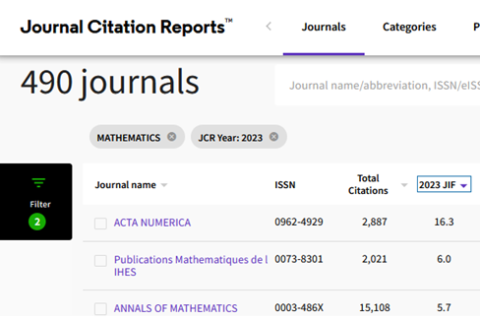
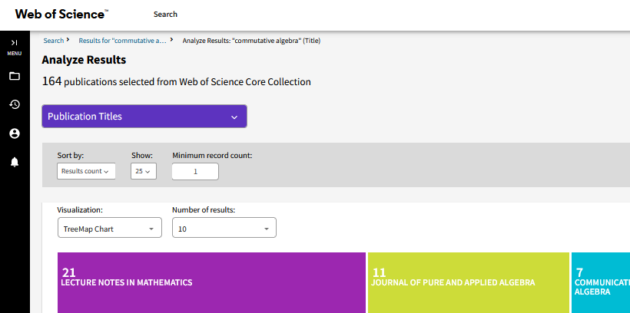
Journal metrics
Library Academic Support Team
Publishing
Bibliometric and publication metrics databases
Search for topic and see which journal titles are most frequent in the results.
Scholarly Communication Team:
Guidelines on how to spot and avoid predatory publications

Slide 5
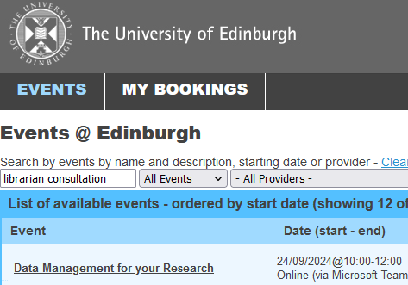
Library Academic Support Team
Research Support Team : managing and publishing your research
Publishing your research - www.ed.ac.uk/openaccess
University policies.
Open Access author fees – money available.
Advice (on copyright implications, next REF etc).
Data Management
Research Data Service
Advice on planning, storing, sharing or publishing the data your research generates.
Open repository, Edinburgh DataShare.
Training
– includes self-enrol and self-paced online course MANTRA.
https://mantra.ed.ac.uk

Slide 6
Library Academic Support Team
Help
Academic Literature Searching and other library-related
problems or questions:
rowena.stewart@ed.ac.uk
Academic Support Librarian (she/her)
Library’s Research Support teams: library.ed.ac.uk/research-support
Library resources and services (introductory presentation):
www.docs.is.ed.ac.uk/docs/Libraries/Presentations/ChemMathsPhysicsInduction.pptx
Where the libraries are, opening hours, knowing what The Library has & getting what the Library does not have, Literature review resources & reference management software.
Choosing a Reference Manager
PDF guide
Bibliographic management tools - comparison table (pdf)

