Slide 1
Library Academic Support
Helping you get the best from the Library, its collections, resources and services
Library Resources and Services
To cover:
Where the libraries are and their opening hours.
Finding out if the Library has what you need
Getting what the Library does not have
Finding academic literature on your subject
Rowena Stewart
(she/her) rowena.stewart@ed.ac.uk Academic Support Librarian
This presentation: www.docs.is.ed.ac.uk/docs/Libraries/Presentations/ChemMathsPhysicsInduction.pptx
AY24-25, v.Aug24

Slide 2
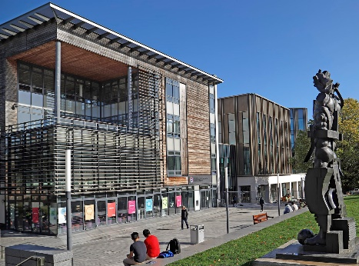
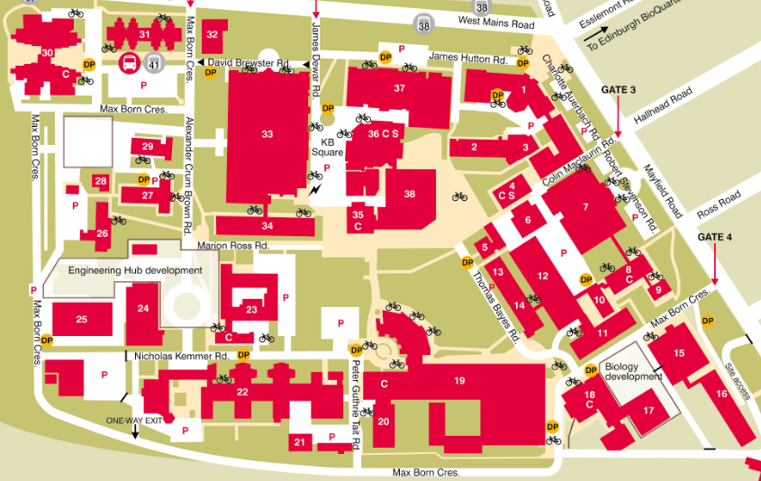
Library Academic Support Team
Noreen and Kenneth Murray Library
Principal print book Collections for: Biological sciences, Chemistry
Engineering, Maths and Physics
Use any of the
11 centrally run libraries:
edin.ac/library-locations
More open access study spaces on the campus:
KB Nucleus building, JCMB &
Murchison House.

Slide 3
Library Academic Support Team
Noreen and Kenneth Murray Library – opening hours
Murray Library
semester opening:
Monday to Thursday (Friday):
09:00 – 21:50 (18:50)
Saturday & Sunday:
12 noon – 16:50
Library opening hours
edin.ac/library-opening
All day & all night, every day (except Dec/Jan):
Main Library building, George Square.

Slide 4
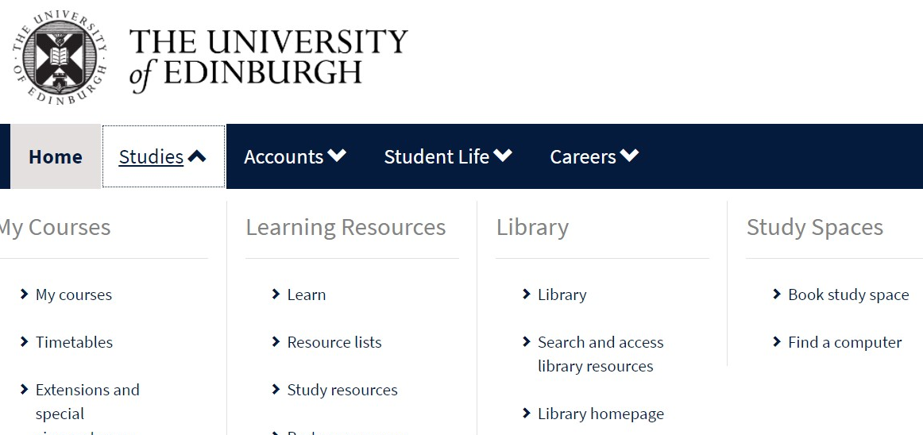
Library Academic Support Team
Library facilities
As well as physical items (books, newspapers, DVDs, musical scores, laptops…) and staff to help.
MyEd > Studies tab
www.myed.ed.ac.uk
study spaces
open-access computers
printing and scanning
uCreate - 3d printing, scanning, VR, casting and molding…

Slide 5
Library Academic Support Team
Bookable study spaces
Group study rooms in many of the libraries, including the Murray Library:
Book via EventMap booker
Single desks all Main Library, Floors 3 and 5 - 169, not many!
65 for postgraduate students only – Floor 5.
Book via online form or the SeatEd @ UoE mobile App.
QR code / unique name on the desk to check-in and out.
edin.ac/study-space
Accessible study rooms
require registration with Disability and Learning Support Services.
https://disability-learning-support-service.ed.ac.uk
Careers service has an Online Interview Booth
A bookable quiet space for an online job interview via MyCareerHub

Slide 6
Library Academic Support Team
Printing
Printing, photocopying and scanning from machines in the libraries and other study spaces.
Send printing to “EdPrintPull” and print from any machine within 24 hours.
Top up your print credit via MyEd.
An initial allowance (£4) is given to new students. Schools may provide more.
Scanning is free
A0 / poster printing at uCreate/Makerspace areas of The Main Library & Noreen and Kenneth Murray Library.
edin.ac/printing

Slide 7
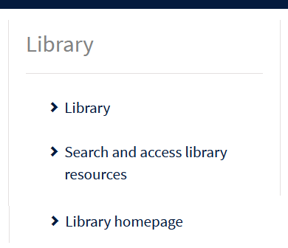
Library Academic Support Team
What the Library provides
https://library.ed.ac.uk
Library Chat:
One way of asking for help with library resources and services

Slide 8
DiscoverEd
Library Academic Support Team
https://discovered.ed.ac.uk
The place of record for what is available from The Library:
Journals, books, theses, newspapers, music scores, CDs, videos…
Online and print.
Records for articles.
Use DiscoverEd because…
Search results should be available to read from The Library.
2. The Library may have bought what you want from somewhere a standard search engine cannot reach.

Slide 9
Course reading
Library Academic Support Team
Course reading may be provided in a number of ways, linking directly to full-text or the information you need to get to it.
Resource Lists are one example.
http://resourcelists.ed.ac.uk
DiscoverEd is the place of record for book and journal titles you can read from The Library, whether print or online
https://discovered.ed.ac.uk

Slide 10
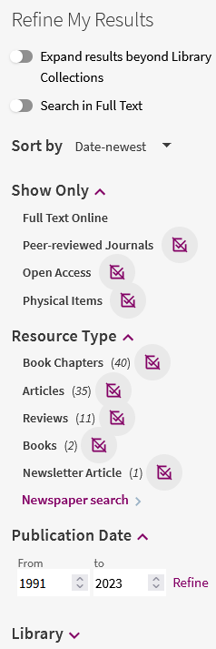
DiscoverEd for books
Library Academic Support Team
To know if The Library has a particular book, use DiscoverEd’s limiting or Refine my Results options.
http://discovered.ed.ac.uk

Slide 11
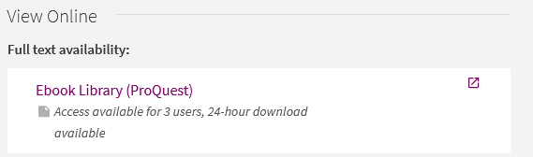
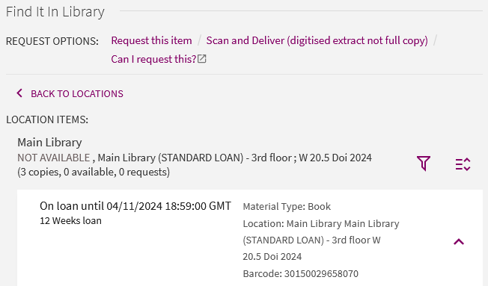
Books
Library Academic Support Team
What is available from where?
Online copies:
Is there a limit on the number of readers at any one time?
Sign-in to DiscoverEd
Print copies:
Which library
How many of the copies bought are available to borrow.
edin.ac/library-opening

Slide 12
Borrowing
Library Academic Support Team
edin.ac/library-borrowing
Borrowing allowance: 100 for all staff & students
(includes up to 10 RESERVE loans)
(STANDARD) loan | 4 weeks – undergraduates 12 weeks – postgraduates & staff
(SHORT) loan | 1 week
automatically renewed* for 36 months
(RESERVE) loan | up to 3 hours or overnight - cannot be renewed
Laptops | 7 days - automatically renewed for 28 days edin.ac/borrowing-laptops
*No renewal if: Requested books/items | The fines on your library account are over £20

Slide 13
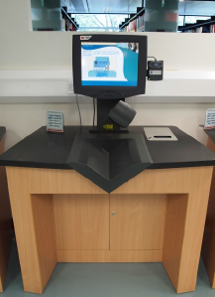
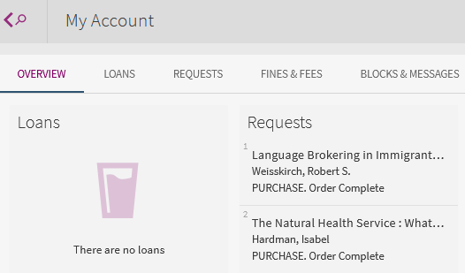
Borrowing
Library Academic Support Team
edin.ac/library-borrowing
Self-issue and self-return machines
Use the Library barcode part of your University swipecard, or its chip.
MyEd’s Library or DiscoverEd (Sign in) My Account
What you have borrowed.
When items should be returned.
Requests you have made.

Slide 14
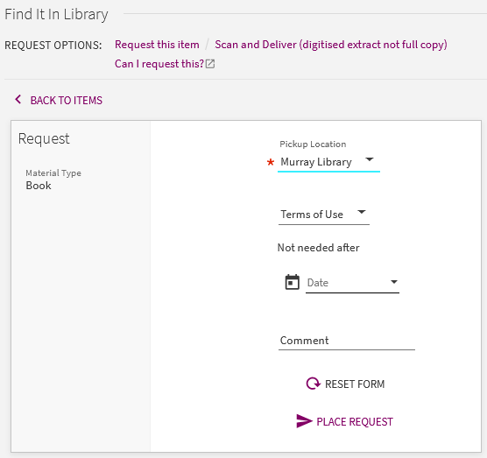
Print books you want to read
Library Academic Support Team
Sign in to DiscoverEd to see the options which allow you to…
Request this item
borrow a print copy already on loan to someone else.
Early return and held for you to collect and borrow.
2) ask for books available to borrow in, e.g. the Main Library to be sent to the Murray Library (or vice versa) for you to collect.
Probably quicker to go to the original library if you can.

Slide 15
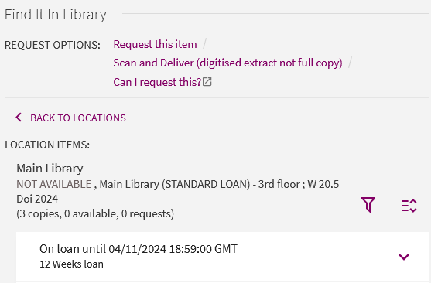
Print books you want to read
Library Academic Support Team
Sign in to DiscoverEd to see the options which allow you to…
Scan and Deliver
Scan of a book chapter (or amount permitted under copyright law) sent to you.
edin.ac/scan-and-deliver

Slide 16
DiscoverEd for journal articles
Library Academic Support Team
To know whether or not you can read an article published in the issue of a particular journal [magazine]:
Look up the journal title in DiscoverEd.
Use the limiting/filtering options available.
https://discovered.ed.ac.uk

Slide 17
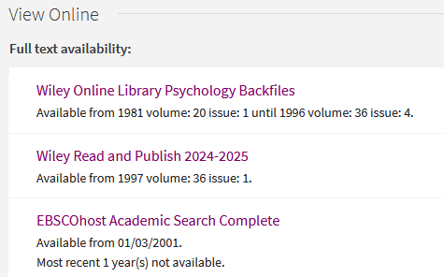
Journals
Library Academic Support Team
Journals may be bought online but from companies other than the publisher.
Many search engine etc links to article full-text will go to the publisher’s site but access to what you want to read my be available to you from elsewhere.
Online holdings without an end date?
Current issues are available.
Check the notes for exceptions.

Slide 18
Journals
Library Academic Support Team
Sign in to DiscoverEd to see the option to use to…
Digitize Other Issue
…get articles from journal issues only available in print
Scan of one article from an issue (within copyright allowance).
Free.
No cap on the number of digitisation requests for print-only journals.
Request Other Issue:
Whole print volume, possibly years’ worth of issues.

Slide 19
Library Academic Support Team
Inter-Library Loan (I.L.L.) service
For when The Library does not have what you want at all
Scan of part (article, chapter etc) to keep, or
Physical items to borrow
edin.ac/inter-library-loans
Free per year (after which £5 per request received):
5 for undergraduates
30 for postgraduates and staff
2 renewals which are done via Helpdesk or I.L.L. staff.

Slide 20
Library Academic Support Team
Request a book be bought for The Library collection
Online copies books bought (unless unavailable)
Do not rely on this being a quicker way of getting what you want to read than the inter-library loan service.
edin.ac/RAB

Slide 21
Off-campus access to online collection
Library Academic Support Team
University login (authentication) / MyEd (portal)
VPN – access to University network + wireless access
www.ed.ac.uk/is/vpn
Connecting to the network www.ed.ac.uk/is/wireless
Visiting
eduroam: secure internet access from eduroam-enabled institution around the world.
https://eduroam.org/where/
SCONUL Access scheme allows borrowing from other UK HEI Libraries - https://access.sconul.ac.uk/sconul-access

Slide 22
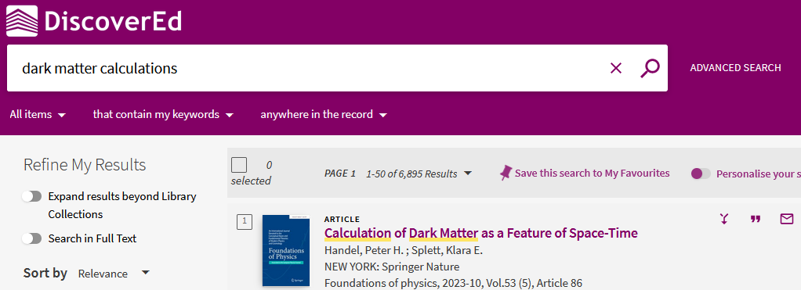
Databases for Reviewing the Literature
Library Academic Support Team
DiscoverEd includes article level records.
Default setting is to what you can read because the library has bought it.
Get more results but which you may not be able to read immediately.

Slide 23
Databases for Reviewing the Literature
Library Academic Support Team
DiscoverEd includes article level records.
Default setting is to what you can read because the library has bought it.
Get more results but in which your search terms may be pages apart.

Slide 24
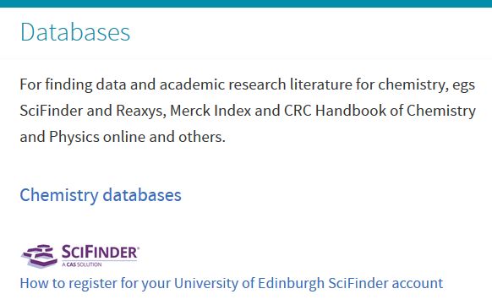
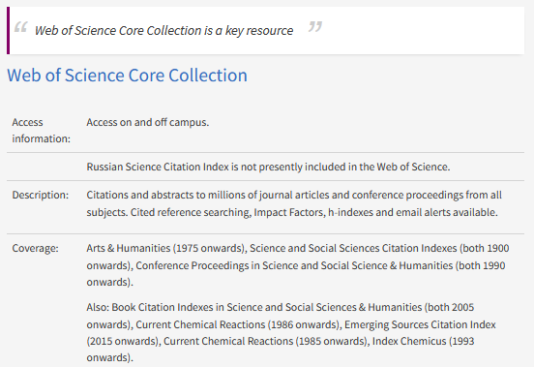
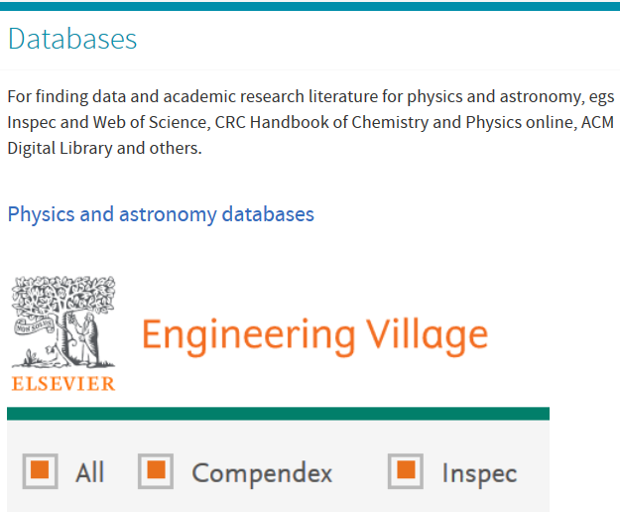
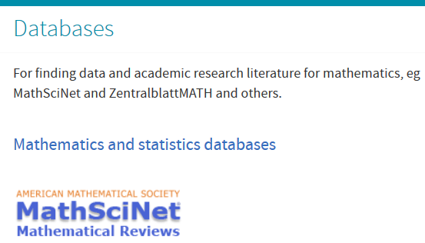
Databases for Reviewing the Literature
Library Academic Support Team
To find what has already been published in your field.
Not limited to journals the Library has.
Library Subject Guides
edin.ac/library-subject-guides
Abstracting & Indexing Databases
edin.ac/databases-subjects
Include large collections of:
Full-text publisher output (eg IEEEXplore, ACM Library).
Newspapers (worldwide, not just English language).
Videos (eg JoVE, Henry Stewart Talks, Box of Broadcasts)
Music (eg Naxos Music Libraries).

Slide 25
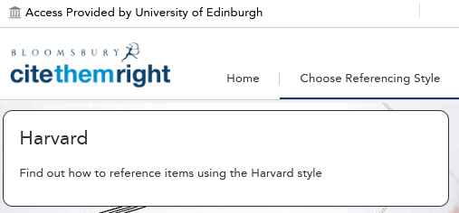
Library Academic Support Team
References
Deciding on a reference management software tool:
Bibliographic management tools - comparison table (pdf)
Choosing a reference manager
Direct import of records from databases, etc; Group records and attach files to them.
Cite while you write in Word.
Export chosen references in BibTeX format.
EndNote desktop for free
(not Schools of Maths or Physics but on Azure Virtual Desktop)
Cite Them Right Online
Principles around referencing
How to cite specific material types in a range of bibliographic styles
Online resources for writing your Dissertation or Thesis
Includes:
“References - How to add footnotes and endnotes; Cross-references; Advice about citing references.”

Slide 26
Library Academic Support Team
Training for anyone
www.events.ed.ac.uk
Digital Skills and Training www.ed.ac.uk/is/skills
Institute for Academic Development www.ed.ac.uk/iad
Librarian consultation (one-to-one session)
Autumn Dissertation and Thesis Festival, 21st – 25th October.
Spring Dissertation and Thesis Festival, 24th – 28th February.
edin.ac/dissertation-festival
LibSmart – Auto-enrolled on course in Learn’s Essentials section
LibSmart I : Introduction to library resources and search strategies in a University of Edinburgh context.
LibSmart II : Subject specific modules, eg Business Information, Digital Images, Systematic Reviews.
edin.ac/libsmart
The Royal Literary Fund Fellowship (RLFF) scheme places professional writers in universities for consultation to foster good writing practice across all disciplines and media.
edin.ac/rlff

Slide 27
Library Academic Support Team
Contacting Information Services (IS)
EdHelp - IT, Finance, Library and Student Admin
www.ed.ac.uk/edhelp
Schools providing IT support for their staff & PGRs
www.ed.ac.uk/is/helpline > Local School Helpdesks
Staffed EdHelpdesk in each centrally run library
Level 1 (entrance level) in the Murray Library.
I am happy to see people and/or to be contacted with questions
rowena.stewart@ed.ac.uk

