Slide 1
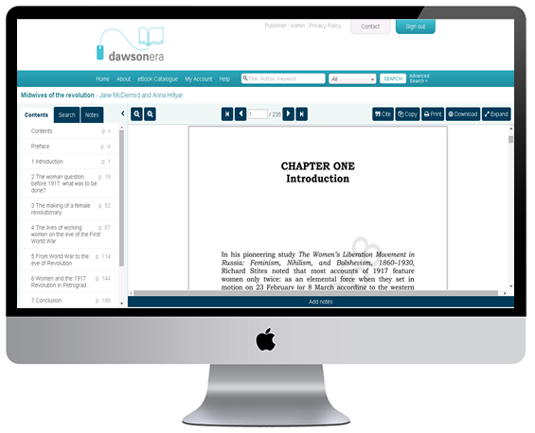
Introducing the new dawsonera Online Reader
(Desktop View)

Slide 2
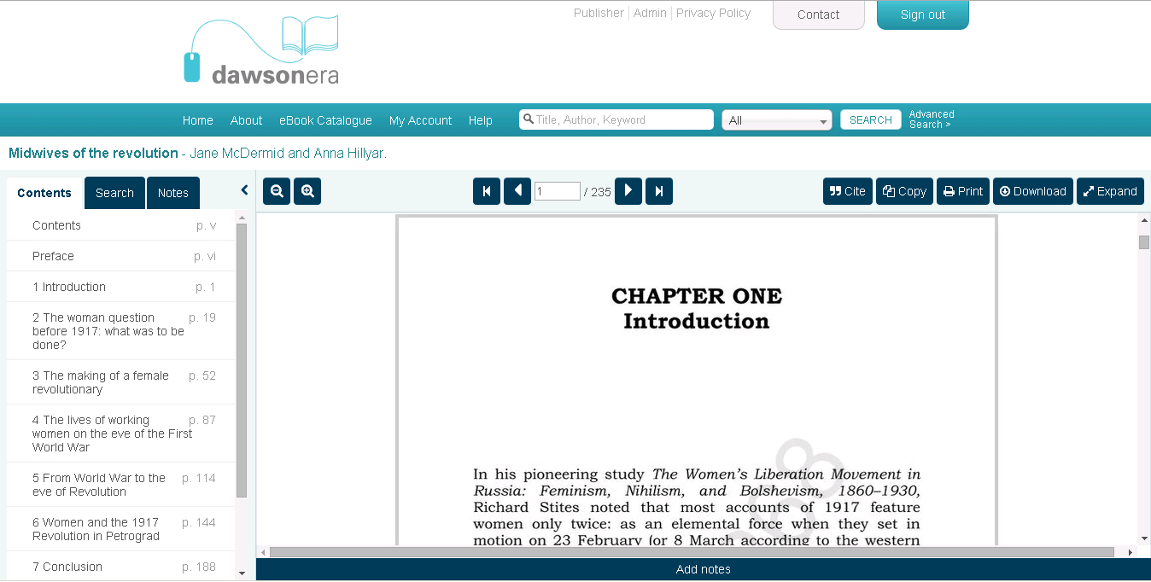
Desktop view – Read Online

Slide 3
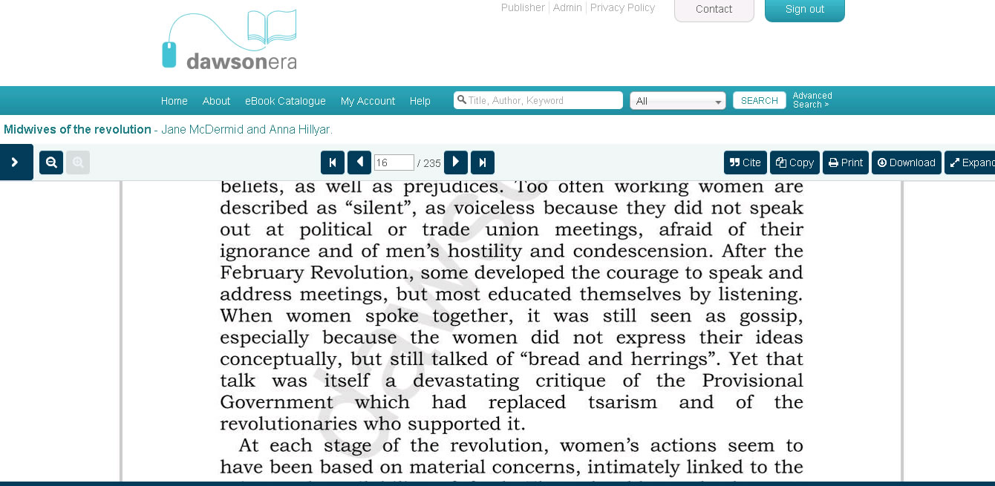
TOC/Search/Notes menu collapsed

Slide 4
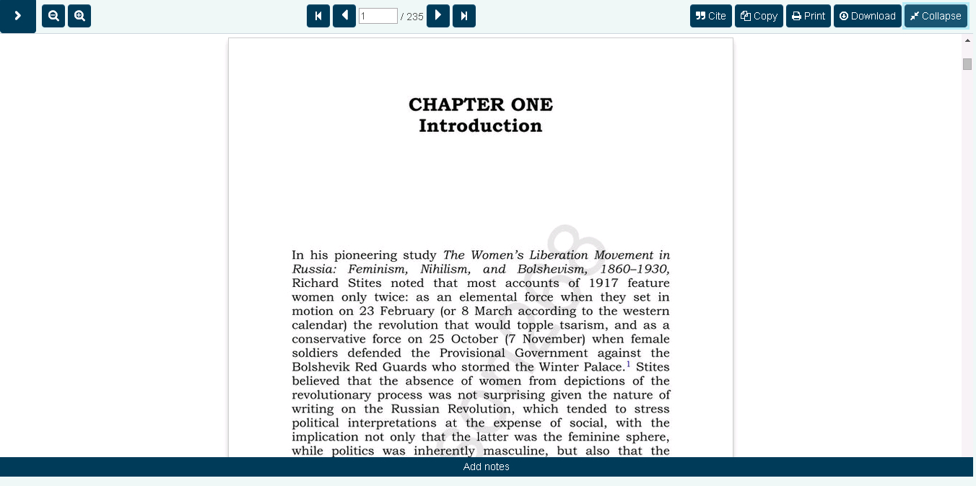
Full screen reading
--------

Slide 5
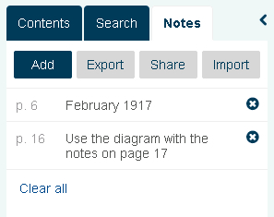
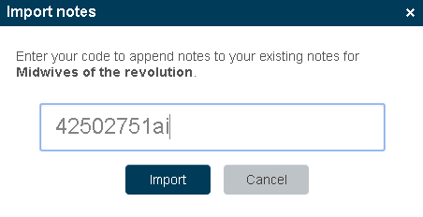
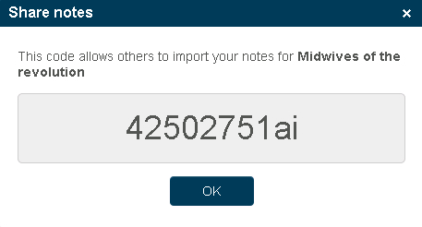
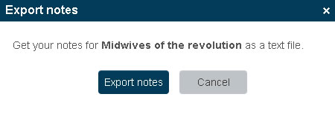
New Notes features

Slide 6
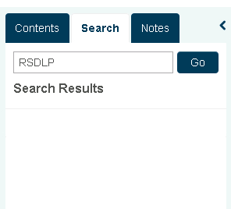
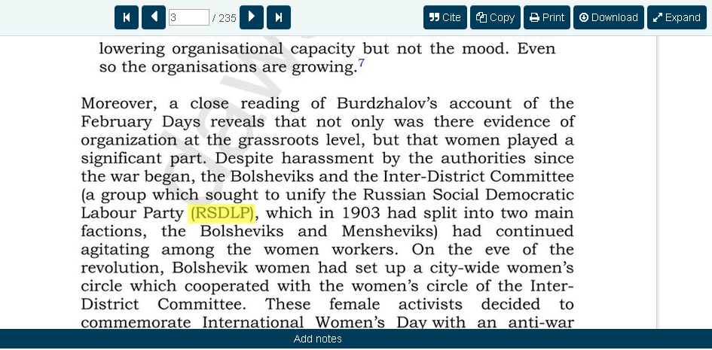
Searching within an eBook & hit highlighting

Slide 7
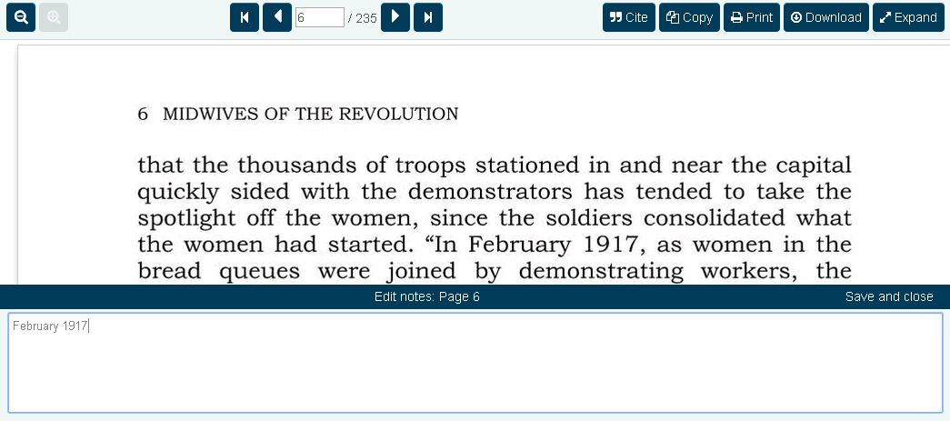
Adding a note
1
3
2

Slide 8
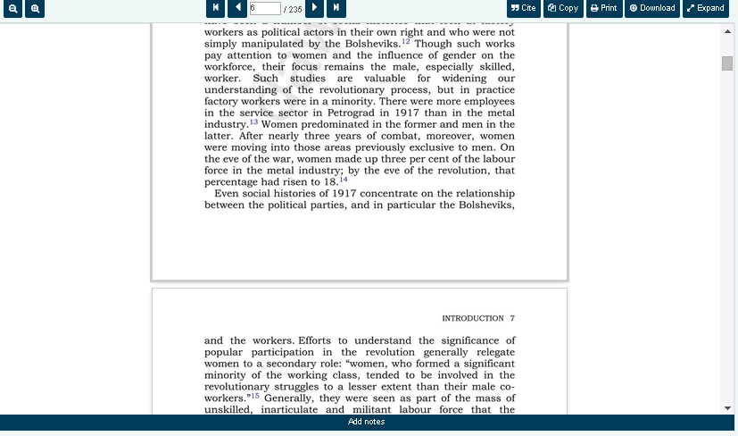
Scrolling between pages

Slide 9
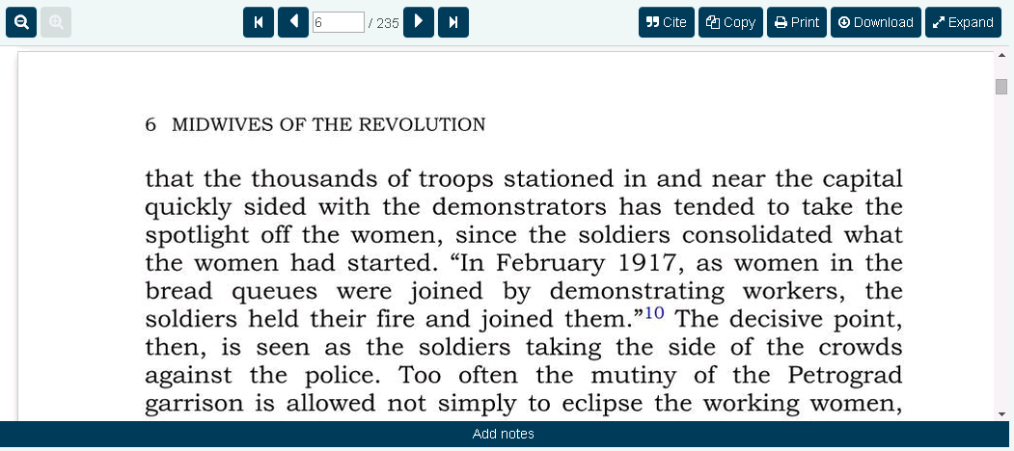
Zoom in/out feature

Slide 10
Improved page navigation
Existing page navigation slider
New!

Slide 11
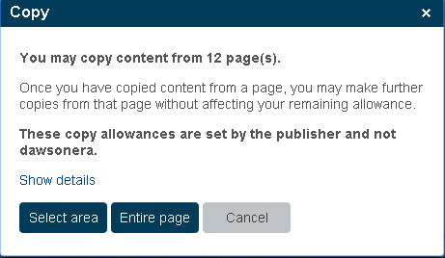
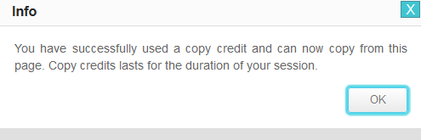
Improved page Copying features
EXISTING VERSION
NEW VERSION

Slide 12
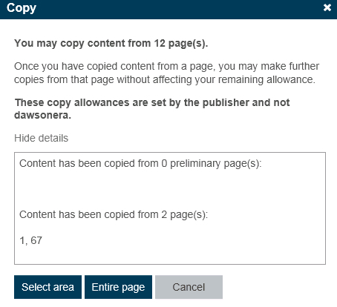
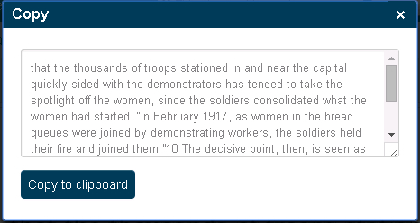
Improved page Copying features
Indicates pages that have previously been copied.
Allows the user to copy the entire page or a selected area.
Shows the user a preview of the selected text.
3
1
2

Slide 13
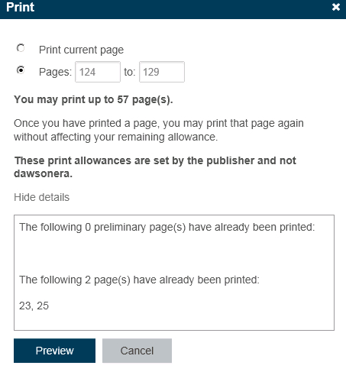
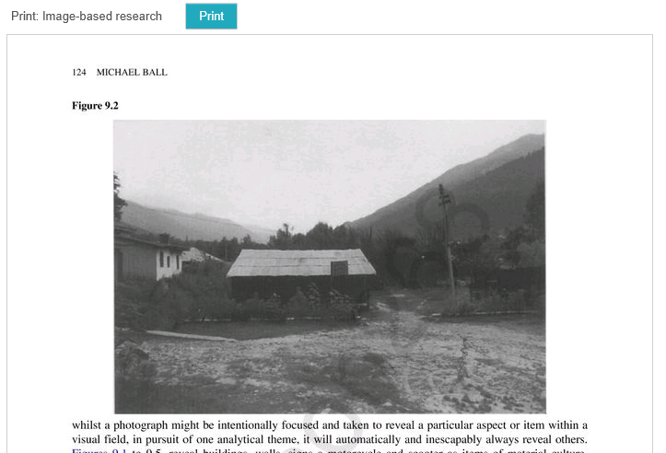
New feature: Printing page ranges

Slide 14
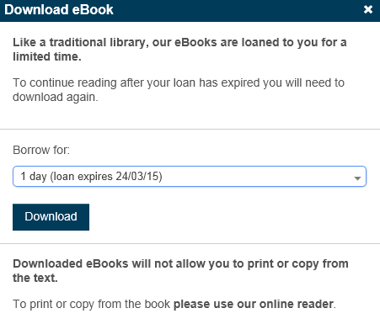
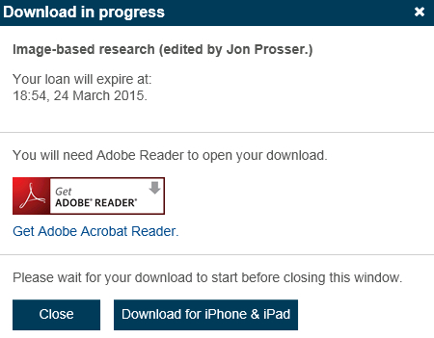
Downloading an eBook

Slide 15
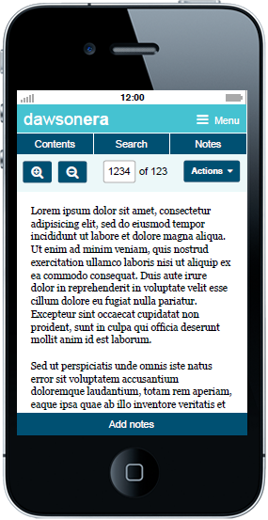
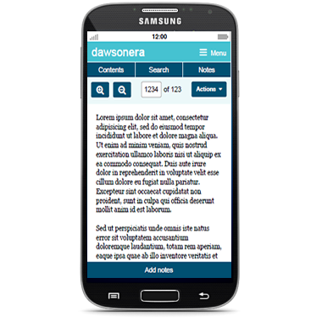
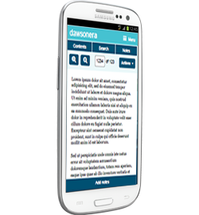
Introducing the new dawsonera Online Reader
(Mobile View)

Slide 16
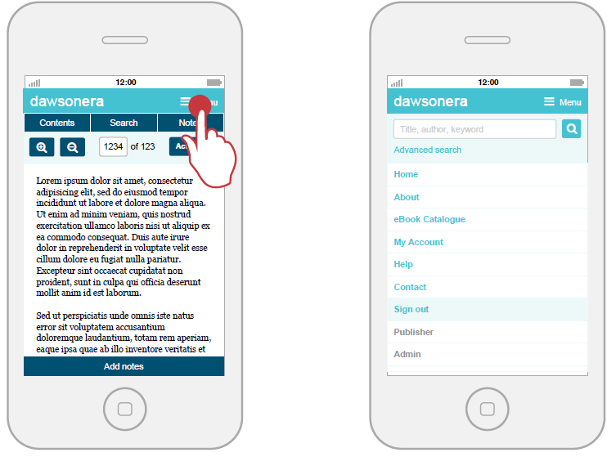
Global menu navigation

Slide 17
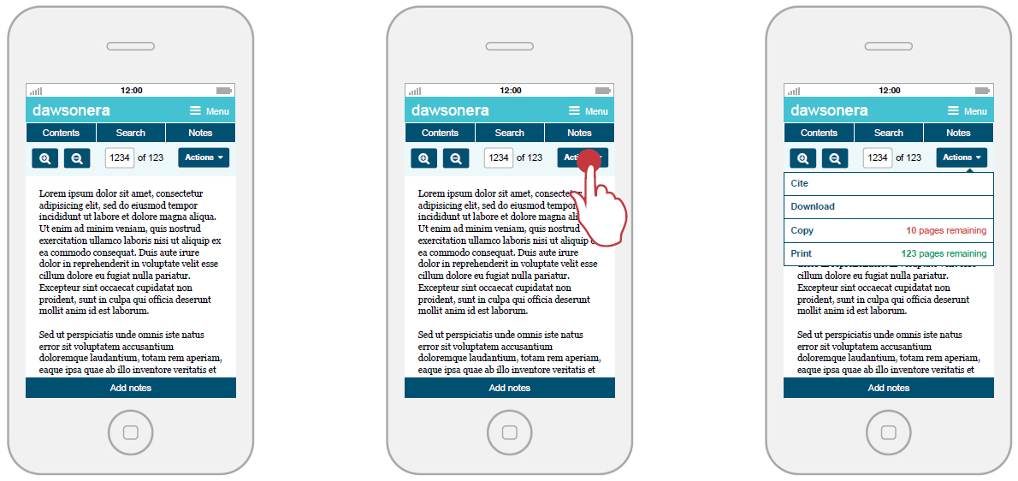
Actions Menu

Slide 18
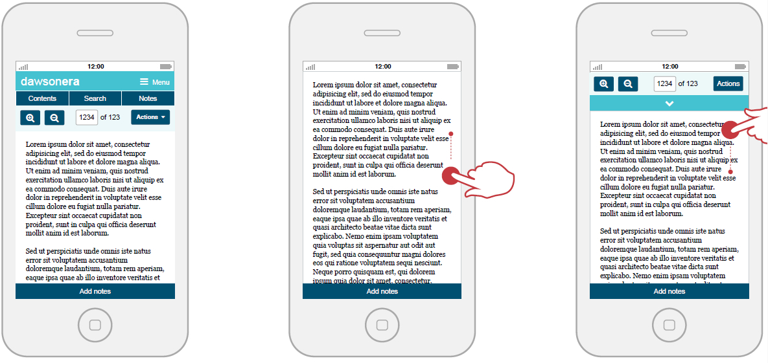
Scrolling hides the mobile navigation
The collapsed navigation becomes visible as the user scrolls up the page.
The navigation becomes hidden as the user scrolls down, giving a more focussed reading experience.

Slide 19
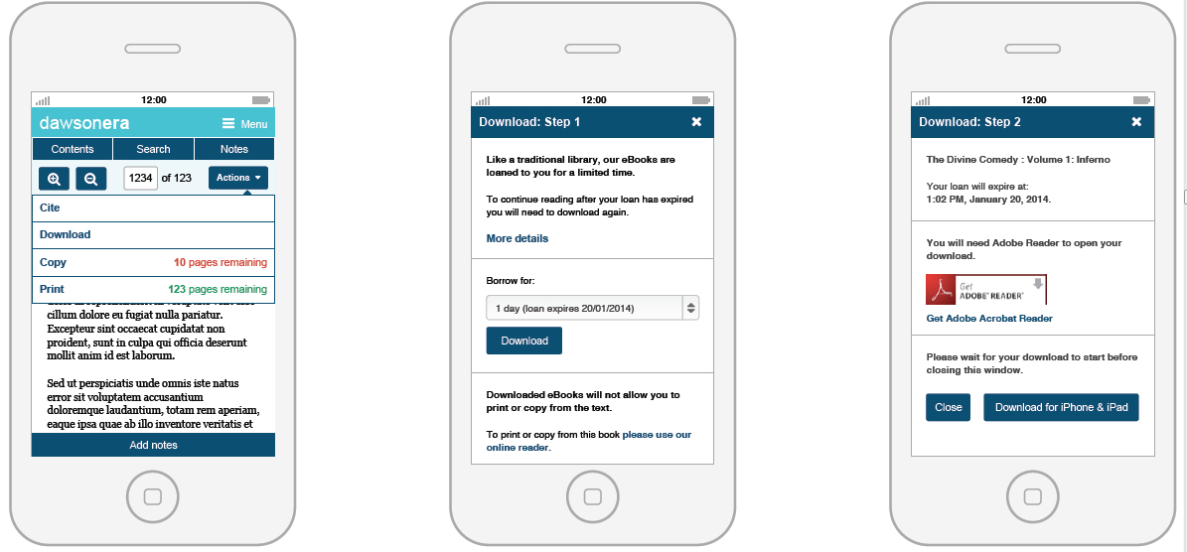
Downloading on a mobile device (PDF)

Slide 20
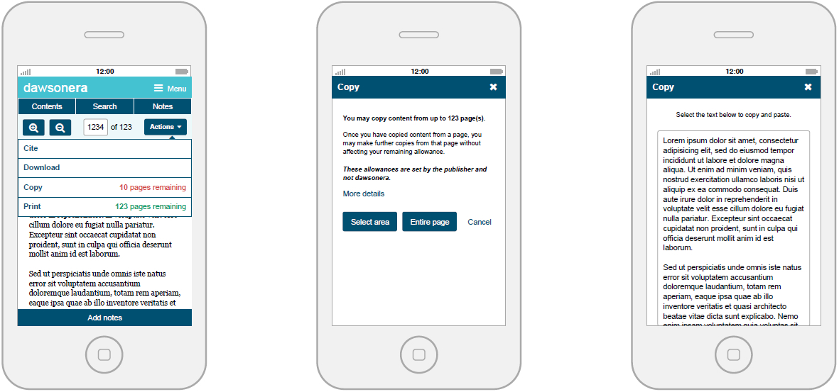
Copying on a mobile device

Slide 21
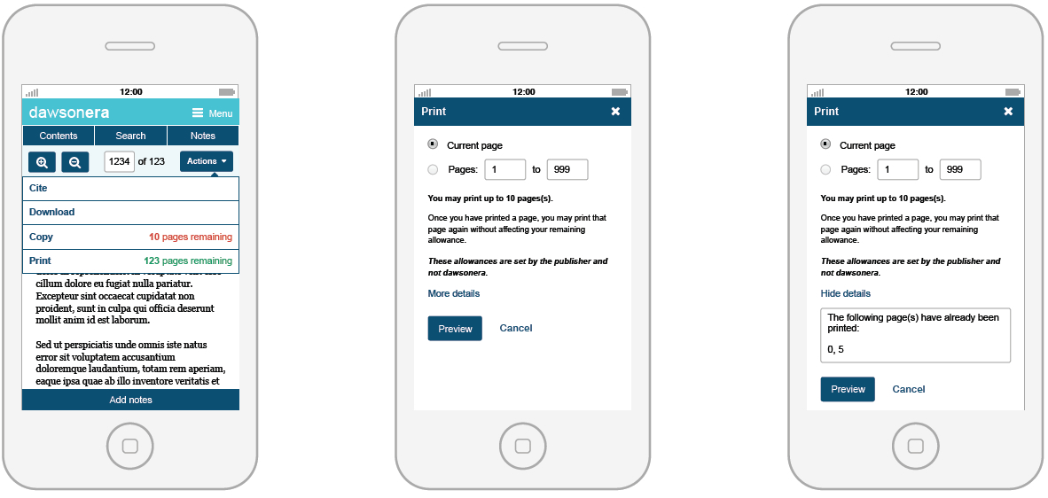
Printing on a mobile device

Slide 22
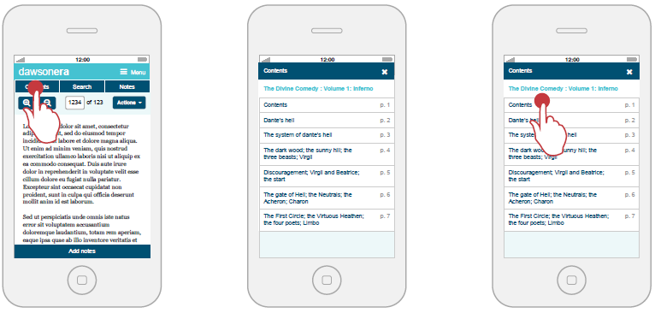
Table of contents

Slide 23
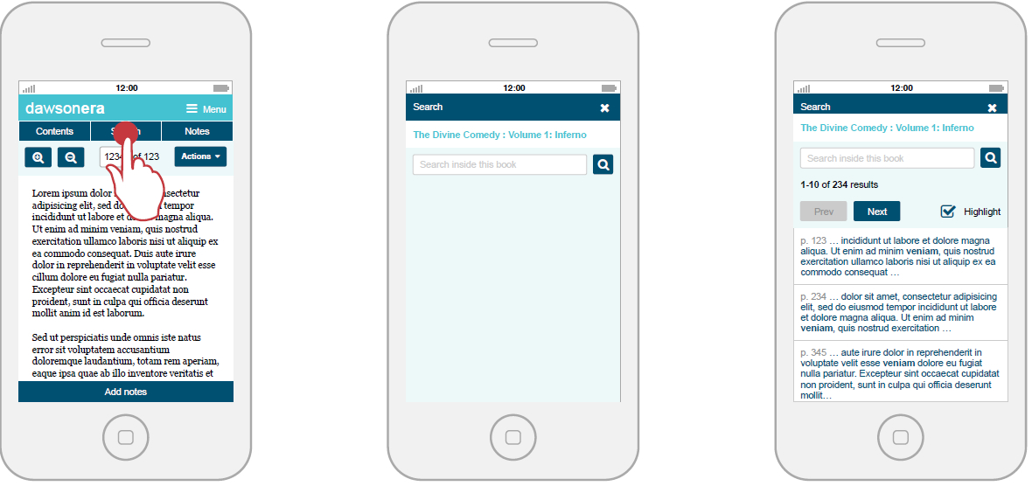
Searching on a mobile device

Slide 24
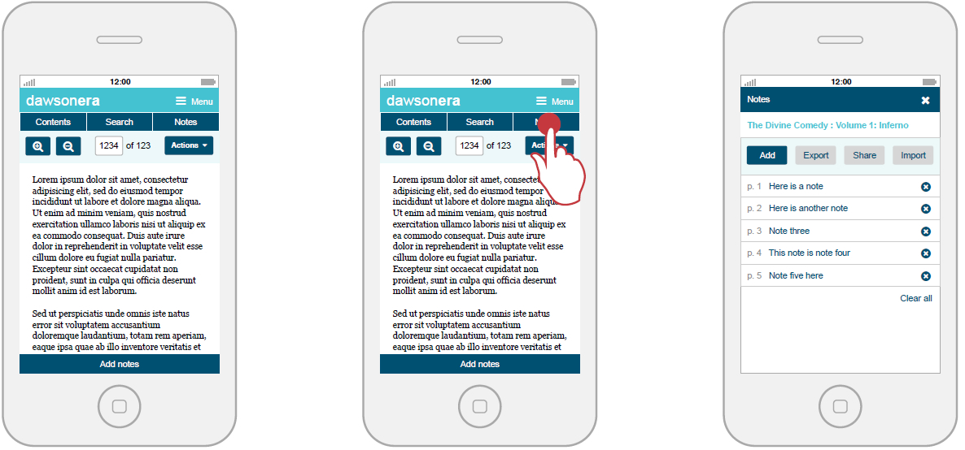
Notes on a mobile device

Slide 25
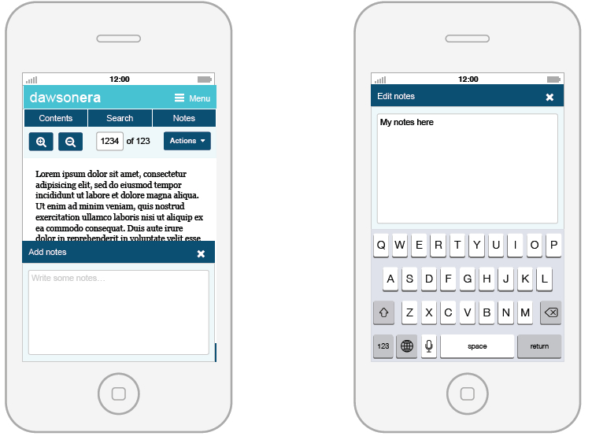
Adding Notes

Slide 26
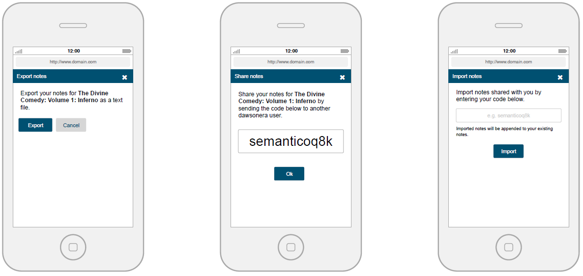
Exporting and Sharing notes

Slide 27
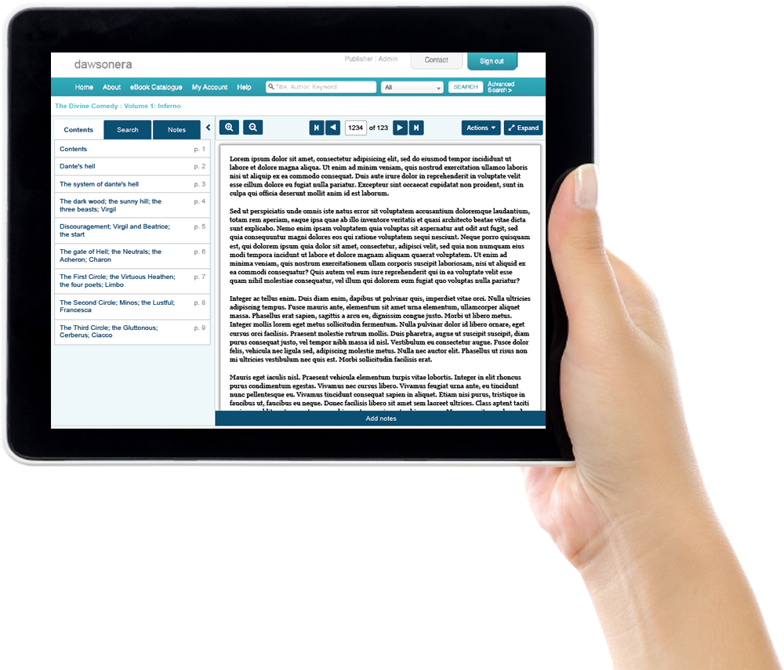
Introducing the new dawsonera Online Reader
(Tablet View)

Slide 28
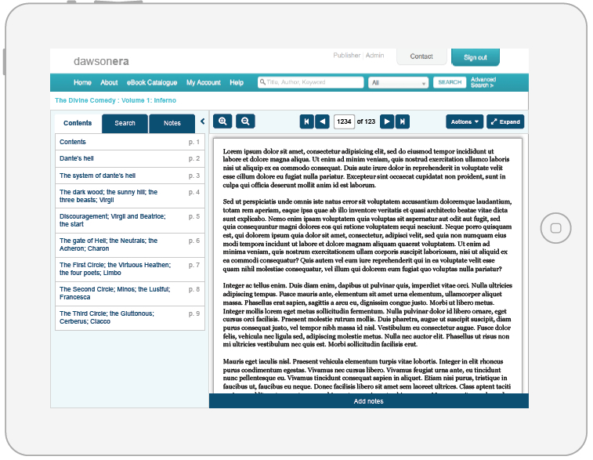
Tablet – Online Reader

Slide 29
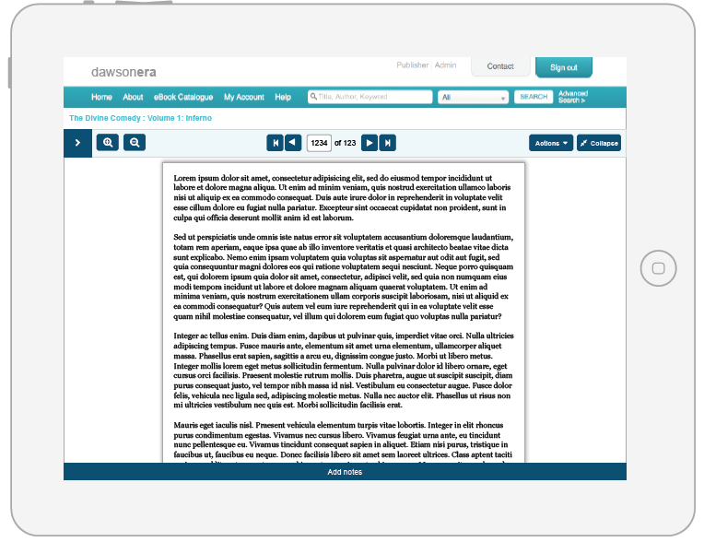
Tablet: Expanded view

